Slide 1

Ansible On Windows
emerson.candido@live.com
https://github.com/emerson-candido/ansibleonwindows

Slide 2

https://www.linkedin.com/in/emerson-candido-55510015/
emerson.candido@live.com
https://github.com/emerson-candido/ansibleonwindows

Slide 3
Is that course designed to you?
Are you responsible for a large number of Windows servers?
Are you facing issues to manage and keep consistency of your environment, even with
standard Microsoft tools, like GPOs and System Center family
Do you need to integrate Microsoft services to other platforms
Is you or your company driving to DevOps culture?
Do you have a small knowledge of Linux platform?
emerson.candido@live.com
https://github.com/emerson-candido/ansibleonwindows

Slide 4
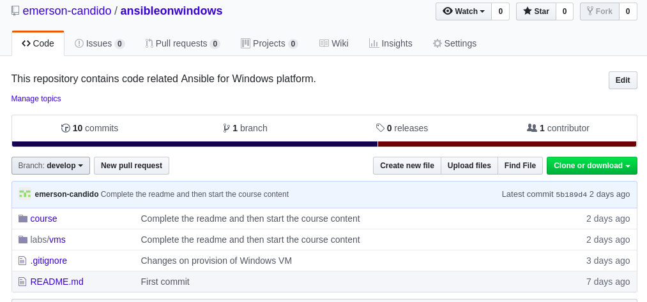
Github
emerson.candido@live.com
https://github.com/emerson-candido/ansibleonwindows

Slide 5
Se you soon!
emerson.candido@live.com
https://github.com/emerson-candido/ansibleonwindows

