Slide 1
LIVE · ON-CHAIN · WORLD CUP 2026
Called It
Call it live. Prove it on-chain.
A live, on-chain-verified FIFA World Cup 2026 prediction game on Solana — the thrill of a casual bet, made provable and trustless.
Solana devnet
Phantom wallet
Real SOL stakes
Live match feed
Solana World Cup 2026 Hackathon — Demo Day · July 2026 · called-it.netlify.app
Notes:
Hook: This is 'Called It'. During a live World Cup match you call what happens next — the next goal, corner or card — you stake real SOL, and the chain proves whether you called it. The thrill of a casual bet, but provable and trustless. In the next few minutes I'll show it running end to end on Solana devnet, with a real on-chain transaction you can verify yourselves.

Slide 2
THE MOMENT WE LIVE FOR
Billions watch. Millions want in on the outcome.
Every match is a stream of moments people would bet on — but the tools to do it are either untrustworthy or too slow.
5B+
48
$1T+
people expected to engage with FIFA World Cup 2026
teams · 104 matches · one global live audience
wagered on sports every year — mostly through houses you must trust
Called It · FIFA World Cup 2026 · Solana
02 / 16
Notes:
Set the stage. The World Cup is the single biggest live audience on the planet — billions of people, hundreds of matches. And sports wagering is a trillion-dollar-a-year habit. The appetite is not the problem. The problem is HOW people act on those live moments today. Keep it fast — this slide is just the size of the opportunity.

Slide 3
THE PROBLEM
Three ways to bet on a live moment — each broken in its own way.
🏦
⏱️
🎲
Bets you must trust a house
Post-hoc markets aren't live
Casual apps have no stakes
Traditional bookmakers are live, but centralized and opaque. You never see the true odds, the settlement, or the money. You just have to trust them.
On-chain prediction markets are provable — but they resolve after the fact. By the time a market settles, the moment you cared about is long gone.
'Guess the score' social apps are fun and instant, but there's no real stake and no proof. Nothing is on the line, so nothing is really at stake.
Called It · FIFA World Cup 2026 · Solana
03 / 16
Notes:
Frame the gap with three cards. One: bookmakers are live but you have to trust a house — opaque odds, opaque settlement. Two: on-chain prediction markets are trustless but post-hoc; they settle after the moment has passed. Three: social 'guess the score' apps are instant and fun but there's no real stake and no proof. Nobody gives you live, real-stakes, AND provable at the same time.

Slide 4
WHO WE BUILD FOR
Two fans, one unmet need.
🔥
The casual fan
🛡️
The skeptic
Watches every match with friends. Loves the rush of calling the next goal out loud. Would happily put a small stake on it — if it were quick, fun, and mobile.
Enjoys a bet but refuses to trust a black-box house. Wants to see the odds, the stake, and the settlement. If it's not verifiable, they're out.
“I called that corner — now let me actually cash it in.”
“Don't tell me I won. Show me on-chain.”
Called It · FIFA World Cup 2026 · Solana
04 / 16
Notes:
Two people. The casual fan — the person who screams 'called it' at the TV and would love to actually stake that instinct. And the skeptic — happy to bet, but only if it's trustless and verifiable, no black-box house. Called It is the one product that satisfies both at once. Keep this human and quick.

Slide 5
THE SOLUTION
Called It — call live, stamp on-chain, settle provably.
1
2
3
Call it live
Stamped on-chain
Settled & paid provably
During the match, call what happens next — next goal, corner or card — before it resolves. Instant, mobile, in the moment.
Your call is a real devnet SOL stake, verified on Solana by the backend and stamped with the transaction hash and block time.
A settlement worker resolves the market off the live feed. Called it → paid in SOL by a real transfer. No house, no dispute.
Called It · FIFA World Cup 2026 · Solana
05 / 16
Notes:
Here's the product in three beats. Call it live — you predict the next event while the match is happening. Stamped on-chain — that call is a real SOL stake on Solana devnet, verified and stamped with the tx hash. Settled and paid provably — a worker reads the live feed, and if you called it you're paid in SOL by a real transfer. Live, real-stakes, and provable — all three, together.

Slide 6
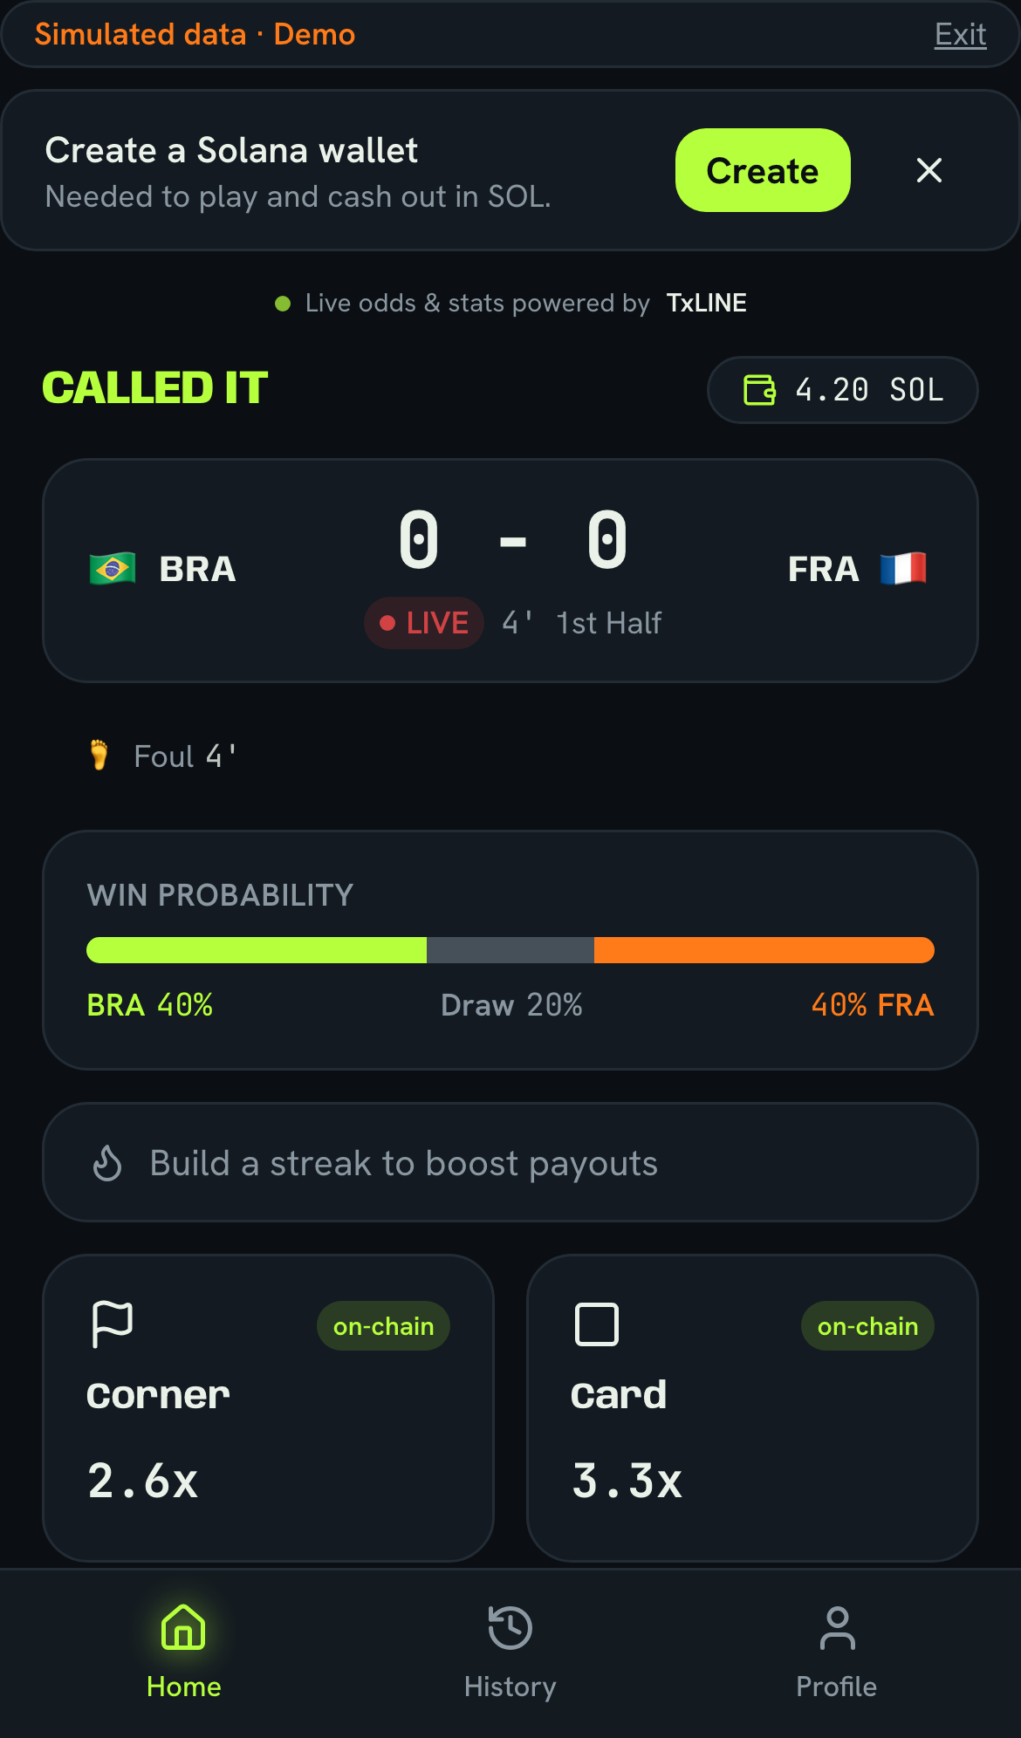
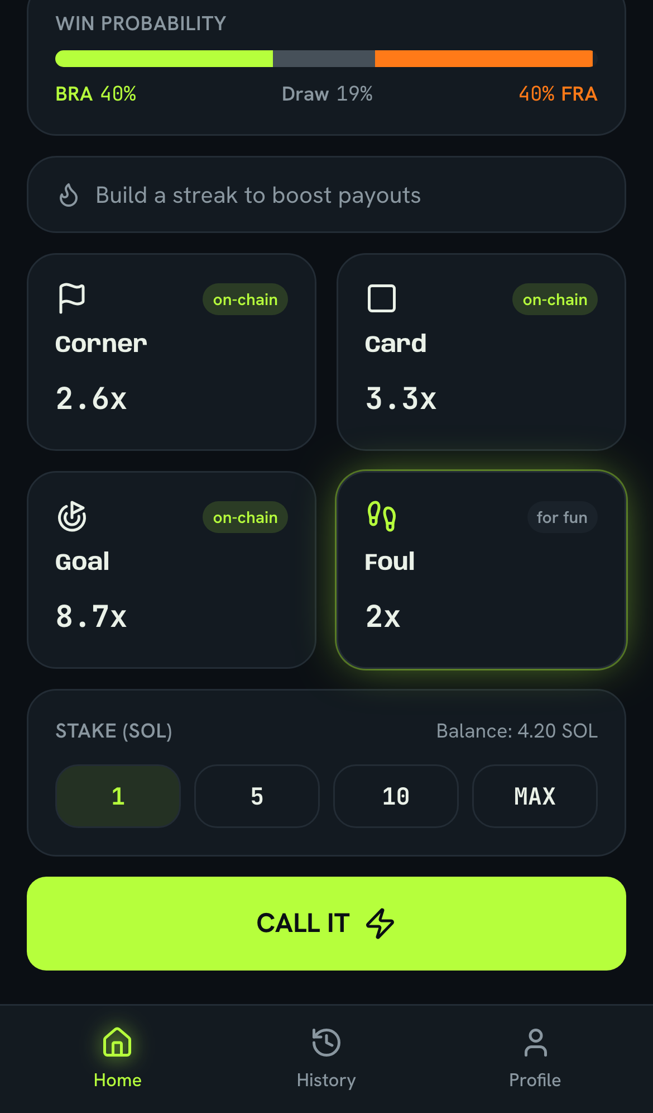
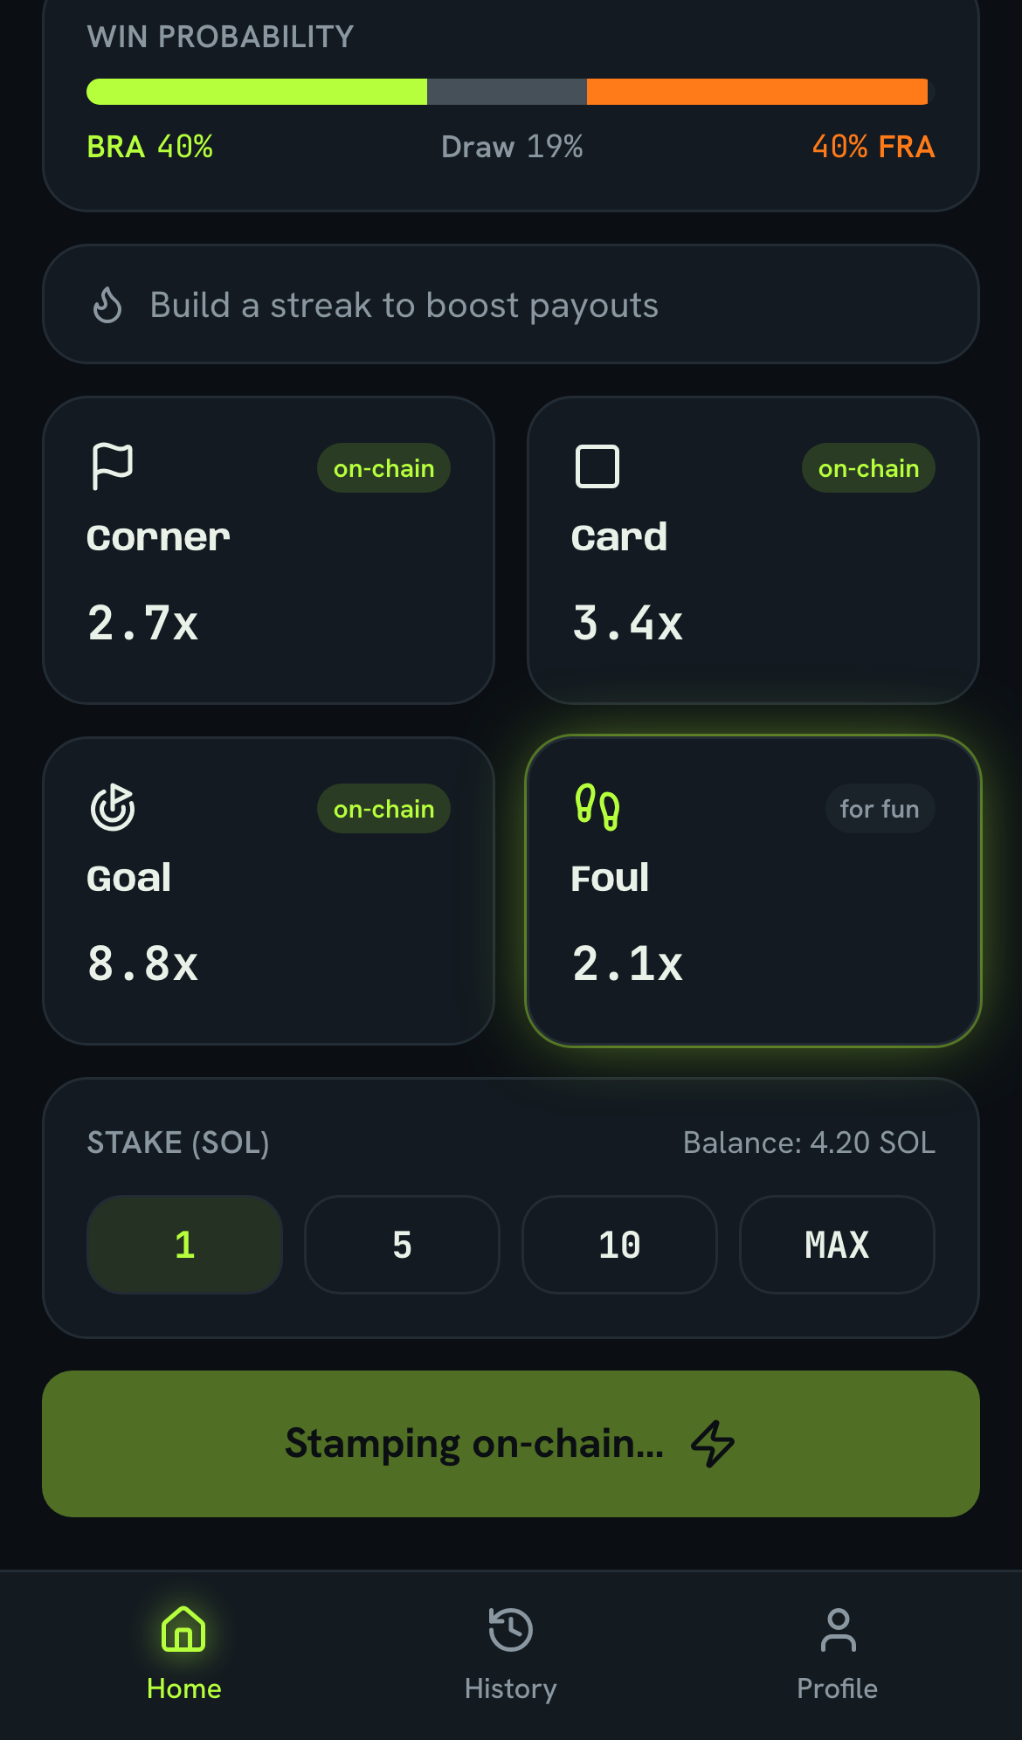
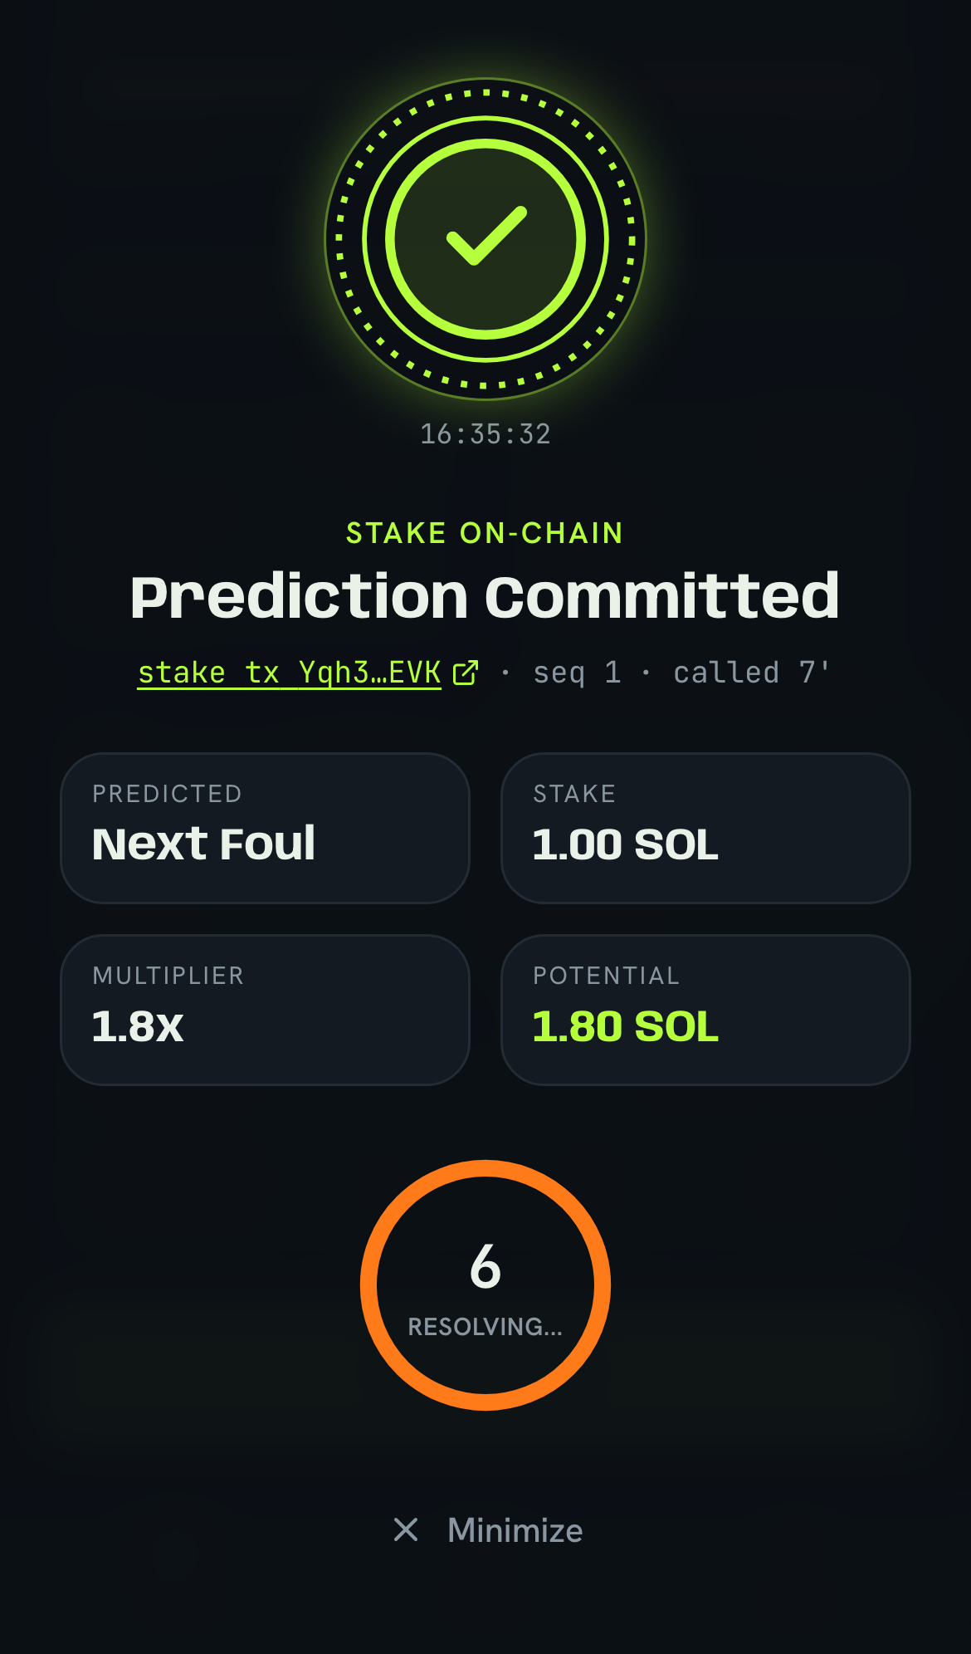
HOW IT WORKS
From tap to payout — six steps, one live loop.
1
2
3
4
5
6
Connect Phantom
See a live match
Make a call
Sign devnet stake
On-chain stamp
Settle & payout
→
→
→
See a live match
Pick market & stake
Sign devnet stake
On-chain seal
Fastify + Postgres on Railway · Solana web3.js · TxODDS TxLINE feed · Vite + React 19 PWA
06 / 16
Notes:
Walk the loop once, fast. Connect Phantom, devnet balance loads. Enter a live match. Make a call and set your stake. Phantom signs a real devnet transfer. The backend verifies that transaction on-chain and stamps the prediction. Then a settlement worker, running every ten seconds, resolves the market off the live feed and pays winners in SOL. Six steps, and every one leaves a verifiable trace.

Slide 7
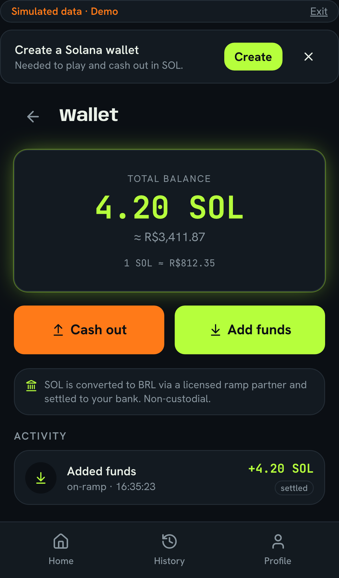
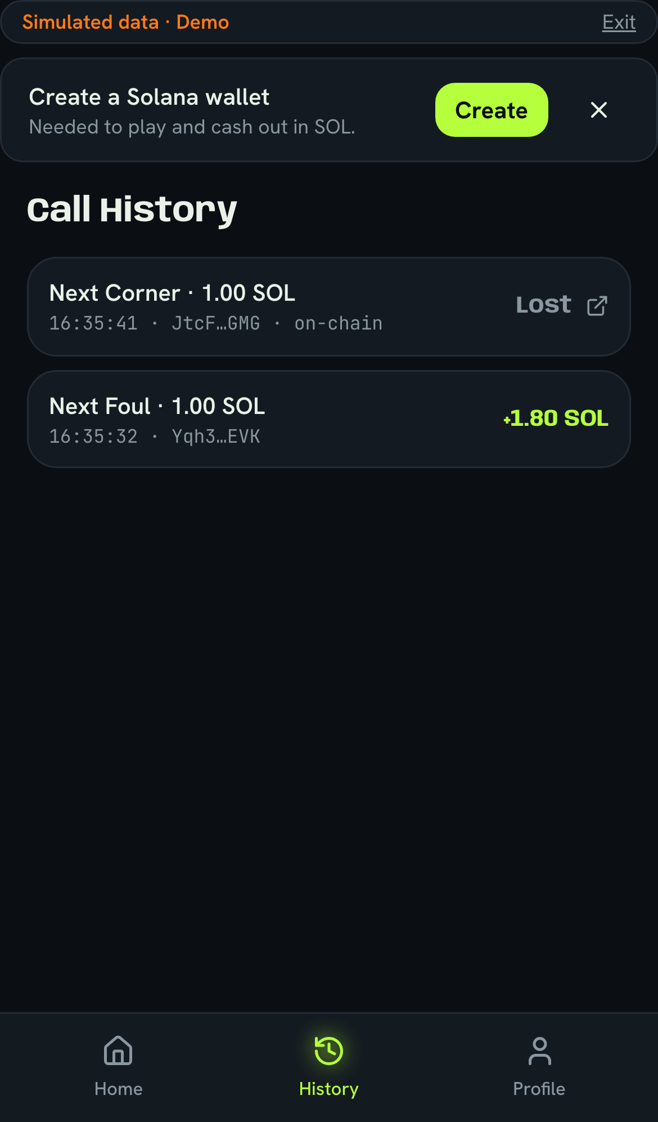
THE DIFFERENTIATOR
Validated against the live feed. Proven on-chain.
Called It is the only experience that is both live and trustless.
Live / instant — You call during the match, before the event resolves — not a post-hoc market.
On-chain provable — Real stake and settlement, verifiable on Solana. No house you have to trust.
Feed-validated — Provable markets settle off the TxODDS live feed and are cross-checked on-chain via the TxOracle validate_stat program.
Live devnet balance
Every call logged
“You call it — the chain proves it.”
Called It · FIFA World Cup 2026 · Solana
07 / 16
Notes:
This is the wedge. Two properties that normally can't coexist: live — you're calling the moment as it happens — and trustless — the stake and settlement are on Solana, verifiable, no house. And it's not just a transfer: provable markets are settled off the TxODDS live feed and cross-checked on-chain by our TxOracle validate_stat program. You call it, the chain proves it. That one line is the whole company.

Slide 8
WHAT IT DELIVERS
Not a mockup — a working on-chain money loop.
100%
Real SOL
Instant
Verifiable
on-chain settlement of provable markets
devnet stakes & payouts — actual transfers, not points
calls placed live, during the match
every stake carries a real tx hash + block time
Proven end-to-end on Solana devnet — deploy green, live fixtures (Spain vs Argentina), real stake tx, prediction stamped, worker settling every 10s.
Called It · FIFA World Cup 2026 · Solana
08 / 16
Notes:
What we actually shipped. One hundred percent of provable markets settle on-chain. Stakes and payouts are real SOL on devnet — real transfers, not points. Calls are placed live during the match. And every stake carries a real transaction hash and block time you can look up. The strip at the bottom is the receipt: deploy green, live fixtures including Spain vs Argentina, a real stake tx, prediction stamped, worker settling every ten seconds.

Slide 9
COMPETITIVE LANDSCAPE
Live and trustless is an empty quadrant — until now.
Live / in-the-moment ↑
THE OPEN SPACE
Everyone owns one property.
Nobody owned both live and trustless — the top-right corner.
Called It sits there alone.
Traditional bookmakers
Called It
Live, but centralized & opaque. Trust the house.
Live AND on-chain provable. No house — the chain settles.
Social 'guess the score'
Post-hoc prediction markets
Fun, but no real stake and no proof.
On-chain, but not live — settles after the fact.
On-chain provable / trustless →
Only Called It is live and trustless — you call it, the chain proves it.
Called It · FIFA World Cup 2026 · Solana
09 / 16
Notes:
The 2x2. Horizontal axis: on-chain provable and trustless, more to the right. Vertical axis: live and in-the-moment, higher up. Top-left, bookmakers — live but you trust the house. Bottom-right, post-hoc prediction markets — trustless but they settle after the fact. Bottom-left, social guess apps — fun but no stake, no proof. The top-right corner, live AND trustless, was empty. That's exactly where Called It sits, alone. You call it, the chain proves it.

Slide 10
MARKET & SCALE
Start at the World Cup. Replicate to every live stat feed.
FIFA World Cup 2026
WHY IT SCALES
104 matches · billions of live viewers · the launch moment
Markets are feed-driven — add a sport by adding a feed, not rebuilding the app.
Any football league
Settlement logic is generic over any provable stat (goals, corners, points…).
domestic leagues run year-round — the same markets, always on
On-chain rails mean no per-market banking, licensing bottleneck, or house float.
Any live sport & stat
Mobile-first PWA — no app-store gate, instant global reach.
basketball, tennis, esports — anything with a live stat feed
Called It · FIFA World Cup 2026 · Solana
10 / 16
Notes:
The World Cup is the launch moment, not the ceiling. The architecture is feed-driven: the settlement logic is generic over any provable stat, so adding a new sport means adding a feed, not rebuilding the product. Domestic leagues run all year. Basketball, tennis, esports — anything with a live stat feed drops in. And because it's on-chain and a mobile PWA, there's no per-market banking or app-store bottleneck to scale.

Slide 11
TECH & TRUST
A real pipeline — signed, verified, settled, and open.
Solana devnet
TxODDS TxLINE feed
Phantom signs real devnet SOL stakes; the backend verifies each tx on-chain before stamping the prediction.
Live match events ingested over SSE into feed_events — the source of truth for what actually happened.
TxOracle validate_stat
Open & verifiable
An Anchor program cross-checks the settling stat on-chain (advisory) before a market pays out.
Every stake carries its tx hash + block time. Anyone can audit any outcome on the public explorer.
Backend: Fastify + Postgres (Railway, Node 22) · Frontend: Vite + React 19 PWA, Feature-Sliced
11 / 16
Notes:
The trust story in four boxes. Phantom signs a real devnet stake and the backend verifies that transaction on-chain before it stamps anything. The TxODDS TxLINE feed streams live match events over SSE — that's our source of truth. Our TxOracle Anchor program cross-checks the settling stat on-chain before a market pays. And everything is open: every stake has a tx hash and block time anyone can audit. Signed, verified, settled, and public.

Slide 12
ROADMAP
Devnet demo today → mainnet → every live market.
NOW
NEXT
LATER
Devnet demo
Mainnet & polish
Multi-sport platform
Live World Cup fixtures
Mainnet-beta with USDC option
More sports via new feeds
Real SOL stakes & payouts
More markets per match
Social & leaderboards
Goal / corner / card markets
Odds/multipliers tuning
Creator-defined markets
Settlement worker + on-chain proof
Wallet UX + onboarding
Liquidity & risk engine
Called It · FIFA World Cup 2026 · Solana
12 / 16
Notes:
Three horizons. Now: what you're seeing today — devnet demo with live fixtures, real SOL, the core markets, and on-chain settlement. Next: mainnet-beta with a USDC option, more markets per match, tuned odds, smoother wallet onboarding. Later: a multi-sport platform — new sports via new feeds, social and leaderboards, creator-defined markets, and a real liquidity and risk engine.

Slide 13
VIABILITY
Legally aware, technically proven, operationally lean.
⚖️
Legal
🧩
Technical
⚙️
Operational
Framed as a skill-based, free-to-play game on devnet — no real-money gambling.
Full loop already runs end-to-end: stake → verify → stamp → settle → pay.
Serverless-friendly deploy on Railway; worker loop is cheap to run.
On-chain settlement is transparent and auditable by design.
Feed-driven, generic settlement — new markets/sports without a rewrite.
No house float or per-market banking — on-chain rails carry the money.
Jurisdiction-aware rollout planned before any mainnet real-money launch.
Standard, well-supported stack: Solana, Fastify, Postgres, React.
Small surface, mobile-first PWA — fast to iterate and ship.
Called It · FIFA World Cup 2026 · Solana
13 / 16
Notes:
Why this is a real project, not just a demo. Legally: we frame it as a skill-based, free-to-play game on devnet — no real-money gambling — and on-chain settlement is transparent by design, with a jurisdiction-aware path before any mainnet money. Technically: the full loop already runs, and it's feed-driven so it grows without a rewrite. Operationally: cheap to run, no house float, small mobile-first surface.

Slide 14
TEAM
Built end-to-end for the Solana World Cup 2026 Hackathon.
Called It
On-chain / Solana
A full-stack build across the API ⇄ chain ⇄ feed boundary:
Solana on-chain integration · TxODDS live-feed ingestion · settlement engine · Fastify + Postgres backend · React 19 PWA — designed, built, and shipped to a live devnet demo.
Feed & settlement
Backend / API
Frontend PWA
Design
Live demo: called-it.netlify.app
Called It · FIFA World Cup 2026 · Solana
14 / 16
Notes:
Quick on the team. Called It is a full-stack build spanning the hardest boundary in the stack — API, chain, and live feed at once: Solana integration, feed ingestion, the settlement engine, the backend, and the PWA, all the way to a working devnet demo. Point people to called-it.netlify.app and move to the proof.

Slide 15
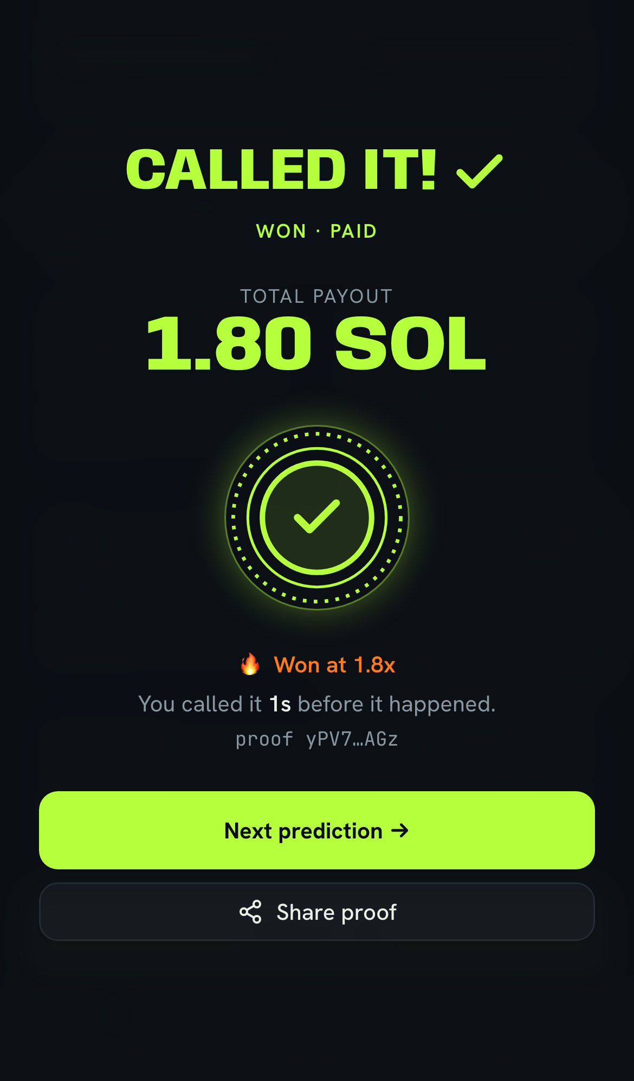
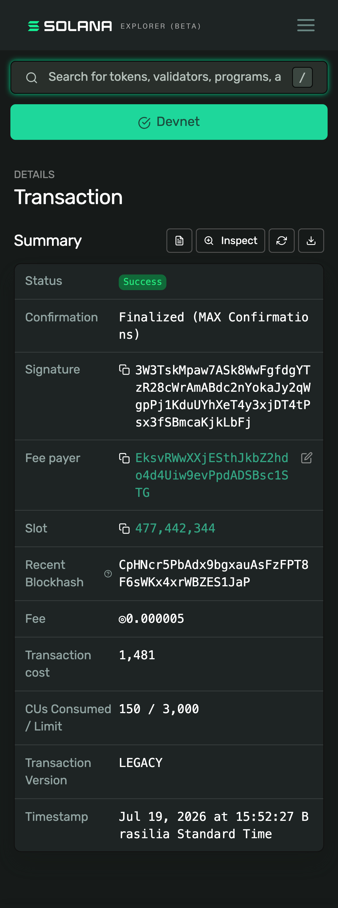
LIVE PROOF
The money shot — call sealed, won & paid, verifiable on-chain.
PROOF · SOLANA DEVNET EXPLORER
SUCCESS · FINALIZED
SIGNATURE (TX HASH)
3W3TskMpaw7ASk8WwFgfdgYTzR28cWrAmABdc2nYokaJy
2qWgpPj1KduUYhXeT4y3xjDT4tPsx3fSBmcaKjkLbFj
EXPLORER
explorer.solana.com/tx/3W3Tsk…KbFj?cluster=devnet
0.01 SOL → treasury · fee 0.000005 SOL
slot 477,442,344 · Jul 19, 2026 · 15:52 BRT
On-chain seal · committed
CALLED IT · WON · PAID
Real devnet tx
Live demo: called-it.netlify.app · Explorer: explorer.solana.com/tx/3W3Tsk…KbFj?cluster=devnet
15 / 16
Notes:
The proof — three real screens. First, the on-chain seal: the call is committed and stamped. Second, the money shot — Called It, Won, Paid, the SOL landed back in the wallet. Third, the actual Solana devnet transaction behind it: status Success, Finalized with max confirmations, 0.01 SOL to the treasury. The panel on the right has the full signature and the explorer link — paste it into the Solana explorer right now and verify it yourselves. This isn't a mockup; it's a real transaction. Try the live demo at called-it.netlify.app. Call it live — and let the chain prove it.

Slide 16
EVIDENCE & SOURCES
Everything on this deck is verifiable.
Devnet stake tx
3W3TskMpaw7ASk8WwFgfdgYTzR28cWrAmABdc2nYokaJy2qWgpPj1KduUYhXeT4y3xjDT4tPsx3fSBmcaKjkLbFj
Explorer
explorer.solana.com/tx/3W3Tsk…KbFj?cluster=devnet
Prediction id
73dd94f0-ba0e-4a17-948c-68f8edee6ba9 (status resolving · 2× · potential 0.02 SOL)
Live demo
called-it.netlify.app
Fixtures API
GET /api/fixtures/upcoming → 200 (match 18257739 · Spain vs Argentina)
Predictions API
POST /api/predictions → 200 (stamped with tx hash + on-chain blockTime)
Health
GET /health → 200 (Railway · Node 22)
Settlement worker
runs every 10s · settles provable markets in the 5-min window · pays winners on-chain
All facts verified on Solana devnet · 2026-07-19 · currency in SOL
Notes:
Close on receipts. Everything on this deck is verifiable. There's the full stake transaction signature — paste it into the Solana explorer on devnet. The prediction id and its stamped values. The live demo URL. The exact API calls that returned 200, including live fixtures for Spain versus Argentina. And the settlement worker that pays winners on-chain. Nothing here is hand-waved — it all resolves to a real transaction or endpoint. Thank you — that's Called It.

