Slide 1
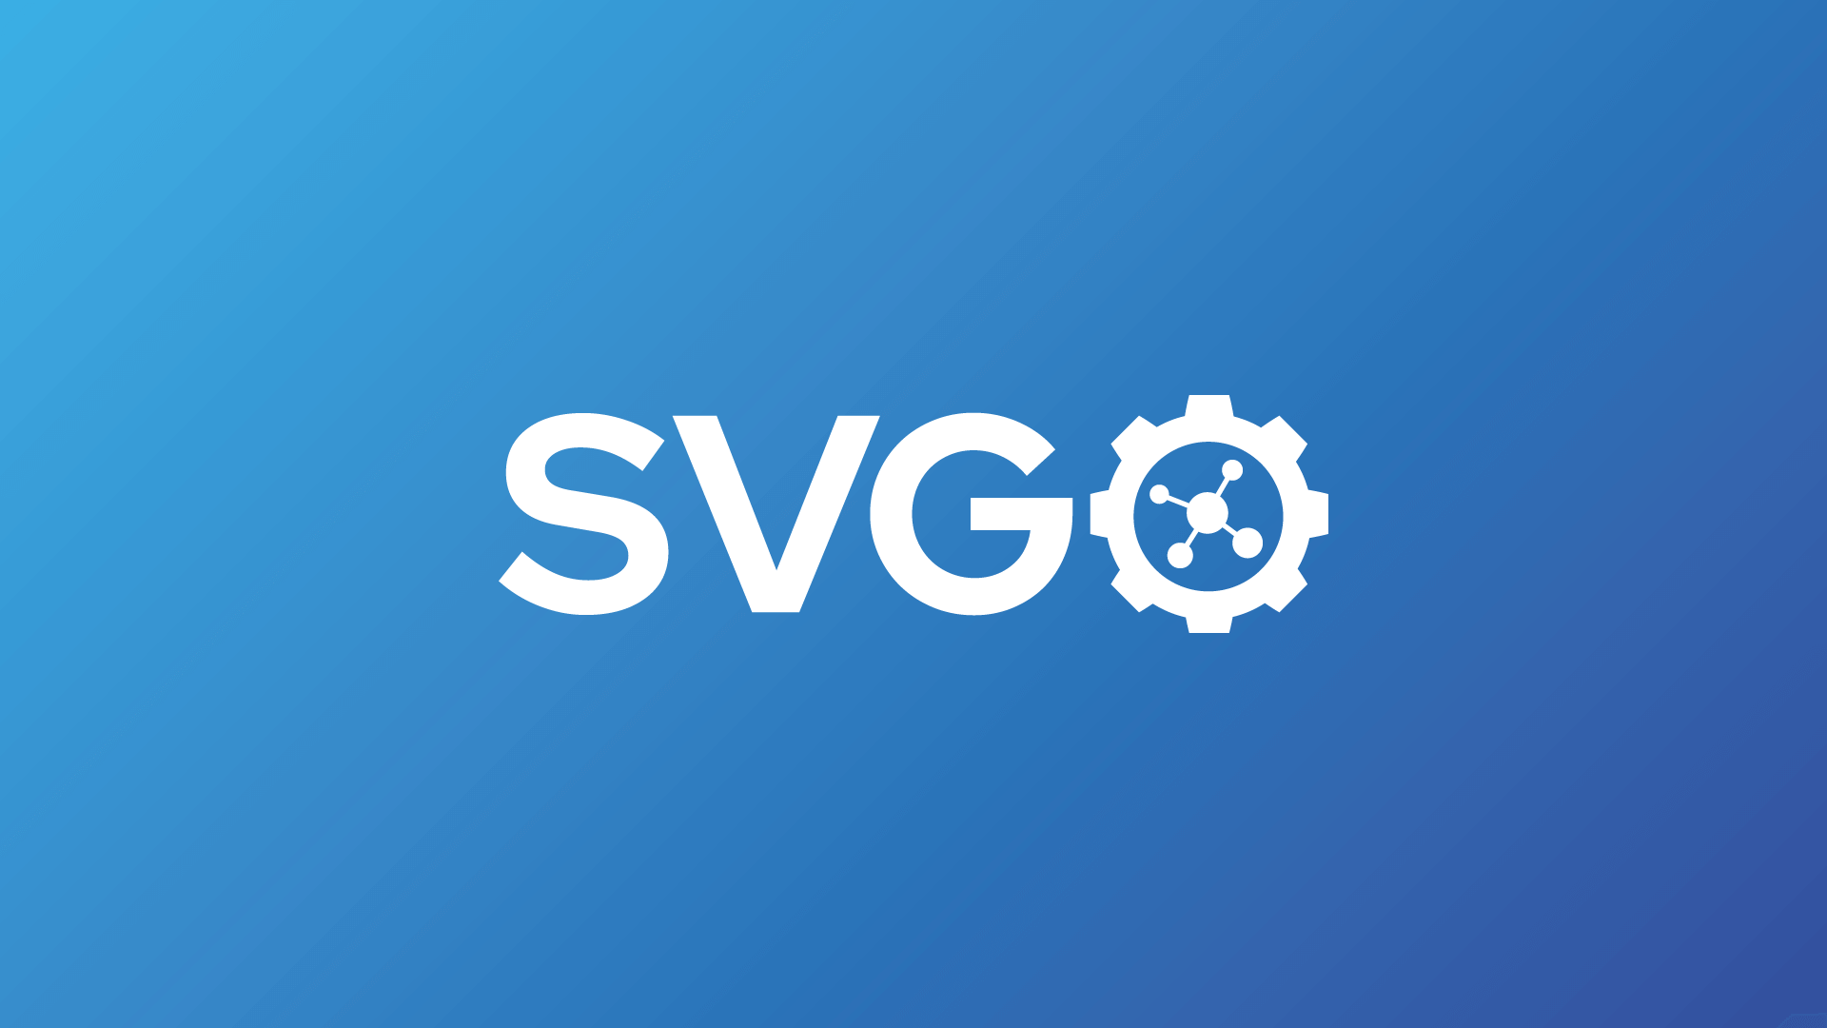
Notes:
Node.js library and command-line application for optimizing SVG files.

Slide 2
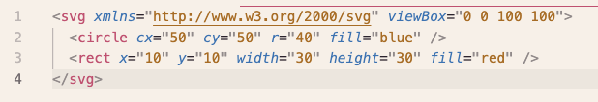
SVG === XML
Notes:
SVG is just a text with coordinates to draw in the screen

Slide 3
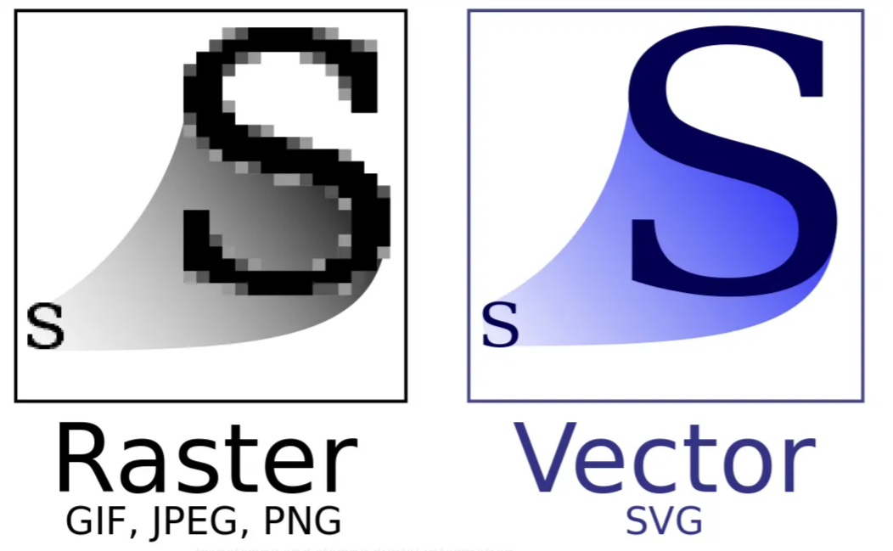
Notes:
comparing with others
good for icons
no Lose of quality in case of Upper the resolution
well used in programs like figma, ilustrator etc

Slide 4
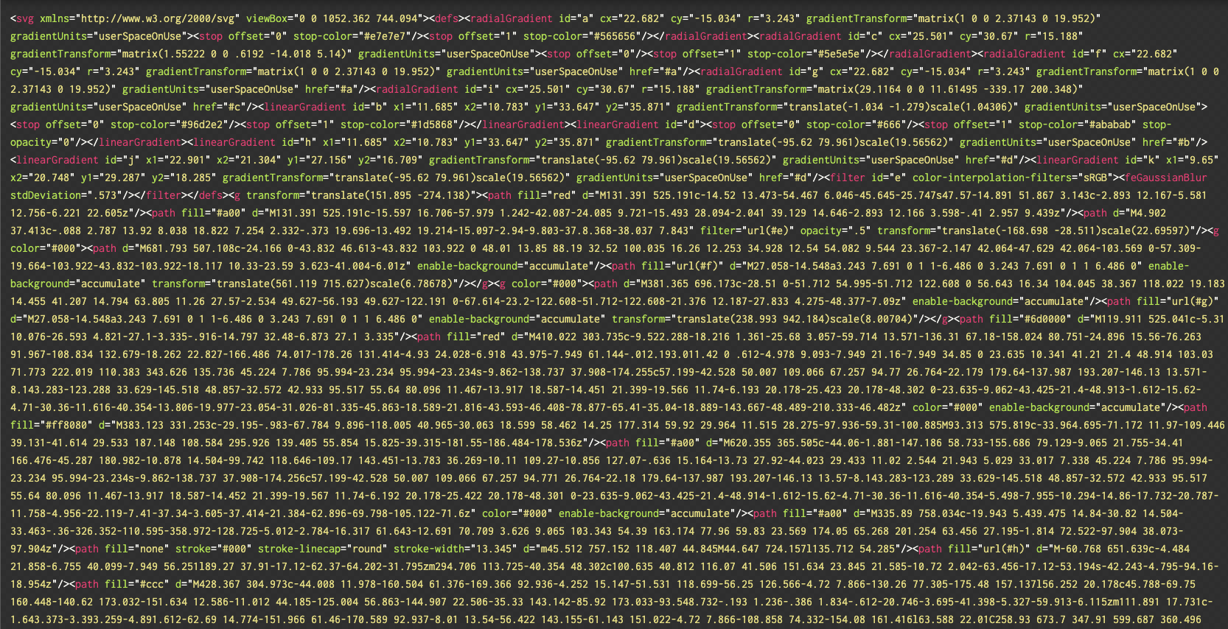
export problem
Notes:
When you export a svg from figma, ilustrator, any other tools, it has a lot of useless information that can contain metadata, comments, atributes the browser or app don’t need to render this

Slide 5

Notes:
node >=16
4 interfaces to use:

Slide 6
tradeoffs
Pros | Cons
Integrates with Vite, runs on every build | multipass adds build time
50-80% average reduction | Can break animations
 | May rename/remove IDs used by external CSS/JS
 | May remove <title> and <desc> for screen readers

Slide 7
thank you all

