Slide 1
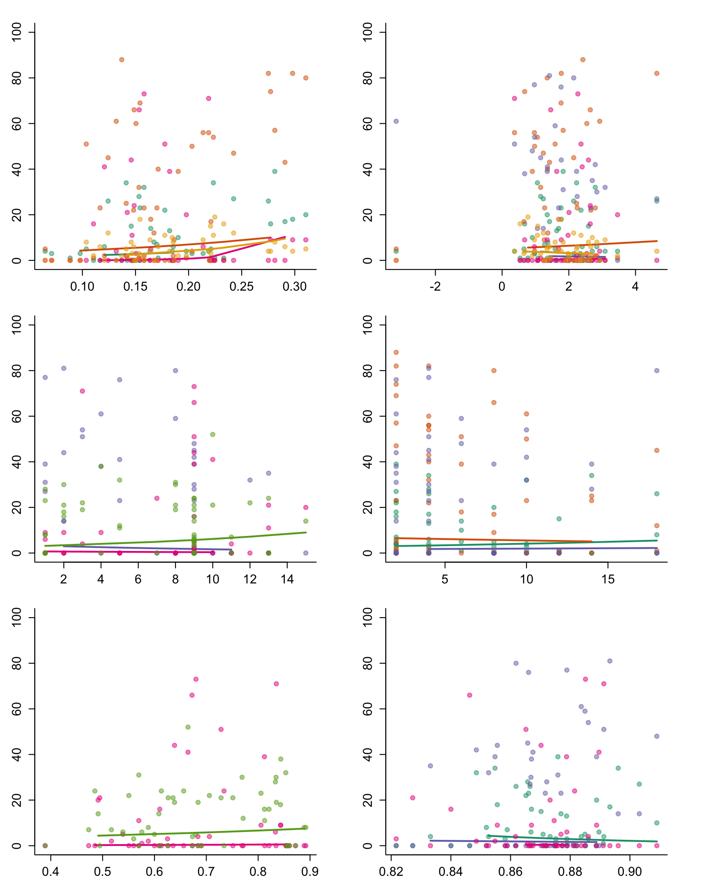
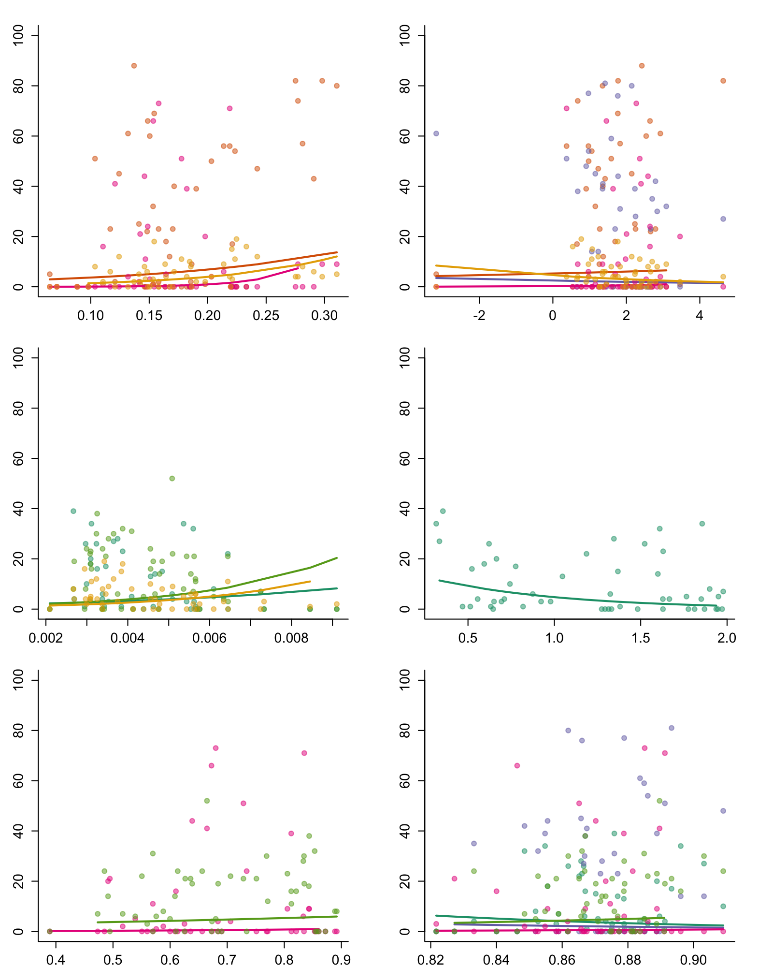
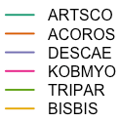
Seasonal
Daily
Abundance
Mean Soil Moisture (5cm)
Mean Soil Temperature (5cm)
Mean Soil Moisture (5cm)
Mean Soil Temperature (5cm)
Abundance
Soil Moisture Variability (5cm)
Soil Temperature Variability (5cm)
Soil Moisture Variability (5cm)
Soil Temperature Variability (5cm)
Abundance
Soil Moisture Predictability (5cm)
Soil Temperature Predictability (5cm)
Soil Moisture Predictability (5cm)
Soil Temperature Predictability (5cm)

Slide 2
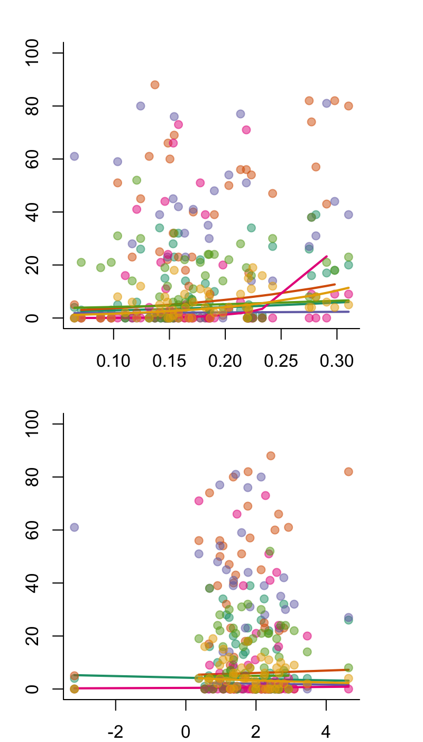
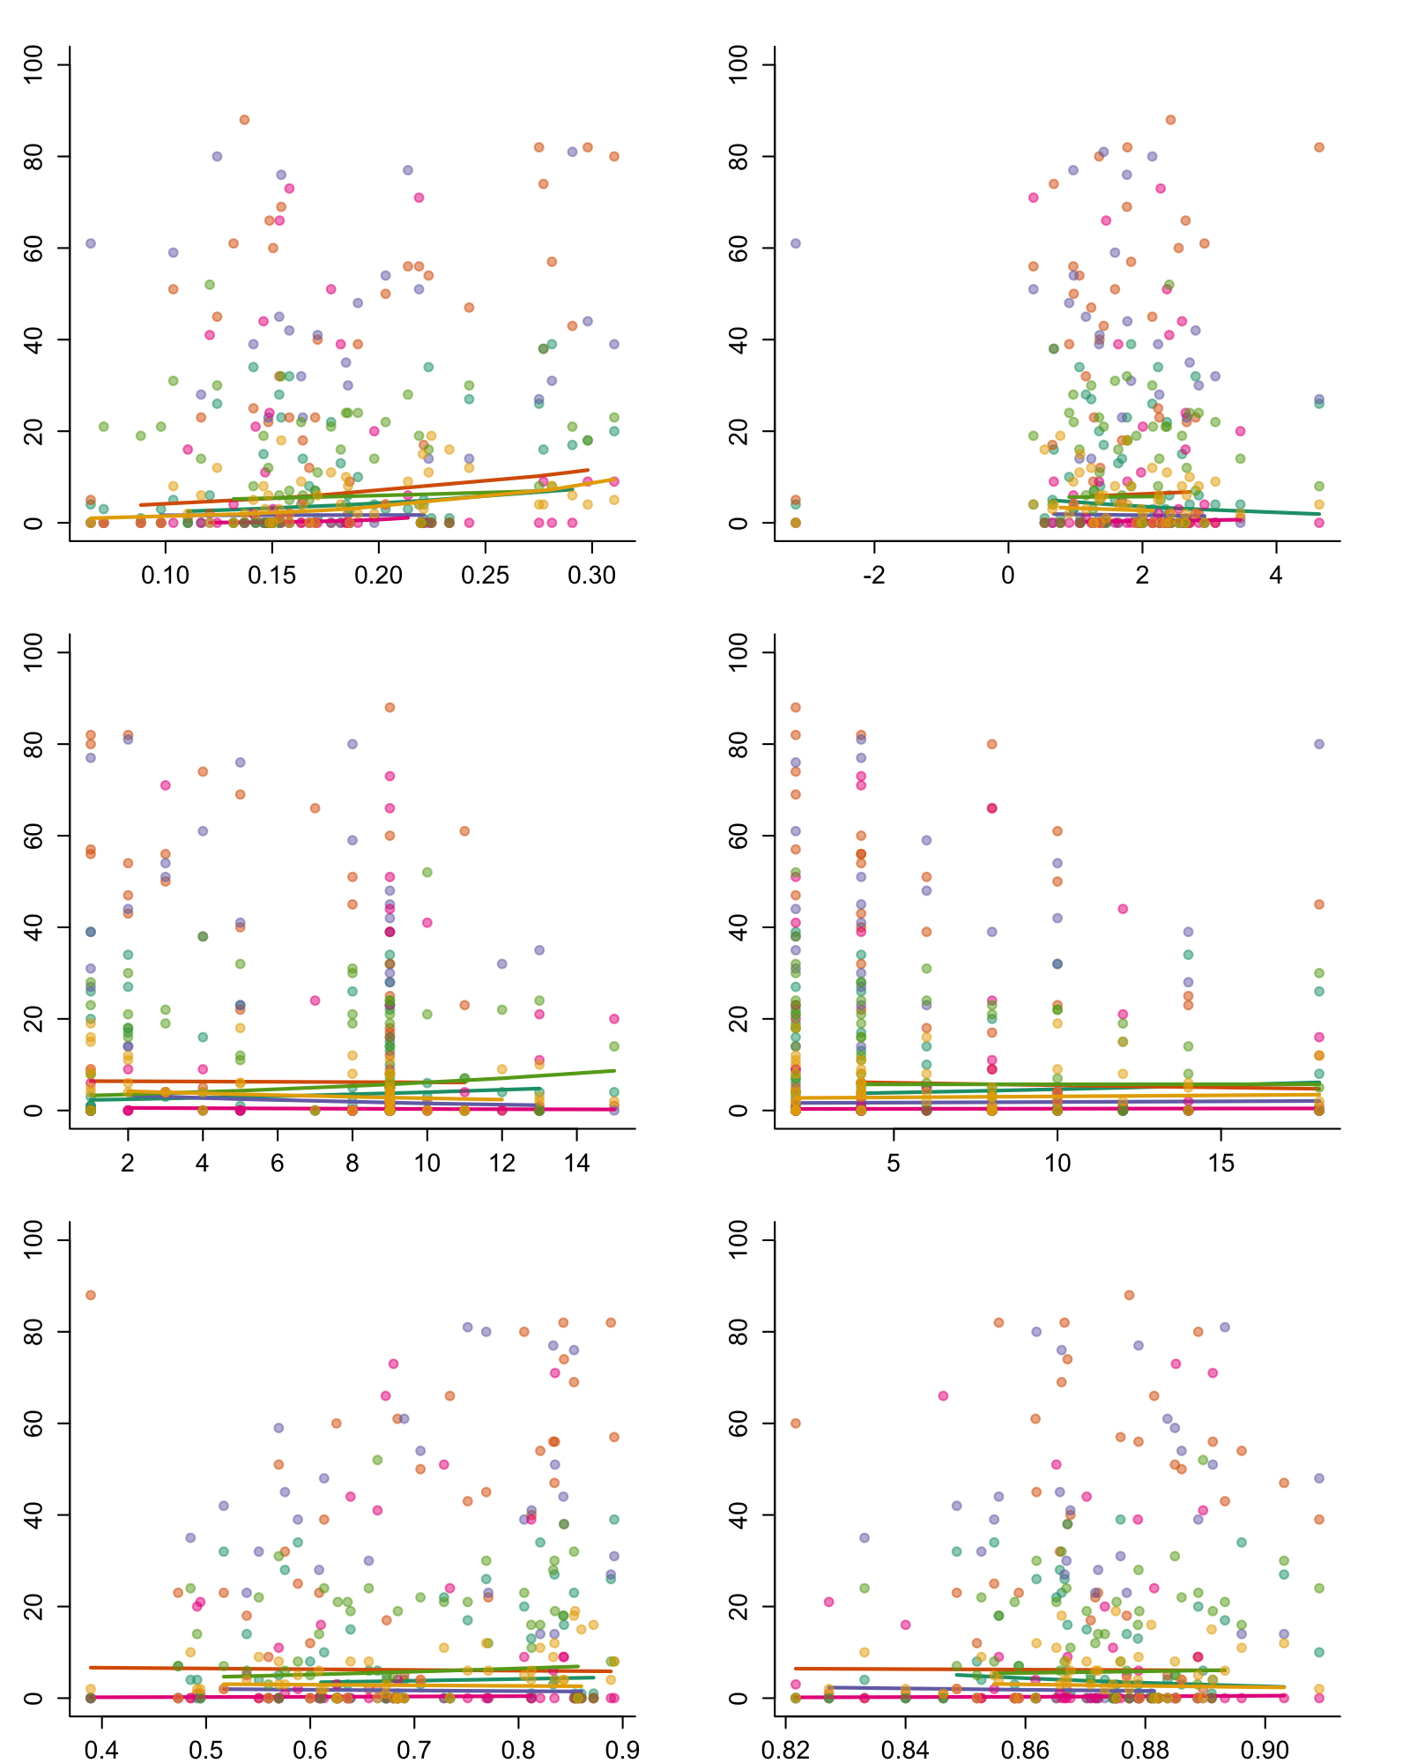
Means Only
Means with Variability and Predictability
Abundance
Abundance
Mean Soil Moisture (5cm)
Mean Soil Temperature (5cm)
Mean Soil Moisture (5cm)
Abundance
Soil Moisture Variability (5cm)
Soil Temperature Variability (5cm)
Abundance
Abundance
Mean Soil Temperature (5cm)
Soil Moisture Predictability (5cm)
Soil Temperature Predictability (5cm)

Slide 3
Artemesia scopulorum (ARTSCO)
npar AIC BIC logLik deviance Chisq Df Pr(>Chisq)
mean.mod.list[[1]] 4 317.25 324.98 -154.62 309.25
all.mod.list[[1]] 8 304.50 319.96 -144.25 288.50 20.747 4 0.0003555 ***
----------------------------------------
Estimate Std. Error z value Pr(>|z|)
(Intercept) 0.82034 0.65461 1.253 0.210
MEAN_SM_5 3.52491 2.66113 1.325 0.185
MEAN_ST_5 -0.06593 0.05814 -1.134 0.257
----------------------------------------
Estimate Std. Error z value Pr(>|z|)
(Intercept) 11.01139 4.68660 2.350 0.01880 *
MEAN_SM_5 5.85930 3.72170 1.574 0.11540
MEAN_ST_5 -0.23819 0.08054 -2.957 0.00310 **
VAR_SM_5_tc 0.06104 0.05148 1.186 0.23578
VAR_ST_5_tc 0.03516 0.01398 2.516 0.01188 *
PRED_SM_5 0.96377 1.16075 0.830 0.40637
PRED_ST_5 -13.38530 4.83704 -2.767 0.00565 **

Slide 4
Geum rossii (ACOROS)
npar AIC BIC logLik deviance Chisq Df Pr(>Chisq)
mean.mod.list[[2]] 4 339.04 346.76 -165.52 331.04
all.mod.list[[2]] 8 340.03 355.48 -162.01 324.03 7.0083 4 0.1354
----------------------------------------
Estimate Std. Error z value Pr(>|z|)
(Intercept) 0.54888 0.76908 0.714 0.475421
MEAN_SM_5 6.26875 1.69427 3.700 0.000216 ***
MEAN_ST_5 0.06860 0.03547 1.934 0.053077 .
----------------------------------------
Estimate Std. Error z value Pr(>|z|)
(Intercept) 1.807299 2.012228 0.898 0.3691
MEAN_SM_5 5.191137 2.351231 2.208 0.0273 *
MEAN_ST_5 0.096691 0.042175 2.293 0.0219 *
VAR_SM_5_tc -0.004916 0.022124 -0.222 0.8241
VAR_ST_5_tc -0.018832 0.008672 -2.172 0.0299 *
PRED_SM_5 -0.257341 0.418445 -0.615 0.5386
PRED_ST_5 -0.902507 1.950790 -0.463 0.6436

Slide 5
Deschampsia ceaspitosa (DESCAE)
npar AIC BIC logLik deviance Chisq Df Pr(>Chisq)
mean.mod.list[[3]] 4 388.67 396.40 -190.34 380.67
all.mod.list[[3]] 8 367.09 382.54 -175.54 351.09 29.581 4 5.957e-06 ***
----------------------------------------
Estimate Std. Error z value Pr(>|z|)
(Intercept) 0.73076 1.32974 0.550 0.58263
MEAN_SM_5 0.97090 1.63902 0.592 0.55360
MEAN_ST_5 -0.09955 0.03151 -3.159 0.00158 **
----------------------------------------
Estimate Std. Error z value Pr(>|z|)
(Intercept) 8.346889 2.896836 2.881 0.00396 **
MEAN_SM_5 0.314434 2.539185 0.124 0.90145
MEAN_ST_5 -0.111352 0.045801 -2.431 0.01505 *
VAR_SM_5_tc -0.096131 0.024509 -3.922 8.77e-05 ***
VAR_ST_5_tc 0.014898 0.008637 1.725 0.08455 .
PRED_SM_5 -0.898321 0.670947 -1.339 0.18061
PRED_ST_5 -7.180049 2.774117 -2.588 0.00965 **

Slide 6
Kobresia myosuroides (KOBMYO)
npar AIC BIC logLik deviance Chisq Df Pr(>Chisq)
mean.mod.list[[4]] 4 540.18 547.91 -266.09 532.18
all.mod.list[[4]] 8 520.03 535.49 -252.01 504.03 28.153 4 1.161e-05 ***
----------------------------------------
Estimate Std. Error z value Pr(>|z|)
(Intercept) -6.7511 1.7671 -3.820 0.000133 ***
MEAN_SM_5 33.0580 4.1127 8.038 9.13e-16 ***
MEAN_ST_5 0.1601 0.1485 1.078 0.280878
----------------------------------------
Estimate Std. Error z value Pr(>|z|)
(Intercept) -20.49244 3.91713 -5.231 1.68e-07 ***
MEAN_SM_5 31.95301 5.80808 5.501 3.77e-08 ***
MEAN_ST_5 0.40932 0.17075 2.397 0.016519 *
VAR_SM_5_tc -0.06990 0.04227 -1.654 0.098212 .
VAR_ST_5_tc 0.01925 0.02123 0.907 0.364632
PRED_SM_5 1.96167 1.13761 1.724 0.084641 .
PRED_ST_5 14.03395 3.82922 3.665 0.000247 ***

Slide 7
Trifolium parrii (TRIPAR)
npar AIC BIC logLik deviance Chisq Df Pr(>Chisq)
mean.mod.list[[5]] 4 348.22 355.95 -170.11 340.22
all.mod.list[[5]] 8 349.64 365.09 -166.82 333.64 6.5851 4 0.1595
----------------------------------------
Estimate Std. Error z value Pr(>|z|)
(Intercept) 1.17583 0.72573 1.620 0.105
MEAN_SM_5 2.22528 2.24358 0.992 0.321
MEAN_ST_5 0.01638 0.05682 0.288 0.773
----------------------------------------
Estimate Std. Error z value Pr(>|z|)
(Intercept) -2.8147654 3.3142569 -0.849 0.3957
MEAN_SM_5 2.0111893 3.3285073 0.604 0.5457
MEAN_ST_5 0.0163534 0.0738146 0.222 0.8247
VAR_SM_5_tc 0.0697232 0.0305143 2.285 0.0223 *
VAR_ST_5_tc 0.0003135 0.0120454 0.026 0.9792
PRED_SM_5 1.1531663 0.9032765 1.277 0.2017
PRED_ST_5 3.1519593 3.5730197 0.882 0.3777

Slide 8
Bistorta bistoides (BISBIS)
npar AIC BIC logLik deviance Chisq Df Pr(>Chisq)
mean.mod.list[[6]] 4 280.78 288.51 -136.39 272.78
all.mod.list[[6]] 8 285.94 301.39 -134.97 269.94 2.8437 4 0.5843
----------------------------------------
Estimate Std. Error z value Pr(>|z|)
(Intercept) -0.19701 0.60594 -0.325 0.74507
MEAN_SM_5 9.26567 3.05871 3.029 0.00245 **
MEAN_ST_5 -0.13769 0.07674 -1.794 0.07279 .
----------------------------------------
Estimate Std. Error z value Pr(>|z|)
(Intercept) 5.59948 5.32959 1.051 0.2934
MEAN_SM_5 9.15467 4.36483 2.097 0.0360 *
MEAN_ST_5 -0.16871 0.09436 -1.788 0.0738 .
VAR_SM_5_tc -0.05721 0.05698 -1.004 0.3154
VAR_ST_5_tc 0.01463 0.01882 0.777 0.4371
PRED_SM_5 -0.46383 1.44511 -0.321 0.7482
PRED_ST_5 -5.87077 5.68146 -1.033 0.3015

Slide 9
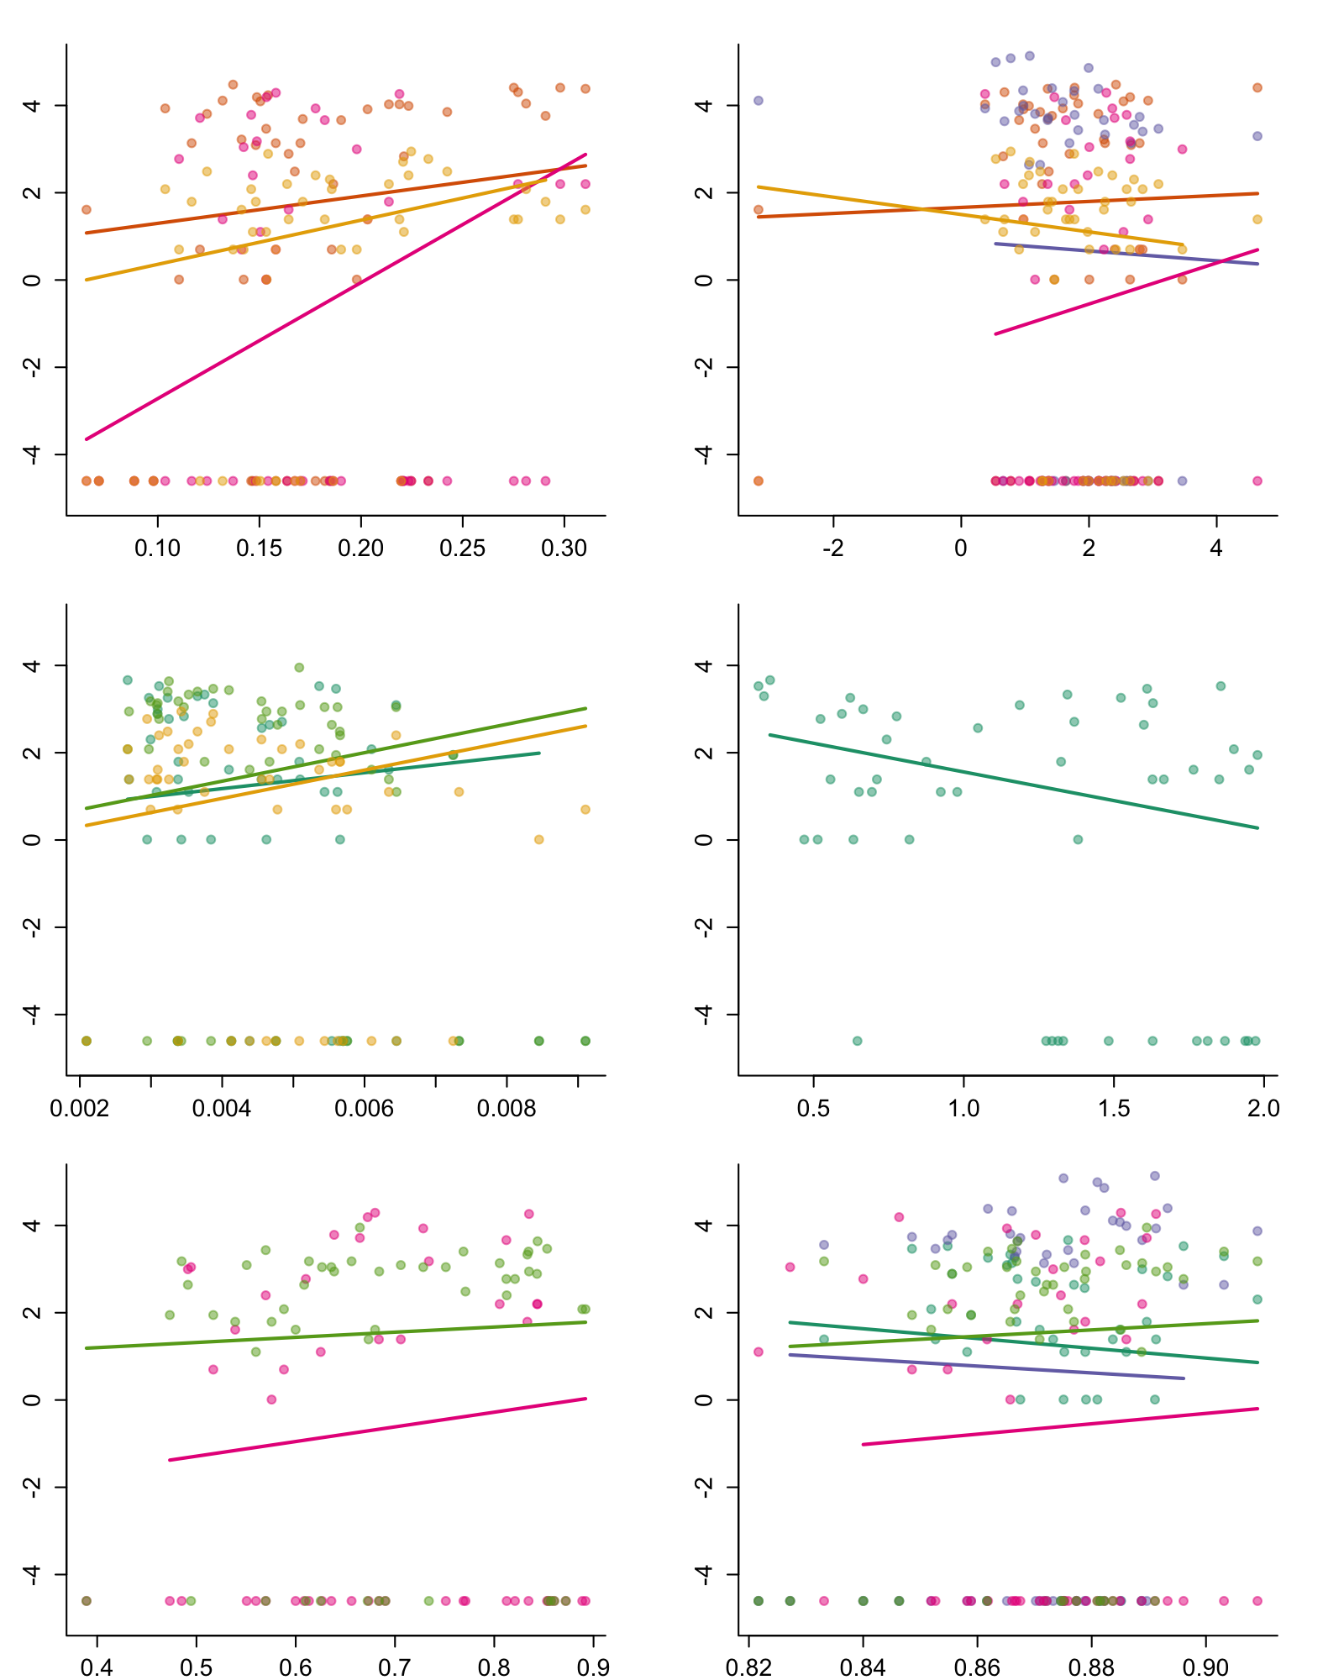
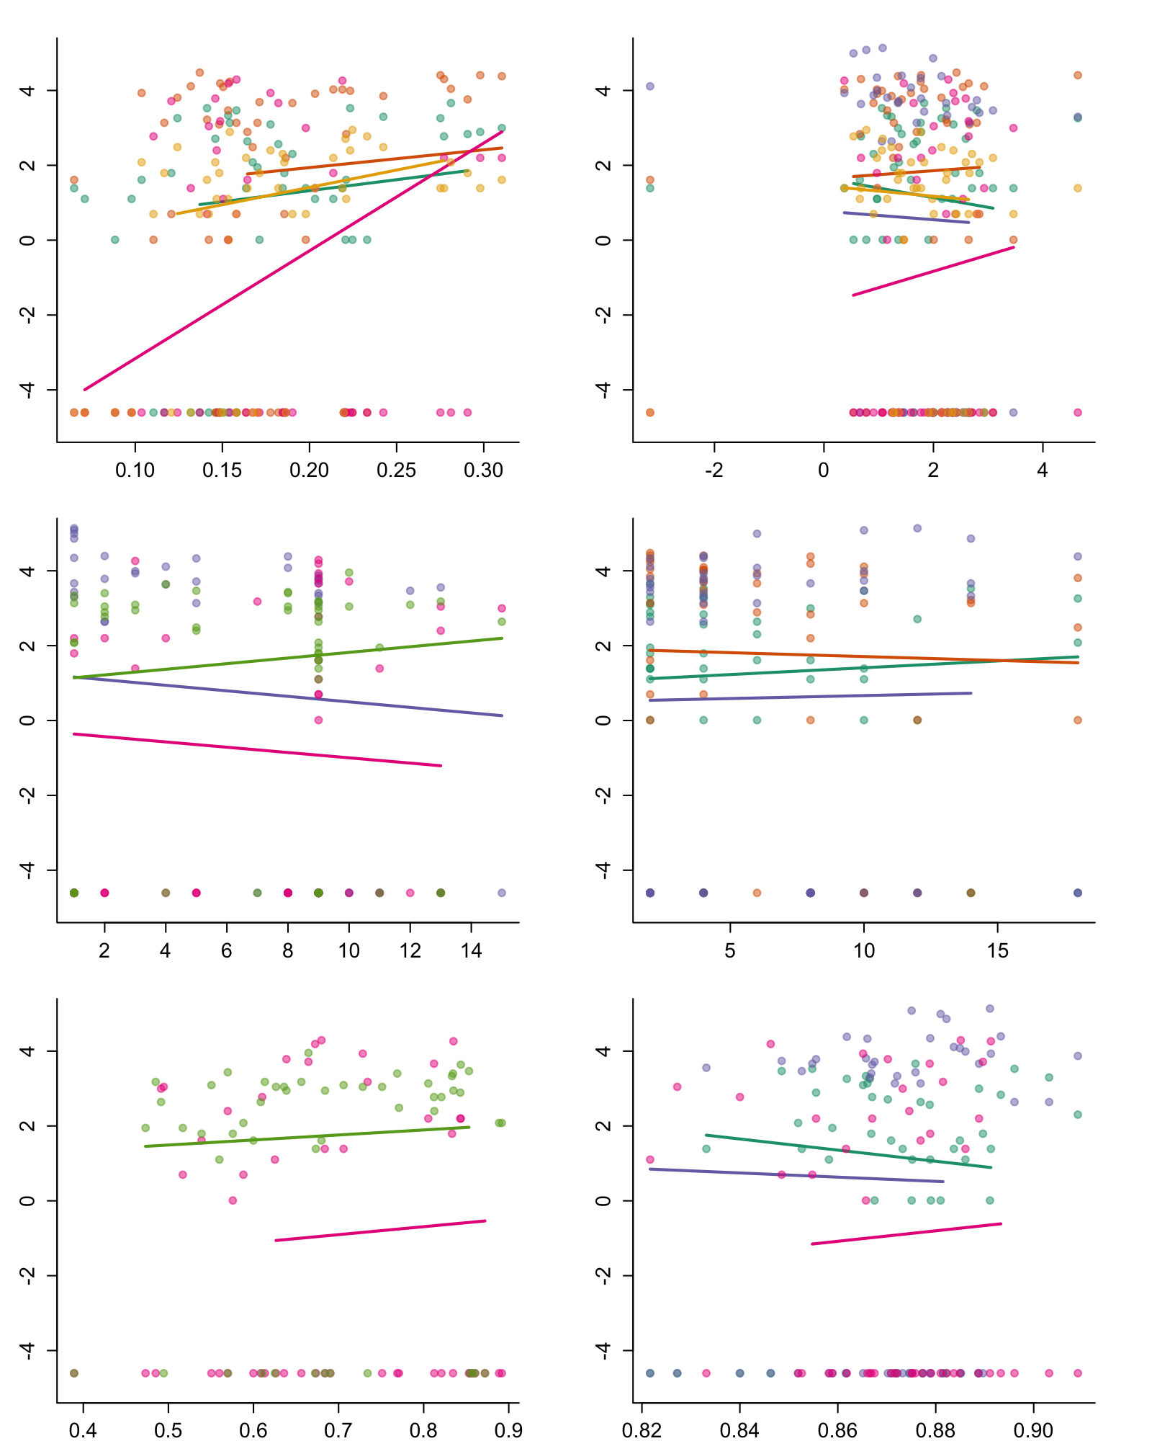
A. Daily
B. Seasonal
ln(Abundance)
Mean Soil Moisture
Mean Soil Temperature
Mean Soil Moisture
Mean Soil Temperature
ln(Abundance)
Soil Moisture Variability
Soil Temperature Variability
Soil Moisture Variability
Soil Temperature Variability
ln(Abundance)
Soil Moisture Predictability
Soil Temperature Predictability
Soil Moisture Predictability
Soil Temperature Predictability

