Slide 1

Quasi-Infinite Heaps
Vitaliy Lvin, Emery Berger
University of Massachusetts Amherst
Joint work with Ben Zorn
(Microsoft Research)

Slide 2
Infinite Heap Semantics
Normally: memory errors ⇒ ⊥
Consider infinite-heap allocator:
  All news fresh;
  ignore delete
    No dangling pointers, invalid frees,
    double frees
  Every object infinitely large
    No buffer overflows, data overwrites
Transparent to correct program
“Erroneous” programs sound

Slide 3
Approximating Infinite Heaps
DieHard:
  Approximate ∞-heaps with M-heaps (e.g., 2)
  Increases odds of benign errors
  Probabilistic memory safety
    i.e., P(no error) ≥ n
Protection increases as M increases

Slide 4
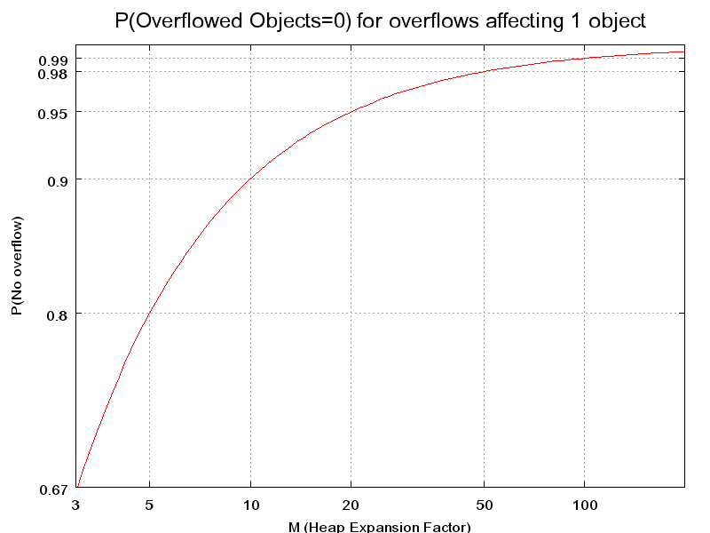
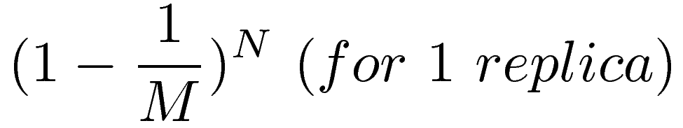
Probabilistic Memory Safety

Slide 5
What if M = Huge?
What if we make the heaps huge?
  e.g., M=1000
Pros:
  Dramatically reduces risk of overflow
Cons:
  Increase memory consumption by 1000x(?)

Slide 6
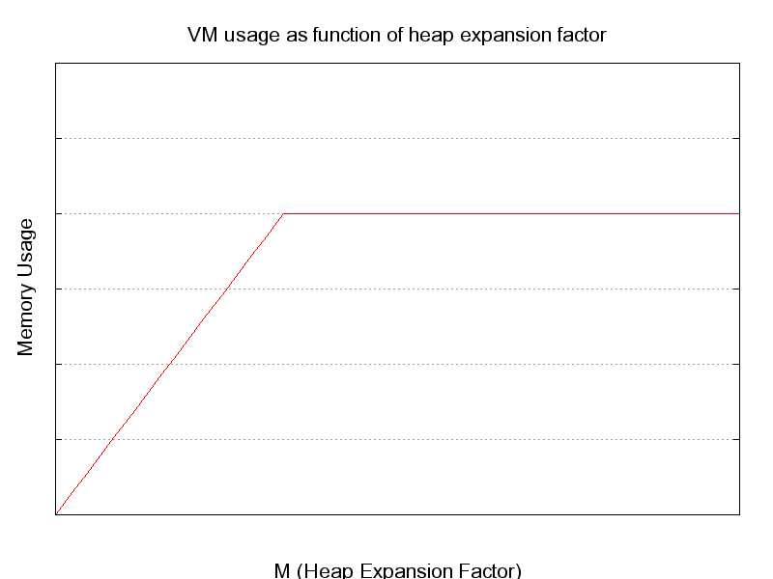
Virtual Memory Usage

Slide 7
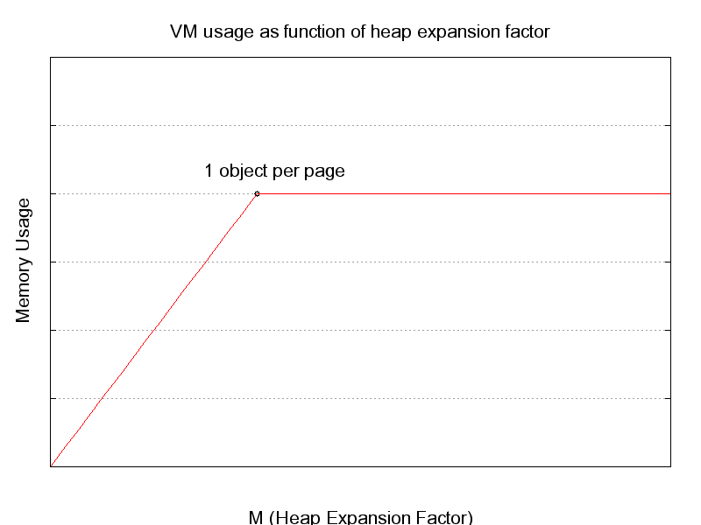
Virtual Memory Usage

Slide 8
Quasi-Infinite Heaps
Idea:
one object per page – each far apart
  Take advantage of large address spaces
    Especially 64-bit
  Closer to “infinite” heaps
Key challenge:
  Reducing physical memory consumption
  Spend address space, not RAM
Initial empirical results
  Running time

Slide 9
Reducing memory consumption
Assume locality of reference:
  90% time, access 10% data
Use 2 different heaps
  Hot space (“10%”)
    1 object per page, empty pages in-between
    Unrestricted access
  Cold space (“90%”)
    Compacted or even compressed
    No direct access
    Copy into Hot space on demand

Slide 10
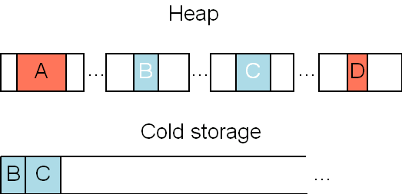
Heap regions
A,D: hot
  Directly accessible
B,C: cold
  Pages allocated, protected & evictable (madvise)
  Contents in Cold Storage (ordinary heap)

Slide 11
Managing Hot-Cold Heap Spaces
  Evict objects from hot space
    Currently using FIFO, fixed # of hot objects
  Page protection traps accesses to cold objects
    Signal handler copies requested object back into place, unprotects page
  Note: manages pages, not whole objects
    Allows eviction of cold parts of arrays, etc.

Slide 12
Maintaining soundness
Buffer overflows
  Small overflows (within page)
    Compaction preserves overflowed data across evictions
  Large overflows (outside page)
    Trigger signal handler
    Can fail (now) or allow use of new page
Dangling pointers
  Defer frees
    Evict freed objects to cold space to save space
    Not yet implemented

Slide 13
Experimental Results
Ran 3 allocation-intensive benchmarks
  cfrac
  espresso
  roboop
Compared GNU libc, Diehard and Diehard QIH
Experimental platform
  P4 3GHZ, 1 GB RAM, 512KB L2 Cache
  Linux 2.6
Measured execution time

Slide 14
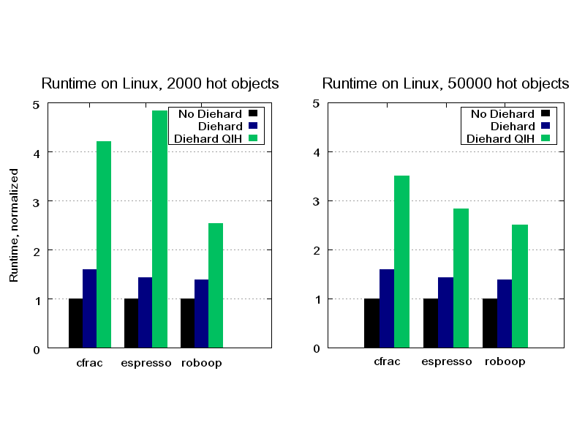
Empirical Results: Runtime

Slide 15
Performance-limiting factors
Increased cost of allocation/dealloc
Reduces/Limits spatial locality
Cache side-effects
  Increased L2 miss rate
VM side-effects
  Increased TLB miss rate
  Larger page tables

Slide 16
Future work
Error-injection experiments
Smarter eviction policies for Hot space
    Clock with s/w referenced bits
    Clock with h/w referenced bits (kernel mod)
Concurrent evictions
  Can be moved to a separate thread
Automatic Hot space sizing
  Adjust to application behavior
Add object coloring to improve cache performance

Slide 17
Conclusion
Our Goal:
  Provide near-infinite heap guarantees against certain memory errors for unaltered C/C++ applications
  Exploit VM and access locality to do it reasonably efficiently
Work in progress

Slide 18
Questions?

