Slide 1
Building a Modern Async API with FastAPI and Uvicorn
Eli Mesika – Continuous Certification Team
[ Clone sample app ]

Slide 2
Agenda
Multi-Processing, Multi-Threading and Asyncio
What is FastAPI
Validation & Serialization
FastAPI VS Flask
Uvicorn and ASGI
Async Request Flow
Dependency Injection & Lifespan
Docs
Demos (CRUD, Bulk Insert)

Slide 3
Multi-Processing, Multi-Threading and AsyncIO on Python
  Think of a Chess master that play N games against N opponents
  Multi-Processing – Each game is played from start to end on a single process
  Multi-Threading – The Chess master joins N-1 additional Chess masters, each of them handling one game.
  AsyncIO – The Chess master makes his move on one board and moves to the 2nd and so forth, it will return to a board only after an opponent makes his move, this is a one process, one thread game (at least per CPU core)

Slide 4
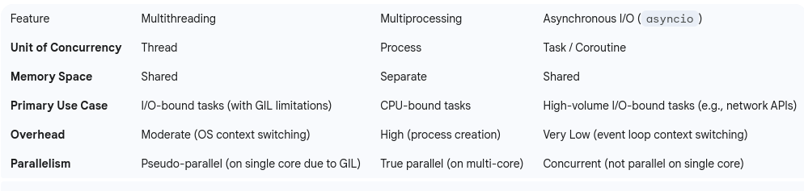
Multi-Processing, Multi-Threading and AsyncIO on Python (Cont)

Slide 5
What is FastAPI
FastAPI integrates with Starlette under the hood for routing and middleware, and with Pydantic for data validation and serialization.
When a request comes in, Starlette (invoked by FastAPI) matches the URL to the correct path operation and calls the endpoint function.
FastAPI handles reading query parameters, path variables, and JSON bodies (via Pydantic models), performs dependency injection, and orchestrates the response.

Slide 6
Validation
FastAPI uses Pydantic models to define the shape and data types of the API's incoming data.
  Schema: Create a class that inherits from Pydantic's BaseModel and define your data fields using standard Python type hints (e.g., str, int, bool, list).
Automatic Validation: When you declare this model as a type hint for a request body or query parameter in your endpoint, FastAPI automatically
  Parses the incoming JSON (or other data).
  Validates the data against the model
Automatic Error Handling

Slide 7
Serialization
Serialization is the process of converting your Python data (like objects or dictionaries) into a format that can be sent over the network, typically JSON.
Define a Response Model
  Automatic Conversion
    Filters the data using the response_model
    Converts (serializes) that Python data into a JSON object,

Slide 8
FastAPI VS Flask
Flask is still more used but there is a strong shift from Flask to FastAPI
Major differences
  Flask (WSGI) → FastAPI (ASGI)
  Sync → Async
  Manual docs → Auto-generated docs

Slide 9
Uvicorn and ASGI
Think of a restaurant. Uvicorn is the waiter getting requests and serving the dishes while FastAPI is the chef preparing all the ordered dishes and signaling the waiter.
Uvicorn - The ASGI server that runs the FastAPI app.
Uvicorn is responsible for listening for HTTP requests and forwarding them into the FastAPI application.
In the request lifecycle, Uvicorn accepts the client connection and HTTP request, then invokes the FastAPI app via the ASGI interface.
Uvicorn’s event loop (using asyncio) allows handling many requests concurrently.

Slide 10
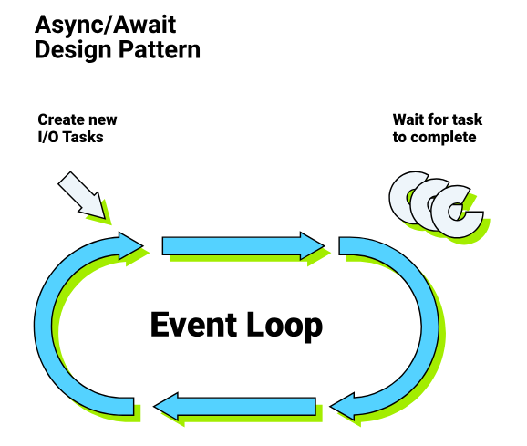
Event loop

Slide 11
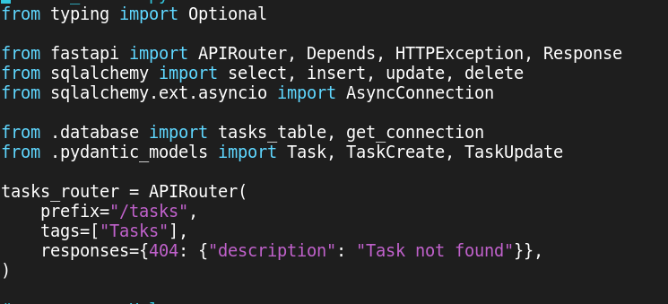
Routing

Slide 12
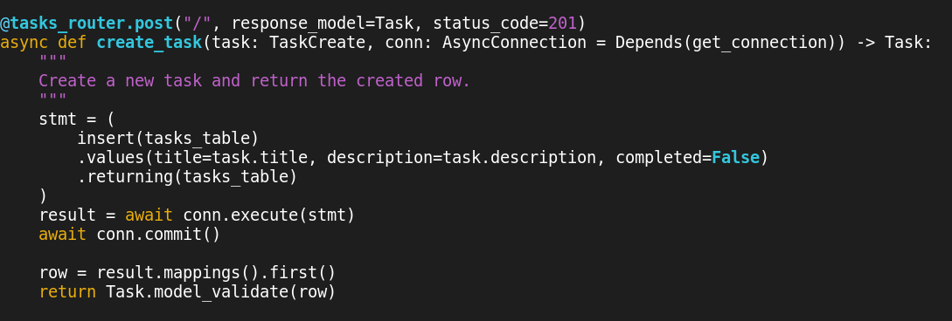
Routing, Co-routine (async and await) and dependency injection

Slide 13
asyncpg
The asynchronous PostgreSQL driver used by SQLAlchemy.
The database URL is prefixed with postgresql+asyncpg, which tells SQLAlchemy’s engine to use asyncpg under the hood.
asyncpg is responsible for the low-level communication with the PostgreSQL database (sending queries, receiving results) in a non-blocking way

Slide 14
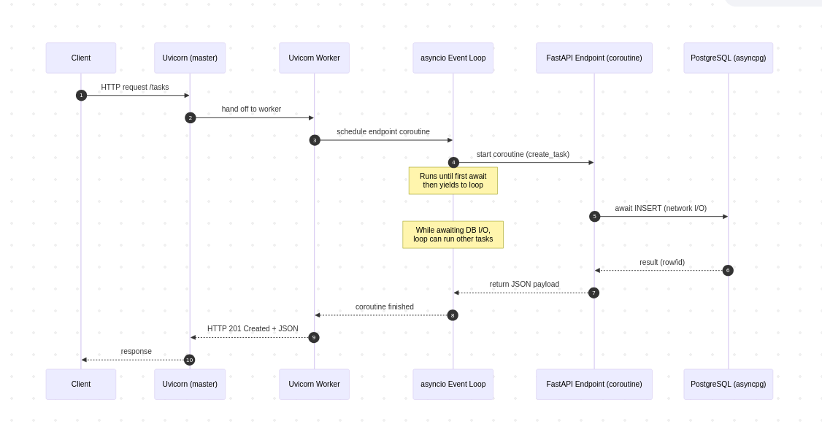
Async Request Flow

Slide 15
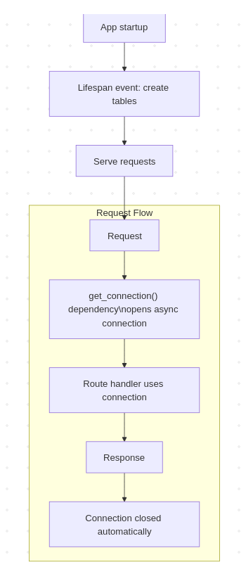
Lifespan

Slide 16
Docs
Swagger style
  http://localhost:8000/docs
New
  http://localhost:8000/redoc

Slide 17
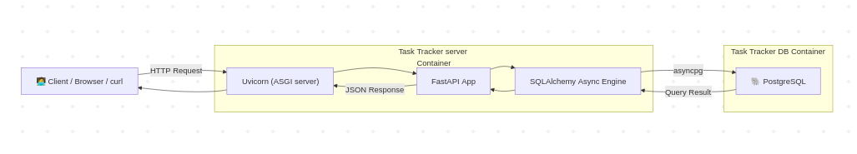
Demo – Task management application

Slide 18
Bulk Insert
Demo
  Inserting 10K tasks into the database

Slide 19
Open issues & further investigation
Regarding new Dashboard application development
  async interface with AWS S3
    aioboto3 ?
    boto3 + asyncio.to_thread
  async interface with Polarion
    Our own httpx or aiohttp + Polarion REST API ?
  async interface with gitlab
    gidgetlab ?
    gitlab + asyncio.to_thread ?

Slide 20
Questions

