Slide 1

Welcome

Slide 2

Spring Framework
ph no: 9513216462 | email : info@emexotechnologies.com | website: https://www.emexotechnologies.com

Slide 3
Spring Core
ph no: 9513216462 | email : info@emexotechnologies.com | website: https://www.emexotechnologies.com

Slide 4
Features of Spring
supports POJO and POJI
light weight
Built-in middleware services
Dependency Injection
Unit Testing
Built-in plugins
All kind of applications
supports web framework
ORM
Easy to learn
ph no: 9513216462 | email : info@emexotechnologies.com | website: https://www.emexotechnologies.com

Slide 5
POJO - Plain Old Java Object
- class is taken as a resource
// pojo
Public class Test {
}
//pojo
Public class Test extends Demo {
}
ph no: 9513216462 | email : info@emexotechnologies.com | website: https://www.emexotechnologies.com

Slide 6
POJO - Plain Old Java Object
// not pojo
public class Test extends HttpServlet {
}
ph no: 9513216462 | email : info@emexotechnologies.com | website: https://www.emexotechnologies.com

Slide 7
POJI – Plain Old Java Interface
- interface is taken as a resource
public interface Test {
}

Slide 8
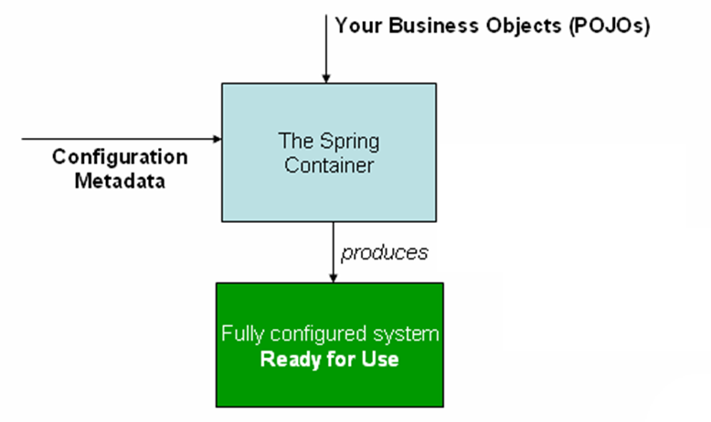
IOC – Inversion Of Control
XML
Annotation
Java Based
Bean

Slide 9
IOC Container
BeanFactory
ApplicationContext

Slide 10
Bean Factory
XmlBeanFactory
XmlBeanFactory factory = new XmlBeanFactory (new ClassPathResource("Beans.xml"));
HelloWorld obj = (HelloWorld) factory.getBean("helloWorld");
obj.getMessage();

Slide 11
ApplicationContext
FileSystemXmlApplicationContext
ClassPathXmlApplicationContext
XmlWebApplicationContext
AnnotationConfigApplicationContext
AnnotationConfigWebApplicationContext

Slide 12
ApplicationContext
ApplicationContext context = new ClassPathXmlApplicationContext("setter_application-context.xml");
TestBean tb = (TestBean) context.getBean("tb");
tb.print();

Slide 13


Slide 14
THANK YOU!
Any questions?
You can find us at
Email: info@emexotechnologies.com
Call/WhatsApp: 9513216462
ph no: 9513216462 | email : info@emexotechnologies.com | website: https://www.emexotechnologies.com

