Slide 1
Sampling distributions, standard errors, and confidence intervals

Slide 2
Overview
Review and continuation of sampling and bias
Sampling distributions
Exploring sampling distributions in R and the Standard Error
If there is time
Point estimates and confidence intervals

Slide 3
Announcement
Homework 4 has been posted!
It is due on Gradescope on Sunday September 28th at 11pm
Be sure to mark each question on Gradescope!
My office hours will be ending a little early on Wednesday
2pm-2:45pm
The material this week is going to be a bit more conceptually challenging. Please attend the practice sessions to reinforce your understanding!

Slide 4
Review: sampling and sampling distributions

Slide 5

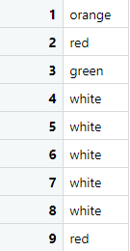
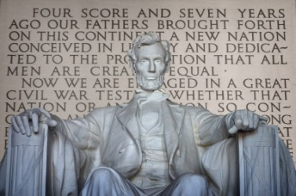

Review: sampling
Q: What symbol do we use to denote the sample size?
A: n

Slide 6
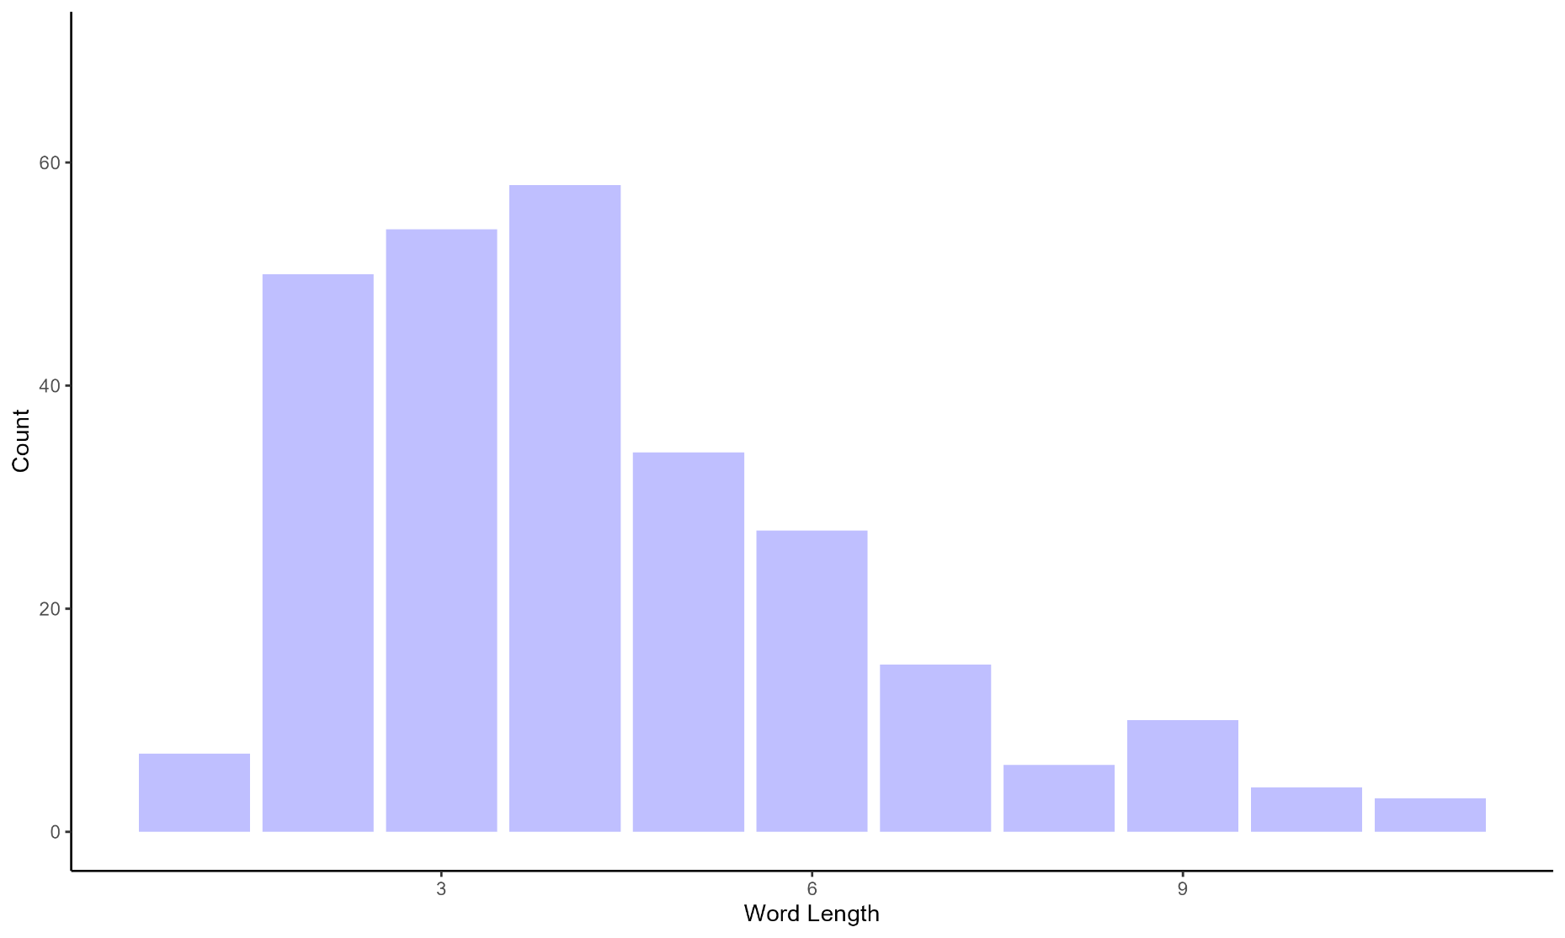
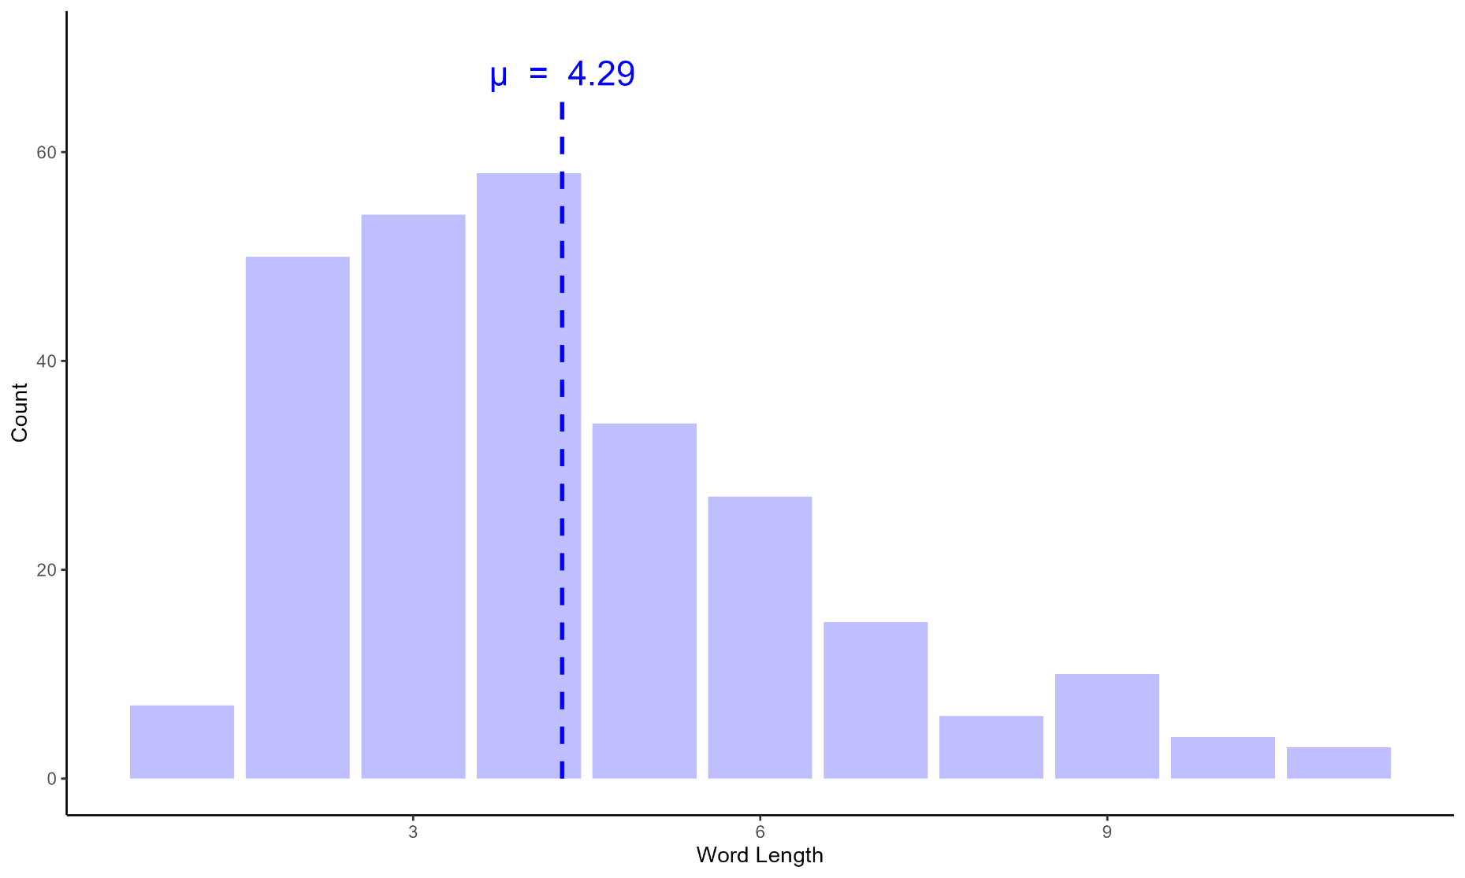
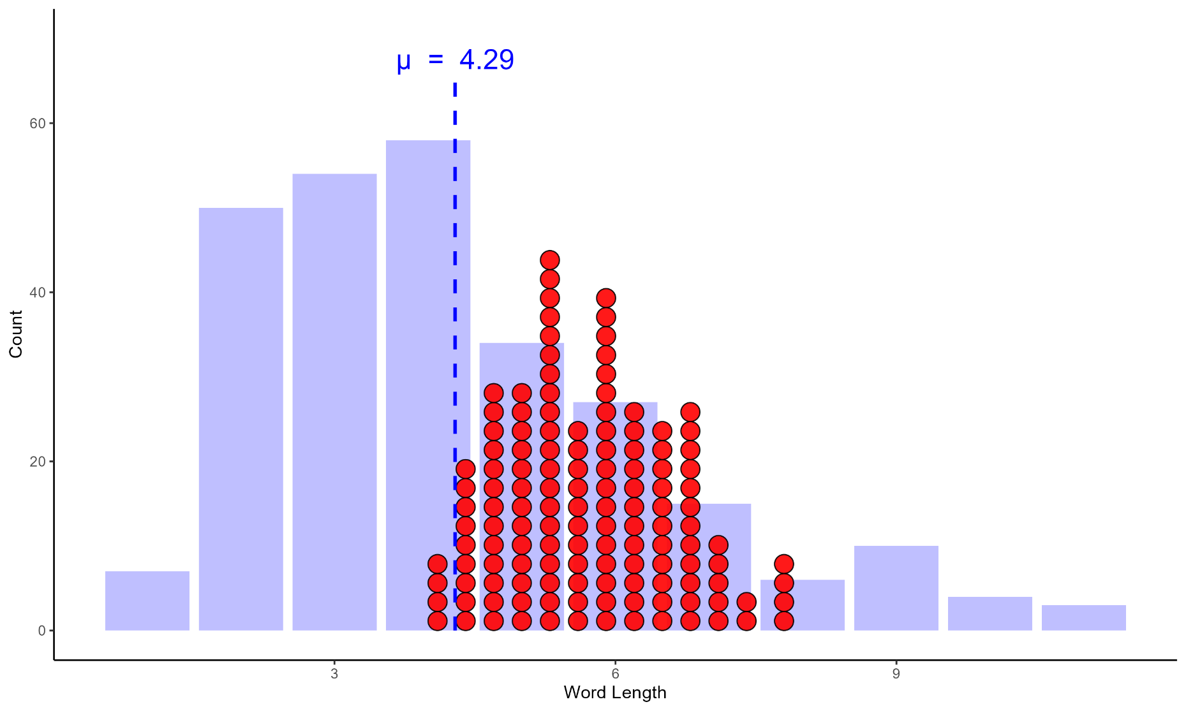
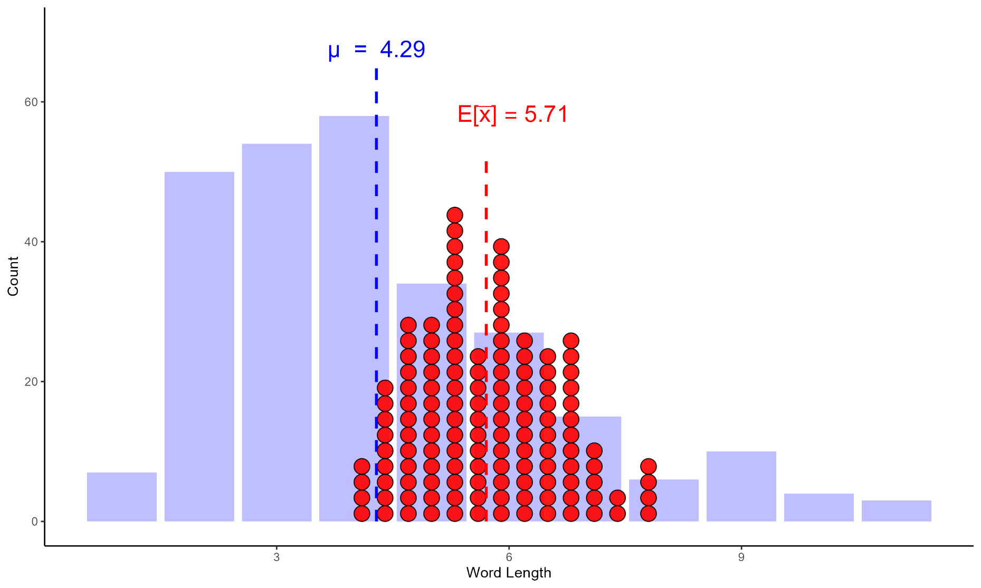
Bias and the Gettysburg address word length distribution

Slide 7

Bias and the Gettysburg address word length distribution
Bias is when the average statistic values does not equal the population parameter
Here:
E_{s}[x̅] ≠ μ

Slide 8
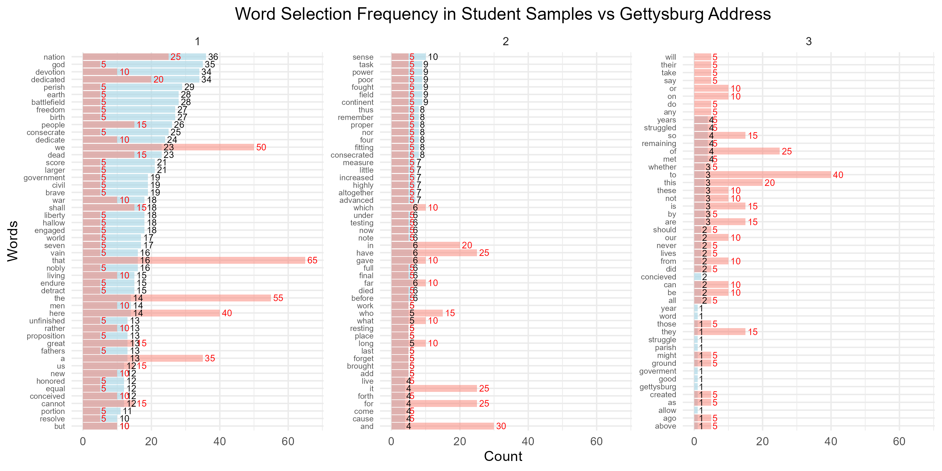
Sidenote: where is the bias coming from?
Notes:
From a visual inspection, not just that shorter words being selected b/c they take up more space, but also b/c they are less “interesting”; e.g., god was selected frequently even though it is a short word. Would be interesting to create a model that takes into account word length and other word properties (e.g., parts of speech, valance, etc.) to see which words are selected most frequently.

Slide 9
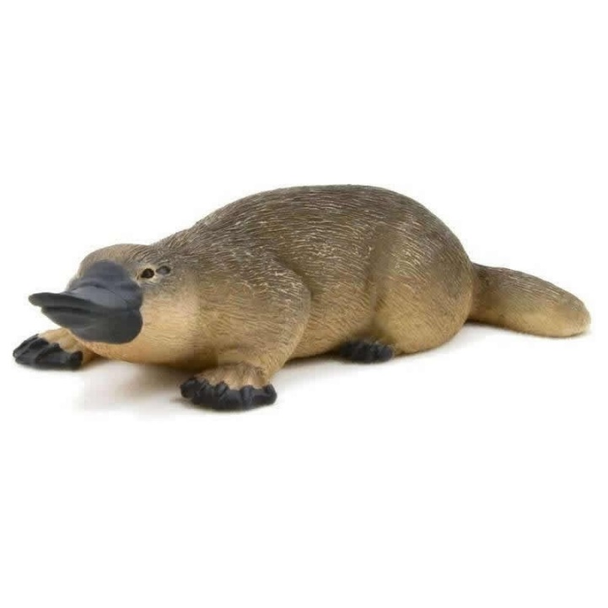
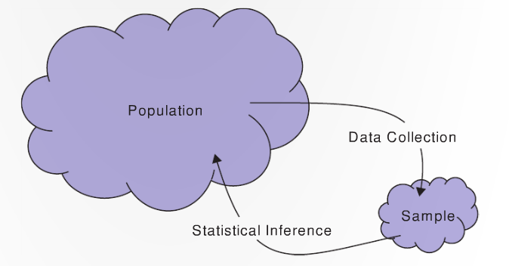


Statistical bias
μ
x̄

Slide 10
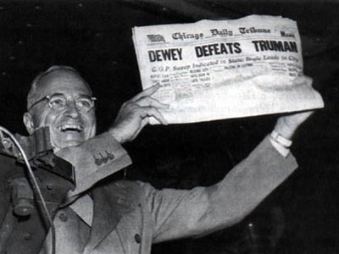
Basic questions for sampling
What is the population?
What is the sample?
Do they differ in a meaningful way?
Notes:
Population: All US citizens who can/will vote
Sample: citizen’s with telephones
Yes, people with telephones tended to be wealthier and wealthier people voted for Dewey.

Slide 11

Bias or no bias?

Slide 12
1948 US election: Dewey vs. Truman
Suppose there was a poll for the Truman/Dewey election that had randomly chosen 6,000 people from all voters in the USA and calculated who they voted for
Bias or no bias?
Notes:
No bias

Slide 13
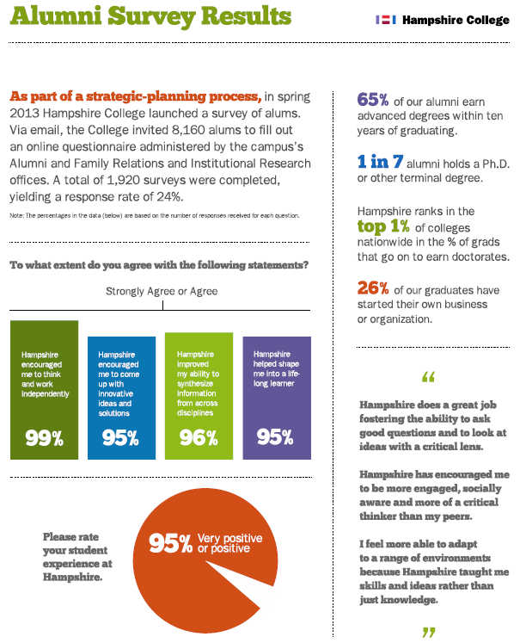
Bias or no bias?
As part of a strategic-planning process, in spring 2013 Hampshire College launched a survey of alums
Via email, the College invited 8,160 alums to fill out an online questionnaire administered by the campus’s offices
A total of 1,920 surveys were completed, yielding a response rate of 24%

Slide 14
Bias or no bias?
Yelp reviews of restaurants?
An anonymous survey randomly select 6,000 people and asked them if have they used an elicit drug in the past month?
https://www.billoreilly.com/poll-center
Notes:
All bias

Slide 15
The way you frame the question matters!
Quinnipiac University conducted two polls on November 5, 2015
First poll they asked: do you support “stricter gun control laws”?
Yes = 46% No = 51% Difference = -5%
Second poll asked: do you support “stricter gun laws”?
Yes = 52% No = 45% Difference = 7%
How could this affect the newspaper headlines?
“Majority of Americans oppose stricter gun control laws” vs.
“Majority of Americans support stricter gun laws”
Also see textbook section 1.2:
“If you had to do it over again, would you have children?”

Slide 16
Practicalities…
It might not be feasible to randomly select equally from all members of a population
This might not be a problem as long as the sample is representative of the population
Example: If we wanted to know proportion of people left-handed in the US, randomly sampling Yale students might be good enough

Slide 17
Need to think carefully to avoid bias!
Statistics requires thought!
Use your own reasoning:
What is the population I am interested in?
Does the sample reflect the population of interest?
Be your own worst critic!

Slide 18
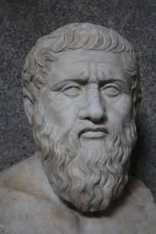


Q: How can we prevent sampling bias?
To prevent bias, use a simple random sample
where each member in the population is equally likely to be in the sample
This allows for generalizations to the population!
Soup analogy!
π, μ, σ, ρ
p̂, x̅, s, r

Slide 19
Q: How do we select a random sample?
Mechanically:
Flip coins
Pull balls from well mixed bins
Deal out shuffled cards, etc.
Use a computer program

Slide 20
Questions about statistical bias?

Slide 21

From now on we are going to assume no bias!
Our statistic values, on average, reflect the parameters

Slide 22
Sampling distributions

Slide 23
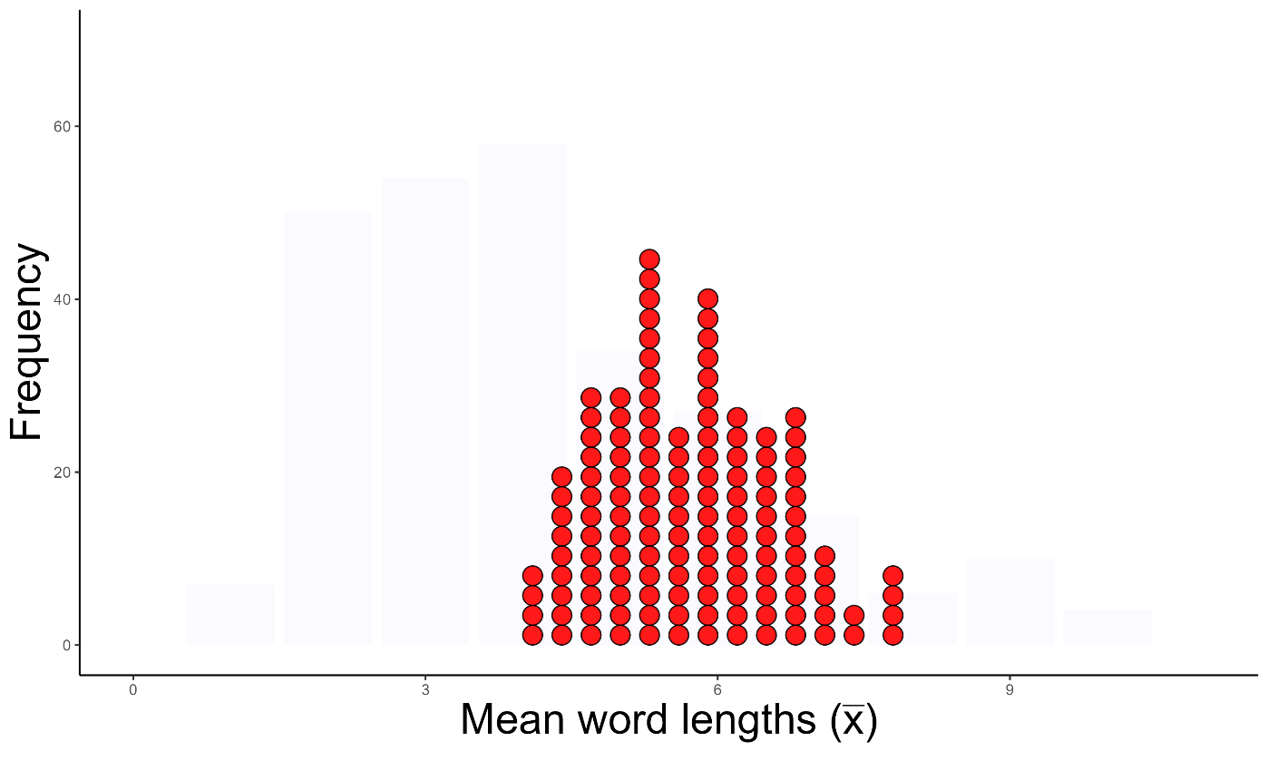
Recall for our distribution of Gettysburg word lengths…
Q: What does each dot that is plotted correspond to?

Slide 24
Sampling distribution
A sampling distribution is the distribution of sample statistics computed from different samples of the same size (n) from the same population
A sampling distribution shows us how the sample statistic varies from sample to sample

Slide 25
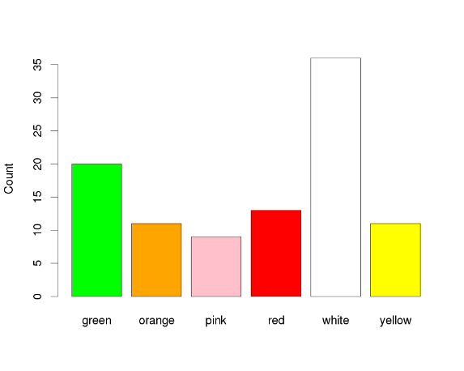


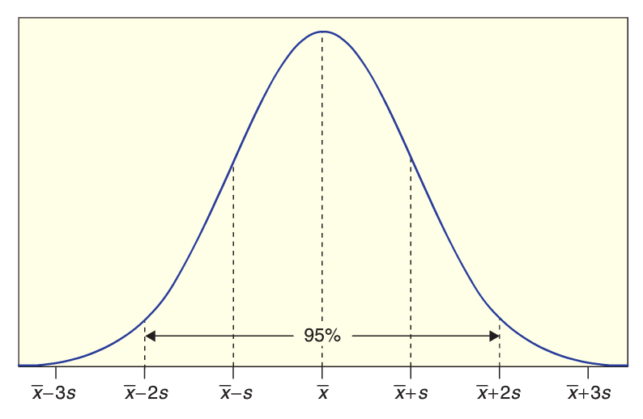
n = 100
π_{red}
p̂_{red}
p̂_{red}
p̂_{red}
Sampling distribution!

Slide 26
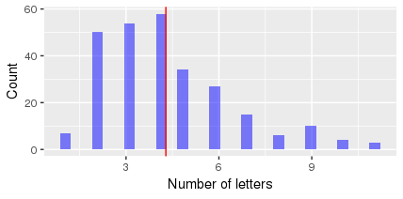
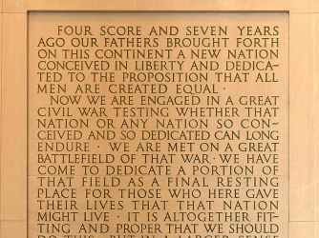
Gettysburg address word length sampling distribution
µ
n = 10
10, 3, 3, 3, 4,
3, 2, 6, 10, 5
x̅ = 5
2, 6, 2, 6, 6,
2, 5, 3, 2, 9
x̅ = 4.3
3, 9, 3, 4, 4,
3, 6, 6, 2, 2
x̅ = 4.2
Sampling distribution!
Gettysburg sampling distribution app

Slide 27
Let’s create a sampling distribution in R!

Slide 28
Let’s create a sampling distribution in R
Load the SDS1000 library to make all SDS1000 functions available
library(SDS1000)
Get the Gettysburg population data
load("gettysburg.Rda")
word_lengths <- gettysburg$num_letters # lengths of the 268 words

Slide 29
Let’s create a sampling distribution in R
We can use the sample(data_vec, n) to get a sample of length n:
curr_sample <- sample(word_lengths, 10)
Q: How can we get x̅ from this sample in R?
mean(curr_sample)
Q: How could we get a full sampling distribution?
A: Repeat this many times to get an approximation of the sampling distribution
If we store the x̅’s in a vector, we can then plot the sampling distribution as a histogram

Slide 30
The do_it() function
The do_it() function (from the SDS1000 package) repeats a piece of code many times.
It returns a vector with the values created each time the code is repeated
do_it(100) * {
2 + 3
}

Slide 31
Let’s create a sampling distribution in R
sampling_dist <- do_it(10000) * {
curr_sample <- sample(word_lengths, 10)
mean(curr_sample)
}
hist(sampling_dist)
Let’s try it ourselves in R!

Slide 32
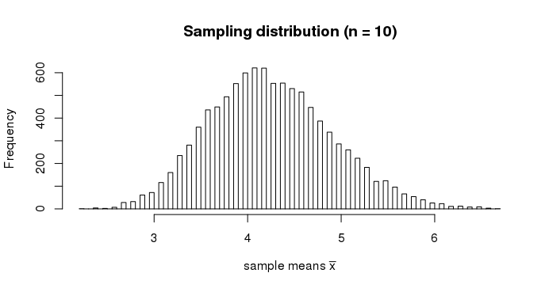
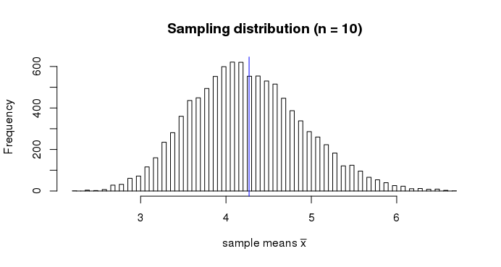
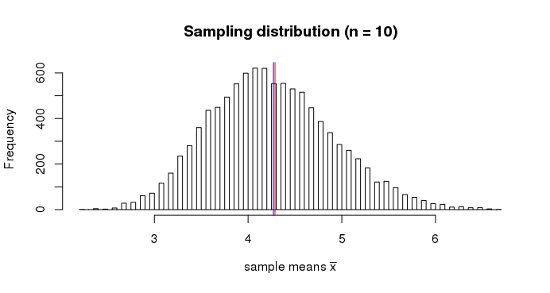
Sampling distribution in R
E[x̅]
= µ
mean(sampling_dist)
mean(word_lengths) # these are the same, so no bias

Slide 33
Changing the sample size n
What happens to the sampling distribution as we change n?
Experiment for n = 1, 5, 10, 20
sampling_dist <- do_it(10000) * {
curr_sample <- sample(word_lengths, 20)
mean(curr_sample)
}
hist(sample_means, breaks = 100)
Gettysburg sampling distribution app

Slide 34
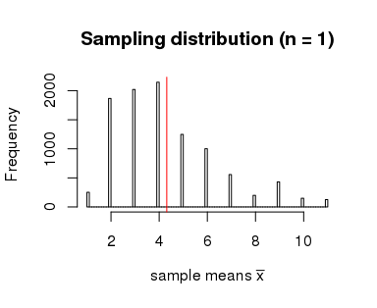
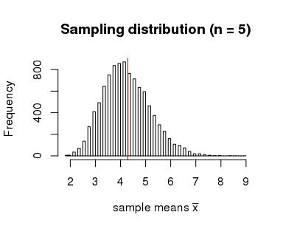
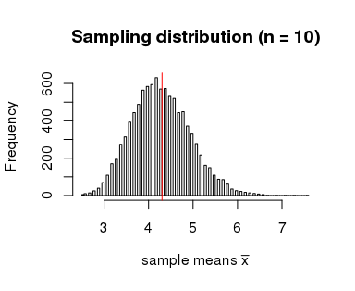
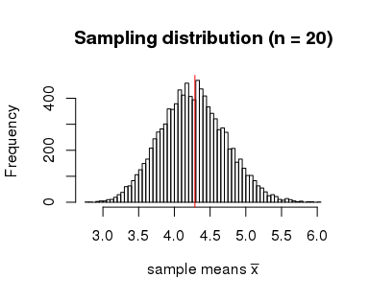
x-axis range 9 vs. 6
As the sample size n increases
1. The sampling distribution becomes more like a normal distribution
2. The sampling distribution points (x̅’s) become more concentrated around the mean E[x̅] = µ

Slide 35
The standard error
The standard error of a statistic, denoted SE, is the standard deviation of the sample statistic
i.e., SE is the standard deviation of the sampling distribution
SE

Slide 36
What does the size of a standard error tell us?
SE
Q: If we have a large SE, would we believe a given statistic is a good estimate for the parameter?
E.g., would we believe a particular x̅ is a good estimate for µ?

Slide 37
Point estimates and confidence intervals

Slide 38
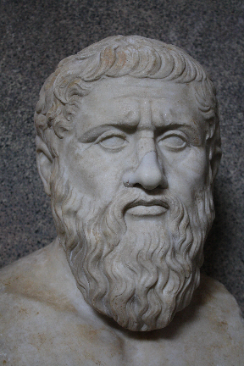
Back to the big picture: Inference
Statistical inference is…?
the process of drawing conclusions about the
entire population based on information in a sample
π, μ, σ, ρ
p̂, x̅, s, r

Slide 39
Point Estimate
We use a statistic from a sample as a point estimate for a population parameter
x̅ is a point estimate for…?
40% of American approve of Trump’s job performance according to a recent Gallup poll
Q: What are π and p̂ here?
μ

Slide 40
Interval estimate based on a margin of error
An interval estimate give a range of plausible values for a population parameter.
One common form of an interval estimate is:
Point estimate ± margin of error
Where the margin of error is a number that reflects the precision of the sample statistic as a point estimate for this parameter

Slide 41
Example: Gallup poll
40% of American approve of Trump’s job performance, plus or minus 3%
How do we interpret this?
Says that the population parameter (π) lies somewhere between 37% to 43%
i.e., if they sampled all voters the true population proportion (π) would be likely be in this range
Notes:
Says that the

Slide 42
Confidence Intervals
A confidence interval is an interval computed by a method that will contain the parameter a specified percent of times
i.e., if the estimation were repeated many times, the interval will have the parameter x% of the time
The confidence level is the percent of all intervals that contain the parameter

Slide 43
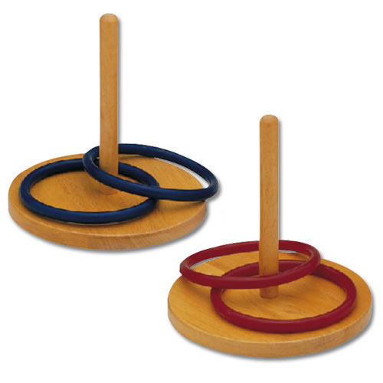
Think ring toss…
Parameter exists in the ideal world
We toss intervals at it
95% of those intervals capture the parameter
Notes:
For a 95% confidence level

Slide 44
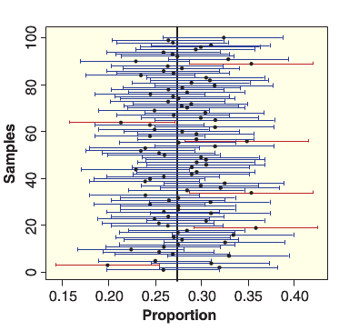
Confidence Intervals
π
For a confidence level of 95%...
95% of the confidence intervals will have the parameter in them

Slide 45
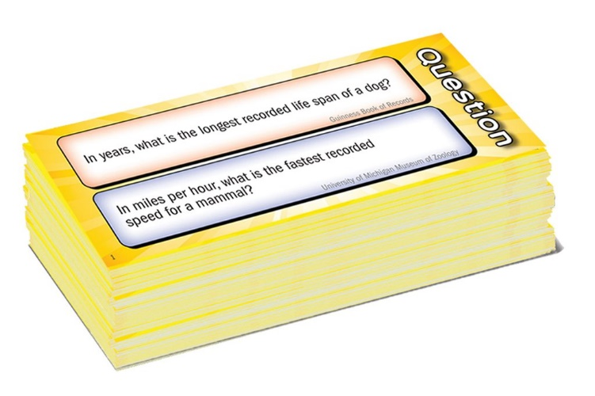
Wits and Wagers: 90% confidence interval estimator
I will ask 10 questions that have numeric answers
Please come up with a range of values that contains the true value in it for 9 out of the 10 questions
I.e., be a 90% confidence interval estimator
Write your range of estimates for each question. as two numbers
E.g., [10.2 to 50.7]

Slide 46
Note
For any given confidence interval we compute, we don’t know whether it has really captured the parameter
But we do know that if we do this 100 times, 95 of these intervals will have the parameter in it
(for a 95% confidence interval)

