Slide 1

YData: Introduction to Data Science
Class 03: Python basics continued

Slide 2

Overview
Review of an intro to Python
Expressions, Names, Call expressions, Strings, Types
More intro to Python
Lists
Text manipulation
If there is time
Booleans and comparisons
Additional string methods

Slide 3
Announcement: Homework 1
Homework 1 has been posted!
import YData
YData.download_homework(1)
It is due on Gradescope on Sunday September 7th at 11pm
Be sure to mark each question on Gradescope!
Practice sessions for this week are:
Thursday (today) in DL 120: 4-5, and 5:15-6:15
Friday (tomorrow) in Marx Classroom C27 (Main Level): 1-2, and 2:15-3:15

Slide 4
Review: Basics of Python
Last class we discussed the basics of Python including…
Expressions:
2 + 3
2**3
Names and assignment:
class_number = 1230
Numerical representations:
my_int = 2
my_float = 3.14159

Slide 5

Review: Basics of Python
We also discussed…
Types of objects
my_string = "hello, world!" # this is a comment about a string
type(my_string)
int('2') # type conversion from a string to an int
Call expressions:
abs(-5)
Let’s quickly practice this in Jupyter!

Slide 6
Lists

Slide 7
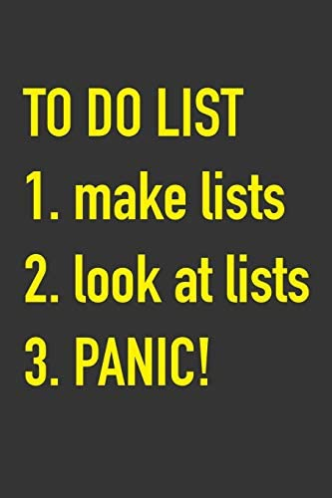
Lists
Lists are ways to store multiple items
We can create lists using square brackets []
my_list = [2, 3, 4]
We can also access list items using square brackets []
my_list[2]
Lists can contain elements of different types
my_list2 = [5, 6, 'seven']
Let's explore this in Jupyter!

Slide 8


Slide 9
Text manipulation
80% of a Data Scientists time is cleaning data
Text manipulation is a big part of cleaning data
20% of a Data Scientists time is complaining about cleaning data
Python has many string methods that are useful for manipulating text and cleaning data!
Notes:
5% of the jokes in this class involve repeating the above statements

Slide 10
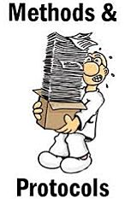
Terminology: functions and methods
Recall: Functions take in values (arguments) and (usually) return another value
E.g., abs(-5) # takes the absolute value of -5 and returns 5
Methods are functions that operate on particular pieces of data
i.e., you can think of methods as a function that are attached to specific type of data
The syntax for methods is: data_object.method()
Example:
"hello".upper()
"HELLO" # returns capitalized string

Slide 11
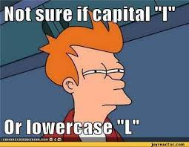
String methods: capitalization
Some of the simplest string methods involve changing capitalization
Changing capitalization can be useful when combining (joining) data sets as we will discuss later in the semester

Slide 12
String methods: capitalization
Python strings have a number of methods to change the capitalization of words including:
.capitalize(): Converts the first character to upper case
.lower(): Converts a string into lower case
.upper(): Converts a string into upper case
.title(): Converts the first character of each word to upper case
.swapcase(): Swaps cases, lower case becomes upper case and vice versa
Let's explore this in Jupyter!

Slide 13
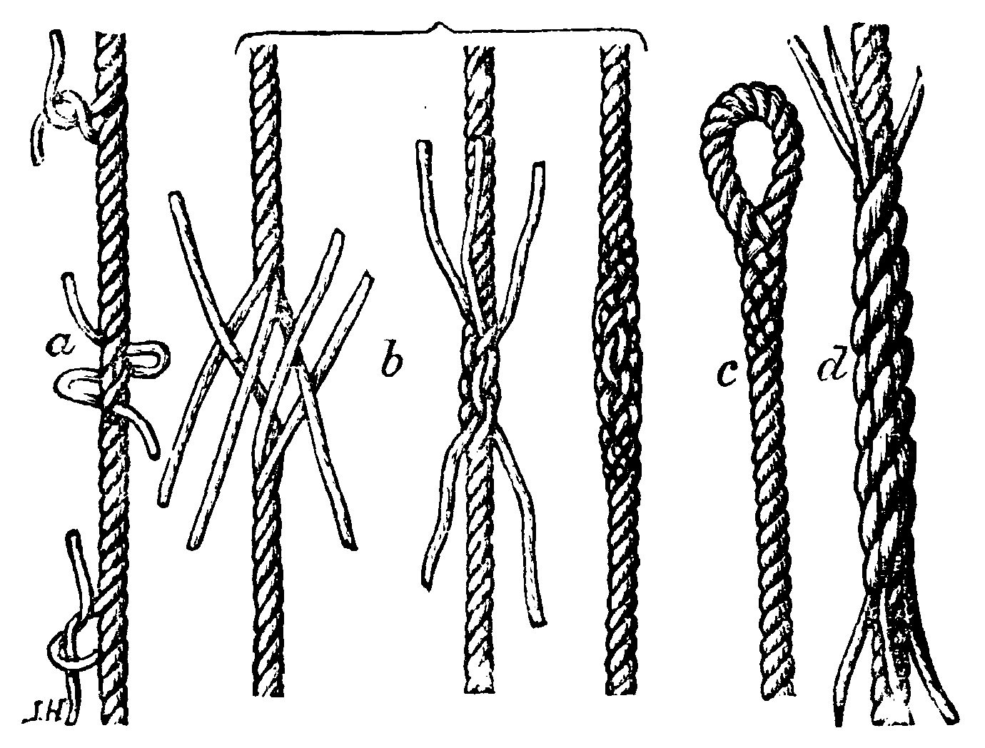
String methods: splitting and joining strings
There are several methods that can help us:
Join list that contains many strings into a single string
Parse a single string into a list of strings
.split(separator_string): Splits the string at the specified separator, and returns a list
.splitlines(): Splits the string at line breaks and returns a list
.join(a_list): Converts the elements of a list (iterable) into a string
Let's explore this in Jupyter!

Slide 14
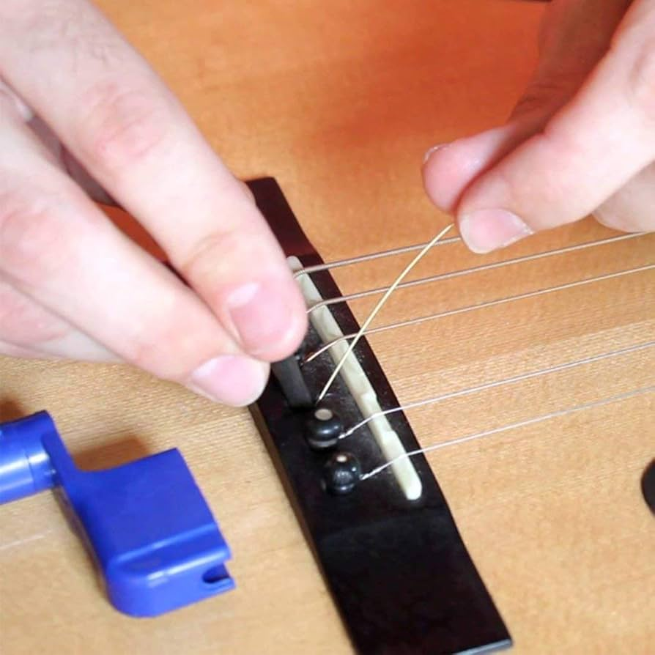
String methods: finding and replacing substrings
Some methods for locating a substring within a larger string include:
.count(substring): Returns the number of times a specified value occurs in a string
.replace(original_str, replacement_str): Replace a substring with a different string
Also:
.startswith(substring): Returns true if the string starts with the specified value
.endswith(substring) : Returns true if the string ends with the specified value
Let's explore this in Jupyter!

Slide 15
Booleans and comparisons

Slide 16
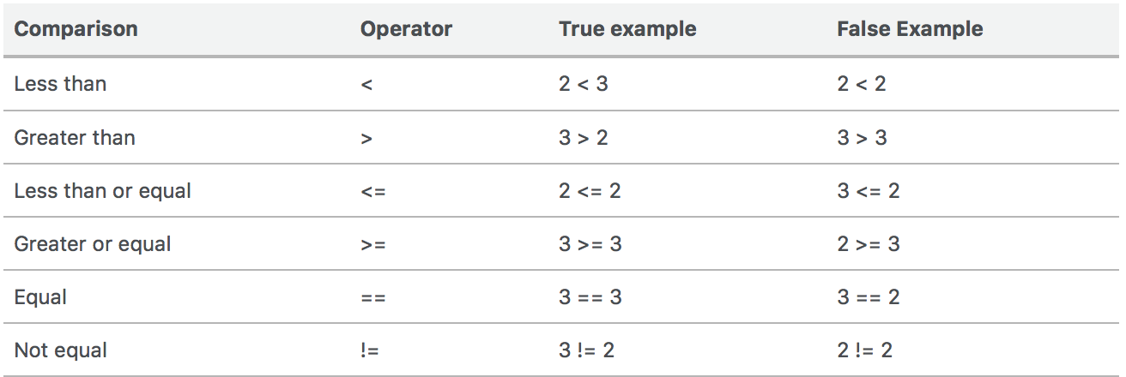
Comparisons
We can use mathematical operators to compare numbers and strings
Results return Boolean values True and False
We can compare strings alphabetically
a < b
True is equal to 1
False is equal to 0
True + True + False is equal to…
2
Let's explore this in Jupyter!

Slide 17
String methods: checking string properties
There are also many functions to check properties of strings including:
.isalnum(): Returns True if all characters in the string are alphanumeric
.isalpha(): Returns True if all characters in the string are in the alphabet
.isnumeric(): Returns True if all characters in the string are numeric
.isspace(): Returns True if all characters in the string are whitespaces
.islower(): Returns True if all characters in the string are lower case
.isupper(): Returns True if all characters in the string are upper case
.istitle(): Returns True if the string follows the rules of a title
Let's explore this in Jupyter!

Slide 18
Additional string methods

Slide 19
String methods: string padding
Often we want to remove extra spaces (called "white space") from the front or end of a string
Conversely, sometimes we want to add extra spaces to make a set of strings the same length
This is known as "string padding"
Python strings have a number of methods that can pad/trim strings including:
.strip(): Returns a trimmed version of the string (i.e., with no leading or trailing white space)
Also, .rstrip() and .lstrip(): Returns a right/left trim version of the string
.center(num): Returns a centered string (with equal padding on both sides)
Also .ljust(num) and .rjust(num): Returns a right justified version of the string
.zfill(num): Fills the string with a specified number of 0 values at the beginning
Let's explore this in Jupyter!

Slide 20
String methods: filling in strings with values
There are a number of ways to fill in strings parts of a string with particular values.
Perhaps the most useful is to use "f strings", which have the following syntax such as:
value_to_fill = "my_value"
f"my string {value_to_fill} will be filled in"
Let's explore this in Jupyter!

Slide 21
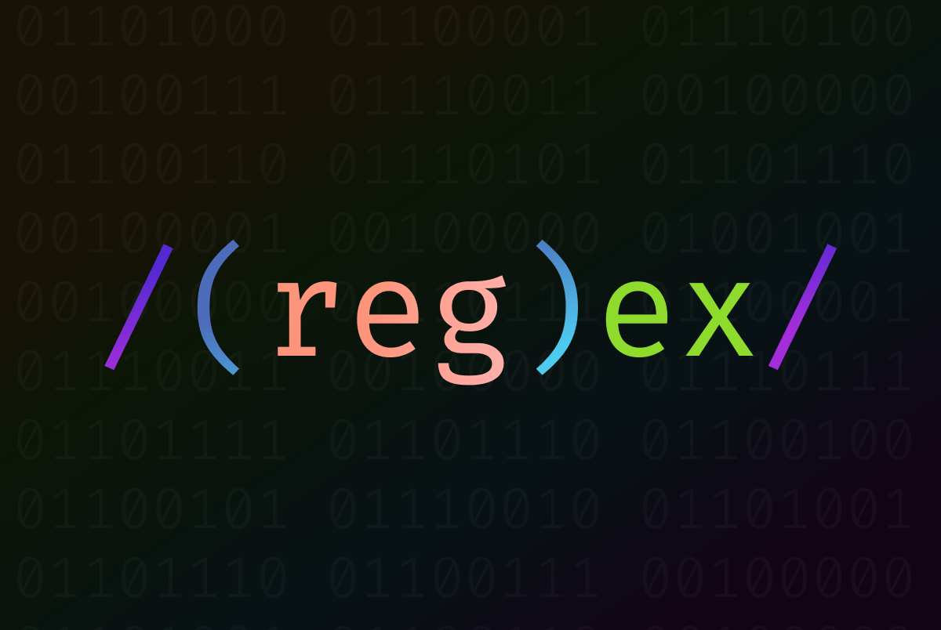
Brief mention: regular expressions
More complex text manipulation can be done using “regular expressions”
import re
bool(re.match("m.ss", "mess"))
We might discuss regular expression later in the semester…

