Slide 1


Mutual Chian Fundation
Mutual Chain Technical Framework
Founded Since 2017
No.1 in Blockchain Infrastructure (private, consortium & public chain)
No.1 Blockchain as a Service
每一个人都能轻松的启动和支持创建全新的区块链技术服务(Blockchain as a Service)，智能合约云(Smart contract Cloud)，基于数字货币的新金融服务和产品的项目。

Slide 2
互助保险
数字资产
区块链电商
交易所
ICO投融平台
ID &
Auth
Rule & Control
Mutual Chain Use Case &
Applications
Ledger
& Assets
Integ. & Services
Trading engine
BlockChain as a Service
Clearing engine
More Details …
Mutual Chain Framework
Blockchain as a Service
Fintech as a Service Framework
Chain.com
Ripple/Corda …
Hyperledger
MutualChain
Bitcoin
Ethereum
Distributive Ledger
VR/AI
Blockchain Infrastructure
Distributive
System
MQ
Cloud, Big Data, MQ, AI, VR
Distributive System
BigData
Cloud

Slide 3
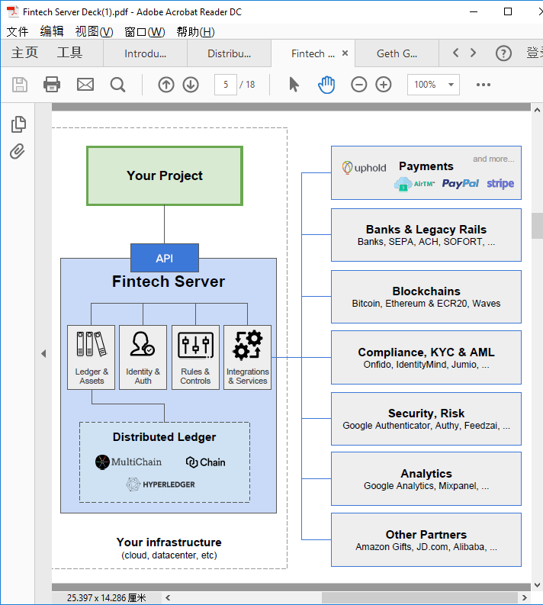
Payments
Digital Asset
Token Issue/Dist.
Digital Exchange
ICO
Insurance
Digitial Assert PayPal Stripe Circle
Banks & Legacy Rails
Mutual Chian
Portal
Mutual Chain Framework
Banks, SEPA, ACH, SOFORT, …
Value Engine
Blockchains
1
2
3
4
5
6
7
8
9
…
Chain#1
#2 #3 #4 #5 …
Bitcoin, Ethereum & ECR20, Waves
Data
Engine
MutualChain
InterChain Protocol
Fintech Core
Compliance, KYC & AML
Ledger &
Assets
Identity &
Auth
Rules &
Control
Integrations
& Services
Onfido, IdentityMind, Jumio, …
Trading Engine
Clearing Engine
Security, Risk
Google Auth. Authy, Feedzai, …
Mutual Chain
Other Chain
Distributive Ledger
Analytics
Corda/Ripple
Ethereum
Bitcoin
Google Analytics, MixPanel, …
Circle
Monero
Other Parners
IT Infrastructure (Cloud, Datacenter …)
Amazon gifts, JD.com, Alibaba, …

Slide 4

Mutual Chain Technologies
THANKS

