Slide 1
Mutual Chain
A High Performance Blockchain Framework for Mutual Financial Service
Executive Briefing
June 2017

Slide 2


互助链（Mutual Chain）是一个基于加密数字货币的互助金融技术构架和完整的（金融）产品及服务的解决方案。
定位
Mutual Chain
存在形态
#1 in Blockchain Infrastructure (private, consortium & public chain)
#1 in Blockchain as a Service
Constructing World’s Largest mutual blockchains - the Platform for Mutual Financial Services & Mutual Insurance
Private Chains:
Private Transactions
Consortium Chains:
Financial Institutions
Public Chains:
Public Mutual Collaboration
Private
Blockchain as a Service
Public
Consortium
World’s Largest Mutual Blockchain
Services

Slide 3
互助链（Mutual Chain）的使命:
每一个人都能轻松的启动和支持创建全新的区块链技术服务(Blockchain as a Service)，智能合约云(Smart contract Cloud)，基于数字货币的新金融服务和产品的项目。
Innovation & Reformation

Slide 4
互助链（Mutual Chain）提供了底层的基础区块链架构，使得基于互助链的应用和（金融）产品具有的天然颠覆性特征，快速实现区块链用户的商业意图
Blockchain Business Transitions
Blockchain Business Outcomes
Outcomes & Results
Blockchain Cloud & New Consumption Models
Decentralization replace Centralization
Smart Contract Cloud,
Blockchain Big Data / Analytics
Growth
Lower Operation Expense
Customer experience
Faster time to market
Operational efficiency
Business Outcome = Change the business
Blockchain Innovation Outcome = Improve the business
Blockchain as a service
Speed of apps delivery
Blockchain data → Information Action
Customer Experience
Agility
Blockchain Application Operational Outcome = Run the business
Security
Lower IT Costs
Asset Utilization
Faster time to provisioning

Slide 5
互助链（Mutual Chain）核心价值
Broader participation, lower cost, increased efficiency
append-only distributed system of record shared across business network
Business terms embedded in transaction database & executed with transactions
Ensuring appropriate visibility; transactions are secure, authenticated & verifiable
All parties agree to network verified transaction
高性能共享账本
共识机制
元素：
智能合约
交易引擎 & 隐私
核心：去中心化的互助共享价值网络
全世界人们都可以通过互助链内置的去中心化区块链互助共享价值网络的形态去获利，提高生活质量，提高生产效率，降低沟通成本

Slide 6
互助链（Mutual Chain）价值网络
Mutual Chain 是一个承载现实社会中实际价值的网络
Mutual Chain价值协议
Mutual Chain价值网络
Mutual Chain价值共识协议 + 分布式Mutual Chain价值节点共同构成价值网络

Slide 7
互助链（Mutual Chain）企业级区块链平台应用
Accelerate 促进与加速
Accelerate 促进与加速
Accelerate 促进与加速
区块链云服务
ICO/数字资产交易
BaaS Services
全新形态
区块链金融
去中心化
Financial Platform
企业级应用
区块链底层构架
Security安全
Mutual Chain Blockchain as a Service Smart Contract Cloud
Decentralized Intelligent Network

Slide 8
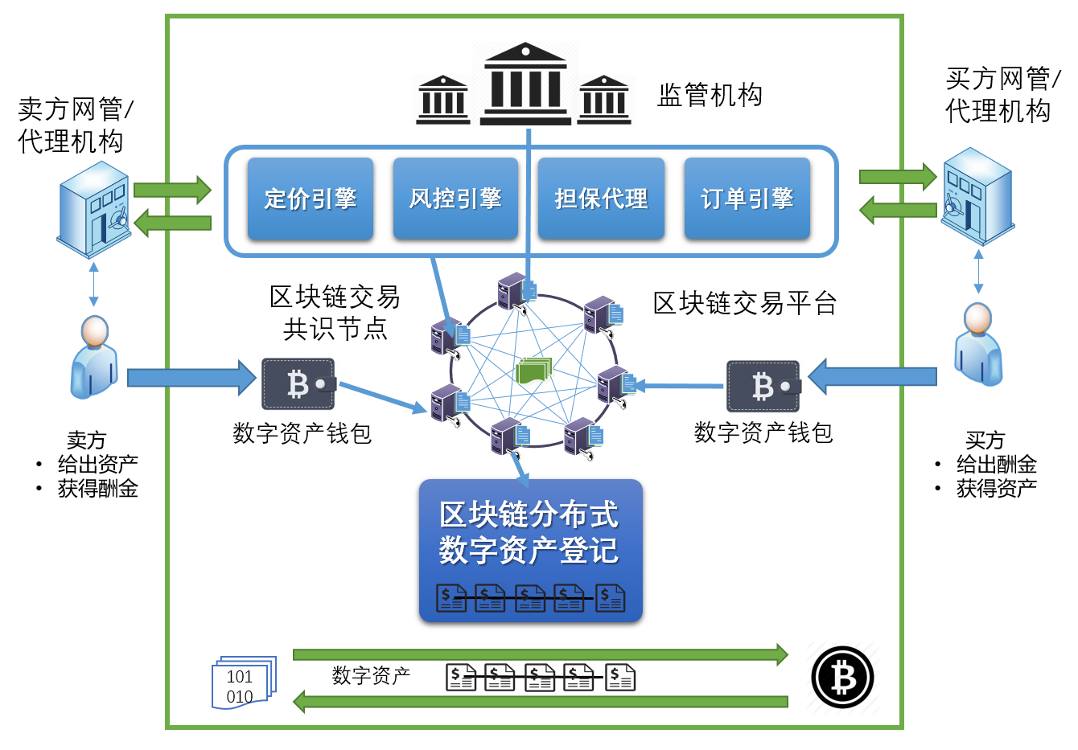
互助链（Mutual Chain）价值网络三大创新：
内置交易引擎
内置结算清算引擎
Universal
State Machine
用户银行
商家银行
状态流转概率
人民银行
S0
状态
S1
S2
支付服务商
用户
S3
商家
公共账本
定价引擎，风控引擎吗，撮合机制接口
交易各方结算与清算自定义完全自动化
平台接口自定义上链数据状态及流转函数

Slide 9
互助链（Mutual Chain）上链数据状态机原理
数据状态机：
E04
Mutual Chain 确定型数据状态机原理描述
E01
S2
E10
Mutual Chain 数据状态是一个确定型有限状态机M=(Σ,S,s0,δ,F)
- Deterministic Finite State Machine(DFSM)
E06
E05
E04
E03
S1
S5
E10
S4
E12
E01
E01
E11
Σ是输入字母表 (有限，非空） - 动作
S是有限非空状态 – 互助链上链数据状态(目前暂定5个状态）
s0是初始状态 S的一个子集
δ是状态转换函数： δ：S x Σ -> S (δ必须返回一个属于S的状态s)
F是一组最终状态集，是（可为空）S的一个子集
E02
E09
E07
S0
E08
S6
S3
E07
区块链数据标准格式：
状态码
输入码
互助链数据
状态流转逻辑…
用户自定义上链数据状态及其流转函数
PreH()
PreH()
PreH()
PreH()
data
data
data
data
区块链

Slide 10









Milestones
Success
Milestones

Slide 11




Mutual Chain Core Team
Never Stop Innovating
Fan Li
Jian Guan
Wenyan Qin
Yu Zheng
CEO & Founder
CEO & Founder
CEO & Founder
CEO & Founder

Slide 12
Thanks
Mutual Chain
0101011100101010101000101010001110101010010110101010111001011100010100101010101110010101010100010
010101110010101010100010101000111010101001011010101011100101110001010010101010111001010101010001010100011
0101011100101010101000101010001110101010010110101010111001011100010100101010101110010101010100010
010101110010101010100010101000111010101001011010101011100101110001010010101010111001010101010001010100011
0101011100101010101000101010001110101010010110101010111001011100010100101010101110010101010100010
010101110010101010100010101000111010101001011010101011100101110001010010101010111001010101010001010100011

