Slide 1
Python金融数据分析教程
解放你的python编程能力
第5关 金融数据的存储
1

Slide 2
课程内容
通过本课程学习，你将学习到
通过csv、excel存储数据
通过mysql存储数据
通过mongodb存储数据
通过HDF5存储数据
闯关作业

Slide 3
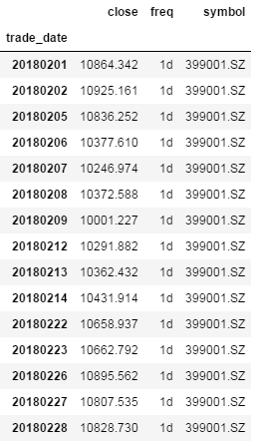
数据准备
# 从quantos上下载深圳综合指数2018年2月份的收盘数据
from jaqs.data import DataApi
import os
user = os.environ.get("QUANTOS_USER")
token = os.environ.get("QUANTOS_TOKEN")
api = DataApi('tcp://data.quantos.org:8910')
api.login(user, token)
df, msg = api.daily(
symbol='399001.SZ',
start_date='2018-02-01',
end_date='2018-02-28',
fields='close'
)
df.set_index('trade_date', inplace=True)

Slide 4
通过csv和excel存储数据（1）
# save to csv
df.to_csv('daily_399001_2.csv')
# save to excel
# pip install xlwt
df.to_excel('daily_399001_2.xls', 'close_price')
# read from csv
import csv
csv_reader = csv.DictReader(open('daily_399001_2.csv', 'r'))
for record in csv_reader:
print(record['trade_date'], record['close'], record['freq'], record['symbol'])
# read from excel
import xlrd
workbook = xlrd.open_workbook('daily_399001_2.xls')
sheet = workbook.sheet_by_name('close_price')
# 遍历整个sheet
for i in range(sheet.nrows):
list_row = []
for j in range(sheet.ncols):
list_row.append(sheet.cell(i,j))

Slide 5
通过pandas读取数据
# read csv by pandas
import pandas as pd
df2 = pd.read_csv('daily_399001_2.csv')
# read excel by pandas
import pandas as pd
df2 = pd.read_excel('daily_399001_2.xls')

Slide 6
通过Mysql存储数据
Mysql是关系型数据库
用于保存结构化的数据
使用前需要安装mysqlclient库
create database test;
create table daily_info (
trade_date int,
close_price decimal(10,2),
freq varchar(10),
symbol varchar(32)
);
import MySQLdb
conn = MySQLdb.connect(
"127.0.0.1", 'root', '123456',
'test', 3306, 'utf8'
)
# begin a transaction
conn.begin()
# read from csv
import csv
csv_reader = csv.DictReader(open('daily_399001_2.csv', 'r'))
cursor = conn.cursor()
for record in csv_reader:
trade_date = int(record['trade_date'])
close_price = float(record['close'])
freq = record['freq']
symbol = record['symbol']
sql = "insert into daily_info values (%d, %.2f, '%s', '%s') " \
% (trade_date,close_price,freq,symbol)
cursor.execute(sql)
cursor.close()
# commit a transaction
conn.commit()

Slide 7
通过Mysql读取数据
# 按照位置访问结果
sql = "select * from daily_info " \
"where trade_date <= 20180202"
cursor = conn.cursor()
cursor.execute(sql)
records = cursor.fetchall()
for record in records:
print(record)
# 按照列访问结果
sql = "select * from daily_info " \
"where trade_date <= 20180202"
cursor = conn.cursor(MySQLdb.cursors.DictCursor)
cursor.execute(sql)
records = cursor.fetchall()
for record in records:
print(record)
(20180201, Decimal('10864.34'), '1d', '399001.SZ')
(20180202, Decimal('10925.16'), '1d', '399001.SZ')
{'trade_date': 20180201, 'close_price': Decimal('10864.34'), 'freq': '1d', 'symbol': '399001.SZ'}
{'trade_date': 20180202, 'close_price': Decimal('10925.16'), 'freq': '1d', 'symbol': '399001.SZ'}

Slide 8
通过mongodb存储数据
需要部署一个本地的mongodb
mongodb是一个内存数据库
支持key-value形式的访问
使用前，需要安装pymongo库
pip instal pymongo
# work as a client
import pymongo
from pymongo import MongoClient
client = MongoClient('localhost',27017)
# select database and table
# mongodb will create if it does not exists
db = client.test
db.daily.drop()
tb_daily = db.daily
import csv
csv_reader = csv.DictReader(open('daily_399001_2.csv', 'r'))
list_record = []
for record in csv_reader:
list_record.append(record)
# insert multiple objects
new_result = tb_daily.insert_many(list_record)
for inserted_id in new_result.inserted_ids:
print(inserted_id)
# query data
tmp = tb_daily.find_one({"trade_date":'20180207'})
print(tmp)

Slide 9
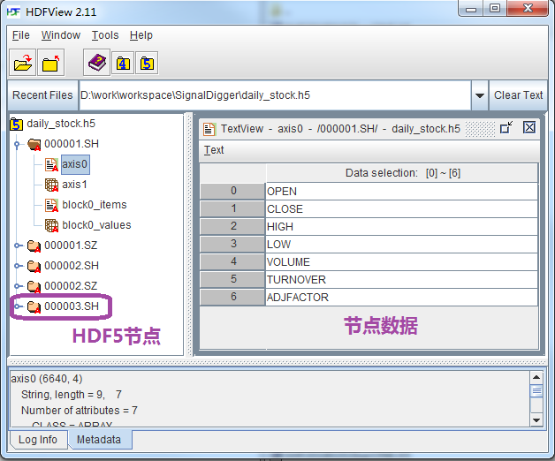
通过HDF5存储和读取数据
# read from csv
import pandas as pd
df2 = pd.read_csv('daily_399001_2.csv')
# must set index before save
df2.set_index('trade_date', inplace=True)
# save to HDF5
df2.to_hdf('daily_399001_2.hdf5', 'daily_close')
# read HDF5
import pandas as pd
df3 = pd.read_hdf('daily_399001_2.hdf5')
HDF5官方网站
https://support.hdfgroup.org/HDF5/
下载一个HDFView，可以查看hdf5的数据

Slide 10
闯关作业
获取招商银行600036.SH从2017年以来的每日收盘价数据，保存到csv，excel，HDF5，mongodb，Mysql中。保存的字段包括：交易日、证券代码、open、high、low、close、volume、turnover等。

Slide 11
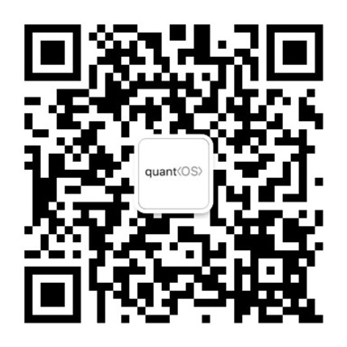
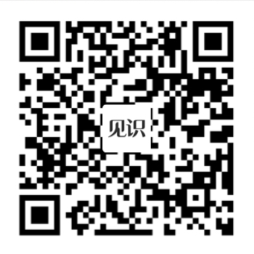
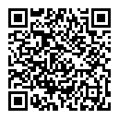
欢迎访问https://www.quantos.org

