Slide 1
Mutual Chain
A High Performance Blockchain Framework for Mutual Financial Service
Executive Briefing
June 2017

Slide 2


Mutual Chain is crypto-currency technologies based end-end solution, Blockchain framework, Infrastructure and platform for Mutual Finance, Mutual Insurance products and services
Blockchain Framework
Position
Mutual Chain
Types & Elements
End-End Solutions
Private
#1 in Blockchain Infrastructure (private, consortium & public chain)
#1 in Blockchain as a Service
Constructing World’s Largest mutual Blockchain - the Platform for Mutual Financial Services & Mutual Insurance
Blockchain
as a Service
Private Chains:
Private Transactions
Consortium Chains:
Financial Institutions
Public Chains:
Public Mutual Collaboration
End-end Solution, Blockchain Framework/Infrastructure, Financial and Insurance Platform
Mutual
Chain
Public
Consortium
World’s Best Mutual Blockchain
Services
Financial Services
Mutual Insurance

Slide 3
Mutual Chain Mission:
Every Organization & Individual can easily start, create, configure, manage & deploy Mutual Finance & Mutual Insurance Services, refine and customize the business logic, develop smart contract, easily trade the financial instruments and digital assets
Innovation & Reformation

Slide 4
Mutual Chain Core Values:
Decentralized Shared, Mutual Value Network
Core:
High Performance & High Availability
Shared Ledger & Consensus
Elements：
Smart Contract & Compliance
Trading Engine & Privacy
World can gain value, profit and benefit through the embedded, decentralized mutual value and insurance policies from the platform, improve quality of life, improve production efficiency, lower total cost of ownership of blockchain technologies.
Broader participation, lower cost, increased efficiency; append-only distributed system of record shared across business network; Business terms embedded in transaction database & executed with transactions; Ensuring appropriate visibility; transactions are secure, authenticated & verifiable; All parties agree to network verified transaction

Slide 5
Mutual Chain Value Network & Community Theory
MutualChain
Automata
(Smart Contract)
MutualChain
Communities
(Value Network)
MutualChain
Society
(Eco-System)
MutualChain
Value Protocol
Blockchain core value protocol
Decentralized State Machine Automata, Smart contract, Consensus, Virtual Machine, Auto Claim & Clearing House, Trading Engine
Value network base mutual Insurance and financial service communities & Decentralized Autonomous Organization
Cross Industry value network base Society & Eco-system

Slide 6
Mutual Chain Enterprise Blockchain framework/Infrastructure
Applications
Middleware engines
Platform & eco-system
Blockchain Cloud
Insurance DApps
ICO/DAX
BaaS Services
Insurance & Financial Services
Financial Platform & Eco-system
Enterprise Apps
Blockchain infrastructure
Security & ID services
Mutual Chain Blockchain as a Service Smart Contract Cloud
Decentralized Intelligent Network

Slide 7
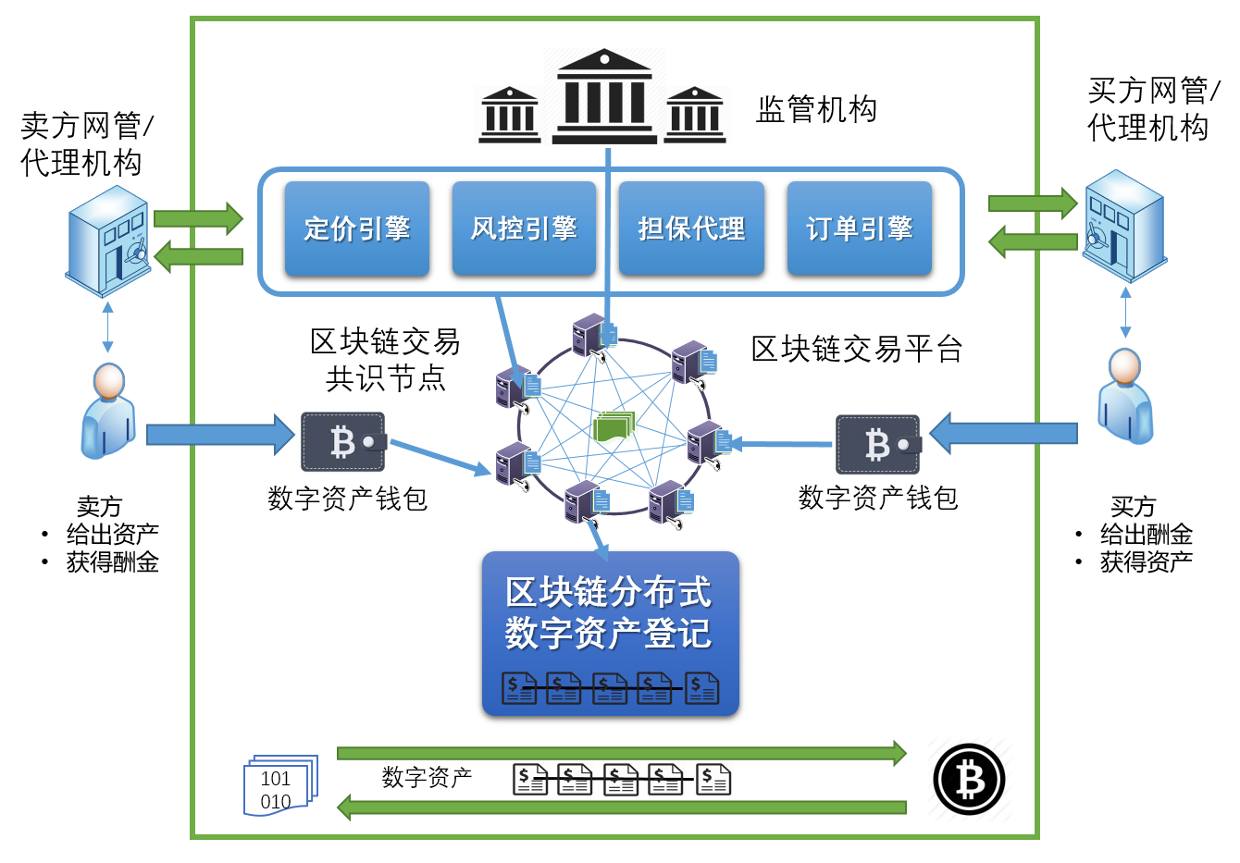
Mutual Chain Key Innovations：
Embedded Trading engine
Embedded Clean & clearing House
Universal
State Machine
User Bank
Commercial Bank
Transition rate
Central Bank
S0
State
S1
S2
Payment Service
User
S3
Merchants
Share Ledger
Price Engine, risk engine, matching service
Counterparties auto clean & Clearing house
User defined on chain data state and its transition function

Slide 8
Mutual Chain State Machine Automata Theory
State Machine：
E04
Mutual Chain Deterministic Finite State Machine
E01
S2
E10
Mutual Chain Automata M=(Σ,S,s0,δ,F) 5-tuple
- Deterministic Finite State Machine(DFSM)
E06
E05
E04
E03
S1
S5
E10
S4
E12
Σ A finite set of Input alphabet - actions
S a finite set of states – Mutual chain states (5 different states for now)
s0 is initial or start state which a subset of S
δ is transition function： (δ：S x Σ -> S) (δ has return an state s which belone to S)
F a set of accept states which is a subset of S
E01
E01
E11
E02
E09
E07
S0
E08
S6
S3
E07
Blockchain Data Standard：
State Code
Input Code
Mutual Chain Data
State transit or transformation
User defined on chain data state and its transition function
PreH()
PreH()
PreH()
PreH()
data
data
data
data
区块链

Slide 9









Milestones
Success
Milestones

Slide 10
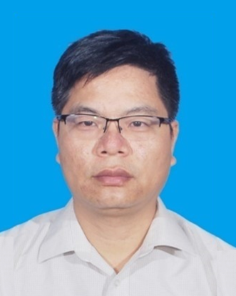

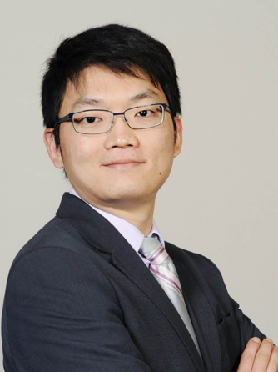


Mutual Chain Core Team
Never Stop Innovating
Wenyan Qin
Ted Que
Warrent Cai
Yu Zheng
Sean Tang
Co-Founder
Co-Founder
Co-Founder
Co-Founder
Co-Founder

Slide 11
Thanks
Mutual Chain
0101011100101010101000101010001110101010010110101010111001011100010100101010101110010101010100010
010101110010101010100010101000111010101001011010101011100101110001010010101010111001010101010001010100011
0101011100101010101000101010001110101010010110101010111001011100010100101010101110010101010100010
010101110010101010100010101000111010101001011010101011100101110001010010101010111001010101010001010100011
0101011100101010101000101010001110101010010110101010111001011100010100101010101110010101010100010
010101110010101010100010101000111010101001011010101011100101110001010010101010111001010101010001010100011

