Slide 1


Mutual Chian Fundation
Mutual Chain Technical Framework
Founded Since 2017
No.1 in Blockchain Infrastructure (private, consortium & public chain)
No.1 Blockchain as a Service
每一个人都能轻松的启动和支持创建全新的区块链技术服务(Blockchain as a Service)，智能合约云(Smart contract Cloud)，基于数字货币的新金融服务和产品的项目。

Slide 2
互助保险
数字资产
区块链电商
交易所
ICO投融平台
ID &
Auth
Rule & Control
Mutual Chain Use Case &
Applications
Ledger
& Assets
Integ. & Services
Trading engine
BlockChain as a Service
Clearing engine
More Details …
Mutual Chain Framework
Blockchain as a Service
Fintech as a Service Framework
Chain.com
Ripple/Corda …
Hyperledger
MutualChain
Bitcoin
Ethereum
Distributive Ledger
Blockchain Infrastructure
P2P
Distributive
System
MQ
Cloud, Big Data, MQ, P2P
Distributive System
BigData
Cloud

Slide 3
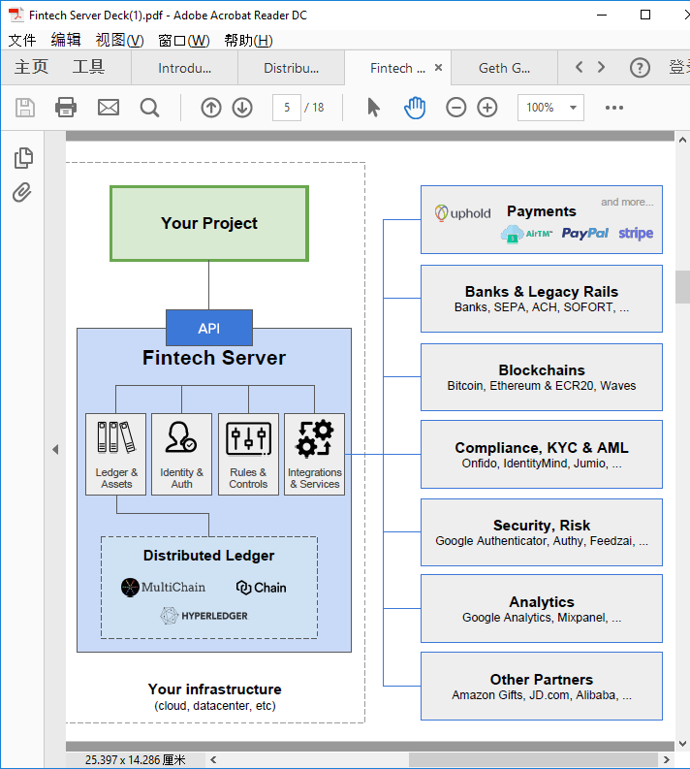
Payments
Digital Asset
Token Issue/Dist.
Digital Exchange
ICO
Insurance
Digitial Assert PayPal Stripe Circle
Banks & Legacy Rails
Mutual Chian
Portal
Mutual Chain Framework
Banks, SEPA, ACH, SOFORT, …
Value Engine
Blockchains
1
2
3
4
5
6
7
8
9
…
Chain#1
#2 #3 #4 #5 …
Bitcoin, Ethereum & ECR20, Waves
Data
Engine
MutualChain
InterChain Protocol
Fintech Core
Compliance, KYC & AML
Ledger &
Assets
Identity &
Auth
Rules &
Control
Integrations
& Services
Onfido, IdentityMind, Jumio, …
Trading Engine
Clearing Engine
Security, Risk
Google Auth. Authy, Feedzai, …
Mutual Chain
Other Chain
Distributive Ledger
Analytics
Corda/Ripple
Ethereum
Bitcoin
Google Analytics, MixPanel, …
Circle
Monero
Other Parners
IT Infrastructure (Cloud, Datacenter …)
Amazon gifts, JD.com, Alibaba, …

Slide 4
Mutual Chain系统实现 – 数字资产计算理论设计原理
（Mutual Chain状态机）确定型有限状态机原理理论描述：
Mutual Chain上链信息是一个确定型有限状态机M=(Σ,S,s0,δ,F) - Deterministic Finite State Machine(DFSM)
Σ是输入字母表 (有限，非空） - 动作
S是有限非空状态 - 状态(目前暂定5个状态）
s0是初始状态 S的一个子集
δ是状态转换函数： δ：S x Σ -> S (δ必须返回一个属于S的状态s)
F是一组最终状态集，是（可为空）S的一个子集
MChain状态机：
E04
E01
S2
MChain区块链数据标准格式：
E10
E01
E06
E05
E04
状态码
输入码
交易数据
商业逻辑…
E03
S0
S1
S5
E10
S4
E12
S6
E02
E01
E11
E09
E07
E08
S3
PreH()
PreH()
PreH()
PreH()
区块链
data
data
data
data
E07

Slide 5
Mutual Chain系统实现 – 数字资产计算理论设计原理
MChain状态转换函数（区块链上链数据结构和流程逻辑数据标准基础）：
输入／状态 | S0(初始） | S1（充值确认） | S2（流转确认） | S3（授信确认） | S4（提现确认） | S5(激活） | S6（完结）
充值请求E01 | S1 | S1 |  |  |  | S1
充值拒绝E02 |  | S0
充值确认E03 |  | S5
流转请求E04 |  |  | S2 |  |  | S2
流转拒绝E05 |  |  | S5
流转确认E06 |  |  | S5
授信请求E07 |  |  |  | S3 |  | S3
授信拒绝E08 |  |  |  | S5
授信确认E09 |  |  |  | S5
提现请求E10 |  |  |  |  | S4 | S4
提现拒绝E11 |  |  |  |  | S5
提现确认E12 |  |  |  |  | S6 |  | Final State
注：
每一个输入都要走相应的金融流程和金融逻辑并做适当的计算
可以根据实际业务需求适当添加可控确定状态
计算机程序具体实现金融逻辑及相应流程控制
根据资产状态及交易数据作为金融平台交易区块链实现的数据标准基础

Slide 6
Open, Trusted Supply Chain
WHAT?
Consumers are demanding genuine transparency on where and how their products are made. Governments require more information about corporate supply chains, with penalties for non-compliance. Secure by design of complex systems depends on total trust across the supply chain.
HOW?
Blockchain enables safe digital transfer of property across the end to end supply chain.
BENEFIT?
Verifiable, preventing any party from altering or challenging the legitimacy of the information being exchanged
Efficiencies through greater transparency to complex global supply chains
Allow consumers to make informed purchases
Governments can quickly and easily request reliable information from across the supply chain.

Slide 7

Mutual Chain Technologies
THANKS

