Slide 1
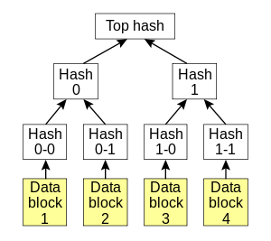
Mutual Chain主链
Merkle Tree
0
1
2
3
4
5
6
7
8
9
…
CCE = Cross Chain Engine
Mutual Chain
Cross Chain Engine
Mutual Chain 二级链
0
1
2
3
4
5
…
0
1
2
3
4
5
…
0
1
2
3
4
5
…
0
1
2
3
4
5
…
CCE
CCE
0
1
2
3
…
0
1
2
3
…
0
1
2
3
…
…
Mutual Chain 三级链
Mutual Chain N级链
…

Slide 2
Mutual Chain Main Chain
Merkle Tree
0
1
2
3
4
5
6
7
8
9
…
CCE = Cross Chain Engine
Mutual Chain
Cross Chain Engine
Mutual Chain 2nd SubChain
0
1
2
3
4
5
…
0
1
2
3
4
5
…
0
1
2
3
4
5
…
0
1
2
3
4
5
…
CCE
CCE
0
1
2
3
…
0
1
2
3
…
0
1
2
3
…
…
Mutual Chain 3rd SubChain
Mutual Chain N level SubChain
…

Slide 3
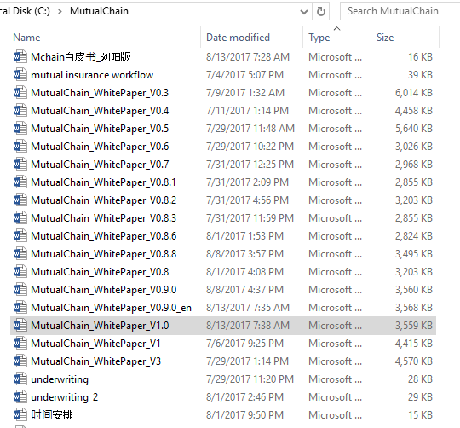

Slide 4
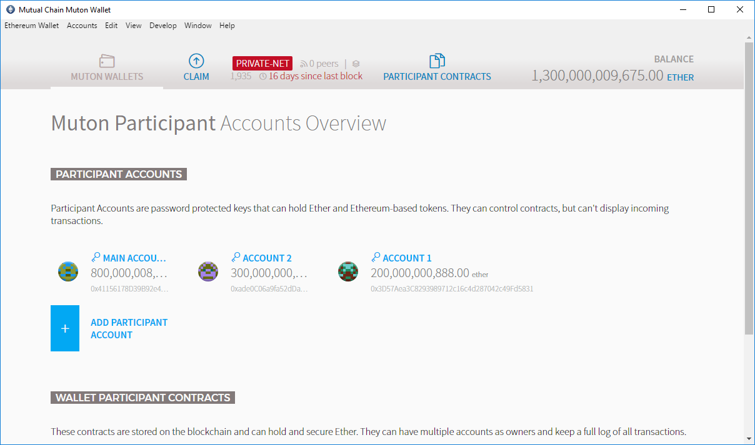

Slide 5
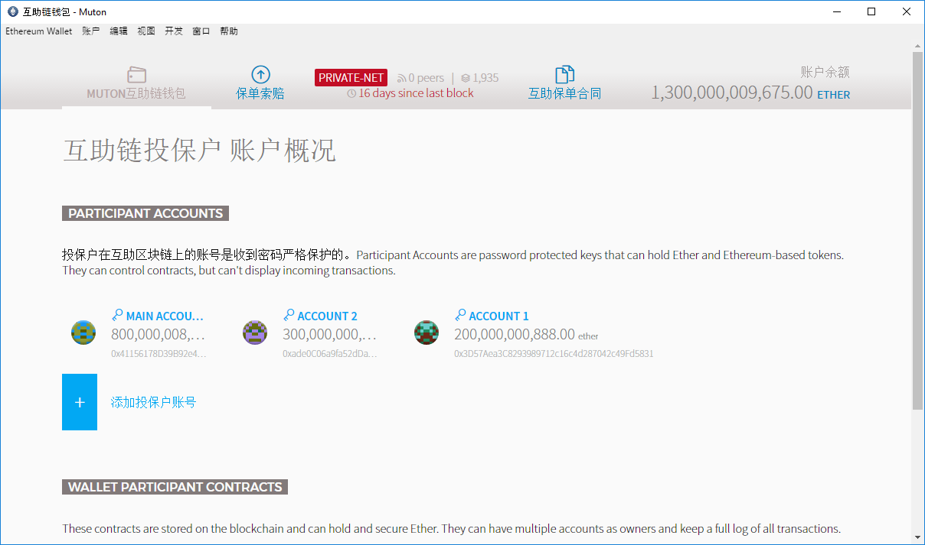

Slide 6
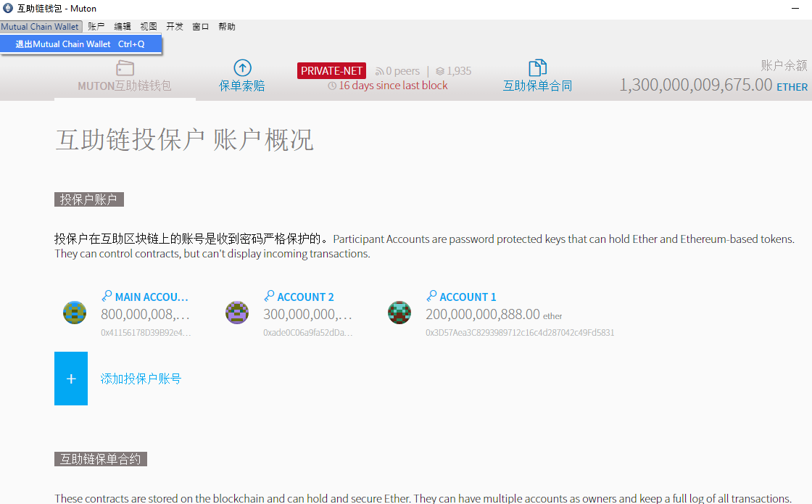

Slide 7
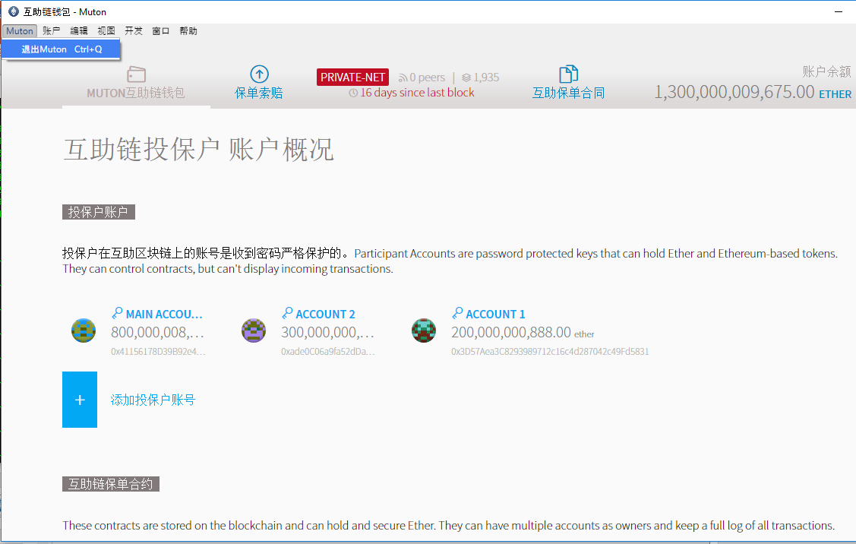

Slide 8

C
B
D
A
Mutual Chain
E
互助区块链对等网络智能合约流转模式

Slide 9
Mutual Chain价值协议
Mutual Chain价值网络

Slide 10
Mutual Chain价值协议

Slide 11

$

Slide 13
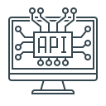



Mutual Chain价值协议
信用分数
M
中间件
仲裁逻辑
Mutual Chain钱包
Mutual Chain Middleware

Slide 14
Mutual Chain价值协议
信用分数
M
商业引擎
仲裁逻辑
Mutual Chain钱包
互保链区块链中间件

Slide 15
DB
DB
DB
M
Mutual Chain价值网络

Slide 16
Mutual Chain Middleware Framework
保险平台
金融监管
数字资产
供应链金融
区块链金融项目
支付
银行保险 &
传统金融系统
1
2
3
4
5
6
7
8
9
…
Chain#1
#2 #3 #4 #5 …
Mutual Chain InterChain Value Gateway
区块链价值网
Mutual Chain 价值引擎
Ledger &
Assets
Identity &
Auth
Rules &
Control
Integrations
& Services
合规，
KYC &反洗钱
Data Engine
InterChain Engine
Trading Engine
Clearing Engine
安全 & 风控
Distributive Ledger 可插拔分布式账本
Ethereum
MutualChain
Fabric
Bitcoin …
分析工具
SQL
noSQL
其他合作伙伴
SQL
其他IT基础设施，（大数据，云计算）

Slide 17
Mutual Chain 区块链中间件
保险平台
金融监管
数字资产
供应链金融
区块链金融项目
Mutual Chain 跨链通讯协议
外
部
应
用
Mutual Chain 价值引擎
Ledger &
Assets
Identity &
Auth
Rules &
Control
Integrations
& Services
Data Engine
InterChain Engine
Trading Engine
Clearing Engine
消息队列，分布式通讯，点对点去中心化通讯构架
Distributive Ledger 可插拔分布式账本
Ethereum
MutualChain
Fabric
Bitcoin …
SQL
noSQL
SQL
传统IT基础设施，（大数据，云计算）

Slide 18
Mutual Chain系统实现 – 数字资产计算理论设计原理
（Mutual Chain状态机）确定型有限状态机原理理论描述：
Mutual Chain上链信息是一个确定型有限状态机M=(Σ,S,s0,δ,F) - Deterministic Finite State Machine(DFSM)
Σ是输入字母表 (有限，非空） - 动作
S是有限非空状态 - 状态(目前暂定5个状态）
s0是初始状态 S的一个子集
δ是状态转换函数： δ：S x Σ -> S (δ必须返回一个属于S的状态s)
F是一组最终状态集，是（可为空）S的一个子集
MChain状态机：
E04
E01
S2
MChain区块链数据标准格式：
E10
E01
E06
E05
E04
状态码
输入码
交易数据
商业逻辑…
E03
S0
S1
S5
E10
S4
E12
S6
E02
E01
E11
E09
E07
E08
S3
PreH()
PreH()
PreH()
PreH()
区块链
data
data
data
data
E07

Slide 19
Mutual Chain系统实现 – 数字资产计算理论设计原理
MChain状态转换函数（区块链上链数据结构和流程逻辑数据标准基础）：
输入／状态 | S0(初始） | S1（充值确认） | S2（流转确认） | S3（授信确认） | S4（提现确认） | S5(激活） | S6（完结）
充值请求E01 | S1 | S1 |  |  |  | S1
充值拒绝E02 |  | S0
充值确认E03 |  | S5
流转请求E04 |  |  | S2 |  |  | S2
流转拒绝E05 |  |  | S5
流转确认E06 |  |  | S5
授信请求E07 |  |  |  | S3 |  | S3
授信拒绝E08 |  |  |  | S5
授信确认E09 |  |  |  | S5
提现请求E10 |  |  |  |  | S4 | S4
提现拒绝E11 |  |  |  |  | S5
提现确认E12 |  |  |  |  | S6 |  | Final State
注：
每一个输入都要走相应的金融流程和金融逻辑并做适当的计算
可以根据实际业务需求适当添加可控确定状态
计算机程序具体实现金融逻辑及相应流程控制
根据资产状态及交易数据作为金融平台交易区块链实现的数据标准基础

Slide 20


数字资产交易平台
分布式交易账本
第一次将资产完全数字化
数据更安全更具公信力
完全透明公开的交易数据和交易历史，不可篡改，任何人（包括交易所平台的监管和运营）都不可以挑战数据的
交易根据智能合约自动匹配，更公平公正高效
交易资产上链存证，产权和所有权管理更方便
结算清算交割自动化与智能合约化，降低交付成本甚至消除大量繁琐的交易前中后台工作
消除交易双方对手风控
担保保险融资和政府监管更透明高效
监管机构
买卖双方
自动匹配
自动交易
智能合约
收集资产
智能合约
分配资产
M
M
Mutual Chain
钱包
Mutual Chain
区块链平台
卖方
给出资产
获得酬金
买方
给出酬金
获得资产
自动化结算
与交付逻辑
区块链分布式
数字资产登记
所有权
无可争议
101010
数字资产

Slide 21
数字资产交易平台
分布式交易账本
第一次将资产完全数字化
数据更安全更具公信力
完全透明公开的交易数据和交易历史，不可篡改，任何人（包括交易所平台的监管和运营）都不可以挑战数据的
交易根据智能合约自动匹配，更公平公正高效
交易资产上链存证，产权和所有权管理更方便
结算清算交割自动化与智能合约化，降低交付成本甚至消除大量繁琐的交易前中后台工作
消除交易双方对手风控
担保保险融资和政府监管更透明高效
监管机构
买卖双方
自动匹配
自动交易
智能合约
收集资产
智能合约
分配资产
M
M
Mutual Chain
钱包
Mutual Chain
区块链平台
卖方
给出资产
获得酬金
买方
给出酬金
获得资产
自动化结算
与交付逻辑
区块链分布式
数字资产登记
所有权
仲裁引擎
101010
数字资产

Slide 22





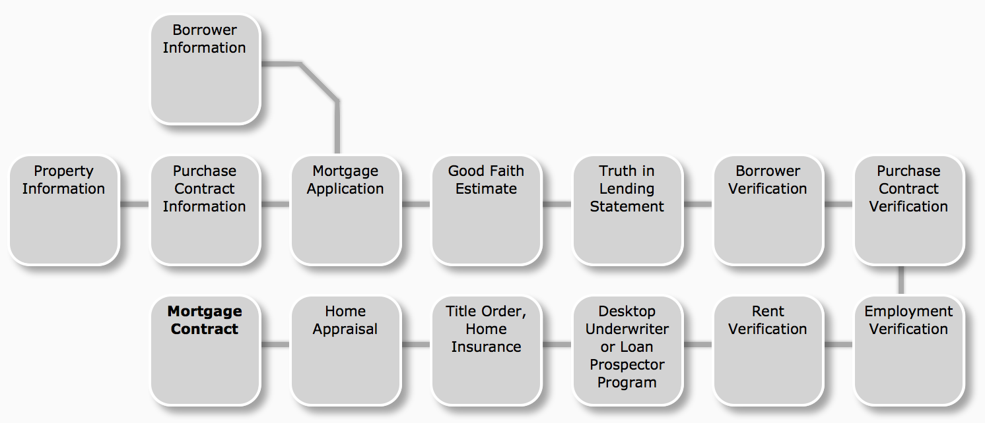
Mutual Chain Mortgage Origination: Processes are timely, costly and can result in search errors, which generate transactional risk
MIC
Investor
Borrower
Appraiser / 3rd Party Service Providers
Authority
Lawyer Office
Loan Origination
Good Faith Estimate, Truth in Lending
Mortgage Application
Purchase Contract
Appraisal, Insurance
Title
IDs
Notes:
This is the “BEFORE” picture representing the “status quo” for business networks.
Each participant keeps their own ledger(s) which are updated to represent business transactions as they occur.
This is EXPENSIVE due to duplication of effort and intermediaries adding margin for services.
It is clearly INEFFICIENT, as the business conditions – the contract – is duplicated by every network participant
It is also VULNERABLE because if a central system(e.g. Bank) is compromised due to an incidents this affects the whole business network. Incidents can include fraud, cyber attack or a simple mistake.

Slide 23

Mutual Chain Mortgage Origination: Processes are timely, costly and can result in search errors, which generate transactional risk
Ledger
Appraiser
Ledger
Authority
Ledger
Mortgage Platform Administrator
Investor
Lawyer Office
Borrower
Ledger
Bank
Ledger
Ledger
Incident
Mortgage Origination Documents
Good Faith Estimate, Truth in Lending
Mortgage Application
Contract
Appraisal, Insurance
Title
IDs
Inefficient, expensive, vulnerable
Notes:
This is the “BEFORE” picture representing the “status quo” for business networks.
Each participant keeps their own ledger(s) which are updated to represent business transactions as they occur.
This is EXPENSIVE due to duplication of effort and intermediaries adding margin for services.
It is clearly INEFFICIENT, as the business conditions – the contract – is duplicated by every network participant
It is also VULNERABLE because if a central system(e.g. Bank) is compromised due to an incidents this affects the whole business network. Incidents can include fraud, cyber attack or a simple mistake.

Slide 24
Mutual Chain A shared ledger between involved parties can increase trust, speed of execution, auditability and cost
Authority
Ledger
Ledger
Admin
Ledger
Investor
Lawyer Office
Ledger
Ledger
Borrower
Ledger
Appraiser
Bank
Larger institutional participants validate shared ledger
Individual and smaller participants have access but don’t validate shared ledger
Good Faith Estimate, Truth in Lending
Mortgage Application
Contract
Appraisal, Insurance
Title
IDs
Consensus, provenance, immutability, finality
Notes:
The novel Blockchain architecture give participants the ability to share a ledger which is updated every time a transaction occurs through peer to peer replication.
Cryptography is used to ensure that network participants see only the parts of the ledger that are relevant to them, and that transactions are secure, authenticated and verifiable.
Blockchain also allows the contract for asset transfer to be embedded in the transaction database determining the conditions under which the transaction can occur.
Network participants agree how transactions are verified through consensus or similar mechanisms. Government oversight, compliance & audit can be part of the same network.
Participants SAME AS BEFORE – this is not a disintermediation play
CONSENSUS– means all participants agree that a transaction is valid
PROVENANCE– means participants know where the asset came from and how it’s ownership has changed over time
IMMUTABILITY– means no participant can tamper with a transaction once it’s agreed. If a transaction was in error then a NEW transaction must be used to reverse the error, with both visible
FINALITY– means that there is ONE place to determine the ownership of an asset or completion of a transaction. This is the role of the SHARED LEDGER.

Slide 25

Blockchain Network Participants
Open Insurance
Insurer
Authority
Alice Sheen
参保人
Insurance Plans
Banks
Heath Care Group
参保人 Data
Claims
Dental Group
Dental Office

Slide 26
Ledger
Blockchain Integration in Bank’s Loan Origination System (LOS)
Smart Contracts
Ledger
Smart Contracts
Ledger
Customer Channel Management
(branches, call centers, mobile, internet, etc)
Business Process Management
Core Banking
3rd Party Integration
Enterprise Service Bus
Ledger
Case Management
Analytics
Data Management
Blockchain and Smart Contracts orchestrate the sharing of the Mortgage process among all parties, including the control of access rights (read, save, sign, revoke) to shared documents
Notes:
This is the “BEFORE” picture representing the “status quo” for business networks.
Each participant keeps their own ledger(s) which are updated to represent business transactions as they occur.
This is EXPENSIVE due to duplication of effort and intermediaries adding margin for services.
It is clearly INEFFICIENT, as the business conditions – the contract – is duplicated by every network participant
It is also VULNERABLE because if a central system(e.g. Bank) is compromised due to an incidents this affects the whole business network. Incidents can include fraud, cyber attack or a simple mistake.

Slide 27
Ledger
互保链在银行贷款发放系统中的集成应用参考方案
Smart Contracts
Ledger
Smart Contracts
Ledger
Customer Channel Management
(branches, call centers, mobile, internet, etc)
Business Process Management
Core Banking
3rd Party Integration
Enterprise Service Bus
Ledger
Case Management
Analytics
Data Management
Blockchain and Smart Contracts orchestrate the sharing of the Mortgage process among all parties, including the control of access rights (read, save, sign, revoke) to shared documents
Notes:
This is the “BEFORE” picture representing the “status quo” for business networks.
Each participant keeps their own ledger(s) which are updated to represent business transactions as they occur.
This is EXPENSIVE due to duplication of effort and intermediaries adding margin for services.
It is clearly INEFFICIENT, as the business conditions – the contract – is duplicated by every network participant
It is also VULNERABLE because if a central system(e.g. Bank) is compromised due to an incidents this affects the whole business network. Incidents can include fraud, cyber attack or a simple mistake.

Slide 28
Investor
系统用户
Borrower
Multual Insurance 区块链
金融平台整合
金融管理交易中心
数据库
Insurer
分析
监管
Authority
…
Multual Chain
金融平台
Bank
定价
Lawyer Office
参保人
注册
事故
风控

Slide 29











全球协作
风控
基金管理
平台管理员
M
政府审批
互助链钱包
理赔
投保人
仲裁
互助链信用

Slide 30

全球协作
风控
平台管理员
链数据
基金管理
Mutual Chain
互助链保险商业模型
价值协议
M
保单，保额，理赔做为链数据在各个功能模块之间以智能合约形式存储和流转
互助链钱包
政府审批
基础模块
功能模块
投保人
理赔
仲裁
互助链信用

Slide 31
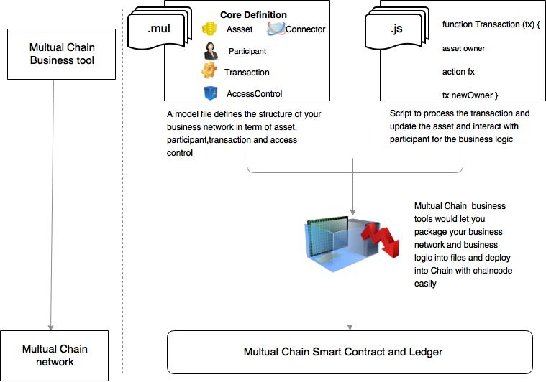

Slide 32
商业逻辑定制
交易细节定制
商业逻辑引擎
平台
资产
流程控制
.js
Tx() {
Asset Owner
Action Tx
Tx newOwner()
Clear() }
.sol
.mul
参与者
.sql
连接器
交易
结算清算
模型文件定义互助链上链商业流程及价值网络的资产，利益方，交易，流程控制逻辑，链见数据连接器，结算清算逻辑等
脚本语言去自动处理交易，更新资产属性，并处理跟交易及利益方的交互。也可以细化交易商业逻辑。
互助链
区块链中间件
互助链
区块链中间件
互助链价值网络
互助链智能合约及分布式账本

Slide 33
Information on blockchain
上链数据
New account register info level 1
投保人一级数据
Insurance underwriting calculator
承保计算引擎
New account register info level 2
投保人二级数据
Current policyholder info on Mchain.io
已经投保人

Slide 34
区块链
上链数据
投保人
一级数据
承保计算引擎
投保人
二级数据
Mchain.io
投保人数据

Slide 35
平台核对用户级别
二级用户获得代币赔偿
理赔申请
需要核查确认死亡证明
平台支付代币赔偿
一级用户获得代币
平台支付代币，可以交易或提现
代币只能获得赔偿支付，用于平台新的承保项目，不可提现。

