Slide 1
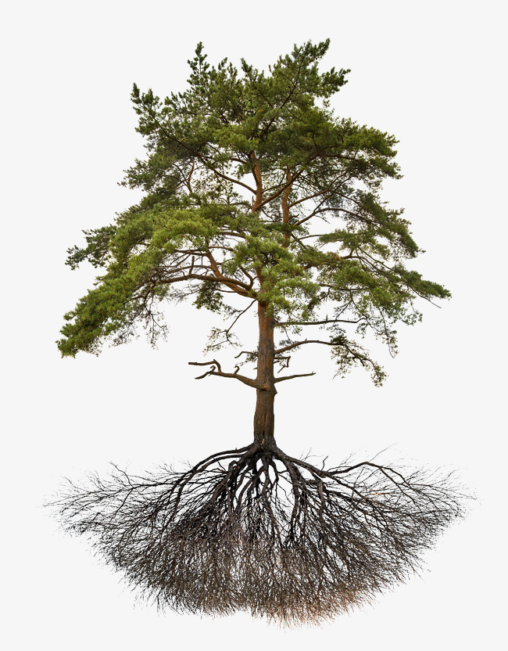
E
Ψ_{rootcrown}
Soil layer 1
Ψ_{rootsurf, 1}
Ψ_{soil, 1}
Soil layer 2
Ψ_{rootsurf, 2}
Ψ_{soil, 2}
…
…
Soil layer S
Ψ_{rootsurf, S}
Ψ_{soil, S}
Roots
Rhizosphere

Slide 2
E
Ψ_{leaf}
Leaf
Ψ_{stem, N}
…
Stem
Ψ_{stem, 2}
Ψ_{stem, 1}
Ψ_{rootcrown}
Soil layer 1
Ψ_{rootsurf, 1}
Ψ_{soil, 1}
Soil layer 2
Ψ_{rootsurf, 2}
Ψ_{soil, 2}
…
…
Soil layer S
Ψ_{rootsurf, S}
Ψ_{soil, S}
Roots
Rhizosphere

Slide 3
E
Ψ_{leaf}
Leaf
Ψ_{stem, 2}
Stem
Ψ_{stem, 1}
Ψ_{rootcrown}
Soil layer 1
Ψ_{rootsurf, 1}
Ψ_{soil, 1}
Soil layer 2
Ψ_{rootsurf, 2}
Ψ_{soil, 2}
…
…
Soil layer S
Ψ_{rootsurf, S}
Ψ_{soil, S}
Roots
Rhizosphere

Slide 4
E_{leaf}
F_{lat, leaf}
Leaf
Ψ_{leaf}
Ψ_{symp, leaf}
Ψ_{stem, 2}
Stem
E_{stem,out}
F_{lat, stem}
Ψ_{stem, 1}
Ψ_{symp,} _{stem}
E_{stem,in}
Ψ_{rootcrown}
Soil layer 1
Roots
Ψ_{rootsurf, 1}
Ψ_{soil, 1}
Soil layer 2
Ψ_{rootsurf, 2}
Ψ_{soil, 2}
Ψ_{rootsurf}
…
…
Soil layer S
Ψ_{rootsurf, S}
Ψ_{soil, S}
Roots
Rhizosphere

Slide 5
a) Hydraulics without storage compartments
b) Hydraulics with storage compartments
E_{leaf}
E_{leaf}
F_{lat, leaf}
Leaf
Ψ_{leaf}
Ψ_{leaf}
Ψ_{symp, leaf}
Ψ_{stem, 2}
Ψ_{stem, 2}
Stem
E_{stem,out}
F_{lat, stem}
Ψ_{stem, 1}
Ψ_{stem, 1}
Ψ_{symp,} _{stem}
E_{stem,in}
Ψ_{rootcrown}
Ψ_{rootcrown}
Soil layer 1
Ψ_{rootsurf, 1}
Ψ_{soil, 1}
Ψ_{rootsurf, 1}
Ψ_{soil, 1}
Roots
Soil layer 2
Ψ_{rootsurf, 2}
Ψ_{soil, 2}
Ψ_{rootsurf, 2}
Ψ_{soil, 2}
…
…
…
…
Ψ_{rootsurf}
Ψ_{rootsurf, S}
Ψ_{soil, S}
Soil layer S
Ψ_{rootsurf, S}
Ψ_{soil, S}
Roots
Rhizosphere
Roots
Rhizosphere

Slide 6
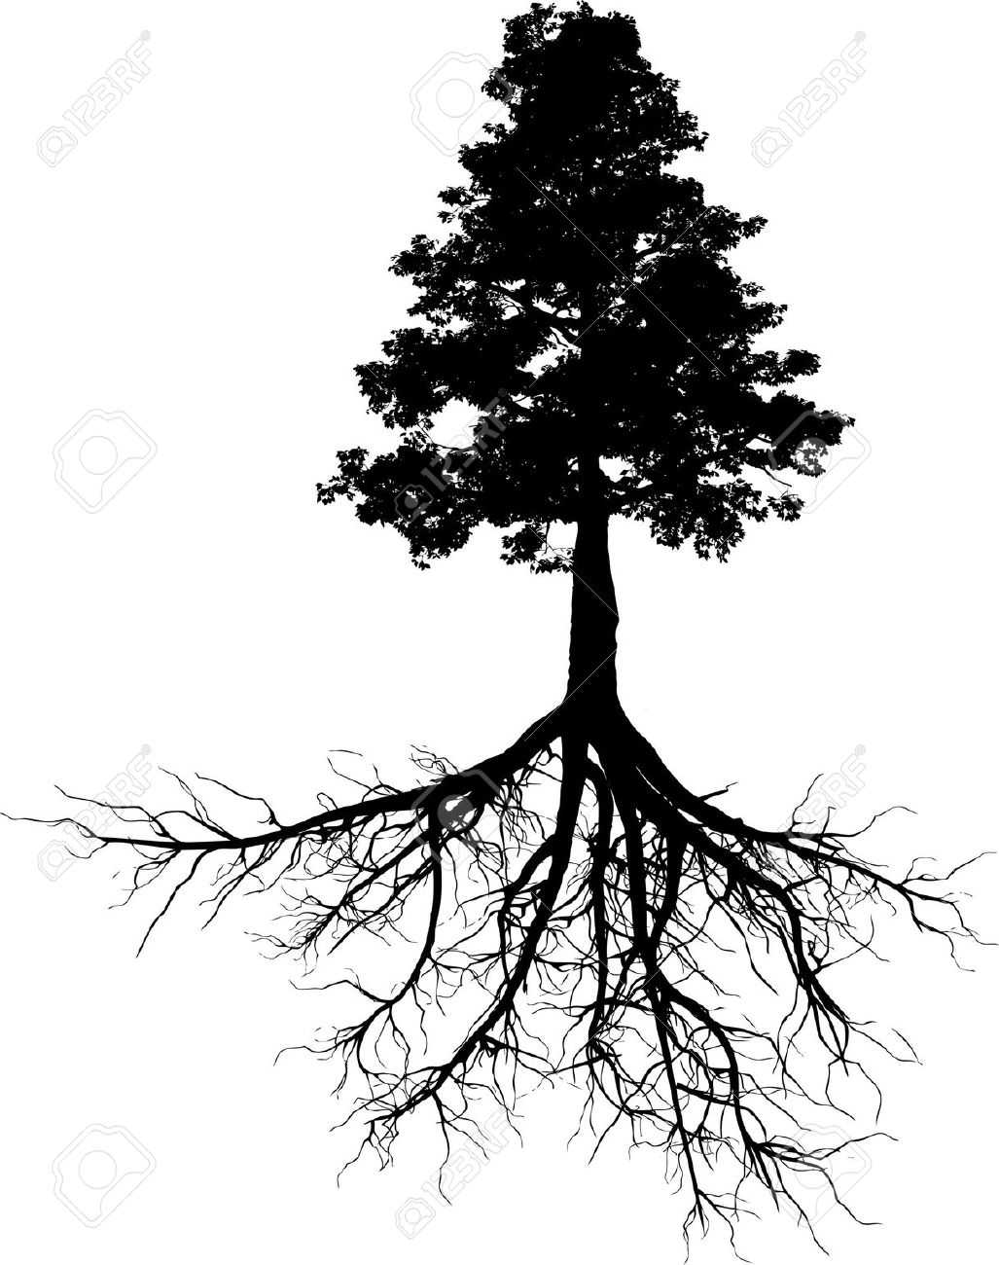
E
Ψ_{leaf}
Leaf
ΔS_{l} /Δt
Ψ_{stem, N}
ΔS_{N} /Δt
…
Stem
Ψ_{stem, 2}
ΔS₂ /Δt
Ψ_{stem, 1}
ΔS₁ /Δt
Ψ_{rootcrown}
Soil layer 1
Ψ_{rootsurf, 1}
Ψ_{soil, 1}
Soil layer 2
Ψ_{rootsurf, 2}
Ψ_{soil, 2}
…
…
Soil layer S
Ψ_{rootsurf, S}
Ψ_{soil, S}
Roots
Rhizosphere

Slide 7
E_{min}
Leaf
Ψ_{apo, leaf}
Ψ_{sym, leaf}
Ψ_{apo, N}
Ψ_{sym, N}
Stem
…
Ψ_{apo, 2}
Ψ_{sym, 2}
Ψ_{apo, 1}
Ψ_{sym, 1}

