Slide 1
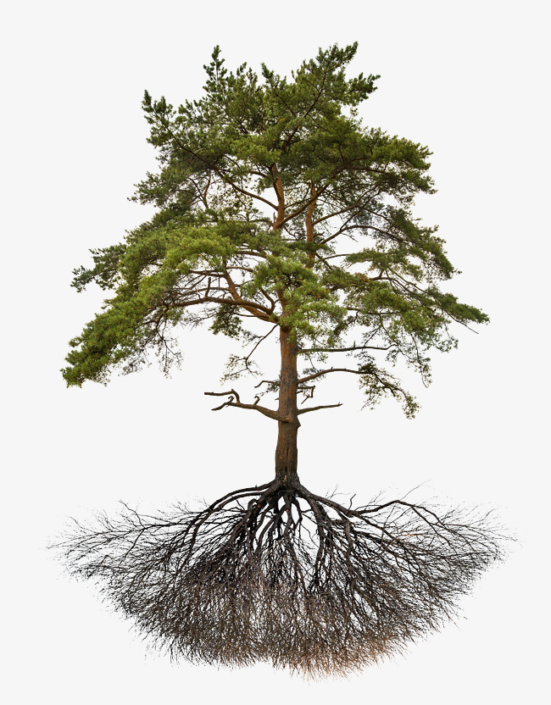
E
Ψ_{rootcrown}
Soil layer 1
Ψ_{rootsurf, 1}
Ψ_{soil, 1}
Soil layer 2
Ψ_{rootsurf, 2}
Ψ_{soil, 2}
…
…
Soil layer S
Ψ_{rootsurf, S}
Ψ_{soil, S}
Roots
Rhizosphere

Slide 2
E
Ψ_{leaf}
Leaf
Ψ_{stem, N}
…
Stem
Ψ_{stem, 2}
Ψ_{stem, 1}
Ψ_{rootcrown}
Soil layer 1
Ψ_{rootsurf, 1}
Ψ_{soil, 1}
Soil layer 2
Ψ_{rootsurf, 2}
Ψ_{soil, 2}
…
…
Soil layer S
Ψ_{rootsurf, S}
Ψ_{soil, S}
Roots
Rhizosphere

Slide 3
E
Ψ_{leaf}
Leaf
Ψ_{stem, 2}
Stem
Ψ_{stem, 1}
Ψ_{rootcrown}
Soil layer 1
Ψ_{rootsurf, 1}
Ψ_{soil, 1}
Soil layer 2
Ψ_{rootsurf, 2}
Ψ_{soil, 2}
…
…
Soil layer S
Ψ_{rootsurf, S}
Ψ_{soil, S}
Roots
Rhizosphere

Slide 4
E_{leaf}
F_{lat, leaf}
Leaf
Ψ_{leaf}
Ψ_{symp, leaf}
Ψ_{stem, 2}
Stem
E_{stem,out}
F_{lat, stem}
Ψ_{stem, 1}
Ψ_{symp,} _{stem}
E_{stem,in}
Ψ_{rootcrown}
Soil layer 1
Roots
Ψ_{rootsurf, 1}
Ψ_{soil, 1}
Soil layer 2
Ψ_{rootsurf, 2}
Ψ_{soil, 2}
Ψ_{rootsurf}
…
…
Soil layer S
Ψ_{rootsurf, S}
Ψ_{soil, S}
Roots
Rhizosphere

Slide 5
a) Hydraulics without storage compartments
b) Hydraulics with storage compartments
E_{leaf}
E_{leaf}
F_{lat, leaf}
Leaf
Ψ_{leaf}
Ψ_{leaf}
Ψ_{symp, leaf}
Ψ_{stem, 2}
Ψ_{stem, 2}
Stem
E_{stem,out}
F_{lat, stem}
Ψ_{stem, 1}
Ψ_{stem, 1}
Ψ_{symp,} _{stem}
E_{stem,in}
Ψ_{rootcrown}
Ψ_{rootcrown}
Soil layer 1
Ψ_{rootsurf, 1}
Ψ_{soil, 1}
Ψ_{rootsurf, 1}
Ψ_{soil, 1}
Roots
Soil layer 2
Ψ_{rootsurf, 2}
Ψ_{soil, 2}
Ψ_{rootsurf, 2}
Ψ_{soil, 2}
…
…
…
…
Ψ_{rootsurf}
Ψ_{rootsurf, S}
Ψ_{soil, S}
Soil layer S
Ψ_{rootsurf, S}
Ψ_{soil, S}
Roots
Rhizosphere
Roots
Rhizosphere

Slide 6
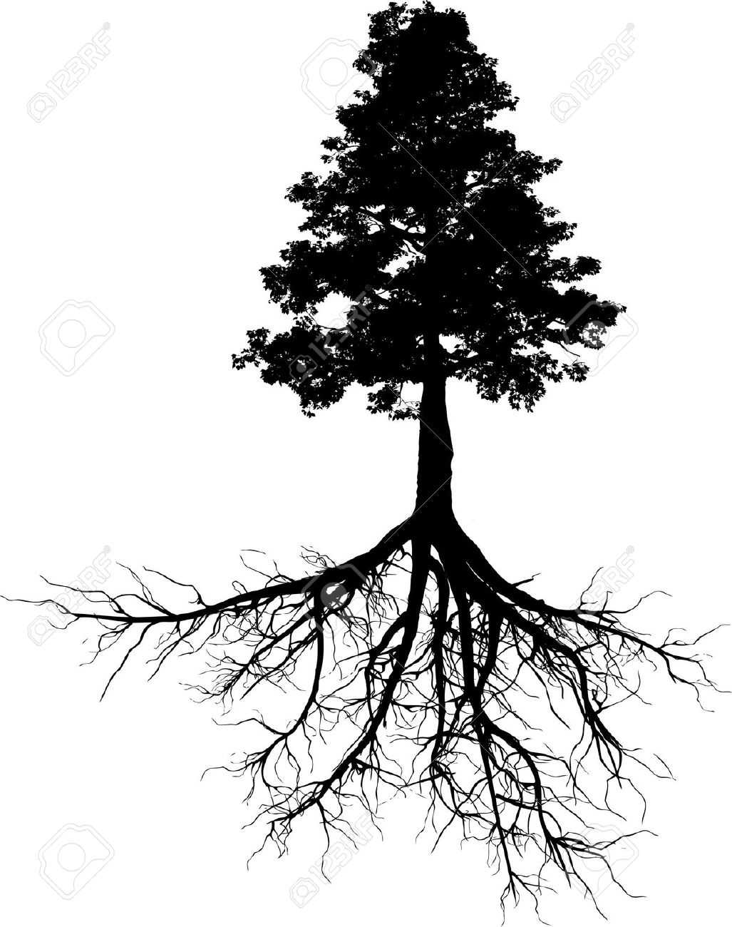
E
Ψ_{leaf}
Leaf
ΔS_{l} /Δt
Ψ_{stem, N}
ΔS_{N} /Δt
…
Stem
Ψ_{stem, 2}
ΔS₂ /Δt
Ψ_{stem, 1}
ΔS₁ /Δt
Ψ_{rootcrown}
Soil layer 1
Ψ_{rootsurf, 1}
Ψ_{soil, 1}
Soil layer 2
Ψ_{rootsurf, 2}
Ψ_{soil, 2}
…
…
Soil layer S
Ψ_{rootsurf, S}
Ψ_{soil, S}
Roots
Rhizosphere

Slide 7
E_{min}
Leaf
Ψ_{apo, leaf}
Ψ_{sym, leaf}
Ψ_{apo, N}
Ψ_{sym, N}
Stem
…
Ψ_{apo, 2}
Ψ_{sym, 2}
Ψ_{apo, 1}
Ψ_{sym, 1}

Slide 8
Hydraulics
Communication variable
Carbon
Stomatal conductance
Transpiration
Photosynthesis
Leaf storage
Leaf osmotic potential
Leaf metabolic carbon
Leaf water potential
Leaf turgor
Leaf growth and senescence
Floem transport
Leaf area
Stem water potential
Sapwood osmotic potential
Sapwood metabolic carbon
Fine root conductance and distribution
Cambium turgor
Stem conductance
Sapwood storage
Sapwood area
Sapwood growth and senescence
Fine root biomass and distribution
Fine root growth and senescence

Slide 9
Atmosphere
Photosynthesis
Storage
Metabolic
Structural
Leaf growth
Leaf senescence
Leaf
ST_{leaf}
SS_{leaf}
B_{leaf}
Sapwood growth
Phloem transport
Sapwood senescence
Sapwood
SS_{sapwood}
SS_{sapwood}
B_{sapwood}
Fine root growth
Root exudation
Fine root senescence
Fine roots
B_{fineroot}
Soil/mycorrhizae

