Slide 1
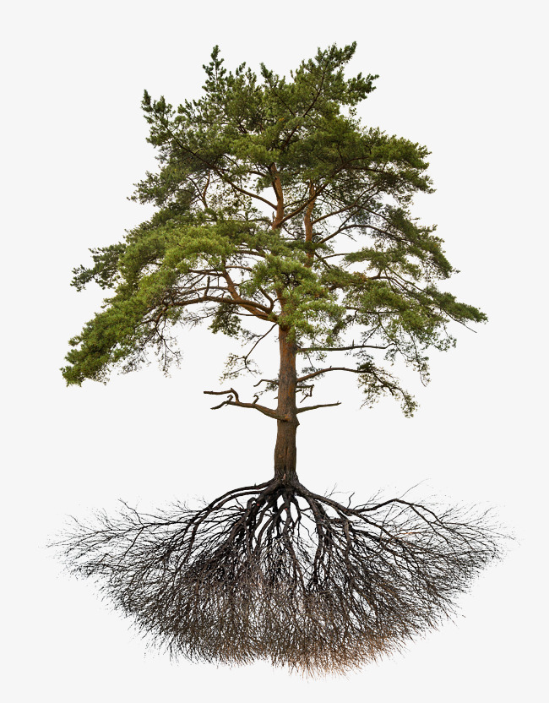
E
Ψ_{rootcrown}
Soil layer 1
Ψ_{rootsurf, 1}
Ψ_{soil, 1}
Soil layer 2
Ψ_{rootsurf, 2}
Ψ_{soil, 2}
…
…
Soil layer S
Ψ_{rootsurf, S}
Ψ_{soil, S}
Roots
Rhizosphere

Slide 2
E
Ψ_{leaf}
Leaf
Ψ_{stem, N}
…
Stem
Ψ_{stem, 2}
Ψ_{stem, 1}
Ψ_{rootcrown}
Soil layer 1
Ψ_{rootsurf, 1}
Ψ_{soil, 1}
Soil layer 2
Ψ_{rootsurf, 2}
Ψ_{soil, 2}
…
…
Soil layer S
Ψ_{rootsurf, S}
Ψ_{soil, S}
Roots
Rhizosphere

Slide 3
E
Ψ_{leaf}
Leaf
Ψ_{stem, 2}
Stem
Ψ_{stem, 1}
Ψ_{rootcrown}
Soil layer 1
Ψ_{rootsurf, 1}
Ψ_{soil, 1}
Soil layer 2
Ψ_{rootsurf, 2}
Ψ_{soil, 2}
…
…
Soil layer S
Ψ_{rootsurf, S}
Ψ_{soil, S}
Roots
Rhizosphere

Slide 4
E_{leaf}
F_{lat, leaf}
Leaf
Ψ_{leaf}
Ψ_{symp, leaf}
Ψ_{stem, 2}
Stem
E_{stem,out}
F_{lat, stem}
Ψ_{stem, 1}
Ψ_{symp,} _{stem}
E_{stem,in}
Ψ_{rootcrown}
Soil layer 1
Roots
Ψ_{rootsurf, 1}
Ψ_{soil, 1}
Soil layer 2
Ψ_{rootsurf, 2}
Ψ_{soil, 2}
Ψ_{rootsurf}
…
…
Soil layer S
Ψ_{rootsurf, S}
Ψ_{soil, S}
Roots
Rhizosphere

Slide 5
a) Hydraulics without storage compartments
b) Hydraulics with storage compartments
E_{leaf}
E_{leaf}
F_{lat, leaf}
Leaf
Ψ_{leaf}
Ψ_{leaf}
Ψ_{symp, leaf}
Ψ_{stem, 2}
Ψ_{stem, 2}
Stem
E_{stem,out}
F_{lat, stem}
Ψ_{stem, 1}
Ψ_{stem, 1}
Ψ_{symp,} _{stem}
E_{stem,in}
Ψ_{rootcrown}
Ψ_{rootcrown}
Soil layer 1
Ψ_{rootsurf, 1}
Ψ_{soil, 1}
Ψ_{rootsurf, 1}
Ψ_{soil, 1}
Roots
Soil layer 2
Ψ_{rootsurf, 2}
Ψ_{soil, 2}
Ψ_{rootsurf, 2}
Ψ_{soil, 2}
…
…
…
…
Ψ_{rootsurf}
Ψ_{rootsurf, S}
Ψ_{soil, S}
Soil layer S
Ψ_{rootsurf, S}
Ψ_{soil, S}
Roots
Rhizosphere
Roots
Rhizosphere

Slide 6
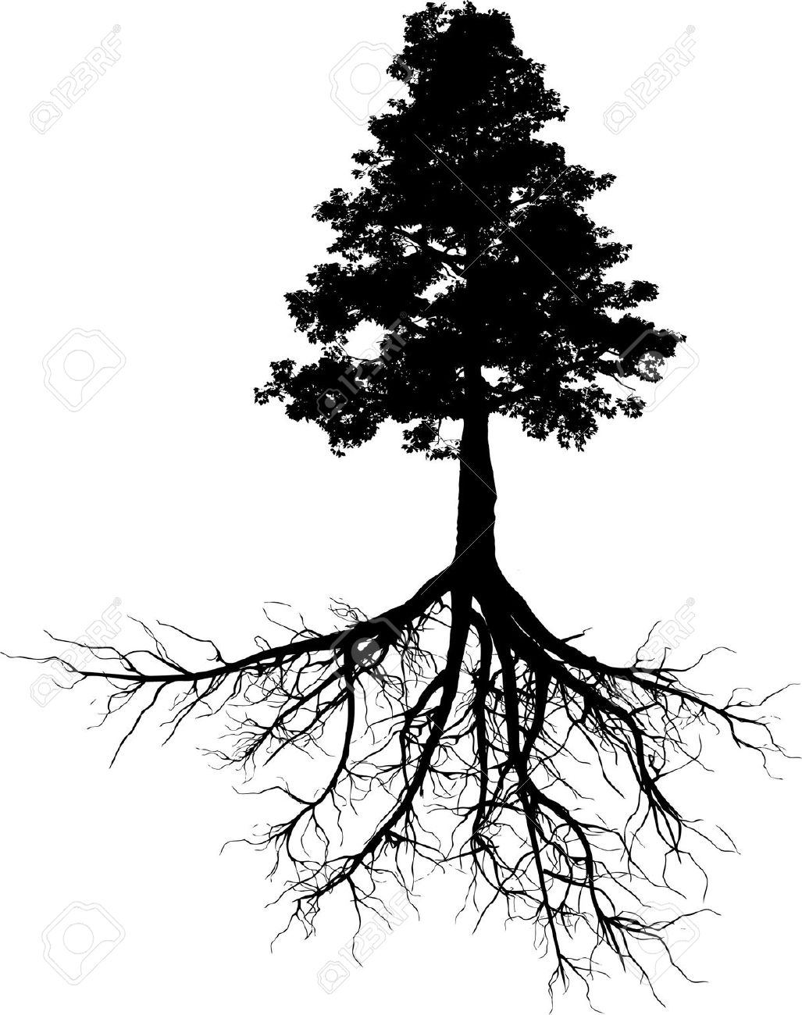
E
Ψ_{leaf}
Leaf
ΔS_{l} /Δt
Ψ_{stem, N}
ΔS_{N} /Δt
…
Stem
Ψ_{stem, 2}
ΔS₂ /Δt
Ψ_{stem, 1}
ΔS₁ /Δt
Ψ_{rootcrown}
Soil layer 1
Ψ_{rootsurf, 1}
Ψ_{soil, 1}
Soil layer 2
Ψ_{rootsurf, 2}
Ψ_{soil, 2}
…
…
Soil layer S
Ψ_{rootsurf, S}
Ψ_{soil, S}
Roots
Rhizosphere

Slide 7
E_{min}
Leaf
Ψ_{apo, leaf}
Ψ_{sym, leaf}
Ψ_{apo, N}
Ψ_{sym, N}
Stem
…
Ψ_{apo, 2}
Ψ_{sym, 2}
Ψ_{apo, 1}
Ψ_{sym, 1}

Slide 8
Growth respiration
Atmosphere
Photosynthesis
Maintenance respiration
Metabolic
Storage
Structural
Leaf growth
Leaf senescence
SS_{leaf}
ST_{leaf}
B_{leaf}
Phloem transport
Sapwood senescence
SS_{sapwood}
ST_{sapwood}
B_{sapwood}
Sapwood growth
Fine root senescence
Root exudation
B_{fineroot}
Fine root growth
Soil/mycorrhizae

Slide 9
fordyn()
seed recruitment
resprouting
forest management
growth()
carbon balance
tissue growth and senescence
mortality
spwb()
advanced (Sperry or Cochard)
energy balance
plant hydraulics
photosynthesis
basic (Granier)
soil hydrology
rainfall interception
soil water balance
plant water balance
leaf phenology
plant transpiration

Slide 10
Water variable/process
Carbon variable/process
Communication variable
Leaf transpiration
Stomatal conductance
Leaf photosynthesis
Leaf water potential
Leaf osmotic potential
Leaf metabolic carbon
Leaf turgor
Leaf growth and senescence
Leaf area
Stem water potential
Sapwood osmotic potential
Sapwood metabolic carbon
Stem conductance
Cambium turgor
Sapwood growth and senescence
Sapwood area
Fine root conductance and distribution
Fine root biomass and distribution
Fine root growth and senescence

Slide 11
0%
0-10%
10-20%
20-30%
30-40%
40-50%
50-60%
60-70%
70-80%
80-90%
100%
PhenologyType
LeafDuration
(24%)
Hmax
Shrub allometric coeff.
(8%)
Tree allometric coeff.
(28%)
HeatContent
(61%)
LifeForm
SAV
(71%)
Radiation/rain interception parameters
(100%)
Group
Leaf shape
r635
(57%)
LigninContent
(78%)
Leaf size
LeafWidth
(26%)
Al2As
(52%)
SLA
(6%)
LeafDensity
(31%)
StemAF/conduit2sapwood
(66%)
VCroot
(100%)
Psi_Critic
(30%)
VCstem_c/VCstem_d
(41%)
Psi_Extract
(55%)
VCleaf_c/VCleaf_d
(100%)
Family
LeafPI0 /LeafEPS
(65%/67%)
LeafAF
(83%)
Kmax_stemxylem
(49%)
Gswmax
(77%)
VCleaf_kmax
(100%)
Nleaf
(11%)
Nfineroot (57%)
Gswmin
(68%)
Vmax298
(49%)
Jmax298
(58%)
WoodDensity
(15%)
StemPI0 / StemEPS
(100%)

Slide 12
Surface weather station networks (AEMET, SMC, …)
Copernicus Data Store
R package meteospain
R package ecrwf
Coarse-scale projections (GCM, RCM)
Observed point weather data
Donwscaled projections on point locations
R package meteoland
Historic weather
MeteorologyInterpolationData
Future weather MeteorologyInterpolationData
R package medfateland

