Slide 1

Get MEAN!

Slide 2
MEAN is a JavaScript tech stack for Single Page Apps

Slide 3
Single Page App (SPA)
HTML/JavaScript client application
Hosted in a single web page (frame)
Executes autonomously in the browser
local application state
local view composition
local view navigation
offline
Web app … not web site
Maximize responsive user experience
Minimize server interaction (mostly data)

Slide 4
MEAN is a JavaScript tech stack for Single Page Apps

Slide 5
MEAN Technology Stack
MongoDb | database
Express | web app framework
Angular | client app framework
Node | runtime environment

Slide 6
MEAN is developer friendly

Slide 7
MEAN is developer friendly
One language (JavaScript)
Easy to get started
Easy to understand
Easy to change
Open source
Vibrant community

Slide 8
MEAN is for production apps

Slide 9
MEAN is for production apps
Deploy what you build
Many large commercial deployments
Many large backers

Slide 10
MEAN has favorable economics

Slide 11
MEAN has favorable economics
Quick time-to-market
Free open source
Competitive support costs
Scales out on commodity h/w
Multi-vendor
Cross-platform
Cloud & on-prem

Slide 12
Agenda
Node | runtime environment
Express | web app framework
MongoDb | database
Angular | client app framework

Slide 13
Node is a
JavaScript runtime

Slide 14
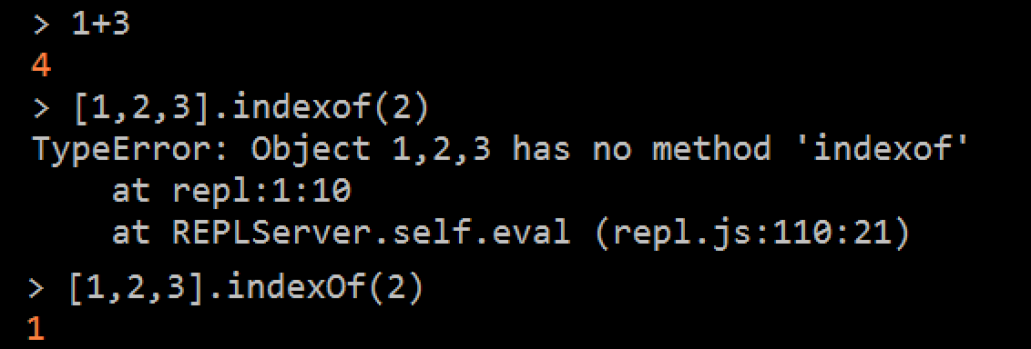
Node REPL

Slide 15
Node modularity
Build modules with modules
Core modules
Console
Crypto
File System (fs)
Process
Timers
Utils
…
npm package manager for external modules
var express = require('express'),
util = require('util');
exports = module.exports = myModule;

Slide 16
Node for server
Core server modules
Http & Https
Net (TCP)
Path
URL
Zlib
…
Just the basics

Slide 17
Node notables
Written for JavaScript, not in Javascript
ECMAScript 5 (ES6 soon)
No DOM (no browser, no shims)
Single event loop (no threads, no concurrency issues)

Slide 18

Threads vs. Events
R
R
R
R
R
R
R
R
R
Zzzzzzzzz
T₀
T₁
T₂
T₃
T₄
R
R
R
R
R
Thread Pool
R
R
R
R
R
R
While some other async process works
R
R
R
R
R

Slide 19
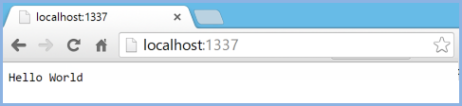
Build a node server
nodeserver.js
var http = require('http');
http.createServer(function (req, res) {
console.log("Got a request from '"+req.url+''; let's respond");
res.writeHead(200, {'Content-Type': 'text/plain'});
res.end('Hello World\n');
})
.listen(1337, '127.0.0.1');
console.log('Server running at http://localhost:1337/');
launch
node nodeserver :: w/o debugger
node-debug nodeserver :: w/ debugger
browse
Notes:
1) copy to clipboard
2) open cmd window
3) > copy con nodeserver.js
3) paste from clipboard
4) ^z to end “copy from console”
5) > node nodeserver (or node-debug nodeserver with node-inspector installed
6) Open browser to http://localhost:1337
7) when done, kill it with ^c and then > del nodeserver.js

Slide 20
Node Design Considerations
Async paradigm
Don’t linger
Server management is your responsibility
Ideal workload:
I/O bound
Low computation
Dispatch to external services for heavy lifting

Slide 21
Express is a node
web app framework

Slide 22
What’s a node web app framework?
a node module
enriches node’s native HTTP/HTTPS
extend request/response object with convenience members
serve selected static files to clients
route parameterized api requests to dynamic handlers
build dynamic html pages with a view engine (several)
redirect requests
handle errors
manage cookies
log activity
authentication
CORS
… much more …
Express does not do all this itself

Slide 23
Express is a stack of middleware

Slide 24
middleware is a function
takes request, response, & do-next
function loggingMiddleware(req, res, next) {
console.log('request path: ' + req.path);
next(); // continue with next middleware
}
respond to client (end of the line)
function helloMiddleware(req, res) {
res.send('hello ' + (req.params.x || 'world'));
}
handle error
function errorMiddleware(err, req, res, next) {
res.status(err.status || 500)
.send(err.message || '** so sad **');
}

Slide 25
stack of middleware
var express = require('express'),
app = express();
app.use(logMiddleware);
app.get('/', helloMiddleware);
app.get('/bad', function(req, res, next) {
next(new Error("bad bad bad"));
});
app.get('/:x', helloMiddleware);
app.use(errorMiddleware);
app.listen(3000);
Notes:
To see it, paste the following in express-gen’s .bin/www and run with “node-debug bin.www”
function loggingMiddleware(req, res, next) {
console.log('request path: ' + req.path);
next();
}
function helloMiddleware(req, res, next) {
res.send('hello ' + (req.params.x || 'world'));
}
function errorMiddleware(err, req, res, next) {
res.status(err.status || 500)
.send(err.message || '** no unicorns here **');
}
var express = require('express'),
app = express();
app.use(loggingMiddleware);
app.get('/', helloMiddleware);
app.get('/bad', function(req, res, next) {
next(new Error("bad bad bad"));
});
app.get('/:x', helloMiddleware);
app.use(errorMiddleware);
app.listen(3000);

Slide 26
Express Generator
to scaffold an app

Slide 27
Quick start w/ express-generator
Install the generator globally (one time)
npm install –g express-generator
Scaffold the app (hogan view engine)
express %TEMP%/foo --hogan && cd %TEMP%/foo
Install app dependencies
npm install
Launch server
npm start
Browse
http://localhost:3000

Slide 28
Debug w/ node-inspector
Instead of npm start, say node-debug ./bin/www Launches a parallel debugging browser with node-inspector

Slide 29
MongoDb is
NoSQL Document database

Slide 30
Document is
a JSON object

Slide 31
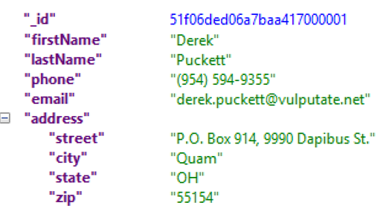
{ }
Document ID
nested object

Slide 32
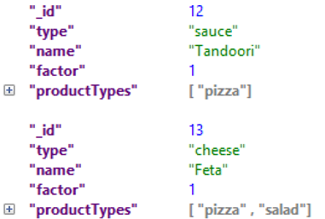
{ }
{ }
arrays of primitive type

Slide 33
Aggregate Document
Order
1..n
OrderItems
1..n
OrderItemOptions
A rich domain aggregate in one document no ORM

Slide 34
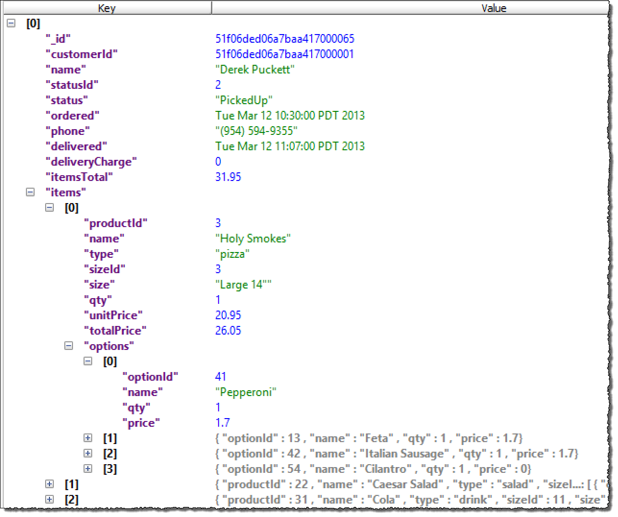
De-normalized customer name & status name
array of OrderItem
array of OrderItemOption

Slide 35
get or save an entire
aggregate
in one shot

Slide 36
MongoDb Queries
db.Customer = collection('Customer'); // get the collection
db.Customer.find()...; // get all customers
db.Customer.find({firstName: 'Derek'}); // search object
async methods with callbacks
db.Customer.find().toArray(function(err, data){ if (err) { ... handle it ... } } else { ... do something with data ... } });

Slide 37
MongoDb Notables
Query properties at depth
Can index properties
Document saves are atomic
No transactions
No relationships
Fast and scalable for intended workflow
Problematic for ad hoc queries and changes

Slide 38
Mongo Design Considerations
Design upfront for client workflow
De-normalize selectively
Simulate relationships in memory
Design for eventual consistency

Slide 39

ngular is an HTML
client app framework

Slide 40
Angular
Templating and Data Binding
Model-View-ViewModel (MVVM)
Modularity / Dependency Injection
View Routing
Testing

Slide 41
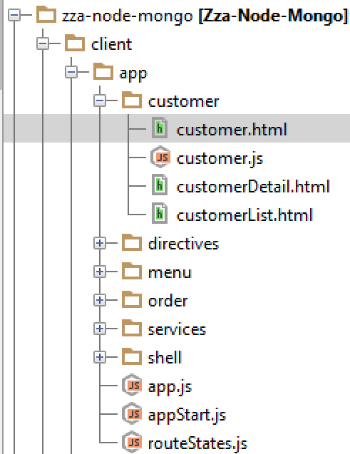
Angular Modularity
The SPA
main customer view
App Modules

Slide 42
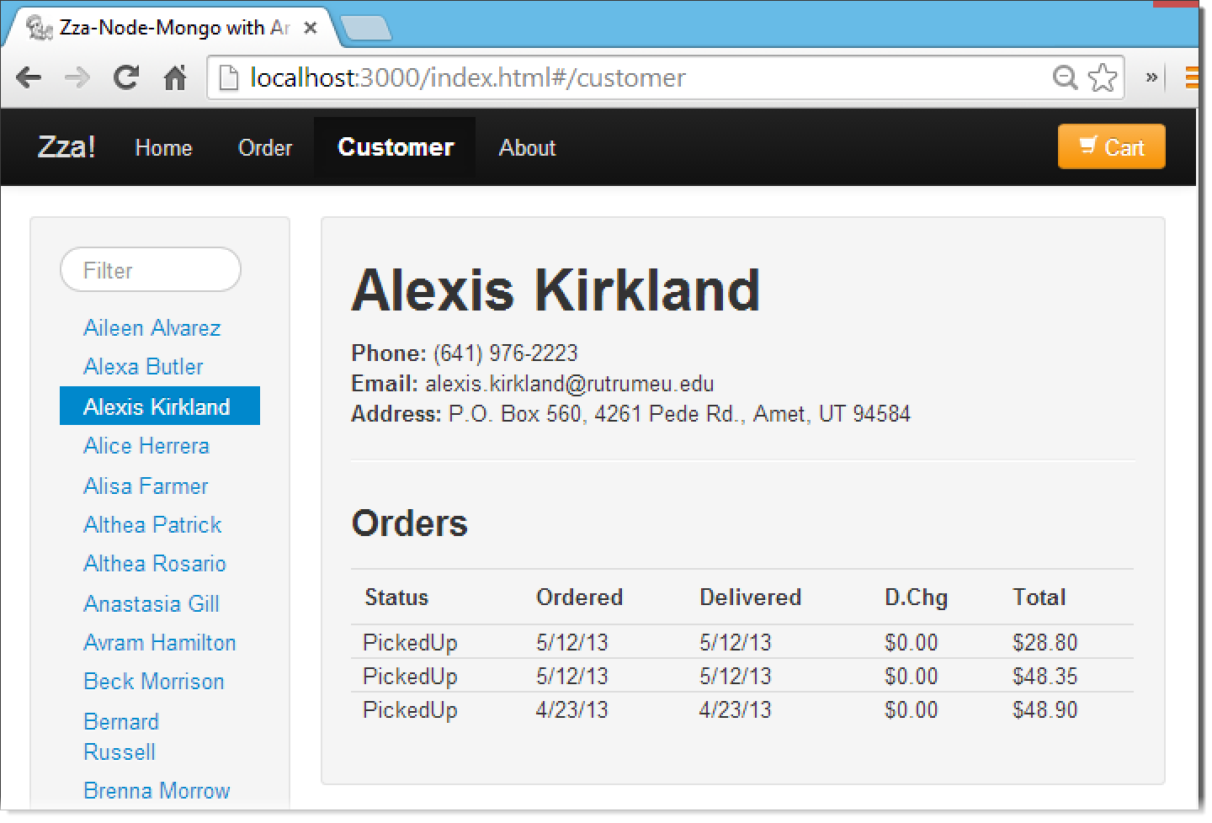
Angular View Composition
Views
customer.html
customerList.html
customerDetail.html
ViewModel
customer.js

Slide 43
Take Aways
You’re in charge
It’s fast
It’s fun
It’s seriously enterprise

Slide 44


Resources
node: http://nodejs.org/
express: http://expressjs.com/
mongoDb
angular: http://angularjs.org/
breeze: http://breezejs.com
express
B

