Slide 1


Social Buzz

Slide 2


Today's agenda
Project recap
Problem
The Analytics team
Process
Insights
Summary

Slide 3

Social Buzz has retaind
Social Buzz is a fast-growing social media unicorn that needs to scale rapidly. Accenture has begun a three-month initial engagement to:
Audit their big data practice
Provide recommendations for a successful IPO
Analyze of their content categories that highlights the top 5 categories with the largest aggregate popularity
Project Recap

Slide 4


Problem
Users post over 100,000 pieces of content every day
With tens of millions of posts and hundreds of millions of users, how do you capitalize?

Slide 5



Andrew Fleming
Chief Technology Architect
The Analytics team
Marcus Rompton
Senior Principal
Eli Gerber
Data Analyst

Slide 6
Process
1
Data Understanding
2
Data Cleaning
3
Data Modelling
4
Data Analysis
5
Uncover Insights

Slide 7

Insights
The top five categories by overall popularity are animals, science, healthy eating, technology, and food
Post popularity was highest in April and May 2021, and lowest from December 2020 through March 2021
Of the top categories, posts about animals are consistently near the most popular each month

Slide 8
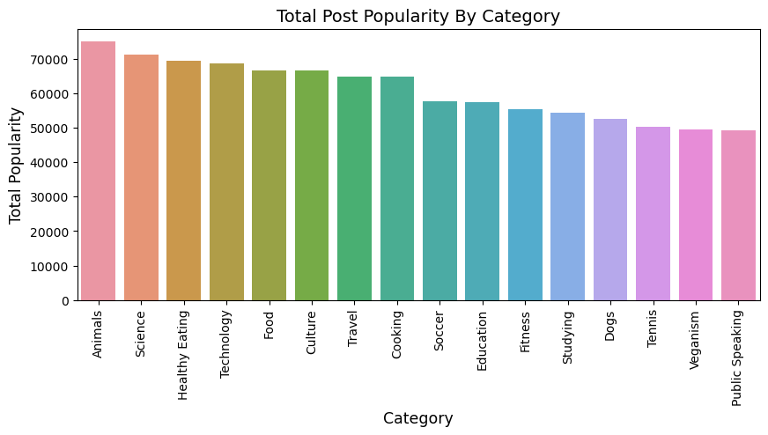

Slide 9
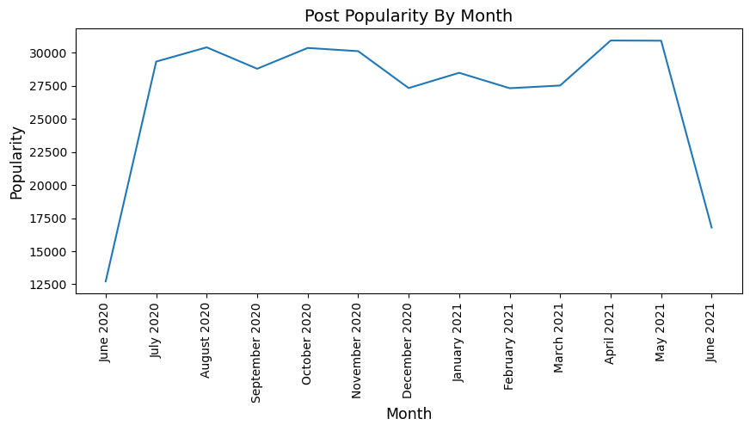

Slide 10
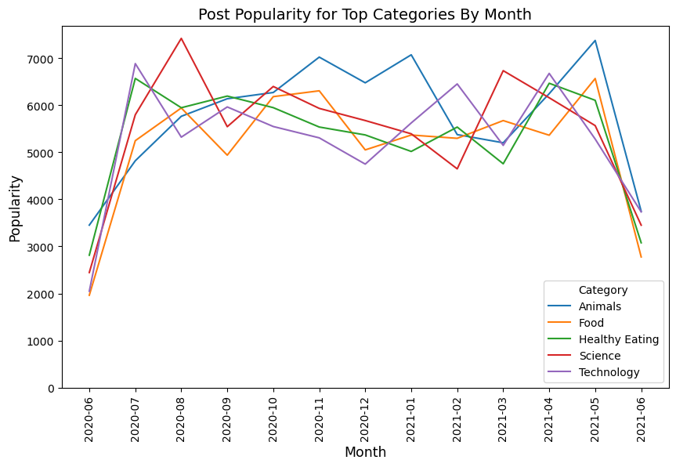

Slide 11

Posts about animals are consistently among the top performers
The two most recent full months (April and May 2021) have had the highest total post popularity of any in our dataset
With more time, we could analyze how overarching themes that encompass multiple categories (e.g. “health lifestyle” for healthy eating and fitness) compare to these more specific categories
Summary

Slide 12

Thank you!
ANY QUESTIONS?

