Slide 1
PHP Startup Prototypes

Slide 2
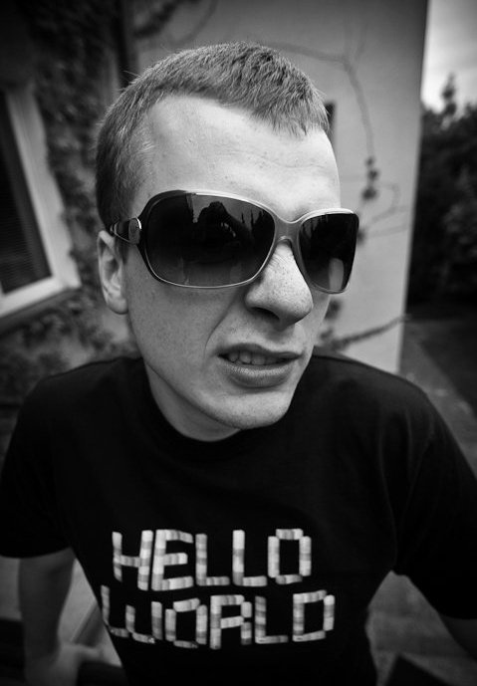
Who am I?
In PHP since 2003
Master @ wmid.amu.edu.pl
Senior Developer @ RedExperts
self-employed
Blogger & Geek

Slide 3
Agenda
= 'Who am I?';
= 'PAAS';
= 'PAAS – Providers';
= 'Costs?';
= 'Let's granade fly!';
= 'Extra services';
= 'Silex';
= 'Laravel4';
= 'Our cloud is under siege!';
= 'Charts and other crap';
= 'Q&A';
= 'Tom Hanks';

