Slide 1


Composing Team Compositions: An Examination of Instructors' Current Algorithmic Team Formation Practices
Emily M. Hastings, Vidushi Ojha, Benedict V. Austriaco, Karrie Karahalios, Brian P. Bailey
CSCW 2023
Notes:
Introduce self
Many of you have worked on a team project before. For the instructors, many of you have probably done team-based activities in your courses, and you may have even used algorithmic team formation tools to help make this process more efficient or easier.
Provide insight on how others are using similar tools to help you make decisions, reassure you that others struggle to use them effectively

Slide 2

Team Formation Matters
Teamwork is a foundational skill and integral in computing courses (e.g., Coleman & Lang 2012; Latulipe, Long, & Seminario 2015)
Instructors must determine how to best form teams from increasingly large and diverse pool of students
Notes:
https://www.pngplay.com/image/161334
Composition can have impact on team outcomes

Slide 3




Criteria-based Team Formation
Strategically select team members to achieve certain compositions
Skill diversity (e.g., Brickell et al. 1994, Horwitz and Horwitz 2007)
Balanced personality types (e.g., Lykourentzou et al. 2016)
Balanced genders (e.g., Jehn, Northcraft, and Neale 1999)
Many more
Notes:
Algorithmic team formation tools help implement this approach

Slide 4

Example Algorithmic Workflow
Select criteria
Notes:
Instructors select the criteria

Slide 5
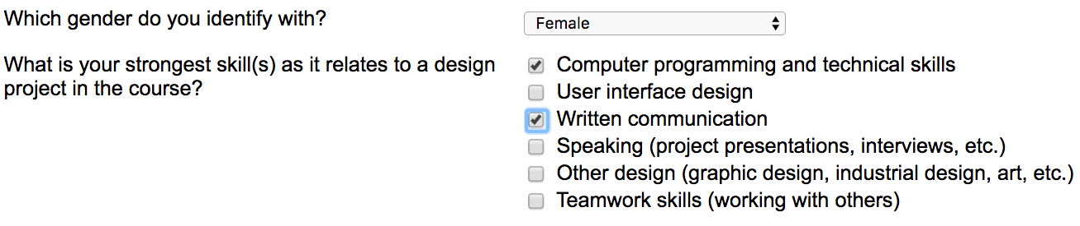
Example Algorithmic Workflow
Select criteria
Gather information from students

Slide 6
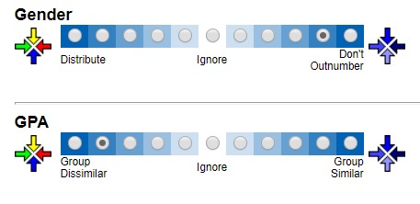
Example Algorithmic Workflow
Select criteria
Gather information from students
Configure weights

Slide 7
Example Algorithmic Workflow
Select criteria
Gather information from students
Configure weights
Form teams

Slide 8
Example Algorithmic Workflow
Select criteria
Gather information from students
Configure weights
Form teams
Notify students

Slide 9
The Problem
Instructor must prioritize large collection of criteria available in the tool with little guidance (Jahanbakhsh et al. 2017)
Could consult literature
Does not cover all possible combinations
May not align with preferences of learners
Not clear how instructors are selecting configurations
Notes:
However, although these tools can be very useful, they also raise significant new challenges.
E.g., CATME has 27^11 possible configurations just for default criteria
Easy to make a mistake that could negatively impact the students
those with the most at stake in the process
However, the relative novelty of team formation tools means that there is currently little knowledge of how instructors choose which of these sources to utilize, how they relate different criteria to their goals for the planned teamwork, or how they determine if their configuration or the generated teams are successful.

Slide 10
Research Questions
RQ1: What goals do instructors have for the teamwork in their courses and how are the goals reflected in their team formation process?
RQ2: Which and how many criteria do instructors use to form teams in their courses, and how do they select these configurations?
RQ3: How do instructors understand the use of team formation tools, and how does this understanding affect their configurations?
Notes:
To close this gap, we conducted a survey and interview study investigating instructors’ goals and decisions when using team formation tools. Specifically…

Slide 11
Methodology
Survey with 2 version: CATME Team-Maker and other methods
Criteria used, details about course, demographics
Interviews and follow-up survey
Goals, understanding of tool
Participants recruited through email and message board posts
Survey: 77 responses (46 CATME, 31 other)
Interview: 21 participants (10 CATME, 11 other)
Notes:
Participants from a variety of departments but mostly Formal and Applied Sciences (50),
primarily US (68) but also UK, India, Australia, Canada, Ireland, Malaysia

Slide 12
Results
Notes:
Going to talk briefly about some of the most interesting results most closely relating to the research questions, encourage you to check out the paper for more information and quotes from instructors, which were really enlightening.

Slide 13
RQ1: Instructor Goals
Most prioritized learning teamwork skills (interview N=15, survey N=19) and facilitating peer-based learning (interview N=14, survey N=21)
Goals led instructors to prioritize diverse teams (interview N=13)
Notes:
Also preparing for industry (interview N=14, survey N=16) and course content (interview N=10, survey N=21)

Slide 14
RQ2: Selecting Criteria Configurations
Survey participants reported using 87 distinct criteria
Mostly defaults in the tool (Schedule, Gender, etc.)
Various weights
Participants using tool selected significantly more criteria (10 vs. 3; Mann-Whitney-Wilcoxon W=765.5, p=0.00)
Included more scheduling constraints
Factors considered:
Student makeup of the course (CATME), prior experience (other)
Considered student input least often, but rated as important (median 5 out of 7)
Trial and error
Notes:
Factors: student makeup of the course (least– student opinions). Rated student preferences important (5 of 7)
Prior experience for people not using tool, makeup was 3rd (not significant, ($\chi^2$(7)=13.36, $p$=0.06))
Learned over time– trial and error
Include how they know good?

Slide 15
Transparency Issues
Some instructors unsure how choices would be perceived:
“I just have an uneasiness about it. That's just related to, `Wait, are we [being] profiled?'... I don't know how that's going to be. Whereas with women being at least 25-ish percent [of the students in the course], it's like, that's conceivable that I got paired with another woman. That's not unreasonable, versus there's four Black students in... a class of 400. And I got paired with one. I could see that not going as well. I just don't know.”
12 interviewed instructors mentioned issues of transparency with students
Notes:
Quote
Relevant to LIFT

Slide 16
RQ3: Understanding the Tool
Instructors expressed confusion about how the tool’s algorithm worked but offered their own interpretations
E.g., a limit exists for how many criteria are useful to include at one time (N=6)
“And so, I do believe if you put too many variables in, you may start to variable yourself right out of teams that function at all.”
Did not accept the tool’s output without question but performed sanity checks (CATME N=9, other N=9)
Understand the tool will not produce perfect teams
Interesting behaviors
Extra criteria
Relying on defaults
Notes:
Understand tools won’t produce perfect teams (link to PS)
Interesting behaviors– extra criteria to obfuscate, defaults?

Slide 17
Discussion
Supports need for learner-centered workflows, e.g., LIFT (CHI 2020)
Instructors want more support and value student input but no mechanism currently exists
Aligns with goal of supporting peer-based learning and learning of teamwork skills
Tool designers could consider including built-in ways to gather student input and help instructors interpret it
Notes:
To touch briefly on implications, Lends support to the need for LIFT, etc. bc instructors want more support, care about student opinions but don’t ask, want students to learn about teamwork skills/from each other

Slide 18
Contributions
Greater knowledge of instructors' goals with respect to algorithmic team formation and how they make decisions with tools in practice
Practical implications for how designers of algorithmic team formation tools can create interfaces that are responsive to instructors' actual processes and provide more guidance in areas where they are unsure
Thank you to our participants!
Contact info:
Emily Hastings (hastinem@uwec.edu)
Notes:
For example, we found that instructors were sometimes uncertain about whether the configurations they selected would be effective or accepted by students, and while they valued students' opinions on what criteria to prioritize, rarely solicited this information themselves. Tools might therefore provide built-in ways to gather student input and help instructors interpret it. Including more explicit recommendations from the literature, especially in relation to the mapping between instructors' goals and specific criteria, may also help clarify the configuration process. The inclusion of this additional support may in turn produce student teams that cooperate more effectively and have better learning experiences.

Slide 19
Extra Slides
Notes:
Extra slides for questions

Slide 20
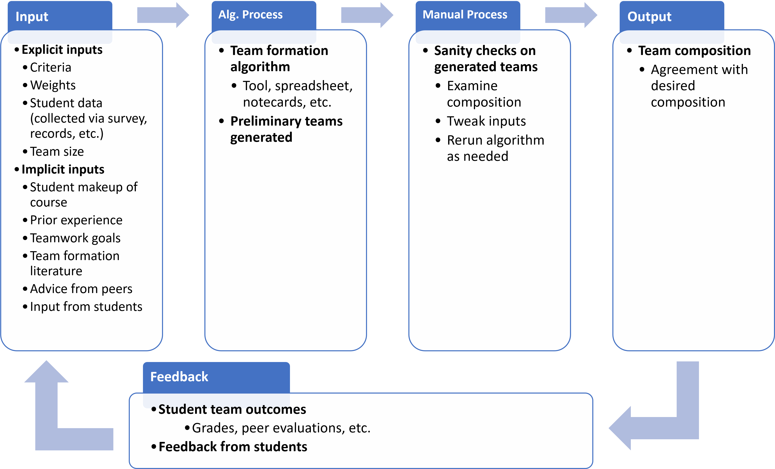
Notes:
To summarize, In general, the team formation process described by looked something like this

Slide 21
Implications, cont’d
Consider alternative algorithmic inputs and outputs
Numerical representations may not align with mental models
Might instead specify “gold standard” team and compare
Notes:
Suggests need to reconsider inputs/outputs– struggle to sanity check
TODO need an image?

Slide 22
Scope
“Staffed teams” (Gómez-Zará et al. 2020)
CATME Team-Maker
Students completing course projects lasting at most one semester
Team size of 4-8
Results may generalize to other contexts
Notes:
Created by a tool according to user-defined criteria
While I believe that many of the techniques and results I describe here will generalize to other teamwork contexts (project types, industry), additional research will be required to determine exactly to what extent they will transfer.

Slide 23
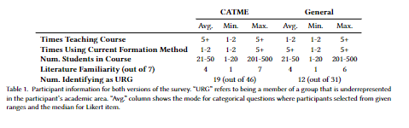
Survey Participants

Slide 24
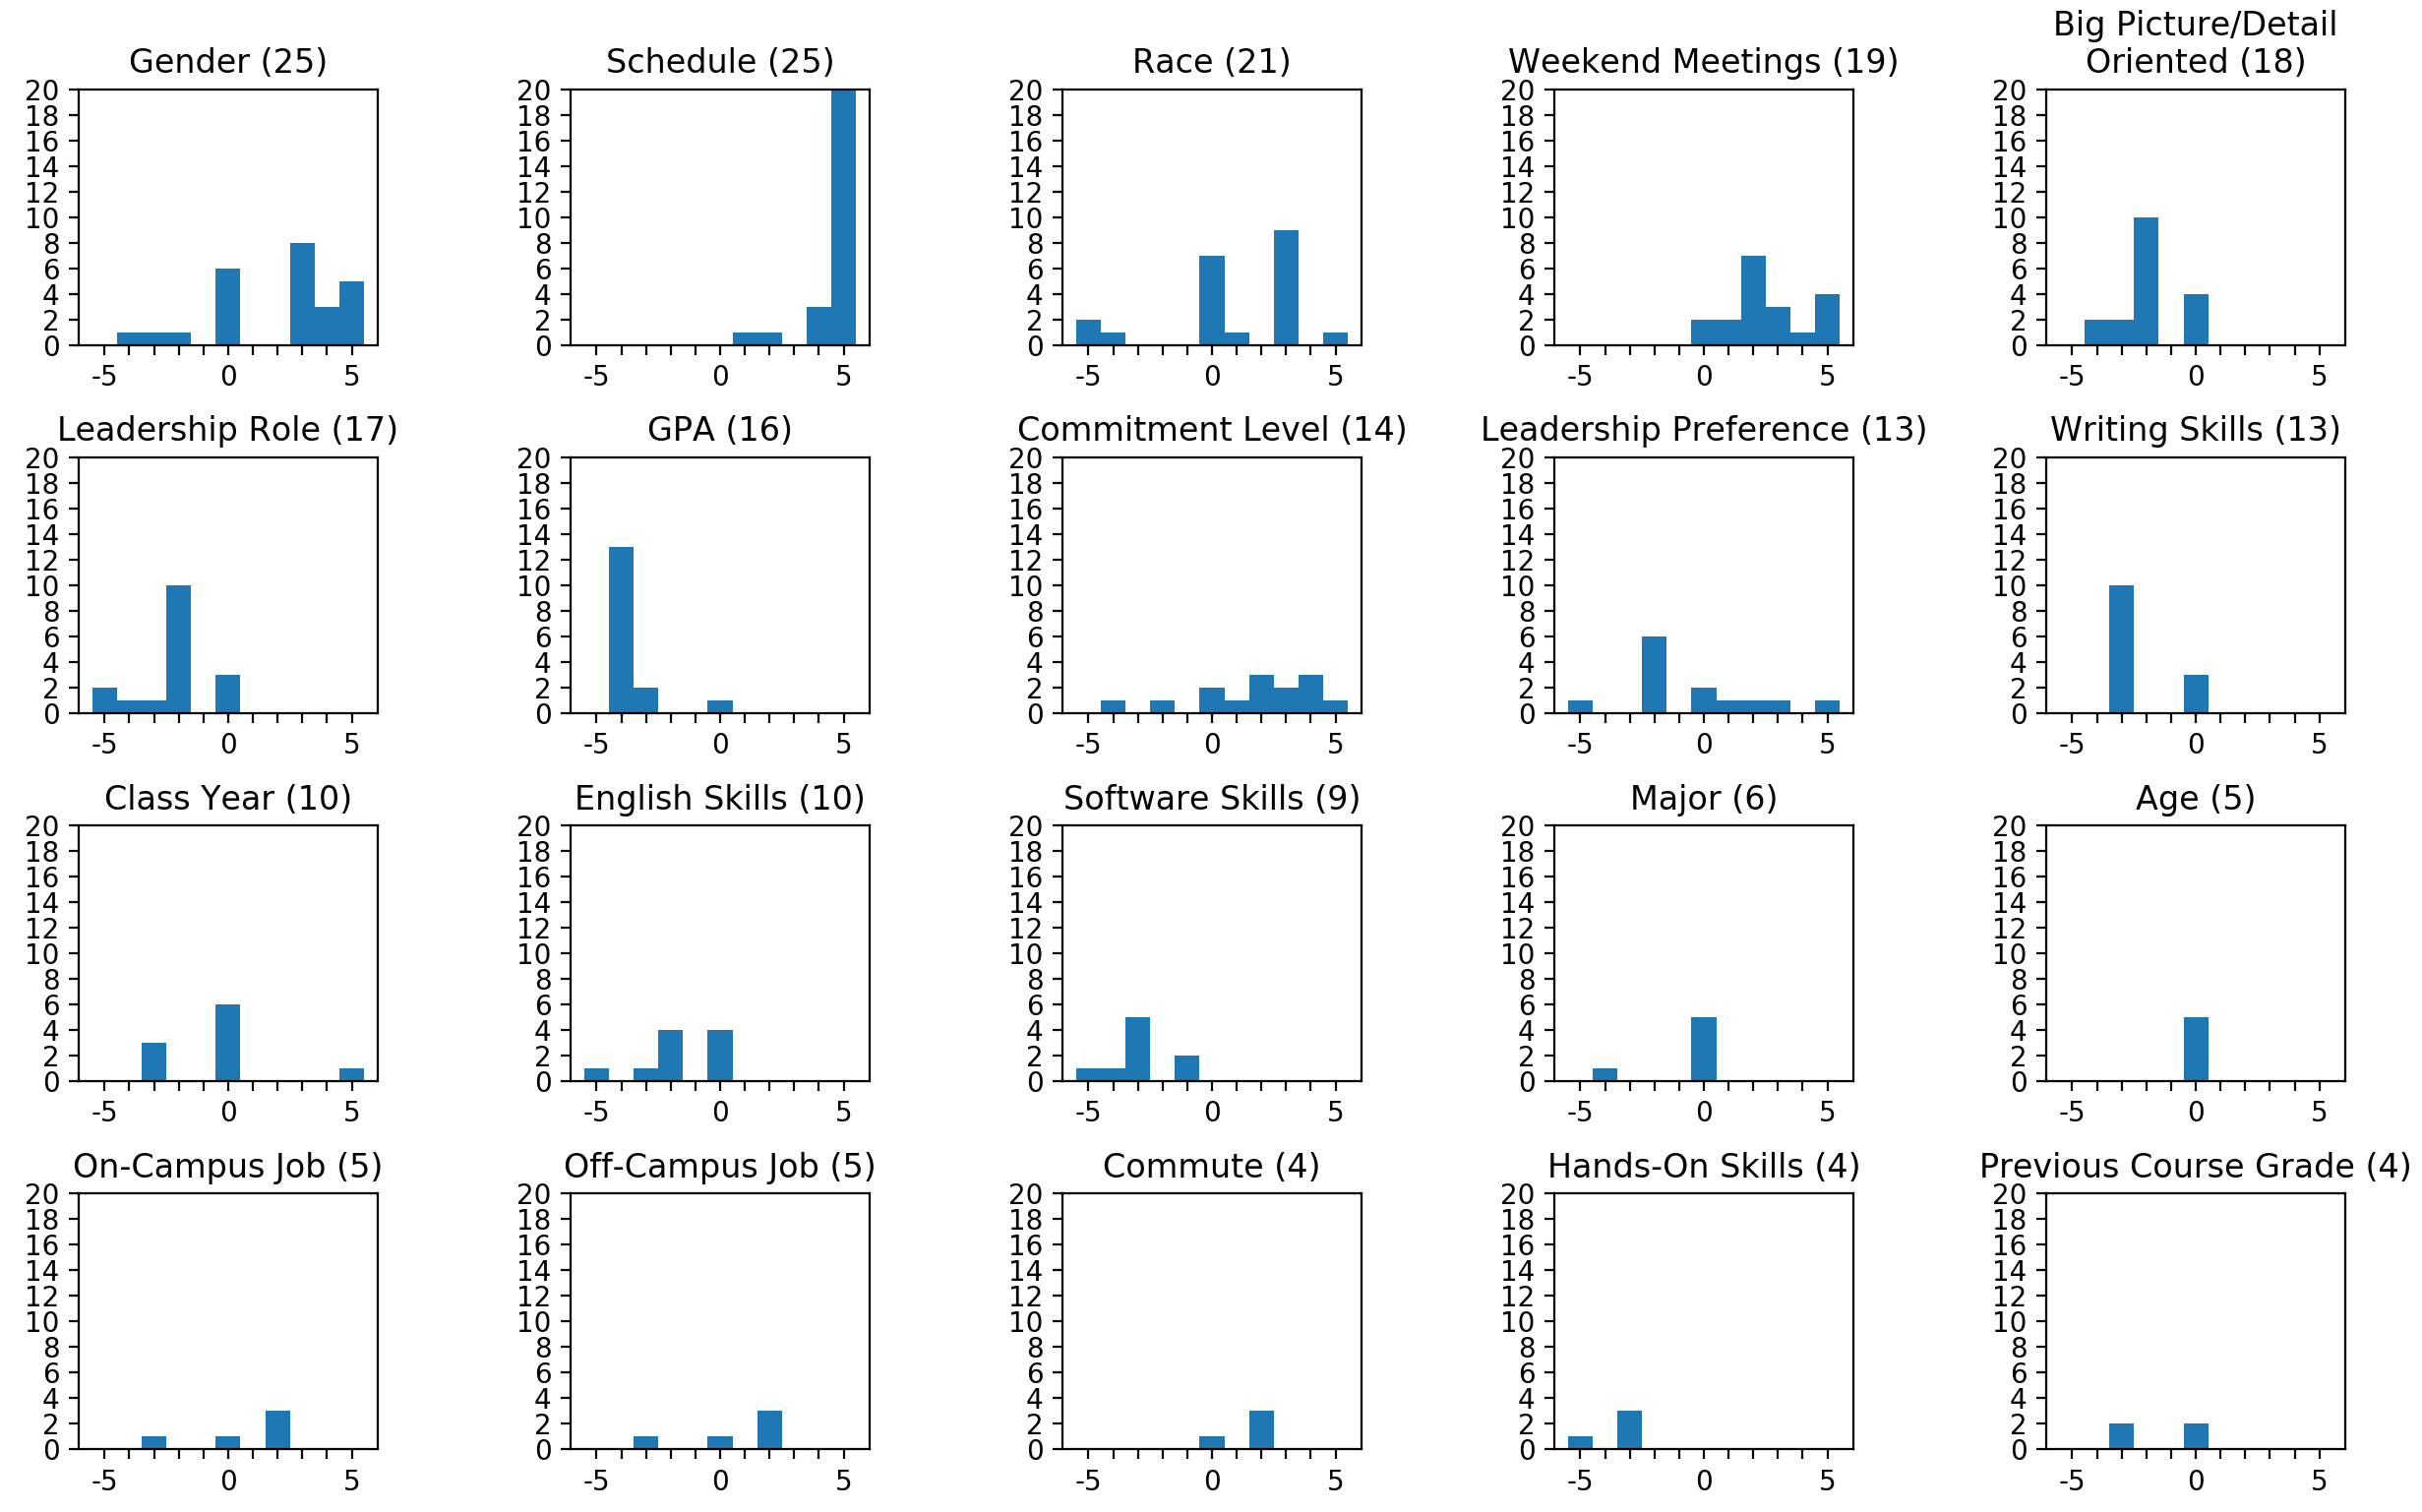

Slide 25
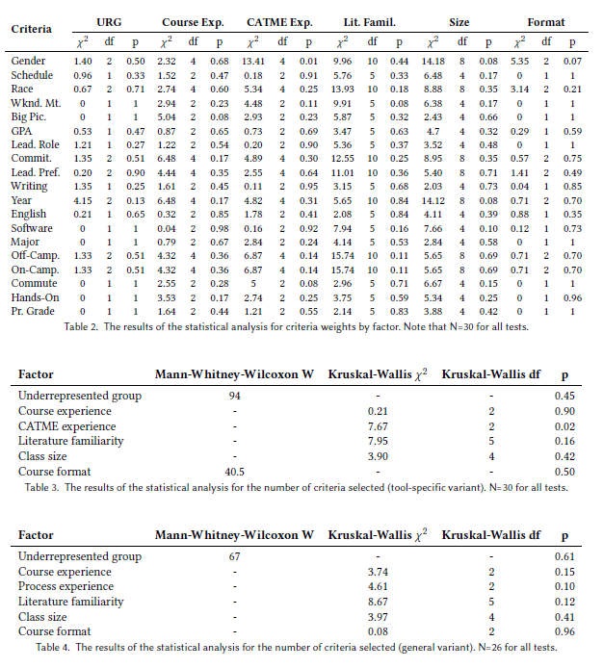
Notes:
Trends According to Instructor or Course Characteristics

Slide 26
Software Engineering Case Study
https://drive.google.com/file/d/17sXE-QXUWt9PwRNwiUQQa1UTfvWHx0EX/view?usp=sharing

Slide 27
Coding Process
First, developed a tentative coding scheme based on the survey and an initial reading of all the interviews, and further refined it while coding a sample of 20% of the interviews
Both coders then independently applied the scheme to a further 25% of the interviews, iterating on the scheme and revising until satisfactory agreement was reached (median Cohen's kappa over all codes was 0.66)
Divided the remaining interviews (including the initial sample) and coded them using the final scheme, discussing as necessary to resolve uncertainties

