Slide 1

Supporting Instructor Decisions on Algorithmic Team Formation through Integrating Stakeholder Voices
Emily M. Hastings
11/16/22
Notes:
Introduce self
Many of you have worked on a team project before. For the instructors, many of you have probably done team-based activities in your courses, and you may have even used algorithmic team formation tools to help make this process more efficient or easier.
Provide insight on how you could give students more of a voice when using algorithmic team formation tools in your courses

Slide 2

Vision
Every student can:
Have a positive team experience
Learn and contribute to a quality team outcome
Work on a high-performing team
Bring together CS, the learning sciences, and other fields to design, deploy, and study a new genre of algorithmic team formation tool that more closely considers the needs and experiences of learners
Notes:
https://pixabay.com/vectors/people-human-group-person-symbol-3245739/

Slide 3

Team Formation Matters
Teamwork is a foundational skill and integral in computing courses (e.g., Coleman & Lang 2012; Latulipe, Long, & Seminario 2015)
Instructors must determine how to best form teams from increasingly large and diverse pool of students
Notes:
https://www.pngplay.com/image/161334
Composition can have impact on team outcomes

Slide 4
2 Common Possibilities
Self-selection
Random assignment
Strengths
Easy to implement
Some students prefer to select their own team
Weaknesses
Students may struggle to find a team to join
Lack of skill diversity
Notes:
(maybe cut?)

Slide 5




Criteria-based Team Formation
Strategically select team members to achieve certain compositions
Skill diversity (e.g., Brickell et al. 1994, Horwitz and Horwitz 2007)
Balanced personality types (e.g., Lykourentzou et al. 2016)
Balanced genders (e.g., Jehn, Northcraft, and Neale 1999)
Many more
Notes:
Algorithmic team formation tools help implement this approach

Slide 6

Example Algorithmic Workflow
Select criteria
Notes:
Instructors select the criteria

Slide 7
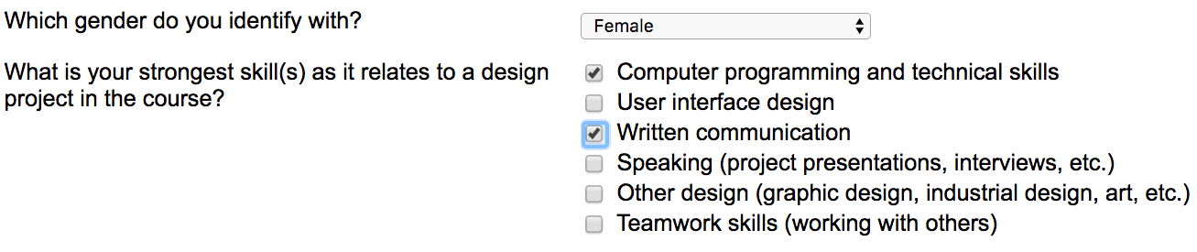
Example Algorithmic Workflow
Select criteria
Gather information from students

Slide 8
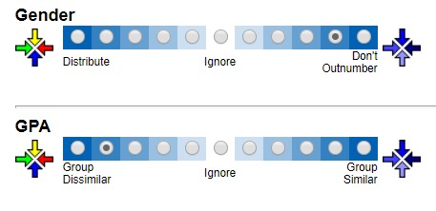
Example Algorithmic Workflow
Select criteria
Gather information from students
Configure weights

Slide 9
Example Algorithmic Workflow
Select criteria
Gather information from students
Configure weights
Form teams

Slide 10
Example Algorithmic Workflow
Select criteria
Gather information from students
Configure weights
Form teams
Notify students

Slide 11
The Problem
Instructor must prioritize large collection of criteria available in the tool with little guidance (Jahanbakhsh et al. 2017)
Could consult literature
Does not cover all possible combinations
May not align with preferences of learners
Notes:
E.g., CATME has 27^11 possible configurations just for default criteria
Easy to make a mistake that could negatively impact the students
those with the most at stake in the process

Slide 12
Alternative Approach
Gather student preferences
Increasing student agency and ownership can improve learning outcomes (e.g., Chan et al. 2014, Conley & French 2014, Horwitz et al. 2009, Mello 1993)
Open questions:
Which criteria do students prioritize?
To what degree to student agree with each other and the literature?
How do students perceive taking ownership?
What impact does using student configuration have on team outcomes?

Slide 13
Outline
Effects of team-building and composition
(CSCW 2018)
LIFT workflow and extensions
(CHI 2020, IJPHM 2021, SIGCSE 2022)
Ongoing and future work
Notes:
Hope to address these issues in my work

Slide 14
Outline
Effects of team-building and composition
(CSCW 2018)
LIFT workflow and extensions
(CHI 2020, IJPHM 2021, SIGCSE 2022)
Ongoing and future work
Notes:
Start by taking a step back and looking at effectiveness of tools vs other methods. Lots of potential, but do they currently work? Also how can we support student teams formed using tools?

Slide 15

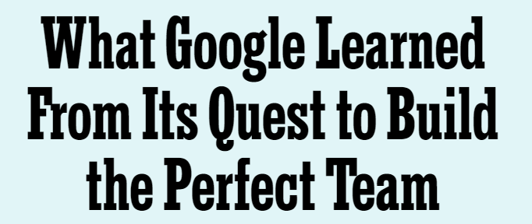
Team-Building
Nurture teamwork after the team is formed
Psychological safety: shared belief that the team is safe for interpersonal risk-taking (Edmondson 1999)
Recent article (Duhigg 2016) suggested that psychological safety contributes more to industry teams’ success than team composition does
Notes:
2nd approach focuses on nurturing team after has been formed. One attribute that can supported is PS…
An open question is do the results generalize to educational context? How best to allocate time/effort?

Slide 16
Research Questions
RQ1: How do composition strategies and team-building affect student team performance and team experience?
RQ2: To what degree do team-building and team composition strategies influence psychological safety for student teams?
RQ3: What is the relationship between psychological safety and team performance and experience?
Notes:
In this work, we combine these strands of research
Compare effects on outcomes, give better idea of how to allocate time
(We measure performance using team project grades, and team experience using surveys capturing perceived performance, satisfaction with team assignment, peer evaluations, cohesiveness, and conflict. )

Slide 17



Experimental Design
Team Formation Strategy
Criteria-based
Random
Task-focus
Activity Focus
Team-focus
Notes:
2x2 factorial design in two courses. Two factors were formation approach and activity focus. Will describe these in more detail in the next slides.
Repeated in 2 courses (UI Design and Software Engineering), n=304 students in total that incorporated semester long projects and had project deliverables throughout the course of the semester

Slide 18
Team Formation Strategy
Condition 1: Criteria-based
Condition 2: Random
Notes:
Some criteria used were gender, gpa, course skills.
For complete list, see paper
In order to keep students blind to condition, …
https://encrypted-tbn0.gstatic.com/images?q=tbn:ANd9GcRCsrgW3HWEdsyKcPXAKERUSdGJUTj8ry61tV7WB-tHsuVW4flj

Slide 19
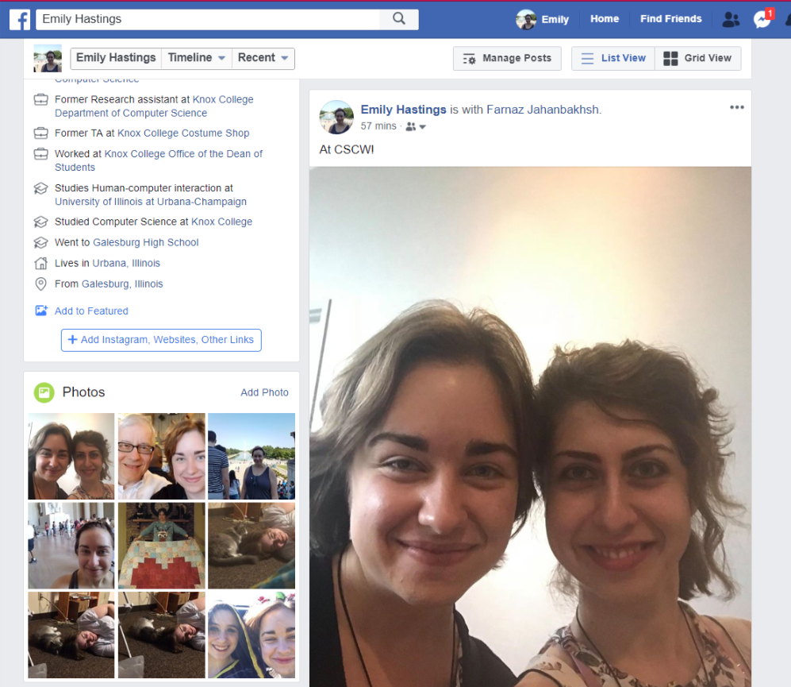

Team Focus Activities
Aimed at nurturing psychological safety within teams
Initial Activity
Midpoint Activity
Notes:
Activity I (beginning of teamwork): Sharing “About Me” page on social media and three recently posted photos with teammates
The purpose of this activity was to nurture interpersonal relationships, as improved relations have been shown to correlate with feelings of psychological safety within teams. By fostering an initial knowing of teammates and directing one’s focus towards others, we also wanted team members to begin to differentiate their respective behaviors, cognitions, and emotions and build connections with each other
Activity II (midpoint of project): Individual essay describing a few strengths of each of their teammates and a few of their own weaknesses
The purpose was to further nurture interpersonal relations and to foster respectful engagement. This activity is similar to the teamwork intervention in [45], in which teams were asked to discuss how to work well together.
https://www.clipartmax.com/middle/m2i8K9b1G6K9Z5Z5_why-social-media-is-important-for-your-business-social-media-marketing-clip/
http://clipart-library.com/clipart/488681.htm

Slide 20
Task Focus Activities
Emphasized producing an outcome, rather than team relationships
Fellowship of the Designers
4 + 2 = 7
Will Code For Money
Initial Activity
Midpoint Activity
Notes:
Activity I (beginning of teamwork): Brainstorming team names following principles of brainstorming
Activity II (midpoint of project): Individual essay describing how the project could be improved
The task-focused activities were designed to evoke mechanics of collaboration and communication (e.g., generating ideas, defining group processes, and reaching consensus), and emphasized producing an outcome (e.g., team name). In contrast, the team-focused activities were designed to evoke inter-personal communication between the members of a team rather than the mechanics of collaboration. For example, the kinds of interaction between members prompted by brainstorming a team name are much shallower and narrower than those experienced when sharing personal photos and mementos. These interactions are therefore likely to be less effective at building positive regard, and consequently psychological safety [9, 38]
https://mbtskoudsalg.com/images/whiteboard-clipart-4.jpg

Slide 21
Measures
Project Grades
Perceived Performance
Satisfaction with Team Assignment
Psychological Safety (Edmondson 1999)
Conflict (Jehn, Northcraft, & Neale 1999)
Cohesiveness (Carless & De Paola 2000)
Notes:
Validated instruments incorporated into CATME’s peer evaluation that students were required to fill out

Slide 22
RQ1: Effects of Composition and Activity on Outcomes
Outcome measures high
No significant differences by condition
Expectation Effect
Using multiple criteria does not necessarily stack benefits
Prior work may not be generalizable to our study context (incentive structures, project length, etc.)
Notes:
Grades, satisfaction, and perceived performance were high
However, there were no differences by condition and no interaction effects
Which means random teams performed as well as criteria-based teams, which is “not supposed to happen”
Context– authentic course settings
Stacking– alg prioritized some criteria at the expense of others

Slide 23
RQ2: Effects of Composition and Activity on Psych. Safety
High across conditions
No significant differences
Nature of courses helped psychological safety develop organically
Both activities helped develop interpersonal relationships
Notes:
Similarly high but no differences
Organically--- equally unfamiliar with topic, comfortable asking questions. Also met/interacted frequently

Slide 24
RQ3: Relation of Psychological Safety to Outcomes
Correlated with almost all subjective measures
No significant relation to project grades
Potential explanations:
Different context from prior literature
Potential for behaviors that negatively influence performance
Notes:
RQ3
Almost all-- (satisfaction, perceived perf, cohesiveness, conflict) (not peer evals p=0.02, threshold .01 after correction)
But no relation to grades-- finding contradicts results from Google article
Say nobody did PS on grades?
This difference in results could be due to the difference in context.
Risks: the consequences of risk-taking in student teams are generally less grave than in work teams, where members could be demoted or dismissed if they are perceived as not possessing the required competencies
Negative Behaviors: psych safety may conceivably put team members at ease to display certain behaviors that negatively influence their performance. For instance, team members can choose to perform less than their share of work if they do not fear retribution from teammates.
Prior work has suggested psych safety has the potential to promote negative behaviors.
We identified multiple students who reported high psychological safety but received low peer evaluation scores from their teammates, who cited a lack of contribution and a disregard for the norms of the group.

Slide 25
Implications
Using an algorithmic tool will not automatically improve team outcomes
Should not use team formation tools as black box to increase performance, but for other benefits
Can incorporate activities to offset initial unfamiliarity
Building psychological safety is important for team experience but won’t automatically improve performance
How might tools be improved?
Notes:
So the main takeaway message from this study is …
Other benefits of team formation tools: efficient, fair, and consistent team formation experiences
Initial unfamiliarity esp when teams are formed algorithmically
These results raise the question of how might tools be improved to possibly be more effective? Motivates rest of work

Slide 26
Outline
Effects of team-building and composition
(CSCW 2018)
LIFT workflow and extensions
(CHI 2020, IJPHM 2021, SIGCSE 2022)
Ongoing and future work

Slide 27
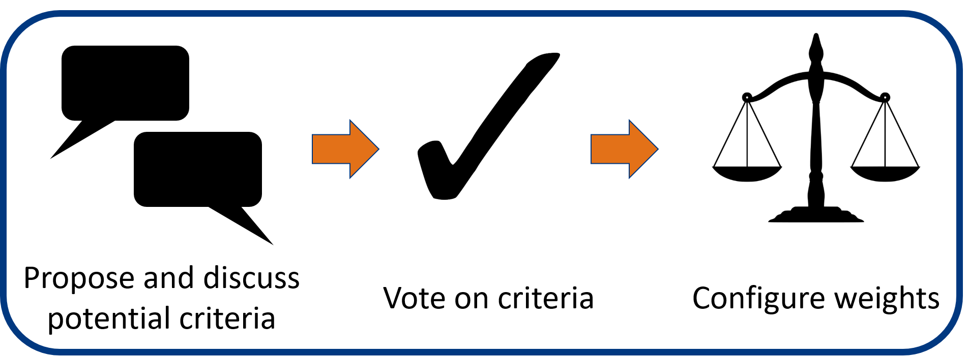
The LIFT Workflow
Notes:
Because of these potential benefits, developed LIFT-- learner involvement in forming teams
Explain
This approach is grounded in theories of crowdsourcing and collective intelligence, and inspired by prior successes of the use of crowdsourcing techniques in learning environments

Slide 28
Research Questions
RQ1: What team formation criteria do students select when given the chance? How do student and instructor choices differ?
RQ2: How do students perceive their agency when they are allowed to have input into the team formation process?
RQ3: How does allowing students to select criteria affect their team performance, satisfaction, and other course experiences compared to having instructors select criteria?
RQ4: How do instructors perceive transferring agency in the team formation process to students, and what do they learn about student preferences?
Notes:
Study aims to answer the following questions

Slide 29

Experimental Design
Mixed-methods between participants experiment (N=289)
Interviews with 18 students and 6 instructors
Condition 1: Learner (LIFT)
Condition 2: Instructor (Control)
Notes:
https://www.needpix.com/photo/download/667974/professor-class-free-pictures-free-photos-free-images-royalty-free-free-illustrations

Slide 30
Measures
Project Grades
Perceived Performance
Satisfaction with Team Assignment
Satisfaction with Team Formation Process
Recommendation to Repeat Approach
Perceived Agency
Importance of Input
Notes:
We had a number of dependent variables….
Wanted to measure effects on these variables/outcomes
Collected via post-survey

Slide 31
RQ1: Student Criteria Choices
75 criteria discussed in total, 48 (64%) newly-proposed
E.g., Organizational style
3 broad categories:
Team management (e.g., Leadership role, Teamwork experience)
Academics (e.g., GPA, Software skills)
Identity (e.g., Gender, Personality type)
Voting phase eliminated all less serious criteria
Most popular: scheduling, skills, work habits
Least popular: aspects of past and identity not under present control
Notes:
Invite to see the paper for more detail on the criteria and votes
Distribute skills, easier meetings
Favored criteria related to immediate topics that could help complete the project more conveniently
Voted against or disregarded gender, gpa, etc

Slide 32
RQ1: Instructor Criteria Choices
All instructor criteria selected from tool
Prioritized learning and long-term success over minimizing present conflict
“High achievers may need to be in teams with other high achievers so that they have this sort of conflict...[and] can work through a disagreement with another student. I think it is a wonderful opportunity for growth.” (I2)

Slide 33
RQ2: Student Perceptions of Agency
Students found it important to have a voice (median 6.0)
Median agency score in Learner condition was higher (median 5.0 vs 4.0), but not statistically significant (Wald χ2(1)=3.05, B= 0.77, p=0.08)
Possible explanation: participation vs. choice
Notes:
students in the Instructor condition participated in the process via the survey but did not have a choice in which criteria were on the survey, or how the criteria would be weighed

Slide 34
RQ2: Student Perceptions of Agency, cont.
Strengths:
LIFT can provide insight to instructors who are disconnected from the student team experience (S=10)
LIFT contributed to increased sense of ownership (S=5)
Weaknesses:
Students are not experts on what makes a good team (S=6)
Instructors more familiar with the course and what skills will be necessary (S=8)
Concerns of gaming (S=5)

Slide 35
RQ3: Effects of Criteria Selector on Outcomes
High across conditions
No significant effect of criteria selector
Potential explanation:
Specifics of criteria configuration may not be most important factor in outcomes

Slide 36
RQ4: Instructor Perceptions
Found student choices reasonable overall, including confirming personal doubts
Some doubts about irrelevant criteria, gaming concerns, excluding important criteria
Three instructors would adopt LIFT as-is, a fourth would integrate student criteria into his own configuration
Responsibility, motivation, sense of ownership
Remaining two instructors were reluctant to adopt due to key exclusions or large course sizes
Notes:
From the interviews

Slide 37
Implications
Possible to incorporate student input into algorithmic team formation without adversely affecting grades or team experiences
Alternatives to full LIFT workflow:
Adopt simplified version of LIFT for convenience
E.g., vote only on weights
Integrate student- and instructor-chosen criteria in a single configuration
Protect voices of minority students

Slide 38
Extensions
Exploration of applying LIFT in other contexts
NIST internship: manufacturing maintenance
Follow-up study: extension of LIFT inspired by Delphi method
Notes:
Did a few extensions of this work
This work was published at CHI 2020 and as my Master’s thesis, and a paper exploring how the LIFT workflow might be applied in other contexts (e.g., manufacturing) was published in IJPHM 2021. I am currently conducting a follow-up study investigating an extension of the LIFT workflow inspired by the Delphi method, where students discuss and vote on the weights to be used for the team formation criteria. A paper reporting initial results from this study (including a dataset showing 4 semesters of student preferences) was accepted at SIGCSE 2022.

Slide 39
Follow-up Study Research Questions
RQ1: What are the criteria and weights that are most valued by students for team formation, and why?
RQ2: Which criteria do students agree on the most and least?
RQ3: How does incorporating an online peer discussion impact student selections for the criteria weights?
RQ4: What do students learn from the team formation discussion and what are their experiences with the process overall?
Notes:
Had a series of research questions similar to the original LIFT study, basically want to investigate effectiveness of the lighter-weight approach where students vote on list of candidate criteria rather than proposing own, and look at trends over time since we have data from multiple semesters

Slide 40
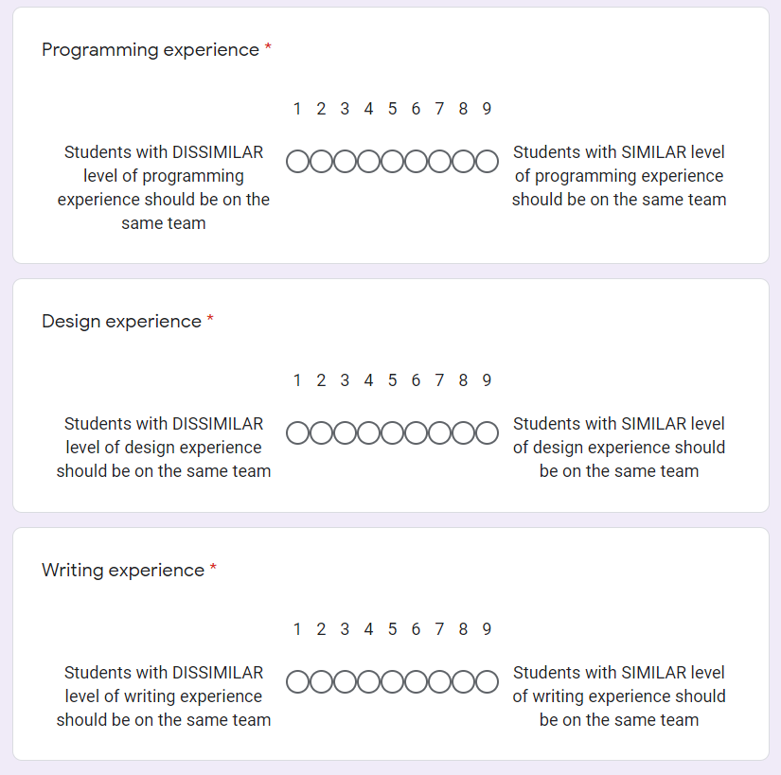
Workflow
Project-based UI design course
Students select weights for each of 13 candidate criteria via an online survey
Preferences aggregated to form final configuration entered into the tool
Notes:
To answer these questions, we followed a learner-centered workflow in 4 semesters of the same project-based UI design course, where…
Candidate criteria and how weights work was explained in a lecture, participation earned course credit

Slide 41
Workflow (SP21)
Project-based UI design course
Students select weights for each of 13 candidate criteria via an online survey
Preferences aggregated to form final configuration entered into the tool
Online peer discussion and opportunity to revise weight selections
Online Discussion
Vote on weights
Notes:
Additionally, in the most recent semester, students took part in an online discussion with their peers about their rationales for their weight selections, and had the opportunity over the course of the week-long activity to revise their selections based on what they learned from the discussion.

Slide 42
Measures
Student-generated weights for selected criteria (and agreement) over 4 semesters
Additional measures from SP21:
Overall perceptions of criteria voting activity (Likert-scale)
Student rationales from discussion (open coded)
What students learned from participating in activity
Notes:
\item \textbf{Criteria weights}: We collected criteria weights from four semesters of the UI Design class. For the most recent instance, we also summarize the rationales for the criteria weight provided by students in the discussion activity.
% \item \textbf{Learning about Team Formation}: Likert question and the open ended coding
% \item \textbf{Impact of Discussion}: changing weights survey likert and open coding questions. Count of student votes (how many times they changed, etc).
% \item Overall perceptions about the activity: weights represent their own preferences, weights will result in good team, able to effect weights, prefer instructor configure weights, tool will produce good teams given any weight, tool will produce good teams only with student approval, students were able to agree on weight
The first two authors of the paper performed open-coding on the student discussions and the open-ended responses from the Team Formation Experience Survey to identify major themes.

Slide 43
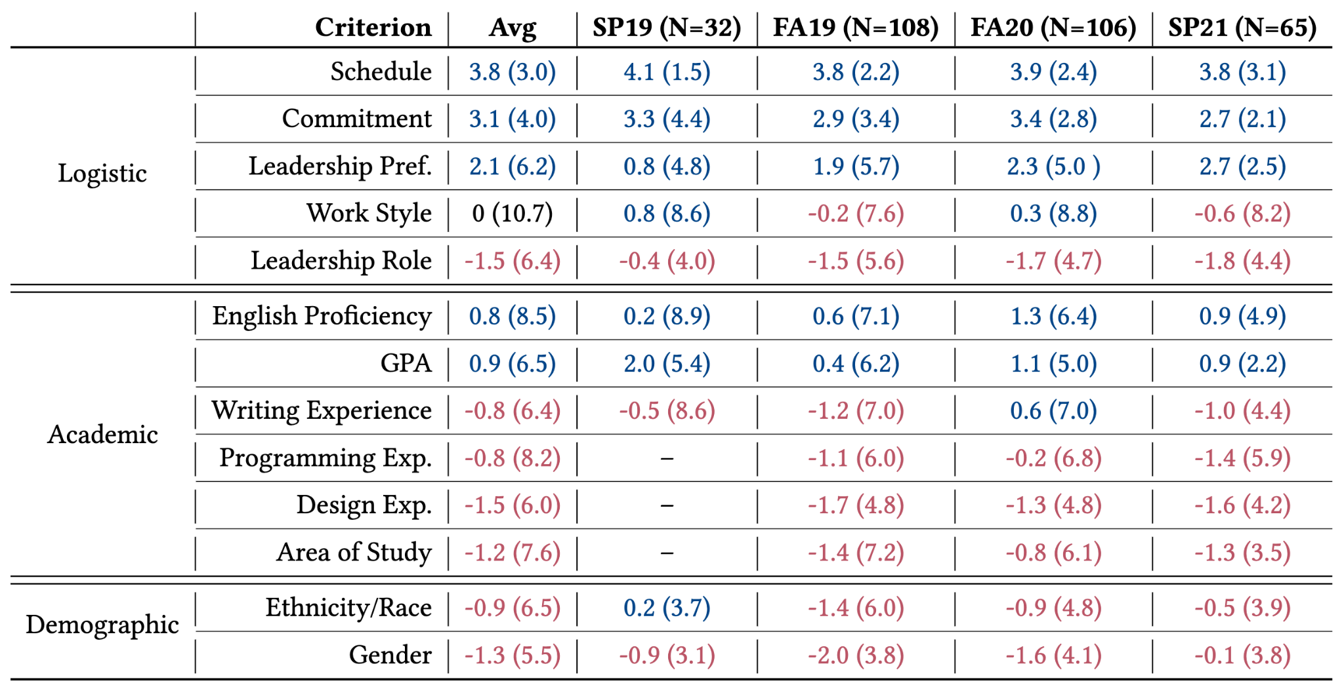
RQ1: Criteria and Weights Valued by Students
Each cell:
Mean (variance)
Scale:
-5 (dissimilar)
to 5 (similar)
Notes:
First look, explain the weights/notation, categories (roughly highest magnitude to least).
Table 1 in paper, invite to look there if interested. Will briefly explain most interesting takeaways.

Slide 44
RQ1: Criteria and Weights Valued by Students
Criterion | Avg (Var) | SP19 | FA19 | FA20 | SP21
Schedule | 3.8 (3.0) | 4.1 (1.5) | 3.8 (2.2) | 3.9 (2.4) | 3.8 (3.1)
Commitment | 3.1 (4.0) | 3.3 (4.4) | 2.9 (3.4) | 3.4 (3.4) | 2.7 (2.1)
“It's unfair to someone who is working really hard for the group to be paired with people who aren't going to do their jobs.”
(P42, Commitment)
Notes:
Consistent– schedule, commitment at the top
Interesting because not much research to our knowledge on commitment
“One of the hardest parts of working on a team project is finding a time that works for all group members … if we are in a group with similar availabilities/schedule, it will be easier to coordinate” (P38, Schedule)

Slide 45
RQ1: Criteria and Weights Valued by Students
Criterion | Avg (Var) | SP19 | FA19 | FA20 | SP21
Ethnicity/Race | -0.9 (6.5) | 0.2 (3.7) | -1.4 (6.0) | -0.9 (4.8) | -0.5 (3.9)
Gender | -1.3 (5.5) | -0.9 (3.1) | -2.0 (3.8) | -1.6 (4.1) | -0.1 (3.8)
"I do feel more comfortable having another woman to advocate with on a team … I don't think it should be an overbearing factor when there are other important criteria such as skills, schedules, and commitment, but it should definitely be considered whenever possible."
(P19, female, Gender)

Slide 46
RQ2: Agreement
Criterion | Avg (Var) | SP19 | FA19 | FA20 | SP21
Work Style | 0 (10.7) | 0.5 (8.6) | -0.2 (7.6) | 0.3 (8.8) | -0.6 (8.2)
English Proficiency | 0.8 (8.5) | 0.2 (8.9) | 0.6 (7.1) | 1.3 (6.4) | 0.9 (4.9)
GPA | 0.9 (6.5) | 2.0 (5.4) | 0.4 (6.2) | 1.1 (5.0) | 0.9 (2.2)
Programming Experience | -0.8 (8.2) | - | -1.1 (6.0) | -0.2 (6.8) | -1.4 (5.9)
Area of Study | -1.2 (7.6) | - | -1.4 (7.2) | -0.8 (6.1) | -1.3 (3.5)
“People with dissimilar programming experience should be grouped together to make the team more well-rounded.” (P25, Programming)
“If a student who excels at writing code [is assigned] to a group where most students don't have experience… then [that student] would end up doing all the coding.” (P3, Programming)
Notes:
These were the criteria with most disagreement. Talk more in the paper about potential reasons why, but:
Concerns about work distribution, relation to other criteria (might be redundant)
May benefit from more discussion (GPA and Area of study decreased in SP21)
I would have agreed with you, except that if students with severely dissimilar levels of experience get grouped together there ends up an uneven split of task delegation. As an example: imagine you and one other member are the only people on your team that can code well and everyone else can write perfect essays and can code a small amount. All coding parts of the project will therefore fall unto you and your partner. 1. How are you supposed to take criticize from your teammates when you know they are unable to see the inner workings of the app? 2. If all the coding tasks are assigned to a few individuals what will happen if they go MIA? 3. Does the distribution of writing all of the code or writing all of the papers seem equal to you? ( I know some of us to hate writing one or the other but how are you going to improve those skills if you hoist it on someone else?) Overall what I am trying to say is that you should imagine BOTH extremes and perhaps the median won't seem that bad. Having a team with an overall average similarity in skill would allow for fluid feedback, even distribution of tasks, and group growth in new skills. Recommended weight: 4-6
I actually think student should be assigned by similar programming experience. People with similar ability would work more harmoniously so the whole group would benefit. I am also worried that if a student who excels at writing code is distributed to a group where most students don't have experience with writing codes, then the student who is good at this would end up doing all the coding works and not getting a chance to do other things.
I agree that people with dissimilar programming experience should be grouped together to make the team more well-rounded. A weight of 3 sounds reasonable.

Slide 47
RQ2: Agreement
Criterion | Avg (Var) | SP19 | FA19 | FA20 | SP21
Work Style | 0 (10.7) | 0.5 (8.6) | -0.2 (7.6) | 0.3 (8.8) | -0.6 (8.2)
English Proficiency | 0.8 (8.5) | 0.2 (8.9) | 0.6 (7.1) | 1.3 (6.4) | 0.9 (4.9)
GPA | 0.9 (6.5) | 2.0 (5.4) | 0.4 (6.2) | 1.1 (5.0) | 0.9 (2.2)
Programming Experience | -0.8 (8.2) | - | -1.1 (6.0) | -0.2 (6.8) | -1.4 (5.9)
Area of Study | -1.2 (7.6) | - | -1.4 (7.2) | -0.8 (6.1) | -1.3 (3.5)
More agreement (lower variance) than previous terms
Notes:
These were the criteria with most disagreement. Talk more in the paper about potential reasons why, but:
Concerns about work distribution, relation to other criteria (might be redundant)
May benefit from more discussion (GPA and Area of study decreased in SP21)
I would have agreed with you, except that if students with severely dissimilar levels of experience get grouped together there ends up an uneven split of task delegation. As an example: imagine you and one other member are the only people on your team that can code well and everyone else can write perfect essays and can code a small amount. All coding parts of the project will therefore fall unto you and your partner. 1. How are you supposed to take criticize from your teammates when you know they are unable to see the inner workings of the app? 2. If all the coding tasks are assigned to a few individuals what will happen if they go MIA? 3. Does the distribution of writing all of the code or writing all of the papers seem equal to you? ( I know some of us to hate writing one or the other but how are you going to improve those skills if you hoist it on someone else?) Overall what I am trying to say is that you should imagine BOTH extremes and perhaps the median won't seem that bad. Having a team with an overall average similarity in skill would allow for fluid feedback, even distribution of tasks, and group growth in new skills. Recommended weight: 4-6
I actually think student should be assigned by similar programming experience. People with similar ability would work more harmoniously so the whole group would benefit. I am also worried that if a student who excels at writing code is distributed to a group where most students don't have experience with writing codes, then the student who is good at this would end up doing all the coding works and not getting a chance to do other things.
I agree that people with dissimilar programming experience should be grouped together to make the team more well-rounded. A weight of 3 sounds reasonable.

Slide 48
RQ3: Impact of Discussion
24 students changed their configuration, sometimes more than once
Rationales for (not) changing vote:
Gained new perspectives from the discussion (N=29)
Personal reflection (N=10)
Independent research (N=2)
Original opinion was reinforced by the discussion (N=4)
Notes:
Looking more specifically at how the discussion impacted selections…
2 members of research team performed open coding on survey items

Slide 49
RQ4: Learning about Team Formation
Thought about what makes a good team (M=6 on scale from 1 to 7)
Explanations:
Learned new perspectives from discussion (N=24)
Reflected on personal values for teamwork (N=23)
Thought about how to be a better team member (N=15)
Notes:
Likert item
Again open coding Survey item– what they thought about or learned from participating in the activity

Slide 50
What should you do?
Utilize the dataset as a starting point or employ workflow
Students benefit from the discussion
Actively review aggregated student votes
Consider different voting and aggregation methods
Students: advocate for yourselves!
Notes:
Consistent over time, so instructors can use our data as a starting point for their configurations for project-based design course or employ workflow in own.
Regardless, recommend including a discussion because students benefit and in some cases, improved consensus
However, also suggest to actively review the aggregated student votes based on their knowledge/experience. Students may not always know what’s best/most applicable for the course, may conflict with literature.
Especially important for the criteria that will mostly affect the students typically under-represented in computing courses (e.g., the impact of Gender on women and the impact of Ethnicity / Race on students of color). In these cases, the instructor may need to revise the configuration to reflect the opinions of these students or discuss with these students directly which types of teams they might be most compatible with and then tweak the tool's output.
For students, bring to instructor attention, advocate

Slide 51
Outline
Effects of team-building and composition
(CSCW 2018)
LIFT workflow and extensions
(CHI 2020, IJPHM 2021, SIGCSE 2022)
Ongoing and future work
Notes:
Getting close to the end of my time, so I want to talk briefly about a few ongoing and upcoming projects

Slide 52
Ongoing and Near Future Work
Continue Delphi study (ongoing)
2 additional semesters of data with modified staged workflow
Instructor survey and interviews (ongoing)
Current instructor goals and practices with and without tools
Opportunities for further improvements to tools
New ways of representing algorithmic inputs and outputs (future)
Currently numeric, don’t match instructor mental models

Slide 53
Future Vision: Data-Driven Teamwork Lifecycle
Evidence-based skill assessment (e.g., prior course assignments, quizzes)
Addresses current tools’ reliance on self-reported data of uncertain quality
Gaming, difficulties with self-assessment
Teamwork profiles
History of team compositions, outcomes, peer evaluations, etc.
Can help identify learning opportunities for students (e.g,, which kinds of teams would be helpful to work on before graduating)
Curate to show to potential employers
Data mining/ML possibilities
Generalize to different contexts
Notes:
See opportunities for undergrad research
Current tools often rely on self-reported data of uncertain quality, which leaves opportunities for gaming behavior if potential team members do not accurately describe their skills or other characteristics. Even for those intending to answer truthfully, self-assessments are notoriously difficult and subject to bias Alamri, A. A., & Bailey, B. P. (2018). Examination of the effectiveness of a criteria-based team formation tool. 2018 IEEE Frontiers in Education Conference (FIE), 1–5.

Slide 54
Discussion and Implications
Little consensus on which/how many criteria to use, weights
Many instructors using large combinations that may not agree with literature
Input from students is one way to help make decisions
Can incorporate student priorities without negatively affecting outcomes
Generally prefer schedule, commitment, etc.
Instructors might still include gender, race/ethnicity, etc. to benefit students underrepresented in their area
Tool designers could incorporate features for gathering student input and facilitating knowledge sharing
Notes:
Want to close with a short discussion of overall implications

Slide 55
Extra Slides
Notes:
Extra slides for questions

Slide 56
Contributions
Empirical results comparing how algorithmic team formation, team building activities, and psychological safety impact team outcomes in learning environments.
Workflow that allows students the opportunity to think and learn more deeply about team formation and reach a consensus with their classmates about the weights assigned to the criteria used by the algorithm.
Longitudinal dataset instructors can use as a starting point for configuring a team formation tool in their own project-based design courses.
Contact: Emily Hastings (ehstngs2@illinois.edu)
Notes:
In conclusion, my research advances knowledge of how to design algorithmic team formation tools to be more supportive of the instructors configuring them and more inclusive of learner voices. It has the following contributions:
Empirical results comparing how algorithmic team formation, team building activities, and psychological safety impact team performance and satisfaction in authentic learning environments. I also provide two team-focused activities and two task-focused activities instructors can deploy in their courses to help teams formed algorithmically gel together and develop psychological safety.
A novel learnersourcing workflow for determining the criteria and weights used to configure algorithmic team formation tools. This study showed that the LIFT workflow can be used without negatively impacting student learning experiences or outcomes, and provided key insights into the kinds of criteria students prefer to be used for forming teams.
With these techniques, I hope to provide students and instructors additional support and opportunities for input during the algorithmic team formation process, which may in turn help students learn more effectively from each other, produce more effective project solutions, and have more favorable attitudes toward teamwork.
Thank you all for your time. I welcome any questions.

Slide 57
Psych. Safety

Slide 58
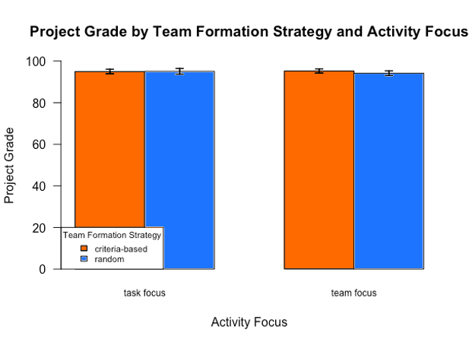
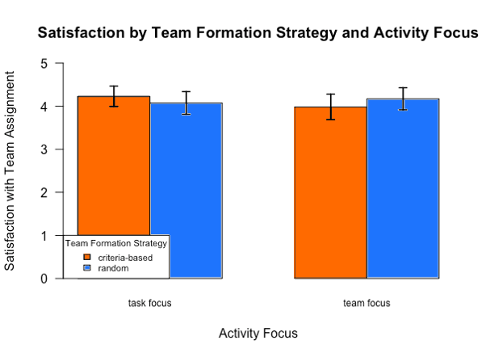
RQ1: Effects of Composition and Activity on Outcomes
Notes:
RQ1– maybe remove graphs and combine?
Grades, satisfaction, and perceived performance were high
However, there were no differences by condition and no interaction effects
Which means random teams performed as well as criteria-based teams, which is “not supposed to happen”
New graph showing selection of measures for each condition

Slide 59
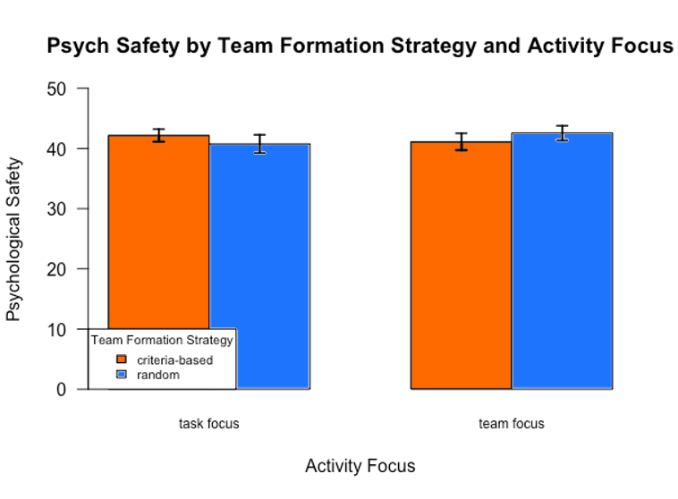
RQ2: Effects of Composition and Activity on Psych. Safety
Notes:
To answer the 2nd question about the effects of our interventions on psych safety
Similarly, it was high, but no differences…
New graph by condition

Slide 60
Statistical Analysis
Developing linear mixed effect models of the form: Outcome variable ~ composition * activity focus + (1| class) + (1| team)
Performing a Wald-Chi Square test on the fitted model

Slide 61
Additional Analyses
Examining the “goodness” scores given by the tool to randomly assigned teams vs those formed by the tool
Criteria-based teams scored higher on gender (t(34.18)=3.14, p<0.01), commitment levels (t(34.89)=3.45, p<0.01), and skillsets (t(33.18)=4.96, p<0.01)
Random teams had higher variation
Hand examined skillsets

Slide 62
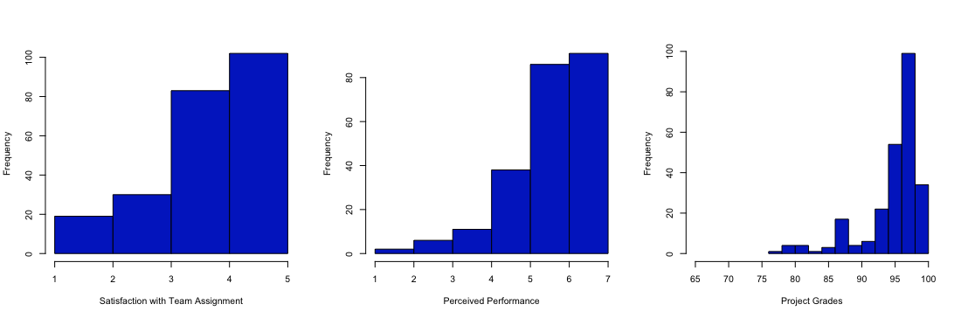
Distributions

Slide 63
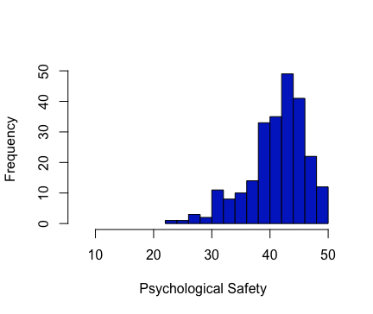
Distributions

Slide 64
LIFT

Slide 65
Quotes
“Was GPA on? See, GPA is not even on there! Gosh, see that! The students are smarter than me… See, I guess I wish [I had] heard or learned this earlier.” (I2)
“That's a hard question... there's a lot of literature on gender and achievements and race, like we should really pay attention to that, but then again I don't know. I'm not the students, and I don't know what their biases are, if they have biases... all I know is literature so... I don't know. I don't know if I trust that much that they know themselves so well.” (I3)

Slide 66
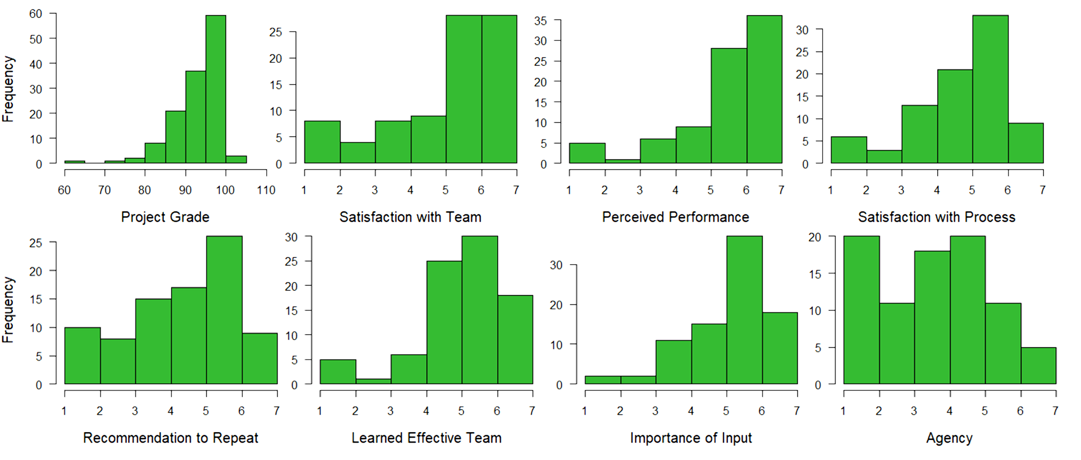

Slide 67
