Slide 1

A Learner-Centered Technique for Collectively Configuring Inputs for an Algorithmic Team Formation Tool
Emily M. Hastings, Sneha R. Krishna Kumaran,
Karrie Karahalios, Brian P. Bailey
Notes:
Many of you have worked on a team project before. For the instructors, many of you have probably done team-based activities in your courses, and you may have even used algorithmic team formation tools to help make this process more efficient or easier.
Provide insight on how you could give students more of a voice when using algorithmic team formation tools in your courses

Slide 2

Team Formation Matters
Teamwork is a foundational skill and integral in computing courses (e.g., Coleman & Lang 2012; Latulipe, Long, & Seminario 2015)
Instructors must determine how to best form teams from increasingly large and diverse pool of students
Notes:
https://www.pngplay.com/image/161334
Composition can have impact on team outcomes
For example, in the course where we conducted the study in this paper (which I’ve TA’d in the past), we typically have ~100 students from computer science and other areas like design, advertising

Slide 3




Criteria-based Team Formation
Strategically select team members to achieve certain compositions
Skill diversity (e.g., Brickell et al. 1994, Horwitz and Horwitz 2007)
Balanced personality types (e.g., Lykourentzou et al. 2016)
Balanced genders (e.g., Jehn, Northcraft, and Neale 1999)
Many more
Notes:
Algorithmic team formation tools help implement this approach

Slide 4

Example Algorithmic Workflow
Select criteria
Notes:
Instructors select the criteria

Slide 5
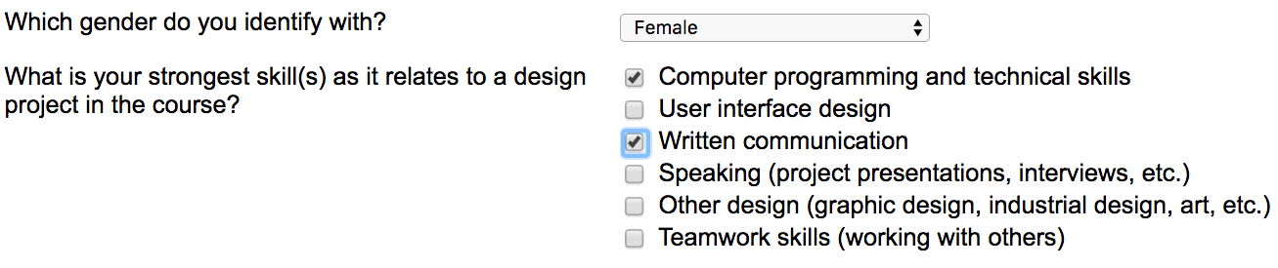
Example Algorithmic Workflow
Select criteria
Gather information from students

Slide 6
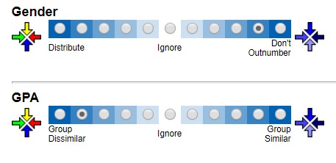
Example Algorithmic Workflow
Select criteria
Gather information from students
Configure weights

Slide 7
Example Algorithmic Workflow
Select criteria
Gather information from students
Configure weights
Form teams

Slide 8
Example Algorithmic Workflow
Select criteria
Gather information from students
Configure weights
Form teams
Notify students

Slide 9
The Problem
Instructor must prioritize large collection of criteria available in the tool with little guidance (Jahanbakhsh et al. 2017)
Could consult literature
Does not cover all possible combinations
May not align with preferences of learners (Hastings et al. 2020)
Notes:
E.g., CATME has 27^11 possible configurations just for default criteria
Easy to make a mistake that could negatively impact the students
those with the most at stake in the process

Slide 10
Alternative Approach
Gather student preferences
Increasing student agency and ownership can improve learning outcomes (e.g., Chan et al. 2014, Conley & French 2014, Horwitz et al. 2009, Mello 1993)
Open questions:
Which criteria do students prioritize?
To what degree to student agree with each other and the literature?
How do students perceive taking ownership?

Slide 11
Research Questions
RQ1: What are the criteria and weights that are most valued by students for team formation, and why?
RQ2: Which criteria do students agree on the most and least?
RQ3: How does incorporating an online peer discussion impact student selections for the criteria weights?
RQ4: What do students learn from the team formation discussion and what are their experiences with the process overall?
Notes:
More specifically, our RQs are…

Slide 12
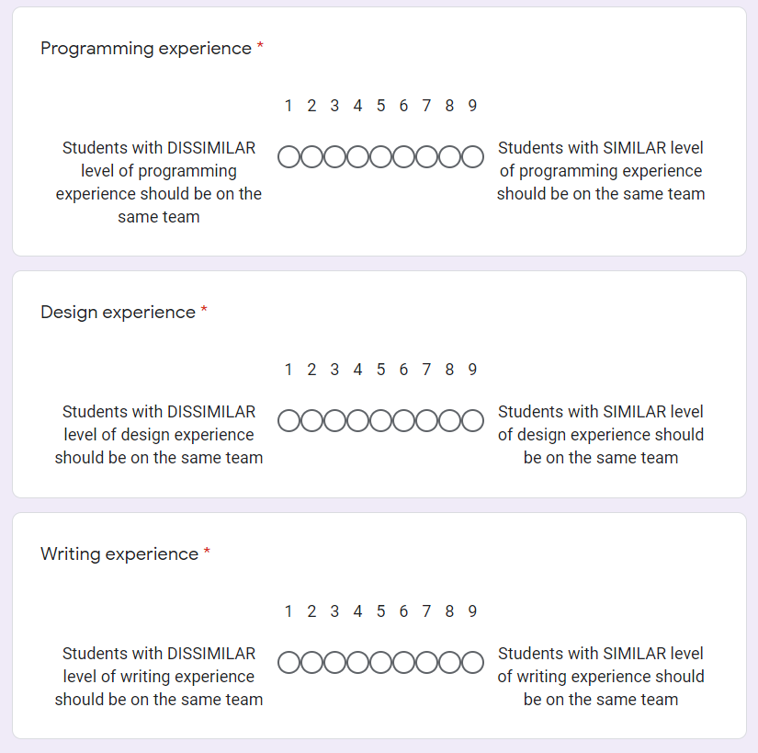
Workflow
Project-based UI design course
Students select weights for each of 13 candidate criteria via an online survey
Preferences aggregated to form final configuration entered into the tool
Notes:
To answer these questions, we followed a learner-centered workflow in 4 semesters of the same project-based UI design course, where…
Candidate criteria and how weights work was explained in a lecture, participation earned course credit

Slide 13
Workflow (SP21)
Project-based UI design course
Students select weights for each of 13 candidate criteria via an online survey
Preferences aggregated to form final configuration entered into the tool
Online peer discussion and opportunity to revise weight selections
Online Discussion
Vote on weights
Notes:
Additionally, in the most recent semester, students took part in an online discussion with their peers about their rationales for their weight selections, and had the opportunity over the course of the week-long activity to revise their selections based on what they learned from the discussion.

Slide 14
Measures
Student-generated weights for selected criteria (and agreement) over 4 semesters
Additional measures from SP21:
Overall perceptions of criteria voting activity (Likert-scale)
Student rationales from discussion (open coded)
What students learned from participating in activity
Notes:
\item \textbf{Criteria weights}: We collected criteria weights from four semesters of the UI Design class. For the most recent instance, we also summarize the rationales for the criteria weight provided by students in the discussion activity.
% \item \textbf{Learning about Team Formation}: Likert question and the open ended coding
% \item \textbf{Impact of Discussion}: changing weights survey likert and open coding questions. Count of student votes (how many times they changed, etc).
% \item Overall perceptions about the activity: weights represent their own preferences, weights will result in good team, able to effect weights, prefer instructor configure weights, tool will produce good teams given any weight, tool will produce good teams only with student approval, students were able to agree on weight
The first two authors of the paper performed open-coding on the student discussions and the open-ended responses from the Team Formation Experience Survey to identify major themes.

Slide 15
Results

Slide 16
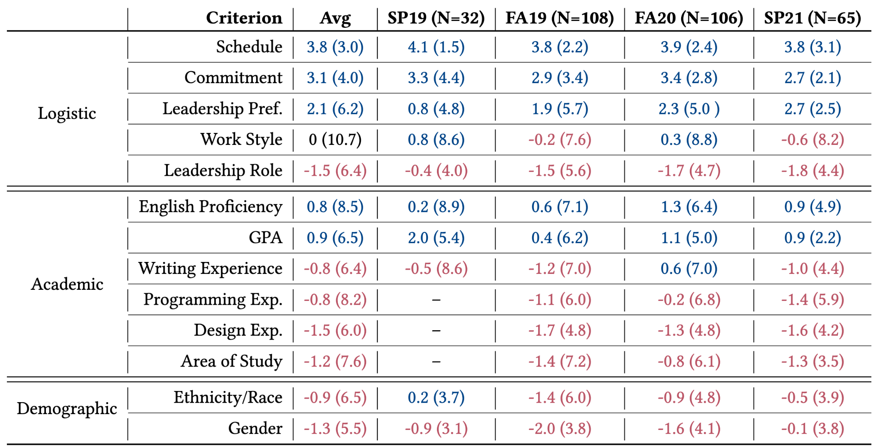
RQ1: Criteria and Weights Valued by Students
Each cell:
Mean (variance)
Scale:
-5 (dissimilar)
to 5 (similar)
Notes:
First look, explain the weights/notation, categories (roughly highest magnitude to least).
Table 1 in paper, invite to look there if interested. Will briefly explain most interesting takeaways.

Slide 17
RQ1: Criteria and Weights Valued by Students
Criterion | Avg (Var) | SP19 | FA19 | FA20 | SP21
Schedule | 3.8 (3.0) | 4.1 (1.5) | 3.8 (2.2) | 3.9 (2.4) | 3.8 (3.1)
Commitment | 3.1 (4.0) | 3.3 (4.4) | 2.9 (3.4) | 3.4 (3.4) | 2.7 (2.1)
“It's unfair to someone who is working really hard for the group to be paired with people who aren't going to do their jobs.”
(P42, Commitment)
Notes:
Consistent– schedule, commitment at the top
Interesting because not much research to our knowledge on commitment
“One of the hardest parts of working on a team project is finding a time that works for all group members … if we are in a group with similar availabilities/schedule, it will be easier to coordinate” (P38, Schedule)

Slide 18
RQ1: Criteria and Weights Valued by Students
Criterion | Avg (Var) | SP19 | FA19 | FA20 | SP21
Ethnicity/Race | -0.9 (6.5) | 0.2 (3.7) | -1.4 (6.0) | -0.9 (4.8) | -0.5 (3.9)
Gender | -1.3 (5.5) | -0.9 (3.1) | -2.0 (3.8) | -1.6 (4.1) | -0.1 (3.8)
"I do feel more comfortable having another woman to advocate with on a team … I don't think it should be an overbearing factor when there are other important criteria such as skills, schedules, and commitment, but it should definitely be considered whenever possible."
(P19, female, Gender)

Slide 19
RQ2: Agreement
Criterion | Avg (Var) | SP19 | FA19 | FA20 | SP21
Work Style | 0 (10.7) | 0.5 (8.6) | -0.2 (7.6) | 0.3 (8.8) | -0.6 (8.2)
English Proficiency | 0.8 (8.5) | 0.2 (8.9) | 0.6 (7.1) | 1.3 (6.4) | 0.9 (4.9)
GPA | 0.9 (6.5) | 2.0 (5.4) | 0.4 (6.2) | 1.1 (5.0) | 0.9 (2.2)
Programming Experience | -0.8 (8.2) | - | -1.1 (6.0) | -0.2 (6.8) | -1.4 (5.9)
Area of Study | -1.2 (7.6) | - | -1.4 (7.2) | -0.8 (6.1) | -1.3 (3.5)
“People with dissimilar programming experience should be grouped together to make the team more well-rounded.” (P25, Programming)
“If a student who excels at writing code [is assigned] to a group where most students don't have experience… then [that student] would end up doing all the coding.” (P3, Programming)
Notes:
These were the criteria with most disagreement. Talk more in the paper about potential reasons why, but:
Concerns about work distribution, relation to other criteria (might be redundant)
May benefit from more discussion (GPA and Area of study decreased in SP21)
I would have agreed with you, except that if students with severely dissimilar levels of experience get grouped together there ends up an uneven split of task delegation. As an example: imagine you and one other member are the only people on your team that can code well and everyone else can write perfect essays and can code a small amount. All coding parts of the project will therefore fall unto you and your partner. 1. How are you supposed to take criticize from your teammates when you know they are unable to see the inner workings of the app? 2. If all the coding tasks are assigned to a few individuals what will happen if they go MIA? 3. Does the distribution of writing all of the code or writing all of the papers seem equal to you? ( I know some of us to hate writing one or the other but how are you going to improve those skills if you hoist it on someone else?) Overall what I am trying to say is that you should imagine BOTH extremes and perhaps the median won't seem that bad. Having a team with an overall average similarity in skill would allow for fluid feedback, even distribution of tasks, and group growth in new skills. Recommended weight: 4-6
I actually think student should be assigned by similar programming experience. People with similar ability would work more harmoniously so the whole group would benefit. I am also worried that if a student who excels at writing code is distributed to a group where most students don't have experience with writing codes, then the student who is good at this would end up doing all the coding works and not getting a chance to do other things.
I agree that people with dissimilar programming experience should be grouped together to make the team more well-rounded. A weight of 3 sounds reasonable.

Slide 20
RQ2: Agreement
Criterion | Avg (Var) | SP19 | FA19 | FA20 | SP21
Work Style | 0 (10.7) | 0.5 (8.6) | -0.2 (7.6) | 0.3 (8.8) | -0.6 (8.2)
English Proficiency | 0.8 (8.5) | 0.2 (8.9) | 0.6 (7.1) | 1.3 (6.4) | 0.9 (4.9)
GPA | 0.9 (6.5) | 2.0 (5.4) | 0.4 (6.2) | 1.1 (5.0) | 0.9 (2.2)
Programming Experience | -0.8 (8.2) | - | -1.1 (6.0) | -0.2 (6.8) | -1.4 (5.9)
Area of Study | -1.2 (7.6) | - | -1.4 (7.2) | -0.8 (6.1) | -1.3 (3.5)
More agreement (lower variance) than previous terms
Notes:
These were the criteria with most disagreement. Talk more in the paper about potential reasons why, but:
Concerns about work distribution, relation to other criteria (might be redundant)
May benefit from more discussion (GPA and Area of study decreased in SP21)
I would have agreed with you, except that if students with severely dissimilar levels of experience get grouped together there ends up an uneven split of task delegation. As an example: imagine you and one other member are the only people on your team that can code well and everyone else can write perfect essays and can code a small amount. All coding parts of the project will therefore fall unto you and your partner. 1. How are you supposed to take criticize from your teammates when you know they are unable to see the inner workings of the app? 2. If all the coding tasks are assigned to a few individuals what will happen if they go MIA? 3. Does the distribution of writing all of the code or writing all of the papers seem equal to you? ( I know some of us to hate writing one or the other but how are you going to improve those skills if you hoist it on someone else?) Overall what I am trying to say is that you should imagine BOTH extremes and perhaps the median won't seem that bad. Having a team with an overall average similarity in skill would allow for fluid feedback, even distribution of tasks, and group growth in new skills. Recommended weight: 4-6
I actually think student should be assigned by similar programming experience. People with similar ability would work more harmoniously so the whole group would benefit. I am also worried that if a student who excels at writing code is distributed to a group where most students don't have experience with writing codes, then the student who is good at this would end up doing all the coding works and not getting a chance to do other things.
I agree that people with dissimilar programming experience should be grouped together to make the team more well-rounded. A weight of 3 sounds reasonable.

Slide 21
RQ3: Impact of Discussion
264 posts total
Most frequently discussed was Programming Experience
Least frequently discussed was Work Style
Notes:
Todo figure as hidden slide for conf, add here?
Programming: as mentioned, was one with least agreement, supports that
Work style: least frequently discussed, least vote changes

Slide 22
RQ3: Impact of Discussion
24 students changed their configuration, sometimes more than once
Rationales for (not) changing vote:
Gained new perspectives from the discussion (N=29)
Personal reflection (N=10)
Independent research (N=2)
Original opinion was reinforced by the discussion (N=4)
Notes:
Looking more specifically at how the discussion impacted selections…
2 members of research team performed open coding on survey items

Slide 23
RQ4: Learning about Team Formation
Thought about what makes a good team (M=6 on scale from 1 to 7)
Explanations:
Learned new perspectives from discussion (N=24)
Reflected on personal values for teamwork (N=23)
Thought about how to be a better team member (N=15)
Notes:
Likert item
Again open coding Survey item– what they thought about or learned from participating in the activity

Slide 24
What should you do?
Utilize the dataset as a starting point or employ workflow
Students benefit from the discussion
Actively review aggregated student votes
Consider different voting and aggregation methods
Students: advocate for yourselves!
Notes:
Consistent over time, so instructors can use our data as a starting point for their configurations for project-based design course or employ workflow in own.
Regardless, recommend including a discussion because students benefit and in some cases, improved consensus
However, also suggest to actively review the aggregated student votes based on their knowledge/experience. Students may not always know what’s best/most applicable for the course, may conflict with literature.
Especially important for the criteria that will mostly affect the students typically under-represented in computing courses (e.g., the impact of Gender on women and the impact of Ethnicity / Race on students of color). In these cases, the instructor may need to revise the configuration to reflect the opinions of these students or discuss with these students directly which types of teams they might be most compatible with and then tweak the tool's output.
For students, bring to instructor attention, advocate

Slide 25
Implications for Research Community
More studies needed about effectiveness of criteria students prefer (e..g, Commitment)
Notes:
Maybe cut for time?? This audience may care more about the instructor part?
Cut “gender/race– think about fairness vs comfort of minority groups”-- not sure how to distinguish between this and previous slide, may not have time

Slide 26
Limitations
Pandemic
Context of specific course
Lack of discrete stages
Measures only at beginning of course
Notes:
Include?-- think there won’t be time

Slide 27
Contributions
Longitudinal dataset instructors can use as a starting point for configuring a team formation tool in their own project-based design courses.
Workflow that allows students the opportunity to think and learn more deeply about team formation and reach a consensus with their classmates about the weights assigned to the criteria used by the algorithm.
Implications for instructors wishing to implement a similar workflow for gathering student input for team formation in their courses.
Contact: Emily Hastings (ehstngs2@illinois.edu)
Thank you!
Notes:
In conclusion, this work contributed….
Researchers can also use the dataset to motivate future experiments to test how the criteria preferred by students impact team effectiveness compared to the criteria reported in the literature.
Instructors can replicate our workflow to gather student preferences for team formation in any course.
For example, we suggest which criteria instructors should ask students to discuss with each other and which criteria instructors could prioritize on their own. We also discuss a few situations where an instructor might intervene to revise the students' choices or the tool's output.

