Slide 1
Repetition with Loops
for & range

Slide 2
The 7 “Habits” of Highly Effective Programmers
Concept
Example from Math
Variables
Math & Logic
Input/Output (IO)
Conditionals
Loops
Functions
Lists
x = 5 hellothere = “howdy”
5 * 7 + a - 3 / b % 4 a is 5 AND x < 7 OR degree ≥ 98
print “Hello World”
if (x == f(x)) then print “x is 0 or 1” else print “x is not 0 or 1”
foreach x in (array) print x
f(x) = x²
array = 1:5 array = 1, 4, 7, 8, a, b, c, d
Notes:
In this assignment we'll investigate the 7 basic concepts in computer programming. Armed with an understanding of these 7 ideas, you could implement any program that's ever been written, in any programming language.
A little different from in the book
I/O often makes use of functions to implement
In using software, have you seen these ideas implemented in the past?

Slide 3
Why Loops? Who Needs Repetition?
Repetitive, frequent tasks:
Shoveling snow or raking leaves
Putting a case of beverages in the fridge one at a time
Waiting for an internet release time (tickets, books, iPhones)
Checking texts or status updates
code.org: moving a zombie painter
Folding socks

Slide 4
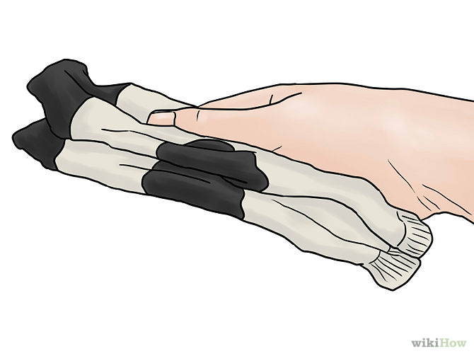
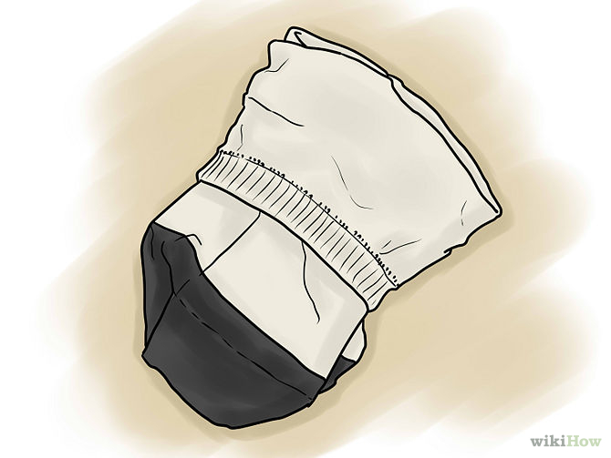
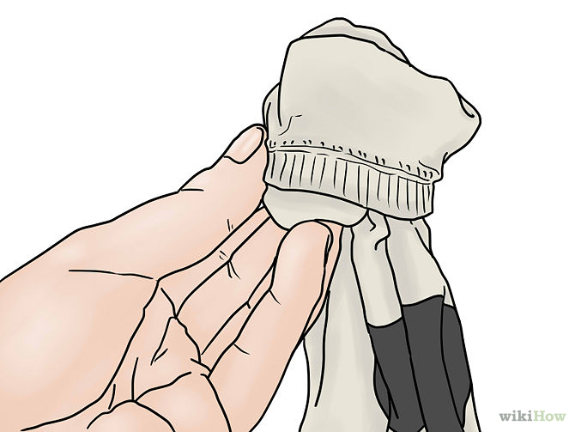
An Algorithm for Folding Socks
Loop!
While there are clean socks:
Select a sock from the pile
Find its match
Line the socks up
Fold one top over the other

Slide 5
Looping/Repetition
Fold a pair of socks
Repeat 10 times
Fold 10 pairs of socks
Fold a pair of socks

Slide 6
Looping/Repetition
Fold a pair of socks
for i in range(10):
Fold 10 pairs of socks
Fold a pair of socks

Slide 7
Definite For Loops
When we know how many times a loop will execute
Repeat N times
Loop variable
Keywords
Range generator
Loop header
for i in range(10):
Fold 10 pairs of socks
Fold a pair of socks
Loop body
Notes:
https://docs.python.org/3/library/functions.html#func-range

Slide 8
What goes in the loop body?
Repeat 10 times
Fold a pair of socks:
Select a sock from the pile
Find its match
Line the socks up
Fold one top over the other

Slide 9
for Loop Definition
When we know how many times a loop will execute
Repeat N times
Number of times to repeat (N)
for x in range(10):
statement_1 statement_2
…
statement_n
Body of for loop
Gets repeated
Note indentation

Slide 10
What does range do?
range generates a list of numbers
Can take up to 3 parameters:
range([start,] stop[, step])
inclusive [start, stop) exclusive
Examples:
range(2, 14, 2): 2, 4, 6, 8, 10, 12
range(8, -10, -3): 8, 5, 2, -1, -4, -7
range(-5, 15, -3): won’t generate anything!
Notes:
To do: animate better so can ask questions

Slide 11
Sequence generated by range
range(1, 15, 3):
-15
-10
-5
0
5
10
15
range(5, -15, -5):
-15
-10
-5
0
5
10
15
range_examples.py

Slide 12
Try it!

Slide 13
Practicing for Loops
Write the Python code to print the following:
A)
B)
1
2
3
4
5
C)
****
****
****
2
5
8
11
What is getting repeated?
How many times?

