Slide 1


Recursion
To understand recursion, you must first understand recursion
To seal: moisten flap, fold over, and seal
Recursive definitions: compiler: program that compiles
teacher: one who teaches

Slide 2
Thinking iteratively
factorial
def factorial(N):
product = 1
for i in range(2,N+1):
product *= i
return product
5 ! = 120
5 ! = 5 * 4 * 3 * 2 * 1
N ! = N * (N-1) * (N-2) * … * 3 * 2 * 1

Slide 3
Thinking recursively
def fac(N):
if N <= 1:
return 1
Base case

Slide 4
Thinking recursively
def fac(N):
if N <= 1:
return 1
else:
return N*fac(N-1)
Base case
Recursive case
Human: Base case and 1 step
Computer: Everything else

Slide 5
Thinking recursively
def fac(N):
if N <= 1:
return 1
else:
rest = fac(N-1)
return rest * N
Base case
Recursive case
(clearer, for some)
Human: Base case and 1 step
Computer: Everything else

Slide 6
def fac(N):
if N <= 1:
return 1
else:
return N * fac(N-1)
Behind the curtain…
fac(5)

Slide 7
def fac(N):
if N <= 1:
return 1
else:
return N * fac(N-1)
Behind the curtain…
fac(5)
5 * fac(4)

Slide 8
def fac(N):
if N <= 1:
return 1
else:
return N * fac(N-1)
Behind the curtain…
fac(5)
5 * fac(4)
4 * fac(3)
5 *
Operation waiting …

Slide 9
def fac(N):
if N <= 1:
return 1
else:
return N * fac(N-1)
Behind the curtain…
fac(5)
5 * fac(4)
4 * fac(3)
5 *
5 * 4 *
3 * fac(2)
More operations waiting…

Slide 10
def fac(N):
if N <= 1:
return 1
else:
return N * fac(N-1)
Behind the curtain…
fac(5)
5 * fac(4)
4 * fac(3)
5 *
5 * 4 *
3 * fac(2)
5 * 4 * 3 *
2 * fac(1)

Slide 11
def fac(N):
if N <= 1:
return 1
else:
return N * fac(N-1)
Behind the curtain…
fac(5)
N=5
"The Stack"
5 * fac(4)
N=4
4 * fac(3)
5 *
N=3
5 * 4 *
3 * fac(2)
N=2
Remembers all of the individual calls to fac
5 * 4 * 3 *
2 * fac(1)
N=1
5 different N's are living in memory…
5 * 4 * 3 * 2 *
1

Slide 12
def fac(N):
if N <= 1:
return 1
else:
return N * fac(N-1)
Behind the curtain…
fac(5)
5 * fac(4)
4 * fac(3)
5 *
5 * 4 *
3 * fac(2)
5 * 4 * 3 *
2 * 1

Slide 13
def fac(N):
if N <= 1:
return 1
else:
return N * fac(N-1)
Behind the curtain…
fac(5)
5 * fac(4)
4 * fac(3)
5 *
5 * 4 *
3 * 2

Slide 14
def fac(N):
if N <= 1:
return 1
else:
return N * fac(N-1)
Behind the curtain…
fac(5)
5 * fac(4)
4 * 6
5 *

Slide 15
def fac(N):
if N <= 1:
return 1
else:
return N * fac(N-1)
Behind the curtain…
fac(5)
5 * 24

Slide 16
def fac(N):
if N <= 1:
return 1
else:
return N * fac(N-1)
Behind the curtain…
fac(5)
Result: 120
factorial.py

Slide 17
Manual Walkthrough Table: factorial
Assume factorial(5) = 5! where
1! = 1
N! = N * (N-1)!
Method call Returns
factorial(5) 5 * factorial(4) =
factorial(4) 4 * factorial(3) =
factorial(3) 3 * factorial(2) =
factorial(2) 2 * factorial(1) =
factorial(1) 1
120
24
6
2

Slide 18
Let recursion do the work for you.
Exploit self-similarity
Less work !
Produce short, elegant code
You handle the base case – the easiest case!
def fac(N):
if N <= 1:
return 1
else:
rest = fac(N-1)
return rest * N
Recursion does almost all of the rest of the problem!
You specify one step at the end

Slide 19
But you do need to do one step yourself…
def fac(N):
if N <= 1:
return 1
else:
return fac(N)
This will not work !

Slide 20

Recursion's challenge?
You need to see BOTH the self-similar pieces AND the whole thing simultaneously!
Nature prefers recursion, too!

Slide 21
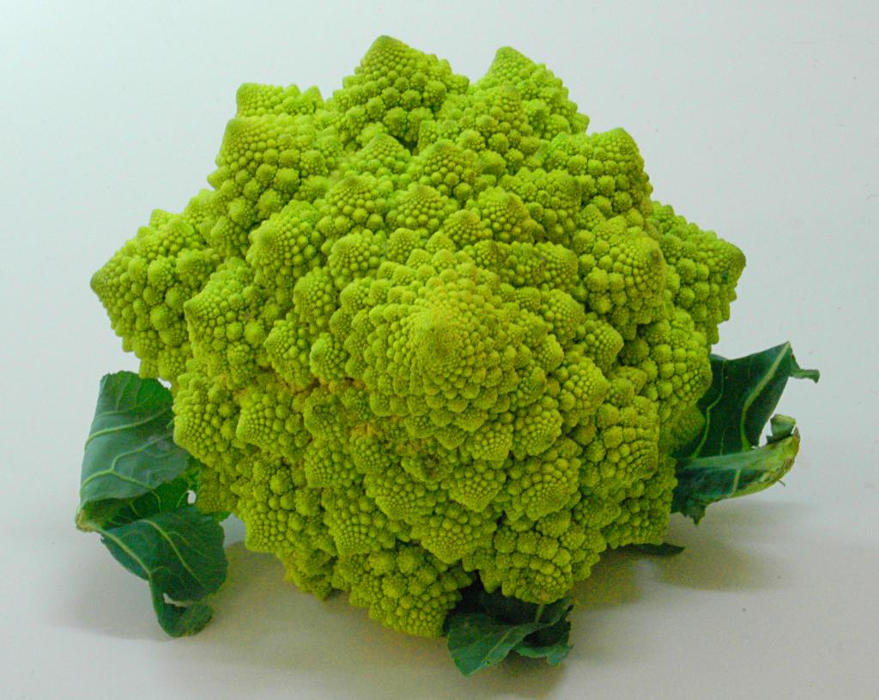

Slide 22
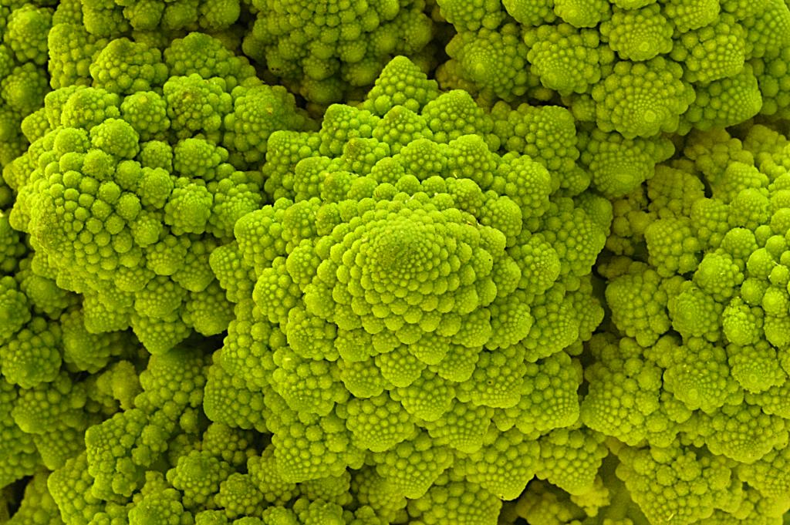
Are these rules for real?
Yes... and no.

Slide 23
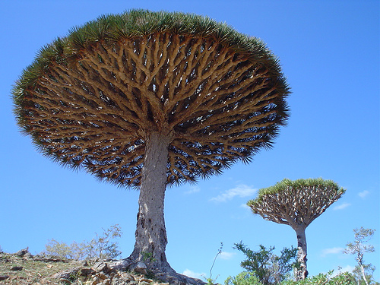

Dragon's-blood Tree

Slide 24

There still has to be a base case…

Slide 25
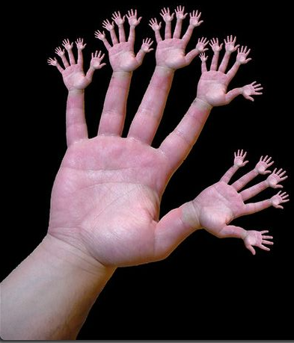
or else!

Slide 26
Warning: this is legal!
def fac(N):
return N * fac(N-1)
Notes:
Was that Gandalf or Dumbledore that "fell forever" ?

Slide 27
legal != recommended
def fac(N):
return N * fac(N-1)
The calls to fac will never stop: there's no BASE CASE!
Make sure you have a base case, then worry about the recursion...

Slide 28

This runs ~ but does not help!
def fac(N):
return fac(N)
Roadsigns and recursion
examples of self-fulfilling danger

Slide 29
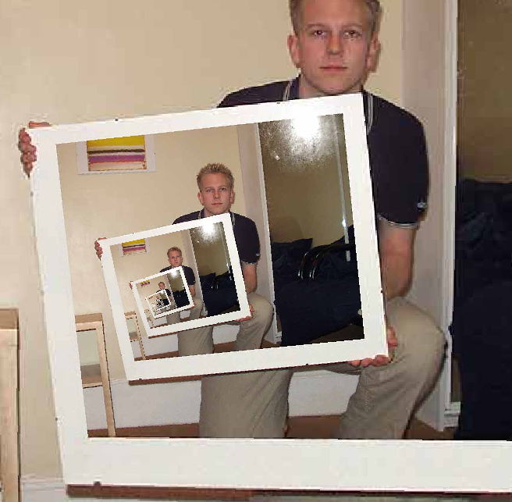
The dizzying dangers of having no base case!
Notes:
I don’t know if this really works...

Slide 30
Recursive design…
fun! easy!?
(1) Program the base case.
(2) Find the self-similarity.
cool!
(3) Do one step!
(4) Delegate the rest to recursion…
Aha!

Slide 31
A Tower of Fun!
Math
Python (Functional)
recursive function
2
2
tower(3) =
2
2
# recursive tower
def tower(n):
2
2
tower(4) =
2
tower(5) =
The tower function is taking recursion to new heights!
Notes:
2 clicks of animation on this slide.

Slide 32
A Tower of Fun!
Math
Python (Functional)
recursive function
2
2
tower(3) =
2
2
# recursive tower
def tower(n):
2
2
tower(4) =
2
2
2
2
2
tower(5) =
2
inductive definition:
inductive case:
tower(n) = 2^{tower(n-1)}
base case:
tower(0) = ?
Notes:
Now let them develop tower(n) from the inductive definition. Solution is on the next slide.

Slide 33
A Tower of Fun!
Math
Python (Functional)
recursive function
2
2
tower(3) =
2
2
# recursive tower
def tower(n):
'''Tower of n'''
if n == 0:
return 1
else:
return 2**tower(n-1)
2
2
tower(4) =
2
2
2
2
2
tower(5) =
2
inductive definition:
inductive case:
tower(n) = 2^{tower(n-1)}
base case:
tower(0) = 1
tower.py
Notes:
First animation is the base case; click to show full solution. If you have time, demo tower(1)-tower(5). Tower(4) is just 65536, but tower(5) has 19,729 digits! (Yet Python calculates it quickly. The same isn’t true for tower(6)…)

Slide 34
Recursion vs. iteration
Any recursive algorithm can be re-implemented as a loop instead
This is an “iterative” expression of the algorithm
Any loop can be implemented as recursion instead
Sometimes recursion is clearer and simpler
Mostly for data structures with a recursive structure
Sometimes iteration is clearer and simpler

Slide 35
Try it!
In other words:
sum(1) = 1
sum(n) = n + sum(n-1)
Write a function to sum 1 to N:
Recursively & Iteratively

Slide 36
sajak(s):
# of vowels in s
D
E
S
I
G
N
When there are no letters, there are ZERO vowels
Base case?
Rec. step?
Look at the initial character.
if s[0] is NOT a vowel, the answer is
sajak( s[1:] )
if s[0] is a vowel, the answer is
1 + sajak( s[1:] )

Slide 37
def sajak(s):
if s == '':
return 0
elif s[0]=='a' or s[0]=='e' or…
Base Case
Checking for a vowel: Try #1

Slide 38
def sajak(s):
if s == '':
return 0
elif s[0]=='a' or s[0]=='e' or…
Base Case
Checking for a vowel: Try #1

Slide 39
let's input 'sequoia' for s
Checking for a vowel: Try #2
def sajak(s):
if len(s) == 0:
return 0
elif s[0] in 'aeiou':
return 1 + sajak(s[1:])
else:
return 0 + sajak(s[1:])
Base Case
if s[0] IS a vowel, the answer is
1 + the # of vowels in the rest of s
Recursive Cases
if s[0] is NOT a vowel, the answer is just
the number of vowels in the rest of s

Slide 40
Can you write this using a loop?
sajak( 'eerier' )
1+ sajak( 'erier' )
1+ 1+ sajak( 'rier' )
1+ 1+ 0+ sajak( 'ier' )
1+ 1+ 0+ 1+ sajak( 'er' )
1+ 1+ 0+ 1+ 1+ sajak( 'r' )
1+ 1+ 0+ 1+ 1+ 0+ sajak( '' )
1+ 1+ 0+ 1+ 1+ 0+ 0
4

