Slide 1
The 7 basic concepts of computer programming
No computer required
Dr. Emily Hill
Fall 2014
Notes:
Favor: submit something to HW 1 assignment so I can grade

Slide 2
RECAP
HW1 Survey

Slide 3

What is Computer Science?
Automated problem solving using information

Slide 4
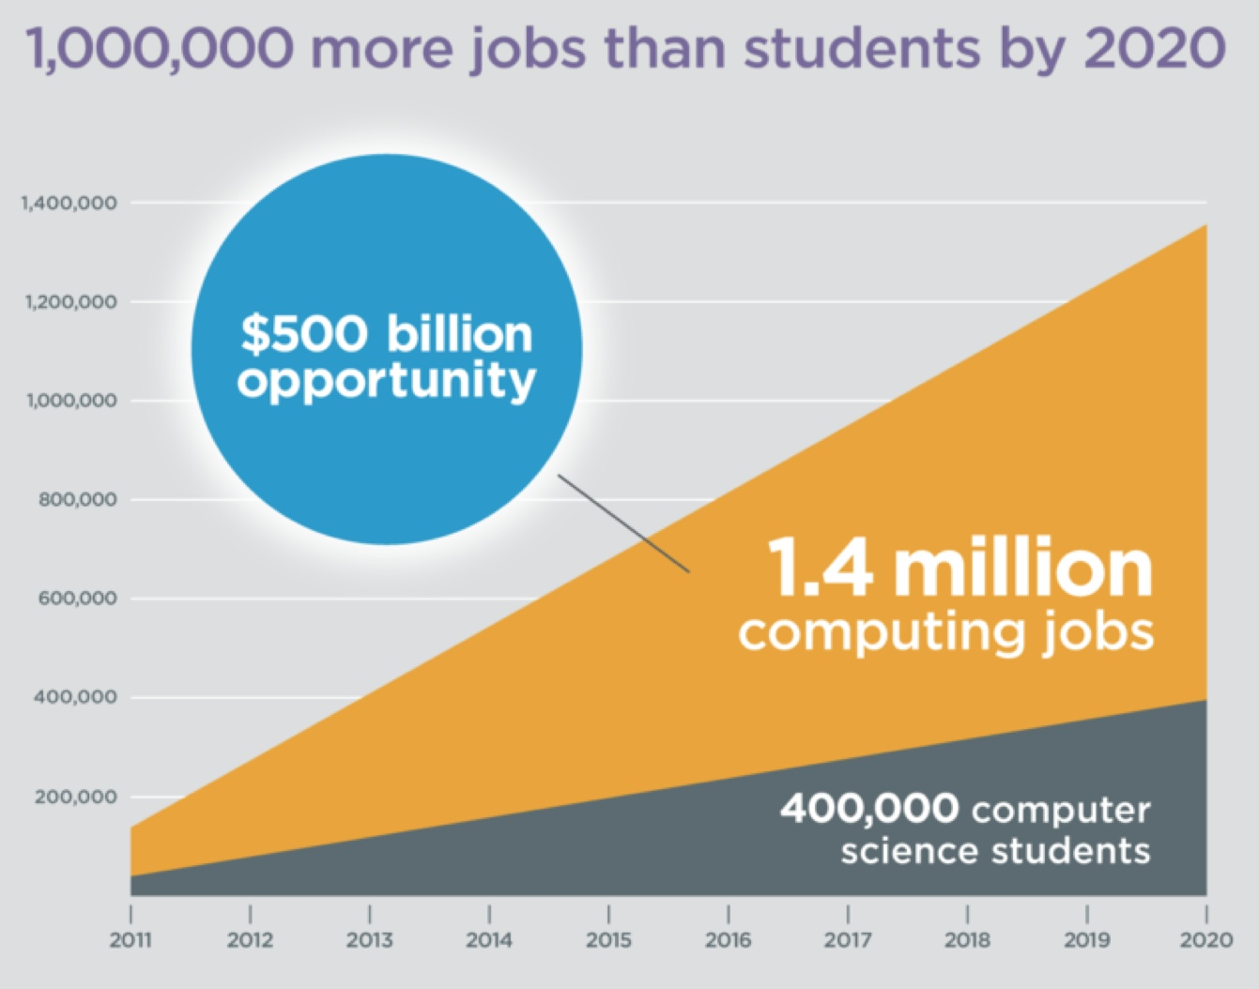
How many more jobs in CS than projected graduates?
Notes:
1 million, code.org/stats

Slide 5
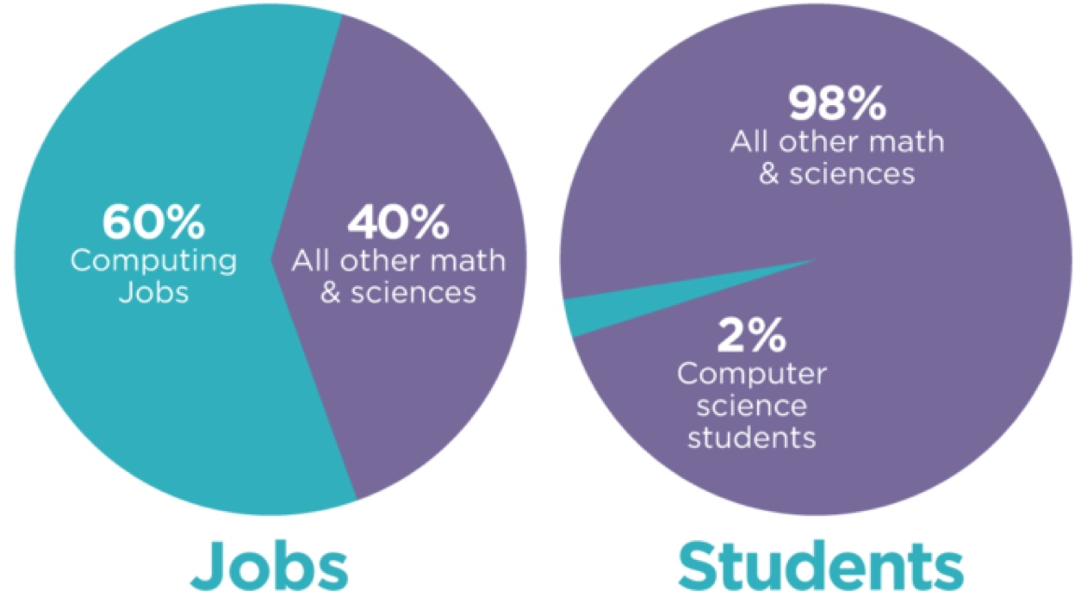
Approx. how many students graduate with a CS degree?

Slide 6
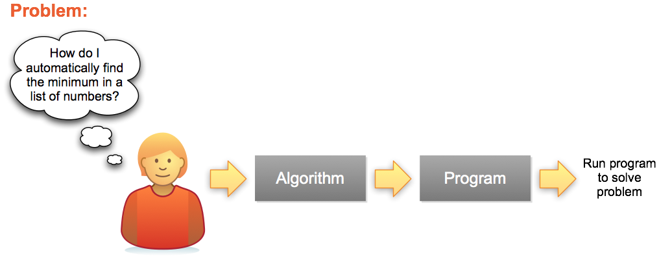
Problem Solving Process
Series of steps for any Programming Language
A specific implementation

Slide 7
WOD Recap
WOD = Workout of the Day
Rx: prescribed time the exercise should take

Slide 8
The 7 “Habits” of Highly Effective Programmers
Variables: storing information (numbers, text)
Math & Logic: writing & evaluating expressions
Input/Output (IO): getting information from the user (or a file/DB) and displaying information to the screen graphically or with the console
Conditions: changing what code statements are executed under different scenarios (i.e., if the day is Sunday, sleep in; otherwise, get up at 6 am)
Loops: repeat code statements (e.g.: while the sink is dirty, keep scrubbing)
Functions: grouped set of statements to accomplish a task based on parameters (e.g.: given f(x)=x+5 then f(2) would be 7)
Lists: store multiple pieces of information (e.g.: an array that stores the integers 1-5 or the letters of the alphabet)

Slide 9
The 7 “Habits” of Highly Effective Programmers
Concept
Example from Math
Variables
Math
Input/Output (IO)
Conditionals
Loops
Functions
Lists
x = 5 hellothere = “howdy”
5 * 7 + a - 3 / b % 4 a is 5 AND x < 7 OR degree ≥ 98
print “Hello World”
if (x == f(x)) then print “x is 0 or 1” else print “x is not 0 or 1”
foreach x in (array) print x
f(x) = x²
array = 1:5 array = 1, 4, 7, 8, a, b, c, d
Notes:
In this assignment we'll investigate the 7 basic concepts in computer programming. Armed with an understanding of these 7 ideas, you could implement any program that's ever been written, in any programming language.
A little different from in the book
I/O often makes use of functions to implement
In using software, have you seen these ideas implemented in the past?

Slide 10
These 7 concepts can be combined in infinitely many ways. Once mastered, you can implement any program that's ever been written, in any programming language.

Slide 11
Give it a try…
Problem: sum all the even numbers from 1 to 10
Use the 7 principles to solve
Assume the following function is already defined: 1 if x is even 0 otherwise
Hint: you may find it helpful to build your solution incrementally:
Step 1: print out the numbers from 1 to 10
Step 2: print out the even numbers from 1 to 10
Step 3: sum the even numbers from 1 to 10
isEven(x) =
Notes:
Think, pair, share
Next time: start with step 1, build confidence, but still want them to see the process of breaking down a problem. Allow more time?

Slide 12
Give it a try
code.org HW Stage 2

Slide 13
Intro to UNIX

Slide 14
Homework for next class
See google classroom site for links:
Read chapter 1 of “Think Python”
Complete stages 2 & 11 on code.org & share progress with me
For check plus: complete stages 15 & 17
Read “CS for all” textbook chapter 4.1-4.2
Watch Monty Python & The Holy Grail
Notes:
Most HWs will get check/check+

Slide 15



What is UNIX?
A well-known operating system that is one of the oldest and still widely used
Developed at AT&T Bell Labs during the 1970s right here in Murray Hill, NJ
Major functionality re-implemented as open source Linux
Today there are many “flavors”
Notes:
http://www.unix.org/what_is_unix/history_timeline.html

Slide 16
Why UNIX?
Most expert computer scientists know how to use the UNIX command line
Why?
Because it comes with a powerful set of programs to quickly automate tasks with little programming
Why doesn’t everyone use it?
Because command line interfaces (CLIs) are not as intuitive as graphical user interfaces (GUIs). However, UNIX is widely used & there is plenty of online help.

Slide 17
My UNIX Experience
Motivation: All the best programmers & hackers I’ve known are proficient in UNIX
To feel like a “real” computer scientist I wanted to learn how to harness this power for myself
In grad school worked on a Linux machine daily in a lab with more experienced students
I asked how they did some cool things
They patiently answered my noob questions
Research projects all relied on UNIX

Slide 18
In this class, we’ll use UNIX to develop our python programs.

Slide 19
DEMO TIME

Slide 20
Basic UNIX commands
ls: directory listing
pwd: present working directory
cd: change directory
cat: display (i.e., concatenate) to the screen
rm: remove
cp: copy
man: manual page
touch: create an empty file
.: current directory
..: parent directory
[tab]: autocomplete
[↑]: previously entered command
Notes:
demo

