Slide 1
Indefinite Loops
Dr. Emily Hill
Fall 2014

Slide 2
Loops

Slide 3
The 7 “Habits” of Highly Effective Programmers
Concept
Python Examples
Variables
Math
Functions
Input/Output (IO)
Conditionals
Lists
Loops
Types:
Integers
Floating point
Strings
Booleans
x = 5 hellothere = “howdy”
5 * 7 + a - 3 / b % 4
def multiply(x, y):
return x * y
print(“Hello World”) input(“What? ”)
if (is_even(num)):
print(num, "is even")
else:
print(num ,"is odd")
range(4)
for i in range(4):
print(“Echo!”)

Slide 4
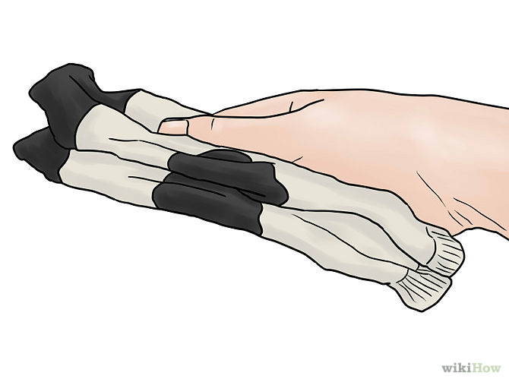
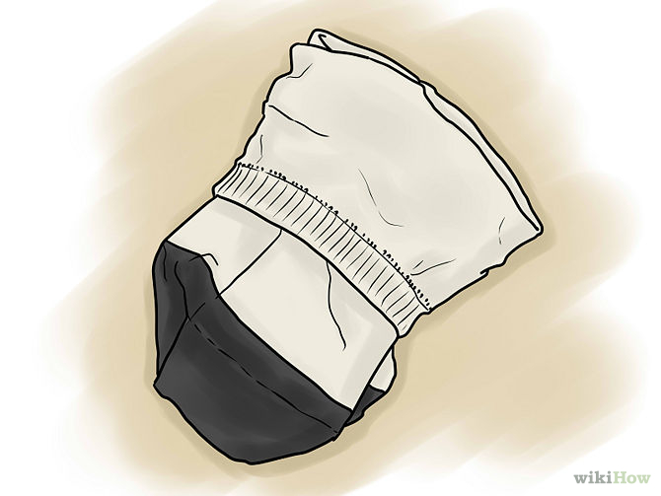
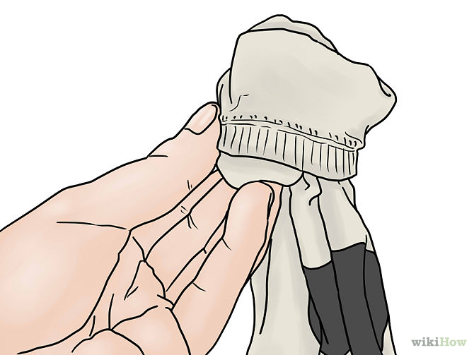
An Algorithm for Folding Socks
Loop!
While there are clean socks:
Select a sock from the pile
Find its match
Line the socks up
Fold one top over the other

Slide 5
Definite For Loops
When we know how many times a loop will execute
Repeat N times
Loop variable
Keywords
Generator
Loop header
for i in range(10):
Fold 10 pairs of socks
Fold a pair of socks
Loop body
Notes:
https://docs.python.org/3/library/functions.html#func-range

Slide 6
for Loop Definition
When we know how many times a loop will execute
Repeat N times
Times to repeat
for x in range(10):
statement_1 statement_2
…
statement_n
“Body” of for loop
Gets repeated
Note indentation

Slide 7



Examples
Python Code:
Output:
6

Slide 8


Examples
Python Code:
Output:

Slide 9
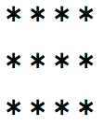

Examples
Python Code:
Output:

Slide 10
Indefinite While Loops
For loops are definite: we know in advance exactly how many times they should execute
What if we don’t know how many times a loop should execute?
Real-life examples:
Folding socks
Checking status (Are we there yet? Any new texts?)
Programming:
Requesting user input
Reading in data from a file

Slide 11
Indefinite While Loops
keyword
while condition :
statement_1
statement_2
…
statement_n
loop stops when condition is False
body of while loop
Like a looped if: execute loop body only while condition is true

Slide 12
While Loop Example
i = 0
while i < 10 :
print("i equals", i)
i = i + 1
print("Done", i)
i = 0
False
i < 10
True
print("i equals", i)
What will be printed?
How many times is the loop body executed?
How many times is the loop condition evaluated?
i = i + 1
print("Done", i)
11-while.py

Slide 13
while vs for
Any for loop can be written as a while loop
i.e., any definite loop can be written as a while OR a for
What are the differences between these loops?
What are the advantages/disadvantages of each?
i = 0
while i < 10 :
print("i equals", i)
i = i + 1
print("Done", i)
for i in range(10):
print("i equals", i)
print("Done", i+1)
11-whilevsfor.py

Slide 14
Shorthand Arithmetic
Make loop increment/decrement easier
The following are equivalent:
i = i + 1
i += 1
i = i - 1
i -= 1
i = i * 10
i *= 10
i = i / 10
i /= 10
i = i ** 2
i **= 2
i = i % 10
i %= 10

Slide 15
What will this loop do?
count = 1
while count > 0:
print(count)
count += 1
11-loop.py

Slide 16
Infinite Loop
Condition will never be False so keeps executing!
To stop an executing program use
Control-C
count = 1
while count > 0:
print(count)
count += 1

Slide 17
Infinite Loop Discussion
Is there ever a time that an infinite loop is wanted?
Yes! For example in web servers:
Can a computer automatically detect infinite loops?
No that is an undecidable problem
Best to prevent infinite loops (more later)
Benefit of Python’s for loops: definite loops
while True:
listenForRequest()
handleRequest()

Slide 18
Try it!

Slide 19
Practicing while Loops
Write the Python code to print the following using while loops:
A)
B)
1
2
3
4
5
C)
****
****
****
2
5
8
11

Slide 20
Control Flow

Slide 21
A matter of scope…
function formal parameters create local variables:
def maximum(x, y):
if x > y:
return x
else:
return y
print(maximum(3, 30))
print(x)
scope of x & y
NameError
11-scope.py
Notes:
Functions & loops have something in common

Slide 22
Control Flow
What order are the statements executed?
7, 1, 2, 4, 5, 7, 8
1 def maximum(x, y):
2 if x > y:
3 return x
4 else:
5 return y
6
7 print(maximum(3, 30))
8 print(x)
Functions, conditions, & loops change program control flow from sequential to out of order
11-scope.py
Notes:
Ans: 7, 1, 2, 4, 5, 7, 8

Slide 23
Control Flow
What order are the statements executed?
7, 1, 2, 4, 5, 7, 8
1 def maximum(x, y):
2 if x > y:
3 return x
4 else:
5 return y
6
7 print(maximum(3, 30))
8 print(x)
11-line.py
Notes:
Loops – see 12-line.py

Slide 24
Homework
Finish Lab 3: Conditionals
HW 9: Go with the flow

