Slide 1
The 7 basic concepts of computer programming
“Computer Science is no more about computers than astronomy is about telescopes.” -Dijkstra
No computer required
Dr. Emily Hill
Fall 2014
Notes:
Favor: submit something to HW 1 assignment so I can grade

Slide 2
RECAP
HW1 Survey

Slide 3

What is Computer Science?
Automated problem solving using information

Slide 4
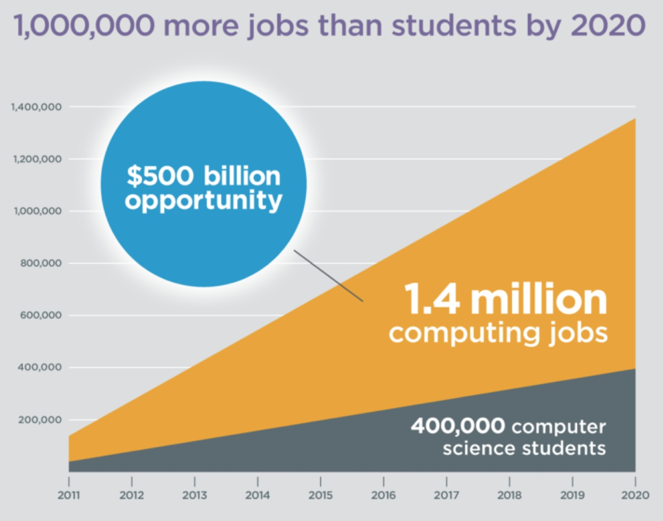
How many more jobs in CS than projected graduates?
Notes:
1 million, code.org/stats

Slide 5
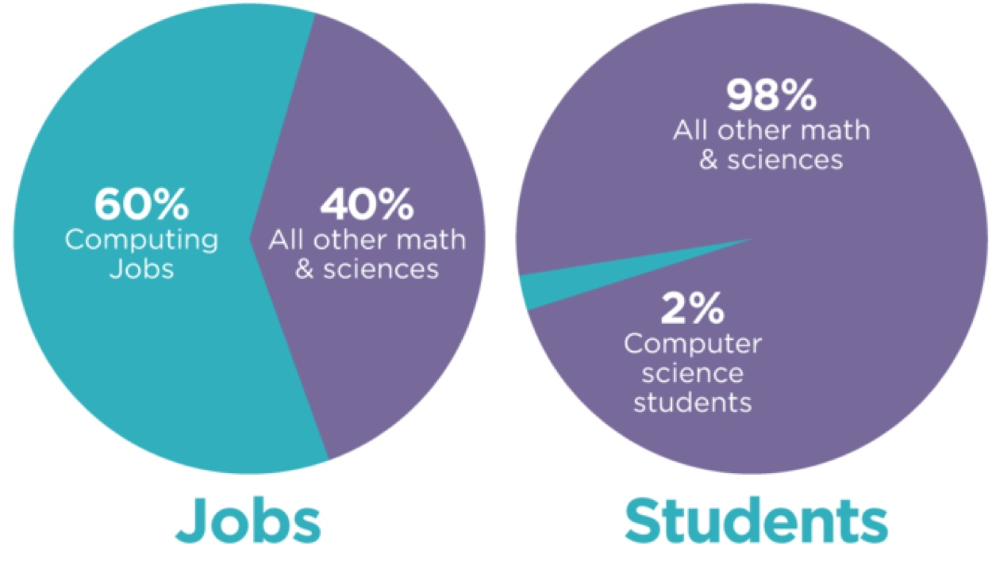
Approx. how many students graduate with a CS degree?

Slide 6
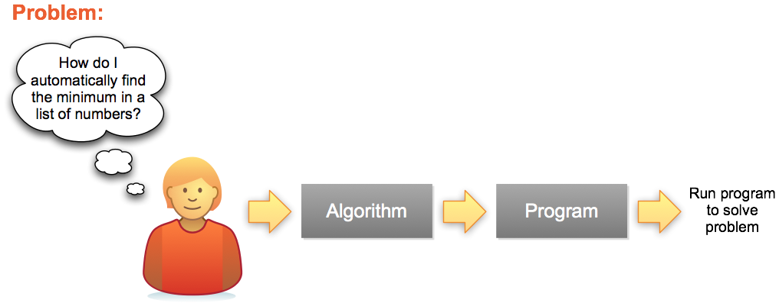
Problem Solving Process
Series of steps for any Programming Language
A specific implementation

Slide 7
The 7 “Habits” of Highly Effective Programmers
Concept
Example
Variables
Math
Functions
Input/Output (IO)
Conditionals
Lists
Loops
x = 5 hellothere = “howdy”
5 * 7 + a - 3 / b % 4 a is 5 AND x < 7 OR degree ≥ 98
f(x) = x²
print “Hello World”
if (x == f(x)) then print “x is 0 or 1” else print “x is not 0 or 1”
array = 1:5 array = 1, 4, 7, 8, a, b, c, d
foreach x in (array) print x
Notes:
In this assignment we'll investigate the 7 basic concepts in computer programming. Armed with an understanding of these 7 ideas, you could implement any program that's ever been written, in any programming language.
A little different from in the book
I/O often makes use of functions to implement
In using software, have you seen these ideas implemented in the past?

Slide 8
Problem Solving 101
Fundamental capabilities of any computer or programming language:
store single values x = 5 hellothere = “howdy”
store lists of values array = 1:5 array = 1, 4, 7, 8
functions f(x) = x²
conditionals if (x == f(x)) then print “x is 0 or 1” else print “x is not 0 or 1”
loop foreach x in (1:5) print x or foreach x in (array) print x
5 principles can combine in infinitely many ways – once mastered, you can create any program ever written!

Slide 9
Give it a try…
Problem: sum all the even numbers from 1 to 10
Use the 7 principles to solve
Assume the following function is already defined: 1 if x is even 0 otherwise
Hint: you may find it helpful to build your solution incrementally:
Step 1: print out the numbers from 1 to 10
Step 2: print out the even numbers from 1 to 10
Step 3: sum the even numbers from 1 to 10
isEven(x) =
Notes:
Think, pair, share
Next time: start with step 1, build confidence, but still want them to see the process of breaking down a problem. Allow more time?

Slide 10
These 7 concepts can be combined in infinitely many ways. Once mastered, you can implement any program that's ever been written, in any programming language.

Slide 11
Give it a try
code.org WOD

Slide 12
Intro to UNIX

Slide 13
Homework for next class
See google classroom site for links:
Read chapter 1 of “Think Python”
Complete stages 2 & 11 on code.org & share progress with me
For check plus: complete stages 15 & 17
Read “CS for all” textbook chapter 4.1-4.2
Watch Monty Python & The Holy Grail
Notes:
Most HWs will get check/check+

Slide 14



What is UNIX?
A well-known operating system that is one of the oldest and still widely used
Developed at AT&T Bell Labs during the 1970s right here in Murray Hill, NJ
Major functionality re-implemented as open source Linux
Today there are many “flavors”
Notes:
http://www.unix.org/what_is_unix/history_timeline.html

Slide 15
Why UNIX?
Most expert computer scientists know how to use the UNIX command line
Why?
Because it comes with a powerful set of programs to quickly automate tasks with little programming
Why doesn’t everyone use it?
Because command line interfaces (CLIs) are not as intuitive as graphical user interfaces (GUIs). However, UNIX is widely used & there is plenty of online help.

Slide 16
My UNIX Experience
Motivation: All the best programmers & hackers I’ve known are proficient in UNIX
To feel like a “real” computer scientist I wanted to learn how to harness this power for myself
In grad school worked on a Linux machine daily in a lab with more experienced students
I asked how they did some cool things
They patiently answered my noob questions
Research projects all relied on UNIX

Slide 17
In this class, we’ll use UNIX to develop our python programs.

Slide 18
DEMO TIME

Slide 19
Basic UNIX commands
ls: directory listing
pwd: present working directory
cd: change directory
cat: display (i.e., concatenate) to the screen
rm: remove
cp: copy
man: manual page
touch: create an empty file
.: current directory
..: parent directory
[tab]: autocomplete
[↑]: previously entered command
Notes:
demo

