Slide 1
Functions
The real power of programming

Slide 2
The 7 “Habits” of Highly Effective Programmers
Concept
Example from Math
Variables
Math & Logic
Input/Output (IO)
Conditionals
Loops
Functions
Lists
x = 5 hellothere = “howdy”
5 * 7 + a - 3 / b % 4 a is 5 AND x < 7 OR degree ≥ 98
print “Hello World”
if (x == f(x)) then print “x is 0 or 1” else print “x is not 0 or 1”
foreach x in (array) print x
f(x) = x²
array = 1:5 array = 1, 4, 7, 8, a, b, c, d
Notes:
In this assignment we'll investigate the 7 basic concepts in computer programming. Armed with an understanding of these 7 ideas, you could implement any program that's ever been written, in any programming language.
A little different from in the book
I/O often makes use of functions to implement
In using software, have you seen these ideas implemented in the past?

Slide 3
Why functions?
Creating a new function means naming a group of statements
makes your program easier to read and debug
Functions can eliminate repetitive code
make changes in only one place
Debug individual functions one at a time
before testing your program as a working whole
Reuse!
once written & debugged, functions can be reused

Slide 4
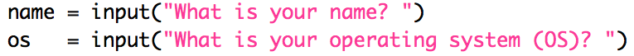
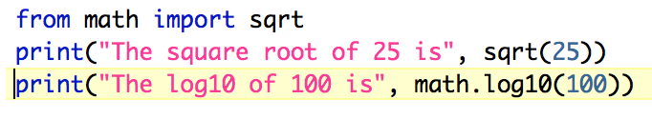
Calling functions
How many different functions are called above?
How many times is each one called?
How many parameters does each function call have?
Notes:
Recall last week we looked at calling functions
Ans: 4
input * 2
print * 3
sqrt * 1
log10 * 1
1

Slide 5
Defining your own functions
Motivation: Google googol
https://www.google.com/search?q=googol
Notes:
Favor: submit something to HW 1 assignment so I can grade

Slide 6
Functioning across disciplines
structure
procedure
g(x) = x¹⁰⁰
def g(x):
return x**100
Math's googolizer
CS's googolizer
defined by what it is
defined by what it does

Slide 7
Defining Your Own Functions
def dbl(x):
return 2 * x
x
dbl
2 * x
def dbl(myArgument):
myResult = 2 * myArgument
return myResult
functions.py

Slide 8
Composing Functions
def quad(x):
return 4 * x
x
quad
4 * x
def quad(x):
return dbl(dbl(x))
Notes:
In math, you can compose functions: f(g(x)). You can do the same in Python.

Slide 9
Multiple Arguments...
x, y
my_fun
x + 42 * y
def my_fun(x, y):
"""returns x + 42 * y"""
return x + 42 * y
my_fun.py

Slide 10
Try it!
add.py: write multiply function

Slide 11
Using functions
Control Flow
Notes:
Favor: submit something to HW 1 assignment so I can grade

Slide 12
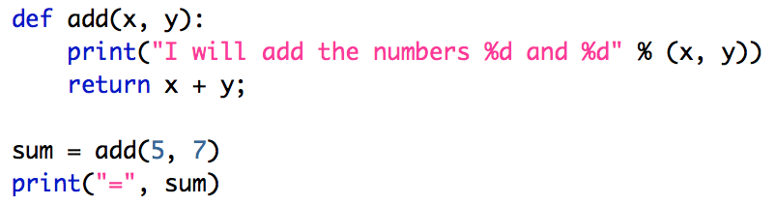
Function Flow
Memory
Formal parameters
Actual parameters
Execution starts here
Notes:
# Adds two numbers
def add(x, y):
print("I will add the numbers %d and %d" % (x, y))
return x + y;
sum = add(5, 7)
print("=", sum)
"""
Next step: write a function that multiplies two numbers
WITHOUT printing anything
"""
#print("%d * %d = %d" % (4, 5, multiply(4, 5)))
#### OR ####
#print(4, "*", 5, "=", multiply(4, 5) )

Slide 13
Function Flow
Memory
x = 5
when the add function is called, actual values get copied into formal parameter variables
y = 7
Notes:
# Adds two numbers
def add(x, y):
print("I will add the numbers %d and %d" % (x, y))
return x + y;
sum = add(5, 7)
print("=", sum)
"""
Next step: write a function that multiplies two numbers
WITHOUT printing anything
"""
#print("%d * %d = %d" % (4, 5, multiply(4, 5)))
#### OR ####
#print(4, "*", 5, "=", multiply(4, 5) )

Slide 14
Function Flow
Memory
x = 5
when the add function is finished, it returns the sum and assigns it to the variable
sum = 12
y = 7
Notes:
# Adds two numbers
def add(x, y):
print("I will add the numbers %d and %d" % (x, y))
return x + y;
sum = add(5, 7)
print("=", sum)
"""
Next step: write a function that multiplies two numbers
WITHOUT printing anything
"""
#print("%d * %d = %d" % (4, 5, multiply(4, 5)))
#### OR ####
#print(4, "*", 5, "=", multiply(4, 5) )

Slide 15
Function Flow
Memory
sum = 12
Execution ends here
Notes:
# Adds two numbers
def add(x, y):
print("I will add the numbers %d and %d" % (x, y))
return x + y;
sum = add(5, 7)
print("=", sum)
"""
Next step: write a function that multiplies two numbers
WITHOUT printing anything
"""
#print("%d * %d = %d" % (4, 5, multiply(4, 5)))
#### OR ####
#print(4, "*", 5, "=", multiply(4, 5) )

Slide 16

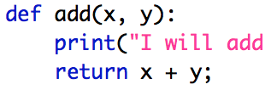


Function Flow
Notes:
# Adds two numbers
def add(x, y):
print("I will add the numbers %d and %d" % (x, y))
return x + y;
sum = add(5, 7)
print("=", sum)
"""
Next step: write a function that multiplies two numbers
WITHOUT printing anything
"""
#print("%d * %d = %d" % (4, 5, multiply(4, 5)))
#### OR ####
#print(4, "*", 5, "=", multiply(4, 5) )

Slide 17


Function “Flavors”
Fruitful: return a value
Example: math
Void: perform an action without returning a value
Example: print
Functions can:
return 0 or 1 items
take 0 or more parameters (i.e., arguments)
Notes:
Functions come in 2 “flavors”
Is add a fruitful or void function?

Slide 18
Which are fruitful vs void?
Notes:
Ans:
input: fruitful
print : void
sqrt: fruitful
log10: fruitful

Slide 19
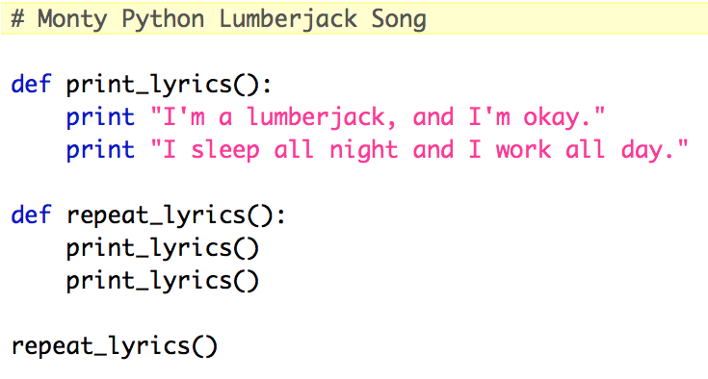
Another example
Fruitful or void?
How many parameters?
Notes:
# Monty Python Lumberjack Song
def print_lyrics():
print "I'm a lumberjack, and I'm okay."
print "I sleep all night and I work all day."
def repeat_lyrics():
print_lyrics()
print_lyrics()
repeat_lyrics()

Slide 20
Functions calling functions
More Control Flow
Notes:
Favor: submit something to HW 1 assignment so I can grade

Slide 21
What Happens Inside a Function?
8
def f(x):
x = x-1
return g(x)+1
def g(x):
return x*2
def h(x):
if x%2 == 1: # x odd
return f(x) + x
else: # x even
return f(f(x))
h(3):
return f(3) + 3
5
f(3):
return g(2) + 1
4
g(2):
return 4
flow.py
Two key points…
Functions return to where they were called from
Each function keeps its own values of its variables
Notes:
5 clicks of animation on this slide

Slide 22
How functions work…
-4
What is demo(-4) ?
def demo(x):
return x + f(x)
def f(x):
return 11*g(x) + g(x/2)
def g(x):
return -1 * x
Notes:
vault 713?

Slide 23
How functions work…
def demo(x):
return x + f(x)
demo
stack frame
x = -4
return -4 + f(-4)
def f(x):
return 11*g(x) + g(x/2)
def g(x):
return -1 * x
>>> demo(-4) ?
Notes:
vault 713?

Slide 24
How functions work…
def demo(x):
return x + f(x)
demo
stack frame
x = -4
return -4 + f(-4)
def f(x):
return 11*g(x) + g(x/2)
f
stack frame
def g(x):
return -1 * x
x = -4
return 11*g(x) + g(x/2)
>>> demo(-4) ?
Notes:
vault 713?

Slide 25
How functions work…
def demo(x):
return x + f(x)
demo
stack frame
x = -4
return -4 + f(-4)
def f(x):
return 11*g(x) + g(x/2)
f
stack frame
def g(x):
return -1 * x
x = -4
return 11*g(x) + g(x/2)
These are distinct memory locations both holding x's.
>>> demo(-4) ?
Notes:
vault 713?

Slide 26
How functions work…
def demo(x):
return x + f(x)
demo
stack frame
x = -4
return -4 + f(-4)
def f(x):
return 11*g(x) + g(x/2)
f
stack frame
def g(x):
return -1 * x
x = -4
return 11*g(-4) + g(-4/2)
g
stack frame
x = -4
>>> demo(-4) ?
return -1.0 * x
Notes:
vault 713?

Slide 27
How functions work…
def demo(x):
return x + f(x)
demo
x = -4
return -4 + f(-4)
def f(x):
return 11*g(x) + g(x/2)
f
def g(x):
return -1 * x
x = -4
return 11* 4 + g(-4/2)
g
x = -4
>>> demo(-4) ?
return -1 * -4
4
Notes:
vault 713?

Slide 28
How functions work…
def demo(x):
return x + f(x)
demo
x = -4
return -4 + f(-4)
def f(x):
return 11*g(x) + g(x/2)
f
def g(x):
return -1 * x
x = -4
return 11* 4 + g(-4/2)
>>> demo(-4) ?
Notes:
vault 713?

Slide 29
How functions work…
def demo(x):
return x + f(x)
demo
x = -4
return -4 + f(-4)
def f(x):
return 11*g(x) + g(x/2)
f
def g(x):
return -1 * x
x = -4
return 11* 4 + g(-4/2)
g
x = -2
>>> demo(-4) ?
return -1 * -2
2
These are distinct memory locations both holding x's – and now they also have different values!!
Notes:
vault 713?

Slide 30
How functions work…
def demo(x):
return x + f(x)
demo
x = -4
return -4 + f(-4)
def f(x):
return 11*g(x) + g(x/2)
f
def g(x):
return -1 * x
x = -4
return 11* 4 + 2
>>> demo(-4) ?
Notes:
vault 713?

Slide 31
How functions work…
def demo(x):
return x + f(x)
demo
x = -4
return -4 + f(-4)
def f(x):
return 11*g(x) + g(x/2)
f
def g(x):
return -1 * x
x = -4
return 11* 4 + 2
46
>>> demo(-4) ?
Notes:
vault 713?

Slide 32
How functions work…
def demo(x):
return x + f(x)
demo
x = -4
return -4 + 46
def f(x):
return 11*g(x) + g(x/2)
def g(x):
return -1 * x
>>> demo(-4)
42
42
Notes:
vault 713?

Slide 33
Function stacking
def demo(x):
return x + f(x)
demo
stack frame
x = -4
return -4 + f(-4)
the stack
def f(x):
return 11*g(x) + g(x/2)
f
def g(x):
return -1 * x
x = -4
return 11* 4 + g(-4/2)
g
x = -2
return -1 * -2
2
Notes:
vault 713?

Slide 34
Function stacking
def demo(x):
return x + f(x)
demo
stack frame
x = -4
return -4 + f(-4)
the stack
def f(x):
return 11*g(x) + g(x/2)
f
def g(x):
return -1 * x
x = -4
return 11* 4 + g(-4/2)
"The stack"
g
x = -2
is a memory area that
return -1 * -2
2
(1) keeps separate variables for each function call…
(2) remembers where to send results back to…
Notes:
vault 713?

Slide 35
return != print
def dbl(x):
""" dbls x? """
return 2*x
def dblPR(x):
""" dbls x? """
print 2*x
>>> ans = dbl(21)
>>> ans = dblPR(21)

Slide 36
return != print
def dbl(x):
""" dbls x? """
return 2*x
def dblPR(x):
""" dbls x? """
print(2*x)
>>> ans = dbl(21)
>>> ans = dblPR(21)
print just prints stuff to the screen...
return yields the function call's value …

Slide 37
Try it!
add.py: write multiply function

