Slide 1
Testing & Debugging
Created by Emily Hill

Slide 2
Testing & Debugging Techniques
Manual Walkthroughs (for loop example – mmm)
Created by Emily Hill

Slide 3
Manual Walk Through
Work through a piece of code line by line, observing changes in state & behavior
  Step 1: pick values for the input variables
  Step 2: keep track of all the variables’ values & how they change as the code is executed (by hand)
Example: what value is returned if mmm(4,5) called?
public int mmm(int x, int y) {
int n = x;
for (int i = 1; i < y; i++) {
n+=x;
}
return n;
}
Copyright © 2012 Pearson Education, Inc.
Notes:
Input x = 4, y=5
n = 4
I n
8
12
16
20

Slide 4
Testing & Debugging Techniques
Manual Walkthroughs (for loop example – mmm)
Unit Testing:
  testing individual parts of an application
  can be single methods, classes, or groups of classes
Application Testing: test the complete application as a whole
Regression Testing: test new version of application with passing test cases from previous version
Print statements (primitive)
Automated debugger (demo in lab)
Created by Emily Hill

Slide 5
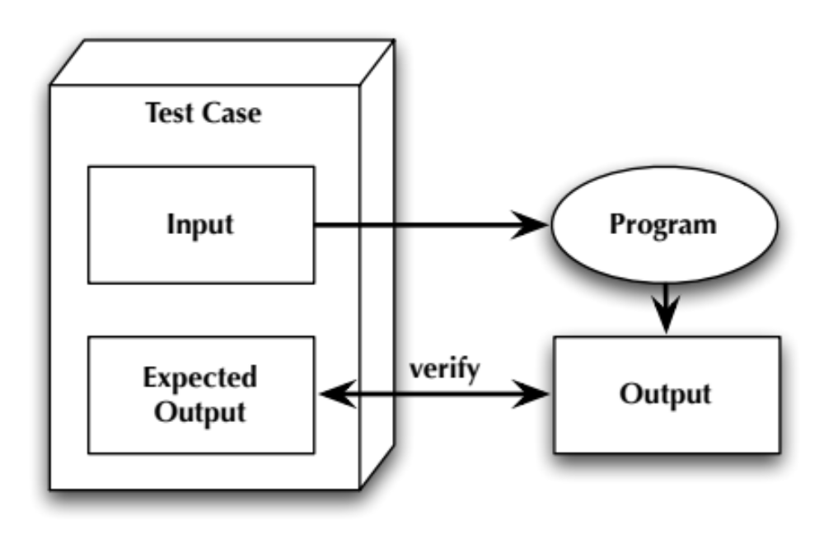
The Testing Process
Created by Emily Hill
Notes:
program/ or method

Slide 6
Example: testing a sort method
public void sort (int[] array) should return a sorted list of numbers
Example test case:
  Input: array = {8, 4, 3, 10, 2}
  Expected Output: {2, 3, 4, 8, 10}
What makes a good test case?
  Test expected functionality
  Get tricky: test unexpected functionality
Goal: find all bugs before user/customer (GA/prof)
Created by Emily Hill

Slide 7
Practice: Area of a Rectangle
public int getArea(int width, int height)
What kinds of test cases? Expected? Unexpected?
  Positive integers
  Negative numbers, 0
Example test cases
(method call & expected output):
getArea(2,2) == 4 // basic functionality, w == h
getArea(3,5) == 15 // basic functionality, w < h
getArea(4,3) == 12 // basic functionality, w > h
What about unexpected functionality?
0, negative numbers, decimals?
Created by Emily Hill
Notes:
Unexpected: 0, negative, decimals

Slide 8
Completeness
Test suite: a set of test cases
Complete test suite: test all possible inputs & execute all statements
  Impossible to test all inputs in general
  Try to test as many combinations of input classes as possible
  Rectangle area example: w = h, w < h, w > h, etc.
Test typical corner cases
  For single values: 0, <1, >1, <0
  For arrays: 0, 1, many
Execute all statements = statement coverage
  Execute all methods, loops, etc
  Execute every block of if/else statements
Created by Emily Hill

Slide 9

Example: getArea(int width, int height)
Expected functionality: getArea(3,5)
  What’s covered?
Are we done yet?
Created by Emily Hill

Slide 10
Example: getArea(int width, int height)
Expected functionality: getArea(3,5)
  What’s covered?
Are we done yet?
Unexpected functionality? getArea(-3,5)
Are we done yet?
Completeness = many input classes
+ statement coverage
Created by Emily Hill

Slide 11
Debugging
Debugging: process of isolating the cause of a
bug/error/failure & designing a way to fix it
Debugging Steps:
  Craft a test case (input) that exposes the bug
  Refine that input to be the minimal input required to cause the bug
  If the fix is not obvious, manually walk thru the code, writing down each execution step & keeping track of the values of each variable
  Once you fully understand the code, you should be able to spot the bug & suggest a fix
  Make the fix & rerun the test cases; none should fail now.
Created by Emily Hill
Notes:
* Stopped here

Slide 12
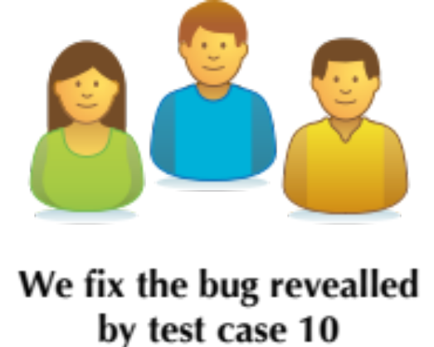
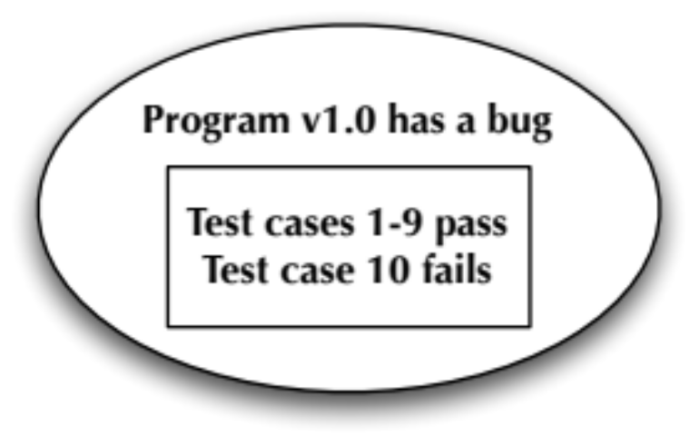
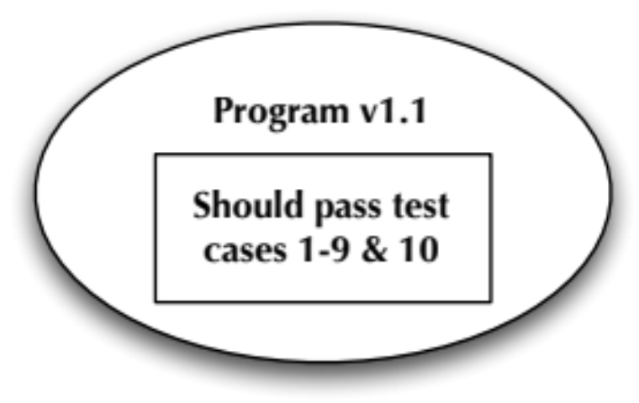
Testing after a code change / bug fix
Regression testing: use passing test cases from a previous version of the software to test the next version
  Goal: verify that bug fix does not introduce new bugs
  Example:
Created by Emily Hill

