Slide 1
Reusing Code: Inheritance & Composition
Dr. Emily Hill
Spring 2015
Notes:
First: go over WOD2

Slide 2
Review: Inheritance
Inheritance: define a class as an extension of another class (i.e., a subclass extends a super class)
Advantages:
Avoid code duplication
Code reuse: take advantage of existing functionality
Easier to maintain: localize changes
Extendibility: easier to extend functionality in future
Subclass can override methods in super class (same signature)
super: access method in parent (super) class
this: access method in current (sub) class

Slide 3
Field modifiers
What are the Java visibility modifiers?
private: only accessible within current class
public: accessible from any class
protected: all subclasses can access
Additional modifiers:
static
Only one copy of field exists per class
No matter how many objects are created, all refer to same memory location
final
Field that can only be assigned to once
Suitable for constant values that don’t change during execution
Example: Math.PI is public, static, and final

Slide 4
Try it!
Ellipse extends Circle (2/18)
Circle extends Ellipse (2/20)
Notes:
PWOD: Rectangle

Slide 5
Composing Objects

Slide 6
Drawing a BoxCar

Slide 7
Drawing a BoxCar
Step 1: Create classes for Circle & Rectangle (done!)
Step 2: Create a BoxCarPart class that can draw this part at any x, y position and any width, height
Step 3: Create a BoxCar class with at least 3 BoxCarParts

Slide 8
BoxCar = Multiple box car parts

Slide 9
BoxCarPart = Rectangle + Circle

Slide 10
Step 2: BoxCarPart class
Create a new BoxCarPart class
Has 2 fields: a circle for the wheel & a rectangle for the car
Has a private method setBounds that takes: x, y, width, height
Car should start at x, y and extend to width & height
Wheel should be relative to the car:
Wheel diameter should be about half the width
Wheel should be drawn centered in the middle of the car, with half its diameter hanging below the car
Has a constructor with 4 parameters: x, y, width, & height
Has a draw method that has a Graphics parameter and calls the corresponding draw methods for the 2 fields
Test: replace the shape fields in Picture with a BoxCarPart
Change the size of the BoxCarPart in the Picture constructor and test that it works

Slide 11
Step 3: BoxCar class
Create a new BoxCar class
Has at least 3 BoxCarPart fields
Has a constructor that takes 4 parameters: x, y, width, height
Has a drawvmethod that has a Graphics parameter and calls the corresponding draw methods for the 3 fields
Test: replace BoxCarPart field in Picture with a BoxCar
Modify position/sizes in the Picture constructor
Look at how easy it is to aggregate components!

Slide 12
Next steps
Many BoxCarParts and BoxCars…

Slide 13
Grouping (i.e., collecting) objects
Many applications involve collections of objects:
Personal organizers.
Library catalogs.
Student-record system.
The number of items to be stored varies.
Items added.
Items deleted.

Slide 14
Example: A personal notebook
Notes may be stored.
Individual notes can be viewed.
There is no limit to the number of notes.
It will tell how many notes are stored.
Consider a Notebook project.

Slide 15
import java.util.ArrayList;
/**
* ...
*/
public class Notebook
{
// Storage for an arbitrary number of notes.
private ArrayList<String> notes;
/**
* Perform any initialization required for the
* notebook.
*/
public Notebook()
{
notes = new ArrayList<String>();
}
...
}
the type of collection
the type of objects in the collection

Slide 16
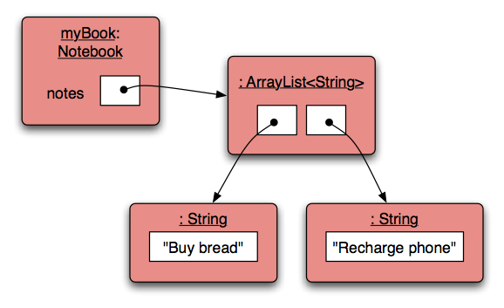
Object structures with collections

Slide 17
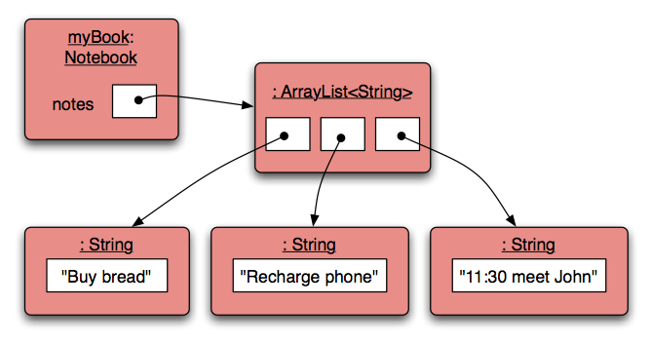
Adding a third note

Slide 18
Features of the collection
It increases its capacity as necessary.
It keeps a private count (size() method).
It keeps the objects in order.
Details of how all this is done are hidden.
Does that matter? Does not knowing how prevent us from using it?

Slide 19
Using the collection
public class Notebook
{
private ArrayList<String> notes;
...
public void storeNote(String note)
{
notes.add(note);
}
public int numberOfNotes()
{
return notes.size();
}
...
}
Adding a new note
Returning the number
of notes (delegation)

Slide 20

Index numbering

Slide 21
Retrieving an object
Index validity checks
public void showNote(int noteNumber)
{
if(noteNumber < 0) {
// This is not a valid note number.
}
else if(noteNumber < numberOfNotes()) {
System.out.println(notes.get(noteNumber));
}
else {
// This is not a valid note number.
}
}
Retrieve and print the note

Slide 22
Removal may affect numbering
notes.remove(1);

Slide 23
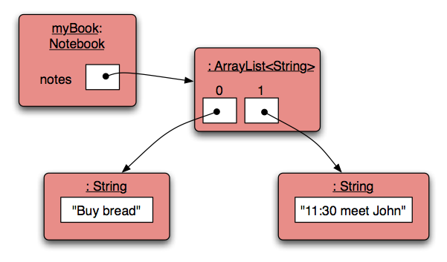
Removal may affect numbering
notes.remove(1);

Slide 24
The ArrayList Class (java.util.ArrayList)
An ArrayList object stores a list of objects, and is often processed using a loop
An ArrayList object grows and shrinks as needed, adjusting its capacity as necessary
You can reference each object in the list using a numeric index

Slide 25
The ArrayList Class
Index values of an ArrayList begin at 0 (not 1):
0 "Bashful"
1 "Sleepy"
2 "Happy"
3 "Dopey"
4 "Doc"
Elements can be inserted and removed
The indexes of the elements adjust accordingly

Slide 26
ArrayList Methods
Some ArrayList methods:
boolean add (E obj)
void add (int index, E obj)
Object remove (int index)
Object get (int index)
boolean isEmpty()
int size()

Slide 27
The ArrayList Class
The type of object stored in the list is established when the ArrayList object is created:
ArrayList<String> names = new ArrayList<String>();
ArrayList<Book> list = new ArrayList<Book>();
This makes use of Java generics, which provide additional type checking at compile time
An ArrayList object cannot store primitive types, but that's what wrapper classes are for (Integer, Double, Character, etc.)
See Beatles.java

Slide 28
//********************************************************************
// Beatles.java Author: Lewis/Loftus
//
// Demonstrates the use of a ArrayList object.
//********************************************************************
import java.util.ArrayList;
public class Beatles
{
//-----------------------------------------------------------------
// Stores and modifies a list of band members.
//-----------------------------------------------------------------
public static void main (String[] args)
{
ArrayList<String> band = new ArrayList<String>();
band.add ("Paul");
band.add ("Pete");
band.add ("John");
band.add ("George");
continue

Slide 29
continue
System.out.println (band);
int location = band.indexOf ("Pete");
band.remove (location);
System.out.println (band);
System.out.println ("At index 1: " + band.get(1));
band.add (2, "Ringo");
System.out.println ("Size of the band: " + band.size());
for (String name : band)
{
System.out.println (name);
}
}
}

Slide 30
Output
[Paul, Pete, John, George]
[Paul, John, George]
At index 1: John
Size of the band: 4
Paul
John
Ringo
George
continue
System.out.println (band);
int location = band.indexOf ("Pete");
band.remove (location);
System.out.println (band);
System.out.println ("At index 1: " + band.get(1));
band.add (2, "Ringo");
System.out.println ("Size of the band: " + band.size());
for (String name : band)
{
System.out.println (name);
}
}
}

Slide 31
Repetition Statements
Repetition statements allow us to execute a statement multiple times
Often they are referred to as loops
Like conditional statements, they are controlled by boolean expressions
Java has three kinds of repetition statements: while, do, and for loops
Like if statements, if you want to repeat more than one line, you will need to use curly braces ({})

Slide 32
For-each Loops
Simplifies repetitive processing of items in a collection
For example, suppose bookList is an ArrayList<Book> object
The following loop will print each book:
for (Book myBook : bookList)
System.out.println (myBook);

Slide 33
Logic of a for-each loop
Are there more items in the collection?
true
false
Statements to process each item

Slide 34
Quick Check
Write a for-each loop that prints all of the Student objects in an ArrayList<Student> object called roster.
for (Student student : roster)
System.out.println (student);

Slide 35
Collection Basics
List (e.g., java.util.ArrayList)
Ordered elements
Allows duplicates
Set (e.g., java.util.HashSet)
Unordered elements
No duplicates
Map (e.g. java.util.HashMap)
Unordered elements, stored as key-value pairs
No duplicate keys (can be duplicate values)

Slide 36
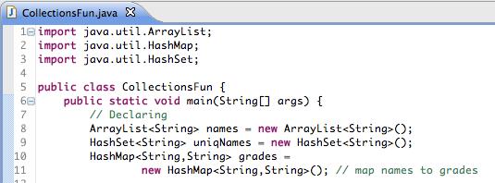
Using collections example

Slide 37
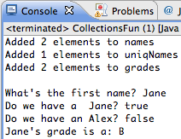
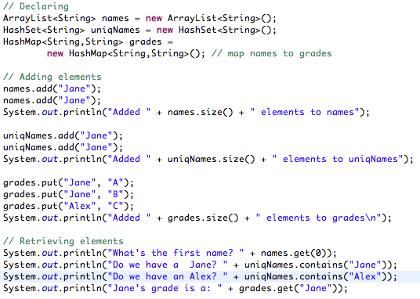
Using collections example

Slide 38
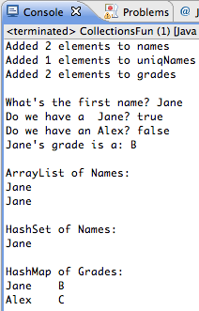
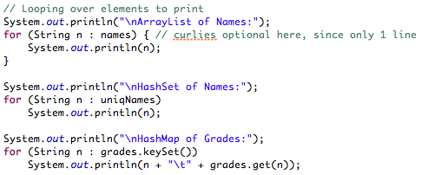
Using collections example

Slide 39
Group Exercise: iTunes class (Review)
Create a class Song with
4 Fields: private String title; private String artist; private String album; private double price;
2 Constructors: default, & with a parameter for each field
9 Methods: getters & setters for each field, and toString
Create an iTunes class that stores a list of songs as an ArrayList, and initialize the list to be empty
Create a method addSong to the iTunes class
Create a main method that adds 3 songs to iTunes (don’t use the default constructor)
Notes:
Should this example wait? Good intro to shopping cart…

Slide 40
Group Exercise: iTunes class
Create a print method that prints the entire song list using a for each loop
Create a getTotalPrice method that returns the total cost of the entire song list
Create a getMinimumPrice method that returns the song with the lowest price in the list
Notes:
D

