Slide 1


Chapter 7 Object-Oriented Design Concepts
Java Software Solutions
Foundations of Program Design
Seventh Edition
John Lewis
William Loftus

Slide 2
OO Class Terminology
Interface (conceptual definition):
Set of public method signatures for a class
Defines how other classes can use it
Implementation:
Code used to perform the desired functionality defined by the interface
Includes private fields & methods & public method bodies
Interface (Java construct definition):
Special class with no source code, no constructors
Used to enforce good design

Slide 3
What is good design?
Making code easy to modify, test, & debug by localizing changes
The less code is changed,
the less chance for bugs to be introduced
reduce amount of testing
Goal: design code so changes can be made to small, independent units
Code duplication: copying & pasting the same (or almost the same) code multiple times
Why we avoid it: makes code modification difficult we might not modify all duplicates

Slide 4
How can we achieve good design?
Cohesion: each code unit (method/class) should be responsible for 1 and only 1 well-defined task
Why we want high cohesion:
localize changes to one well-defined place
Cohesive code is easier for others to understand, & modify
Cohesive code is easier to reuse, thus reducing code duplication
Responsibility-driven design (RDD): store data where it’s predominantly manipulated
Coupling: the degree to which 2 classes are inter-dependent
When the implementation of a class changes, other classes should not be affected (when the interface changes, they might be)
Why we avoid tight-coupling: more work to modify code; can’t just change 1 class, have to change all the tightly-coupled classes
Encapsulation: what a class/method does is visible to the outside (to other classes) by not how it does it

Slide 5
Design Concepts in Practice: World of Zuul
Command-line adventure game
Step 1: understand what the code does (run it)
Step 2: understand how the code does it (zipped project)
Step 3: can we improve the code’s design? (Tasks.docx)
You should be migrating from ZuulOrignalUML to ZuulEnumUML

Slide 6
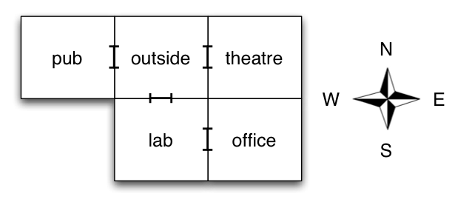
Design Concepts in Practice: World of Zuul
Command-line adventure game
Step 1: understand what the code does (run it) Map:
Step 2: understand how the code does it (zipped project)
Step 3: can we improve the code’s design? (Tasks.docx)

Slide 7
Design Concepts in Practice: World of Zuul
Command-line adventure game
Step 1: understand what the code does (run it)
Step 2: understand how the code does it (zipped project)
Step 3: can we improve the code’s design? (Tasks.docx)
You should be migrating from ZuulOrignalUML to ZuulEnumUML

Slide 8
Design Concepts in Practice: World of Zuul
Command-line adventure game
Step 1: understand what the code does (run it)
Step 2: understand how the code does it (zipped project) Code consists of 5 classes:
Game: runs game, puts all the other pieces (classes) together with the game’s logic
Parser: processes user input
Room: manages room info [description, exits]
CommandWords: manages valid commands in game & supports Parser
Command: manages info about a command entered by a user [command + option]
Step 3: can we improve the code’s design? (Tasks.docx)

Slide 9
Design Concepts in Practice: World of Zuul
Command-line adventure game
Step 1: understand what the code does (run it)
Step 2: understand how the code does it (zipped project)
Step 3: can we improve the code’s design? (Tasks.docx)
You should be migrating from ZuulOrignalUML to ZuulEnumUML

Slide 10
Design Concepts in Practice: World of Zuul
Command-line adventure game
Step 1: understand what the code does (run it)
Step 2: understand how the code does it (zipped project)
Step 3: can we improve the code’s design? (Tasks.docx)
Your turn: in small groups, try to find design issues in the code
Can you find any duplicated code?

Slide 11
Design Concepts in Practice: World of Zuul
Command-line adventure game
Step 1: understand what the code does (run it)
Step 2: understand how the code does it (zipped project)
Step 3: can we improve the code’s design? (Tasks.docx)
Your turn: in small groups, try to find design issues in the code
Can you find any duplicated code?
Improve design, not functionality
Remove code duplication in Game between printWelcome() & goRoom() by refactoring printLocationInfo()

Slide 12
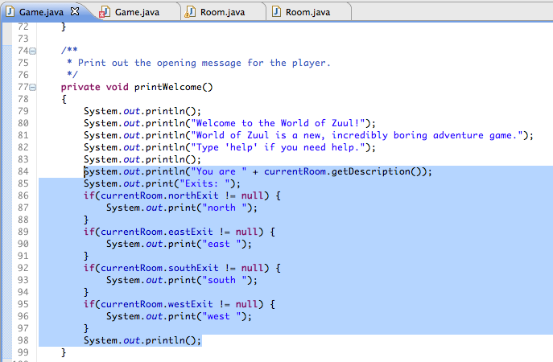
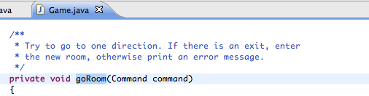
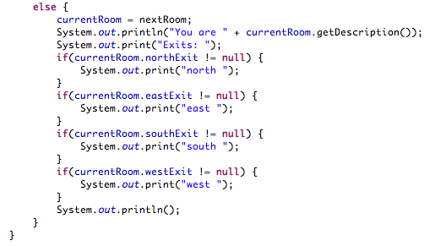
Code duplication in Game

Slide 13
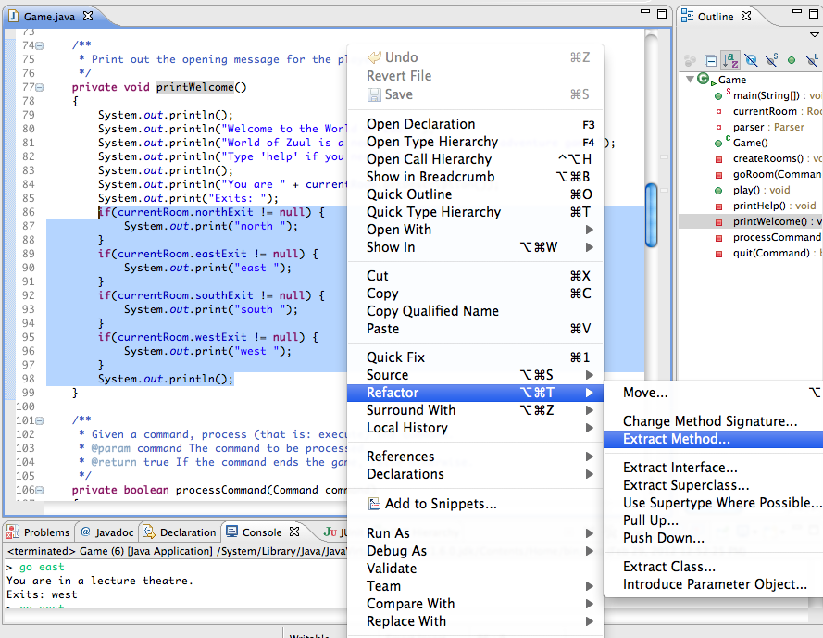

Slide 14
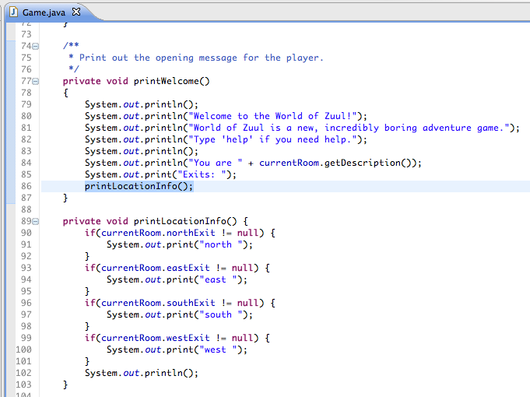
Refactor

Slide 15
Exploring Design through Modification Tasks
How could we change the design of the code to make the following tasks easier?
Add another direction of movement to NESW: Up/Down
Add a new room: cellar
Add an additional command word
Add a different command language besides English *See Tasks.docx
Notes:
Don’t make change, just walk through all the steps – how could we change the design of the code to make these tasks easier?

Slide 16
Homework
Practice design concepts with the exercises on BB (Designing Classes Practice under MPL)
Think about Project 2
Notes:
Take from BB quiz last year

Slide 17
Review Material

Slide 18
Method Overloading
The compiler determines which method is being invoked by analyzing the parameters
float tryMe(int x)
{
return x + .375;
}
Invocation
result = tryMe(25, 4.32)
float tryMe(int x, float y)
{
return x*y;
}

Slide 19
Method Overloading
The println method is overloaded:
println (String s)
println (int i)
println (double d)
and so on...
The following lines invoke different versions of the println method:
System.out.println ("The total is:");
System.out.println (total);

Slide 20
Enumerated Types
In Chapter 3 we introduced enumerated types, which define a new data type and list all possible values of that type:
enum Season {winter, spring, summer, fall}
Once established, the new type can be used to declare variables
Season time;
The only values this variable can be assigned are the ones established in the enum definition

Slide 21
Enumerated Types
An enumerated type definition is a special kind of class
The values of the enumerated type are objects of that type
For example, fall is an object of type Season
That's why the following assignment is valid:
time = Season.fall;

Slide 22
Enumerated Types
An enumerated type definition can be more interesting than a simple list of values
Because they are like classes, we can add additional instance data and methods
We can define an enum constructor as well
Each value listed for the enumerated type calls the constructor
See Season.java
See SeasonTester.java

Slide 23
//********************************************************************
// Season.java Author: Lewis/Loftus
//
// Enumerates the values for Season.
//********************************************************************
public enum Season
{
winter ("December through February"),
spring ("March through May"),
summer ("June through August"),
fall ("September through November");
private String span;
//-----------------------------------------------------------------
// Constructor: Sets up each value with an associated string.
//-----------------------------------------------------------------
Season (String months)
{
span = months;
}
//-----------------------------------------------------------------
// Returns the span message for this value.
//-----------------------------------------------------------------
public String getSpan()
{
return span;
}

Slide 24
//********************************************************************
// SeasonTester.java Author: Lewis/Loftus
//
// Demonstrates the use of a full enumerated type.
//********************************************************************
public class SeasonTester
{
//-----------------------------------------------------------------
// Iterates through the values of the Season enumerated type.
//-----------------------------------------------------------------
public static void main (String[] args)
{
for (Season time : Season.values())
System.out.println (time + "\t" + time.getSpan());
}
}

Slide 25
Output
winter December through February
spring March through May
summer June through August
fall September through November
//********************************************************************
// SeasonTester.java Author: Lewis/Loftus
//
// Demonstrates the use of a full enumerated type.
//********************************************************************
public class SeasonTester
{
//-----------------------------------------------------------------
// Iterates through the values of the Season enumerated type.
//-----------------------------------------------------------------
public static void main (String[] args)
{
for (Season time : Season.values())
System.out.println (time + "\t" + time.getSpan());
}
}

Slide 26
Enumerated Types
Every enumerated type contains a static method called values that returns a list of all possible values for that type
The list returned from values can be processed using a for-each loop
An enumerated type cannot be instantiated outside of its own definition
A carefully designed enumerated type provides a versatile and type-safe mechanism for managing data

Slide 27
Static Class Members
Recall that a static method is one that can be invoked through its class name
For example, the methods of the Math class are static:
result = Math.sqrt(25)
Variables can be static as well
Determining if a method or variable should be static is an important design decision

Slide 28
The static Modifier
We declare static methods and variables using the static modifier
It associates the method or variable with the class rather than with an object of that class
Static methods are sometimes called class methods and static variables are sometimes called class variables
Let's carefully consider the implications of each

Slide 29
Static Variables
Normally, each object has its own data space, but if a variable is declared as static, only one copy of the variable exists
private static float price;
Memory space for a static variable is created when the class is first referenced
All objects instantiated from the class share its static variables
Changing the value of a static variable in one object changes it for all others

Slide 30
Static Methods
public class Helper
{
public static int cube (int num)
{
return num * num * num;
}
}
Because it is declared as static, the cube method can be invoked through the class name:
value = Helper.cube(4);

Slide 31
Static Class Members
The order of the modifiers can be interchanged, but by convention visibility modifiers come first
Recall that the main method is static – it is invoked by the Java interpreter without creating an object
Static methods cannot reference instance variables because instance variables don't exist until an object exists
However, a static method can reference static variables or local variables

Slide 32
Static Class Members
Static methods and static variables often work together
The following example keeps track of how many Slogan objects have been created using a static variable, and makes that information available using a static method
See SloganCounter.java
See Slogan.java

Slide 33
//********************************************************************
// SloganCounter.java Author: Lewis/Loftus
//
// Demonstrates the use of the static modifier.
//********************************************************************
public class SloganCounter
{
//-----------------------------------------------------------------
// Creates several Slogan objects and prints the number of
// objects that were created.
//-----------------------------------------------------------------
public static void main (String[] args)
{
Slogan obj;
obj = new Slogan ("Remember the Alamo.");
System.out.println (obj);
obj = new Slogan ("Don't Worry. Be Happy.");
System.out.println (obj);
continue

Slide 34
continue
obj = new Slogan ("Live Free or Die.");
System.out.println (obj);
obj = new Slogan ("Talk is Cheap.");
System.out.println (obj);
obj = new Slogan ("Write Once, Run Anywhere.");
System.out.println (obj);
System.out.println();
System.out.println ("Slogans created: " + Slogan.getCount());
}
}

Slide 35
Output
Remember the Alamo.
Don't Worry. Be Happy.
Live Free or Die.
Talk is Cheap.
Write Once, Run Anywhere.
Slogans created: 5
continue
obj = new Slogan ("Live Free or Die.");
System.out.println (obj);
obj = new Slogan ("Talk is Cheap.");
System.out.println (obj);
obj = new Slogan ("Write Once, Run Anywhere.");
System.out.println (obj);
System.out.println();
System.out.println ("Slogans created: " + Slogan.getCount());
}
}

Slide 36
//********************************************************************
// Slogan.java Author: Lewis/Loftus
//
// Represents a single slogan string.
//********************************************************************
public class Slogan
{
private String phrase;
private static int count = 0;
//-----------------------------------------------------------------
// Constructor: Sets up the slogan and counts the number of
// instances created.
//-----------------------------------------------------------------
public Slogan (String str)
{
phrase = str;
count++;
}
continue

Slide 37
continue
//-----------------------------------------------------------------
// Returns this slogan as a string.
//-----------------------------------------------------------------
public String toString()
{
return phrase;
}
//-----------------------------------------------------------------
// Returns the number of instances of this class that have been
// created.
//-----------------------------------------------------------------
public static int getCount ()
{
return count;
}
}

Slide 38
Quick Check
Why can't a static method reference an instance variable (i.e., non-static field)?

Slide 39
Quick Check
Why can't a static method reference an instance variable (i.e., non-static field)?
Because instance data is created only when an
object is created.
You don't need an object to execute a static method.
And even if you had an object, which object's instance
data would be referenced? (remember, the method is
invoked through the class name)

Slide 40
Review: the this Reference
The this reference allows an object to refer to itself
That is, the this reference, used inside a method, refers to the object through which the method is being executed
Suppose the this reference is used inside a method called tryMe, which is invoked as follows:
obj1.tryMe();
obj2.tryMe();
In the first invocation, the this reference refers to obj1; in the second it refers to obj2

Slide 41
The this reference
The this reference can be used to distinguish the instance variables of a class from corresponding method parameters with the same names
The constructor of the Account class from Chapter 4 could have been written as follows:
public Account (String name, long acctNumber,
double balance)
{
this.name = name;
this.acctNumber = acctNumber;
this.balance = balance;
}

