Slide 1
Improving program structure (design) with inheritance
Chapters 7.5, 9-10

Slide 2
Example: DoME
DoME = Database of Multimedia Entertainment
Load DoME projects from BB
Look at DoMEv1: is there code duplication? Where?

Slide 3
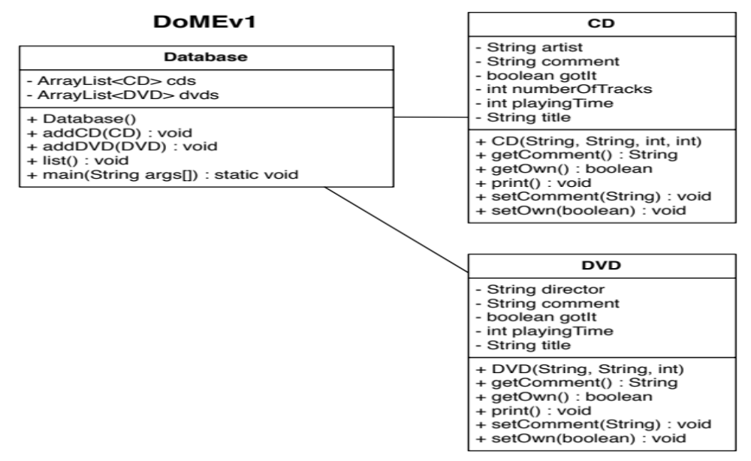
DoMEv1
Copyright © 2012 Pearson Education, Inc.

Slide 4
DoMEv1
Copyright © 2012 Pearson Education, Inc.

Slide 5
Inheritance
Inheritance: define a class as an extension of another class
Advantages:
  Avoid code duplication
  Code reuse: take advantage of existing functionality
  Easier to maintain: localize changes
  Extendibility: easier to extend functionality in future
Java supports single inheritance, meaning that a derived class can have only one parent class

Slide 6
Example: DoMEv1
Use inheritance to remove code duplication between CD & DVD (DoMEv1 → DoMEv2)
Step 1: identify where CD/DVD overlap & differ in terms of fields & methods
Step 2: pull out the duplicate code into its own class, Item, using Refactor > Extract Superclass
Step 3: update CD/DVD classes to extend Item & call super() in the constructors

Slide 7
The super Reference
Constructors are not inherited, even though they have public visibility
Yet we often want to use the parent's constructor to set up the "parent's part" of the object
The super reference can be used to refer to the parent class, and often is used to invoke the parent's constructor
A child’s constructor is responsible for calling the parent’s constructor
Copyright © 2012 Pearson Education, Inc.

Slide 8
Example: DoMEv1
Use inheritance to remove code duplication between CD & DVD (DoMEv1 → DoMEv2)
Step 1: identify where CD/DVD overlap & differ in terms of fields & methods
Step 2: pull out the duplicate code into its own class, Item, using Refactor > Extract Superclass
Step 3: update CD/DVD classes to extend Item & call super() in the constructors

Slide 9
Example: DoMEv1
Use inheritance to remove code duplication between CD & DVD (DoMEv1 → DoMEv2)
Step 1: identify where CD/DVD overlap & differ in terms of fields & methods
Step 2: pull out the duplicate code into its own class, Item, using Refactor > Extract Superclass
Step 3: update CD/DVD classes to extend Item & call super() in the constructors
Step 4: update Database class to use Item instead of keeping 2 lists

Slide 10
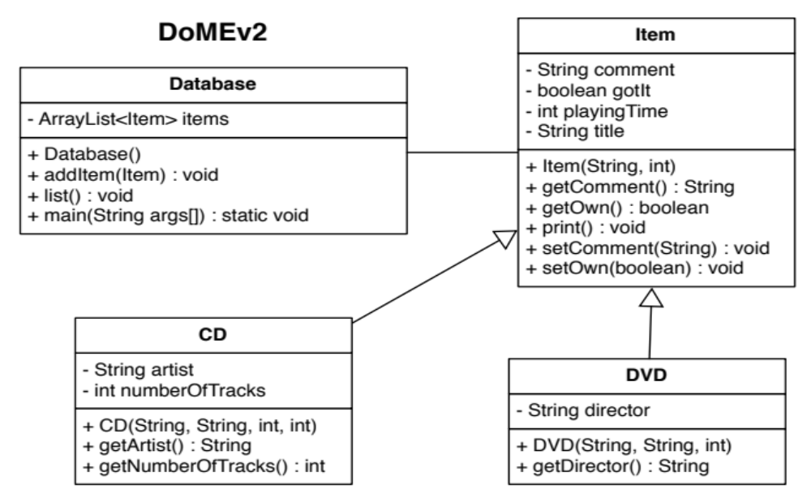
DoMEv2
Look at how much simpler the design is!
Copyright © 2012 Pearson Education, Inc.

Slide 11
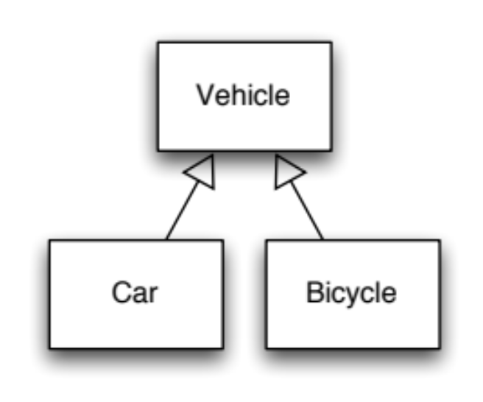
Variables & subtypes
Polymorphic variable: a variable that can hold objects of different types (example: Item)
Type on RHS of declaration must be ≤ type on LHS in type hierarchy
Valid variable declarations:
Vehicle v1 = new Vehicle();
Vehicle v2 = new Car();
Vehicle v3 = new Bicycle();
Invalid variable declarations:
Car c1 = new Vehicle();
Car c2 = new Bicycle();
Easy way to remember: RHS is-a LHS
Copyright © 2012 Pearson Education, Inc.

Slide 12
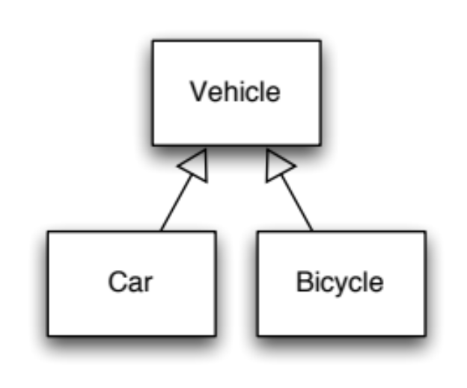
Casting Revisited
In general, can’t assign from a super type to a subtype
BUT, because of polymorphism, sometimes a super-typed variable may contain a valid subtype for assignment
Example:
Vehicle v;
Car c = new Car();
v = c; // correct
c = v; // compiler error but we know is valid!
c = (Car) v; // no error
What if we cast when we shouldn’t? Runtime error
Copyright © 2012 Pearson Education, Inc.

Slide 13
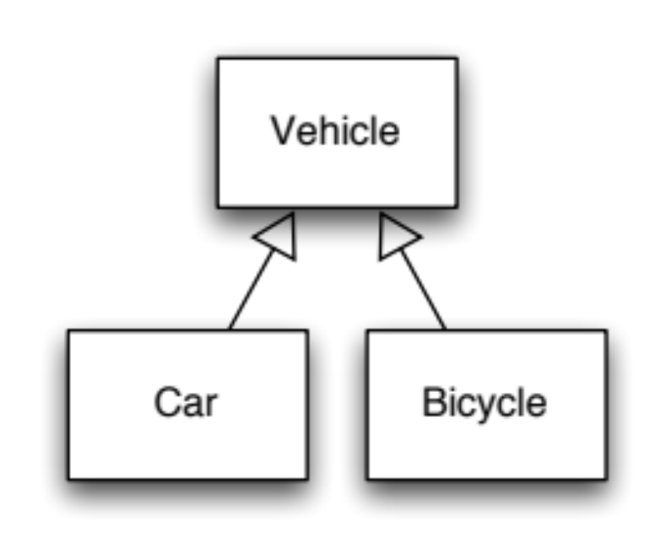
Example 2
Vehicle v;
Car c = new Car();
Bicycle b;
v = c; // ok
b = (Bicycle) c;
b = (Bicycle) v;
// compiler error
// runtime error
Copyright © 2012 Pearson Education, Inc.

Slide 14
Quick Check
If MusicPlayer is the parent of CDPlayer, are the following assignments valid?
MusicPlayer mplayer = new CDPlayer();
CDPlayer cdplayer = new MusicPlayer();
Copyright © 2012 Pearson Education, Inc.

Slide 15
Quick Check
If MusicPlayer is the parent of CDPlayer, are the following assignments valid?
MusicPlayer mplayer = new CDPlayer();
CDPlayer cdplayer = new MusicPlayer();
Yes, because a CDPlayer is-a MusicPlayer
No, you'd have to use a cast (and you shouldn't
knowingly assign a super class object to a
subclass reference)
Copyright © 2012 Pearson Education, Inc.

