Slide 1
Improving program structure (design) with inheritance
Part II
Chapters 7.5, 9-10

Slide 2
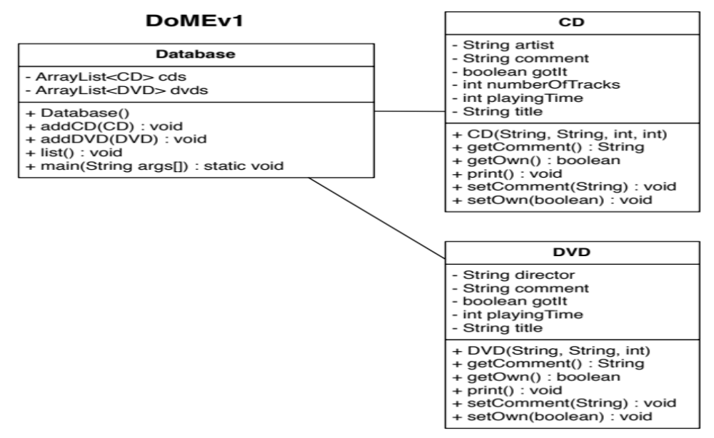
DoMEv1
Copyright © 2012 Pearson Education, Inc.

Slide 3
DoMEv1
Copyright © 2012 Pearson Education, Inc.

Slide 4
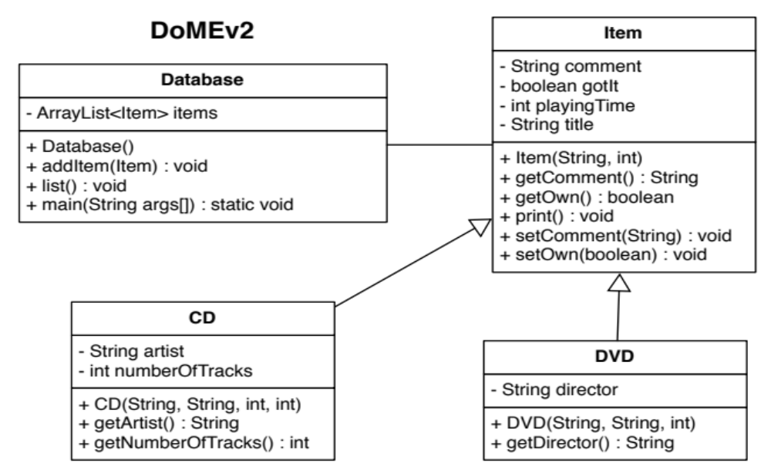
DoMEv2
Look at how much simpler the design is!
Copyright © 2012 Pearson Education, Inc.

Slide 5
Recall DoME from last time…
DoME = Database of Multimedia Entertainment
Load DoME projects from BB
Look at the print methods in DoMEv2
  Item.print() prints general info that is shared by both CDs & DVDs
  CD.print() & DVD.print() print information specific to CDs & DVDs, respectively
  In the for loop in Database.list(), Item is a polymorphic variable:
    Static type = variable’s declared type (Item)
    Dynamic type = actual type stored @ runtime (CD/DVD)

Slide 6
Polymorphic methods
We changed the print-specific behavior for CD & DVD using method overriding
  Just as we created fields specific to CD/DVD, we created specific print methods by overriding Item.print()
Method polymorphism: the same method call may invoke different methods depending on the dynamic type of the object
Useful things to override:
  Object.toString()
  Object.equals()
If multiple methods defined in class hierarchy, which will be executed?
  Closest super method to actual (dynamic) type
Copyright © 2012 Pearson Education, Inc.

Slide 7
Overriding method example
Visibility note:
  Private (-): only current class can access
  Protected (#): all subclasses in class hierarchy can access
  Public (+) all classes can access
Should the visibility of any fields in CD/DVD/Item be changed? Why or why not?
Copyright © 2012 Pearson Education, Inc.

Slide 8
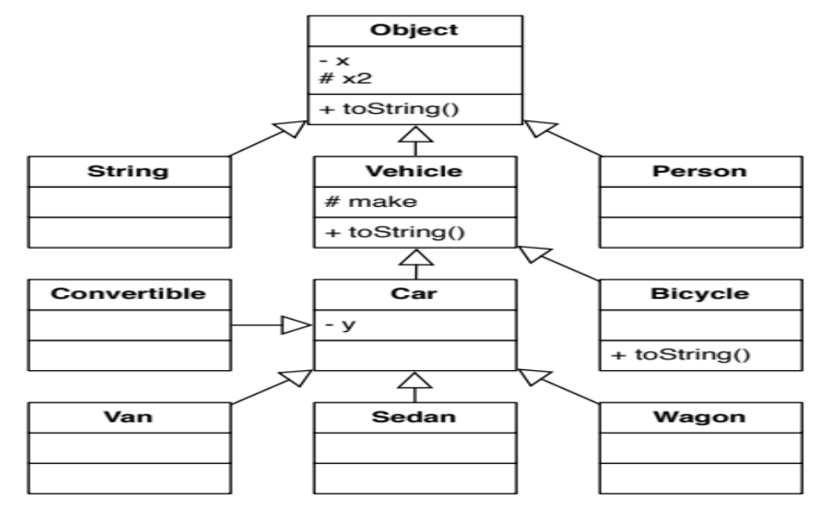
Copyright © 2012 Pearson Education, Inc.
Notes:
Draw on board

Slide 9
Let’s look at an example…
What will be executed if … called?
  Bicycle.toString()
  Person.toString()
  Sedan.toString()
Where can field …. Be accessed from?
  x
  y
  x2
  make
Bicycle
Object
Vehicle
Object
Car
All classes in diagram
Vehicle, Car, Bicycle, Van, Sedan, Wagon, Convertible
Copyright © 2012 Pearson Education, Inc.

Slide 10
Abstract classes
DoME: do we want to allow general Items in our DB, or only specific ones like CDs, DVDs, or Games?
How can we keep shared code in Item but ensure it’s never instantiated?
Abstract class: share code without allowing constructors
  Allows for abstract methods: methods that must be implemented by an concrete (not abstract) subtypes
Item.print(): instead of using overriding/super, make it abstract (demo)
Copyright © 2012 Pearson Education, Inc.

Slide 11
Interfaces
Issue: what if I want to inherit functionality from multiple classes?
  In Java, a class can only inherit from ONE class (concrete or abstract)
But polymorphism is so cool in the DB class…
  Java classes can conform to multiple interfaces
Interface: a class with no source code, all methods are abstract by default (don’t need to specify), and no constructors
Demo: extract DoMEEntry interface from Item
Copyright © 2012 Pearson Education, Inc.

Slide 12
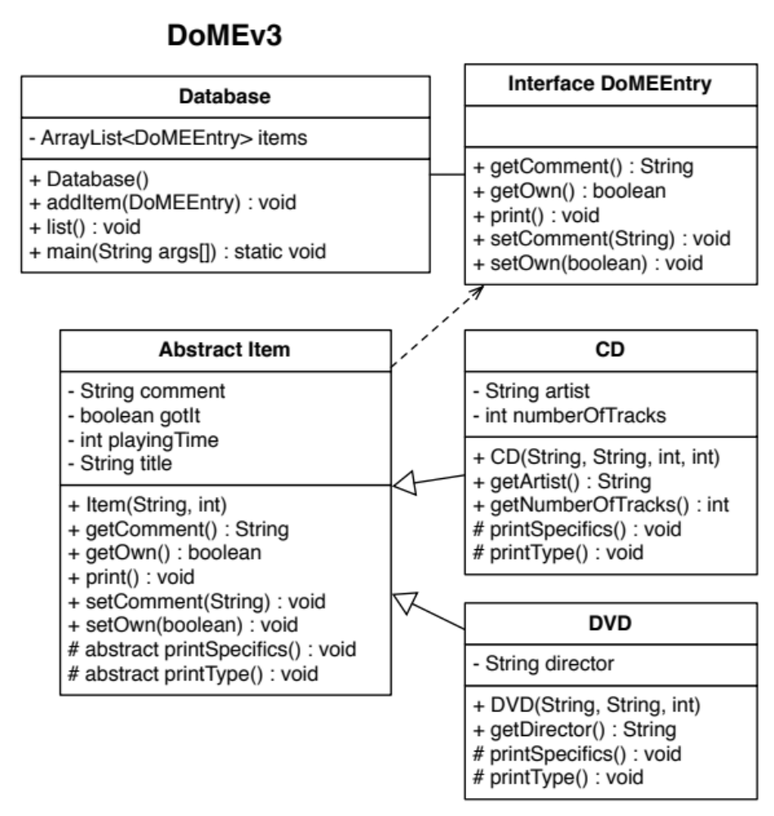
Easier to add new items without changing Database code
Copyright © 2012 Pearson Education, Inc.

Slide 13
Next Step in DoME
What if we added video games to our DB? What types of fields would they have?
Does the shared code in Item make sense?
  No! Games (board/video) may need their own shared code: # players, etc.
  By using the DoMEEntry interface in DB, we can add as many new types to our DB without changing the DB class source code
Draw a new class diagram for adding Video & Board Games & update your implementation to support these new types. Be sure to test them in main.
Copyright © 2012 Pearson Education, Inc.

Slide 14
Abstract classes & Interfaces for Design
Abstract classes
  use inheritance to avoid code duplication
  Leave some implementation details to subclasses
Interfaces: ultimate de-coupling tool
  enforce loose coupling
  Subclasses can’t depend on implementation because there is none!
“interface” can mean 2 things:
  Informally, interface = public method signatures of a class
  In Java, “interface type” = formal construct for defining classes with no source code
Copyright © 2012 Pearson Education, Inc.

Slide 15
Abstract Classes vs Interfaces
How do we decide which to use?
Use abstract classes when:
  You want to reuse default functionality & leave some specific functionality up to the implementing classes
  Especially when base functionality will frequently change, or is complex/difficult to modify
  (because interfaces can cause code duplication)
Use an interface when:
  You want to force decoupling design from implementation
  Esp. when common functionality is implemented in a very different way for each class
Copyright © 2012 Pearson Education, Inc.

Slide 16
Abstract Classes vs Interfaces
Best of both worlds: use interfaces @ highest level, and then implement shared functionality using abstract classes conforming to an interface
Example:
  CD & DVD have code duplication, so we avoid with an abstract Item class
  We implement DB in terms of an interface so in future we can add significantly different DB entries like books or games without modifying the general DB application code
Copyright © 2012 Pearson Education, Inc.

