Slide 1
CSCI151: Object-Oriented Programming
Dr. Emily Hill
Spring 2015

Slide 2
CSCI 117
“Computer Science is no more about computers than astronomy is about telescopes.” -Dijkstra
RECAP

Slide 3
“Everybody in this country should learn how to program a computer… because it teaches you how to think.”
—Steve Jobs

Slide 4
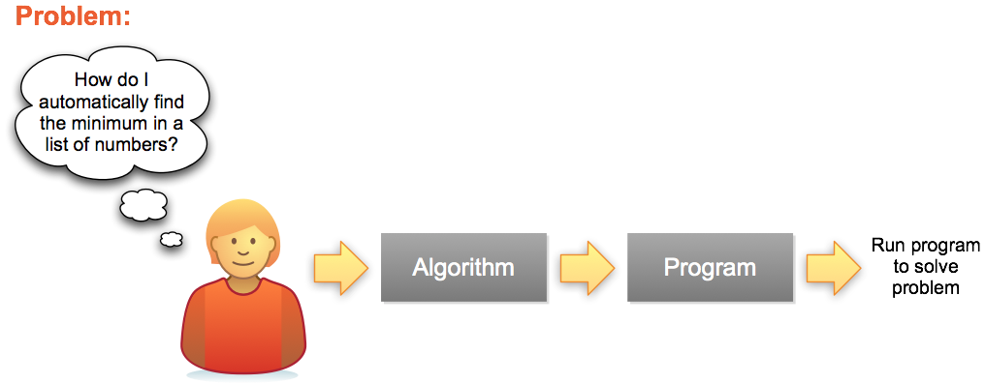
Problem Solving Process
Series of steps for any Programming Language (Python, Java, C, C++, C#, Ruby, perl, php…)
A specific implementation

Slide 5
The 7 “Habits” of Highly Effective Programmers
Variables: storing information (numbers, text)
Math & Logic: writing & evaluating expressions
Input/Output (IO): getting information from the user (or a file/DB) and displaying information to the screen graphically or with the console
Conditions: changing what code statements are executed under different scenarios (i.e., if the day is Sunday, sleep in; otherwise, get up at 6 am)
Loops: repeat code statements (e.g.: while the sink is dirty, keep scrubbing)
Functions: grouped set of statements to accomplish a task based on parameters (e.g.: given f(x)=x+5 then f(2) would be 7)
Lists: store multiple pieces of information (e.g.: an array that stores the integers 1-5 or the letters of the alphabet)

Slide 6
These 7 concepts can be combined in infinitely many ways. Once mastered, you can implement any program that's ever been written, in any programming language.
Then what do we need 151 for?

Slide 7
CSCI 151
Course Overview

Slide 8
Course Goals
In 117:
Basic python programming in a single file
Problem solving (i.e., computational thinking)
Text-based UNIX development environment
In 151: transition from programmer to software developer
Design object-oriented programs by breaking a problem down into actions & objects
Build event-driven GUI applications
Use industry standard development tools (Eclipse)
Design & build larger software applications
Notes:
If you didn’t master these concepts in 183, I will expect you to take extra time to master them, in addition to the new material we’re covering.

Slide 9
Consider the scenario…
You’ve graduated and been hired as a developer at Microsoft
You are asked to add a new feature (sync menu) to the 47 million line code base. How will you:
Design the code to be easy for others to understand?
Integrate your new feature into the rest of the code base?
During testing, you find a bug. How will you:
Craft test cases to isolate the cause of the bug?
Locate the code you need to fix the bug?
Design the bug fix to make modification easier in the future?
Know if your fix affects other parts of the software?
In this class, we’ll learn design concepts to help you answer such questions as well as deepen your programming skills.

Slide 10

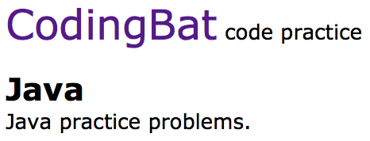



FREE Textbooks & Resources
Notes:
+ free online resources

Slide 11
How do you get to Carnegie Hall?
Practice!
Riding a bike, sports, music, foreign languages
Notes:
Bike, athletics, music, foreign language

Slide 12
Tips for success:
Practice coding every day. No excuses.
Workout of the Day (WODs)
Google is your friend. Learn to use it effectively.
Be the leader of your learning. When you get stuck, answer the following questions:
What don’t I understand?
What do I expect to happen?
What is actually happening?
What resources can I use to understand better? (scientific method, google, peer, instructor, etc.)
Start early & work often
Piazza!
Notes:
To do add example self-help scenarios?

