Slide 1
Reusing Code: Inheritance & Composition
Dr. Emily Hill
Spring 2015
Notes:
First: go over WOD2

Slide 2
Review
Defining a class

Slide 3
Classes & Objects
Class: a blueprint for objects A class defines
The object’s attributes (field types & names)
What an object can do (methods)
How to setup an object (constructors)
Object: specific instance of a class
Has values for attributes (field values)
Initialized by the constructor
Methods operate on these values & may change them
Example: car

Slide 4
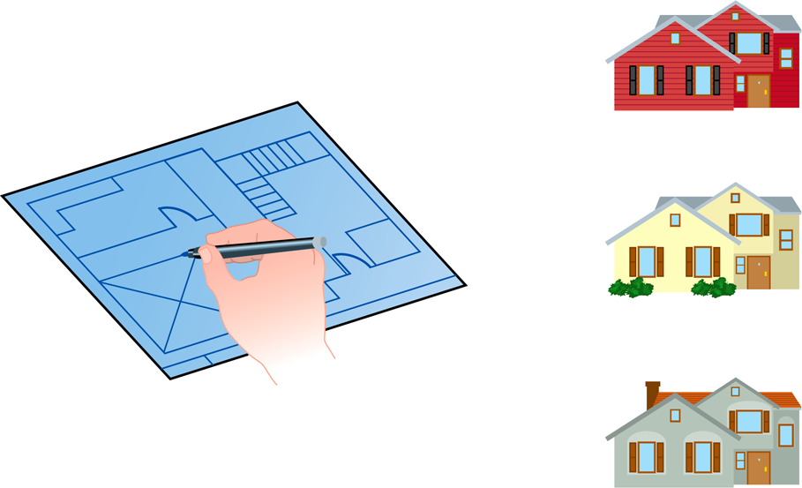
Class = Blueprint
One blueprint to create several similar, but different, houses:

Slide 5
Java Program Structure
public class ClassName
{
Fields
Constructors
Methods
}
A program is made up of one or more classes
Fields: store data for the object to use
Constructors: create new instance of the object and initialize data
Methods – implement the object’s actions (i.e., what you can do with it)

Slide 6
Inheritance
Extending the functionality of a class

Slide 7
Inheritance
Inheritance: define a class as an extension of another class (i.e., a subclass extends a super class)
Advantages:
Avoid code duplication
Code reuse: take advantage of existing functionality
Easier to maintain: localize changes
Extendibility: easier to extend functionality in future
Subclass can override methods in super class (same signature)
super: access method in parent (super) class
this: access method in current (sub) class

Slide 8
Field modifiers
What are the Java visibility modifiers?
private: only accessible within current class
public: accessible from any class
protected: all subclasses can access
Additional modifiers:
static
Only one copy of field exists per class
No matter how many objects are created, all refer to same memory location
final
Field that can only be assigned to once
Suitable for constant values that don’t change during execution
Example: Math.PI is public, static, and final

Slide 9
Try it!
Ellipse
Notes:
PWOD: Rectangle

Slide 10
Review: Using Classes Example
(offline)

Slide 11
A Special Car
Imagine you have a special remote control car called sc that can spray paint the ground and has the following behaviors:
turn(int degrees)
That turns the remote control car by a specified degree
Where right is positive left is negative
E.g. sc.turn(90), sc.turn(-90)
startSpray()
That starts spraying the ground
stopSpray()
That stops spraying the ground
forward(int x)
That moves the remote control car forward x distance
E.g. sc.forward(100)
Split into groups and draw shapes
E.g. square, rectangle, triangle, pentagon, circle
Notes:
Like logo turtle!

