Slide 1
Intro to Java
Dr. Emily Hill
Spring 2015

Slide 2
Java Program Structure
public class ClassName
{
Fields
Constructors
Methods
}
A program is made up of one or more classes
Fields: store data for the object to use
Constructors: create new instance of the object and initialize data
Methods – implement the object’s actions (i.e., what you can do with it)

Slide 3
Java Program Structure Example
//***********************************************************
// Lincoln.java Author: Lewis/Loftus
//
// Demonstrates the basic structure of a Java application.
//***********************************************************
public class Lincoln
{
//---------------------------------------------------------
// Prints a presidential quote.
//---------------------------------------------------------
public static void main (String[] args)
{
System.out.println ("A quote by Abraham Lincoln:");
System.out.println ("Whatever you are, be a good one.");
}
}
comments
class header
method signature
class body
method body
parameter/argument

Slide 4
Output
A quote by Abraham Lincoln:
Whatever you are, be a good one.
//***********************************************************
// Lincoln.java Author: Lewis/Loftus
//
// Demonstrates the basic structure of a Java application.
//***********************************************************
public class Lincoln
{
//---------------------------------------------------------
// Prints a presidential quote.
//---------------------------------------------------------
public static void main (String[] args)
{
System.out.println ("A quote by Abraham Lincoln:");
System.out.println ("Whatever you are, be a good one.");
}
}

Slide 5
Java Comments
// this comment runs to the end of the line
/* this comment runs to the terminating
symbol, even across line breaks */
/** this is a javadoc comment */

Slide 6
White Space
Spaces, blank lines, and tabs are white space
White space is used to separate words and symbols in a program – extra is ignored
Unlike python, a valid Java program can be formatted many ways
Notes:
* Take screenshots?

Slide 7
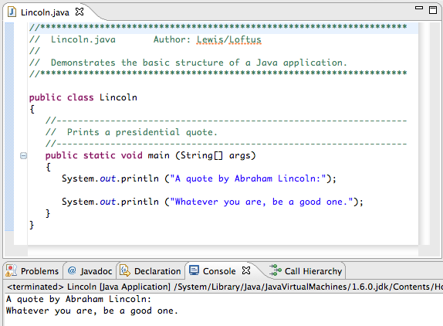
Original Lincoln.java
Source Code
Output

Slide 8
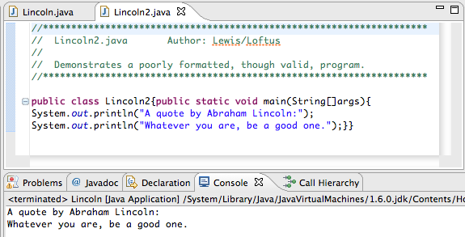
Different white space & comments
Notes:
Still readable

Slide 9
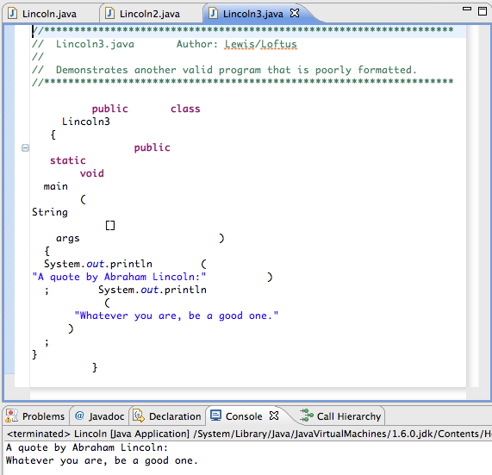
Different white space & comments
Notes:
Terrible!
Which was the most readable?

Slide 10
Classes & Objects
Class: a blueprint for objects A class defines
The object’s attributes (field types & names)
What an object can do (methods)
How to setup an object (constructors)
Object: specific instance of a class
Has values for attributes (field values)
Initialized by the constructor
Methods operate on these values & may change them
Example: car

Slide 11
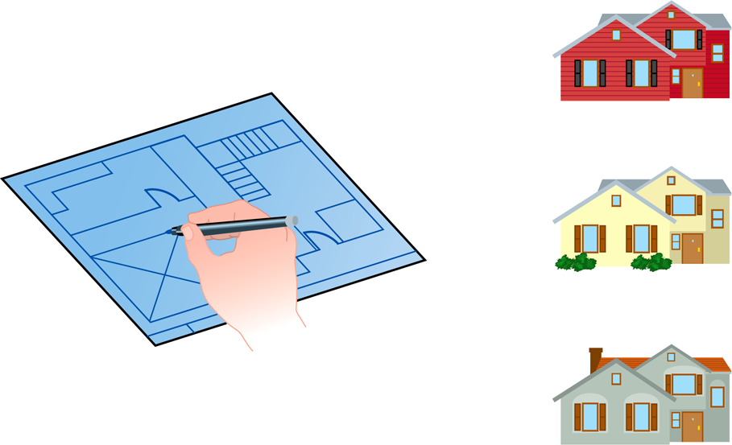
Class = Blueprint
One blueprint to create several similar, but different, houses:

Slide 12
Identifying Objects
Think about activities you do everyday
What real-world entities do you interact with?
What about programs you use?
Your phone, laptop/desktop
Identify
Classes
Information/data
Behaviors/actions
Notes:
Use the Word document handout for them to fill in classes, data, and behaviors
Identify (~4+ minutes)
Share/Group (3-4 people; ~6+ minutes)
Choose one from the group that everyone is pretty familiar with and write as much detail as you can on the board (~4 minutes)
Share/Class (~4+ minutes)

Slide 13
Game: Identify…
Classes
Behaviors/actions
Information/data
Input/output?
Notes:
Break out into groups for angry birds
Use the Word document handout for them to fill in classes, data, and behaviors
Go and Play the Wii ~15 minutes

Slide 14
WOD
Hello World Import & Export
Notes:
http://emhill.github.io/151-S15/morea/01.WOD-intro/pwod1.html

Slide 15
Submit your WOD
Right-click on your project folder, select
“Export > General > Archive File”
Name it “HelloWorld_uLogin”
Upload to Moodle

Slide 16
PWOD
Hello World GUI

Slide 17
Importing Hello World GUI
Download HelloWorldGUI.zip
Open Eclipse and go to File > Import > General > Existing Projects into Workspace
Select archive file, hit “Browse”, and select the HelloWorldGUI.zip you just downloaded
Double-click the project folder, the src folder, and then the default package. You should now see a class file, HelloWorldShapes.java.
To run the applet:
Right-click HelloShapes.java class and select “Run As > Java Application”
Click on the green play button at the top of the screen
Notes:
Demo

Slide 18
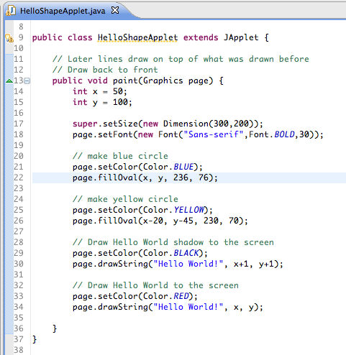
You should see…

Slide 19
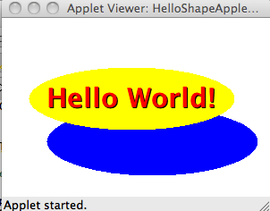
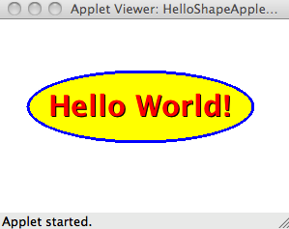
Graded WOD
Edit the paint? method in the HelloWorldGUI class so that the blue circle forms an even boarder around the yellow:
Replace “Hello World” with your name and update both circles so your name is centered within them

Slide 20
Submit your WOD
Right-click on your project folder, select
“Export > General > Archive File”
Name it “HelloWorldGUI_uLogin”
Upload to Moodle

Slide 21
Defining a Class

Slide 22
Java Program Structure
public class ClassName
{
Fields
Constructors
Methods
}
A program is made up of one or more classes
Fields: store data for the object to use
Constructors: create new instance of the object and initialize data
Methods – implement the object’s actions (i.e., what you can do with it)

Slide 23
Fields
Fields store values for an object.
They are also known as instance variables.
Fields define the state of an object.
public class Circle
{
private int x;
private int y;
private int size;
private Color fillColor;
// Further details omitted.
}
type
visibility modifier
variable name
private int size;

Slide 24
Similar Names for Fields
All of these terms can be used interchangeably:
Fields
Instance Variables
Characteristics
Data
Attributes
Properties
The values of the fields define the object’s _______
state

Slide 25
Data Types In Java
boolean
char
int
long
float
double
String
(any class)
— true, false
— a…z,A…Z,[symbols]
— integers
— larger integers (2x)
— floating decimal
— larger floating decimal (2x)
— characters strung together
— defined class

Slide 26
8 Primitive Data Types in Java
Four represent integers:
byte, short, int, long
Two represent floating point numbers (with decimals):
float, double
One represents single characters:
char
One represents boolean values:
boolean
What about other data?
It must be defined as a class!

Slide 27
Numeric Primitive Data
Why so many types to hold numbers?
Different sizes affect what values can be stored:
Type
byte
short
int
long
float
double
Storage
8 bits
16 bits
32 bits
64 bits
32 bits
64 bits
Min Value
-128
-32,768
-2,147,483,648
< -9 x 10¹⁸
+/- 3.4 x 10³⁸ with 7 significant digits
+/- 1.7 x 10³⁰⁸ with 15 significant digits
Max Value
127
32,767
2,147,483,647
> 9 x 10¹⁸

Slide 28
Constructors
public Square()
{
x = 0;
y = 0;
size = 0;
color = Color.blue;
}
Constructors initialize an object.
They have the same name as their class.
They store initial values into the fields.
They often receive external parameter values for this.
Notes:
Only here as a brief introduction and to reinforce what they saw last class

Slide 29
Methods
method header/signature
return type
visibility modifier
method name
/**
* Gets the size of the square.
*/
parameter list (empty)
public int getSize()
{
return size;
}
return statement
start and end of method body (block)
Notes:
Only here as a brief introduction

