Slide 1
Defining a class & Java Types
Dr. Emily Hill
Spring 2015

Slide 2
Java Program Structure Example
//***********************************************************
// Lincoln.java Author: Lewis/Loftus
//
// Demonstrates the basic structure of a Java application.
//***********************************************************
public class Lincoln
{
//---------------------------------------------------------
// Prints a presidential quote.
//---------------------------------------------------------
public static void main (String[] args)
{
System.out.println ("A quote by Abraham Lincoln:");
System.out.println ("Whatever you are, be a good one.");
}
}
comments
class header
method signature
class body
method body
parameter/argument

Slide 3
Java Program Structure
public class ClassName
{
Fields
Constructors
Methods
}
A program is made up of one or more classes
Fields: store data for the object to use
Constructors: create new instance of the object and initialize data
Methods – implement the object’s actions (i.e., what you can do with it)

Slide 4
Fields
Fields store values for an object.
They are also known as instance variables.
Fields define the state of an object.
public class Circle
{
private int x;
private int y;
private int size;
private Color fillColor;
// Further details omitted.
}
type
visibility modifier
variable name
private int size;

Slide 5
Similar Names for Fields
All of these terms can be used interchangeably:
Fields
Instance Variables
Characteristics
Data
Attributes
Properties
The values of the fields define the object’s _______
state

Slide 6
Data Types In Java
boolean
char
int
long
float
double
String
(any class)
— true, false
— a…z,A…Z,[symbols]
— integers
— larger integers (2x)
— floating decimal
— larger floating decimal (2x)
— characters strung together
— defined class

Slide 7
8 Primitive Data Types in Java
Four represent integers:
byte, short, int, long
Two represent floating point numbers (with decimals):
float, double
One represents single characters:
char
One represents boolean values:
boolean
What about other data?
It must be defined as a class!

Slide 8
Numeric Primitive Data
Why so many types to hold numbers?
Different sizes affect what values can be stored:
Type
byte
short
int
long
float
double
Storage
8 bits
16 bits
32 bits
64 bits
32 bits
64 bits
Min Value
-128
-32,768
-2,147,483,648
< -9 x 10¹⁸
+/- 3.4 x 10³⁸ with 7 significant digits
+/- 1.7 x 10³⁰⁸ with 15 significant digits
Max Value
127
32,767
2,147,483,647
> 9 x 10¹⁸

Slide 9
Constructors
public Square()
{
x = 0;
y = 0;
size = 0;
color = Color.blue;
}
Constructors initialize an object.
They have the same name as their class.
They store initial values into the fields.
They often receive external parameter values for this.
Notes:
Only here as a brief introduction and to reinforce what they saw last class

Slide 10
Methods
method header/signature
return type
visibility modifier
method name
/**
* Gets the size of the square.
*/
parameter list (empty)
public int getSize()
{
return size;
}
return statement
start and end of method body (block)
Notes:
Only here as a brief introduction

Slide 11
Demo
Circle
Notes:
http://emhill.github.io/151-S15/morea/01.WOD-intro/pwod1.html

Slide 12
Defining a Circle
Create a new Java project Shapes_uLogin
Create a Circle class with:
fields for x position, y position, color, and radius
default constructor & constructor with parameters
Default constructors have no parameters, you need to set the fields to be actual values
Add getter & setter methods
Add paintComponent & main methods using HelloWorldGUI as an example (see next slide)

Slide 13
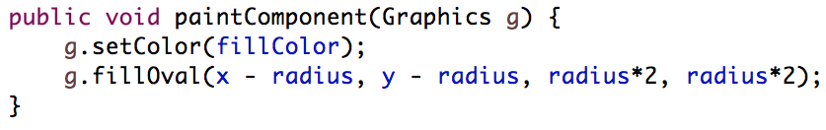
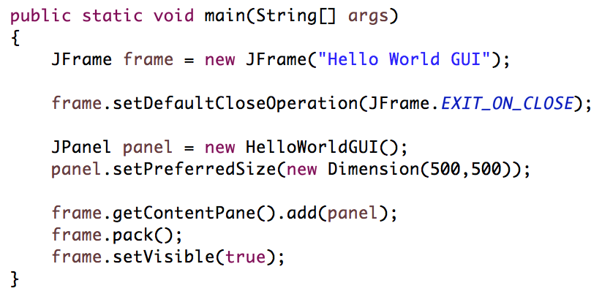
Drawing a circle & main

Slide 14
PWOD
Hello World GUI

Slide 15
Importing Hello World GUI
Download HelloWorldGUI.zip
Open Eclipse and go to File > Import > General > Existing Projects into Workspace
Select archive file, hit “Browse”, and select the HelloWorldGUI.zip you just downloaded
Double-click the project folder, the src folder, and then the default package. You should now see a class file, HelloWorldShapes.java.
To run the applet:
Right-click HelloShapes.java class and select “Run As > Java Application”
Click on the green play button at the top of the screen
Notes:
Demo

Slide 16
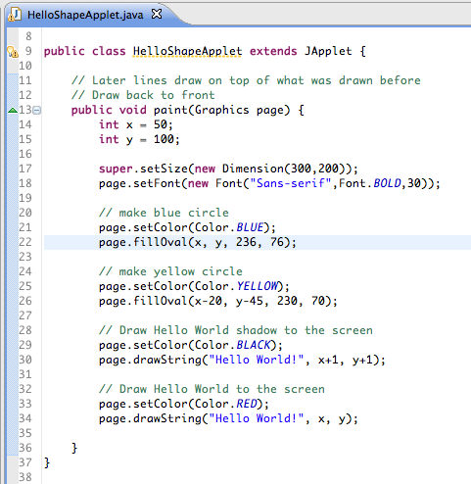
You should see…

Slide 17
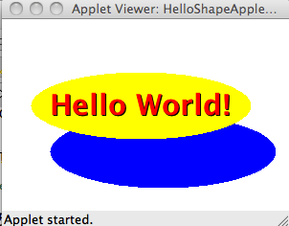
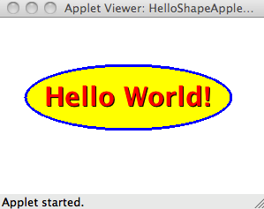
Graded WOD
Edit the paint? method in the HelloWorldGUI class so that the blue circle forms an even boarder around the yellow:
Replace “Hello World” with your name and update both circles so your name is centered within them

Slide 18
Submit your WOD
Right-click on your project folder, select
“Export > General > Archive File”
Name it “HelloWorldGUI_uLogin”
Upload to Moodle

