Slide 1
Collections, Loops, & Ifs
Dr. Emily Hill
Spring 2015
Notes:
First: go over WOD2

Slide 2
Grouping objects (i.e., Collections & Lists)
Many applications involve collections of objects:
Personal organizers.
Library catalogs.
Student-record system.
The number of items to be stored varies.
Items added.
Items deleted.

Slide 3
Example: A personal notebook
Notes may be stored.
Individual notes can be viewed.
There is no limit to the number of notes.
It will tell how many notes are stored.
Consider a Notebook project.

Slide 4
import java.util.ArrayList;
/**
* ...
*/
public class Notebook
{
// Storage for an arbitrary number of notes.
private ArrayList<String> notes;
/**
* Perform any initialization required for the
* notebook.
*/
public Notebook()
{
notes = new ArrayList<String>();
}
...
}
the type of collection
the type of objects in the collection

Slide 5
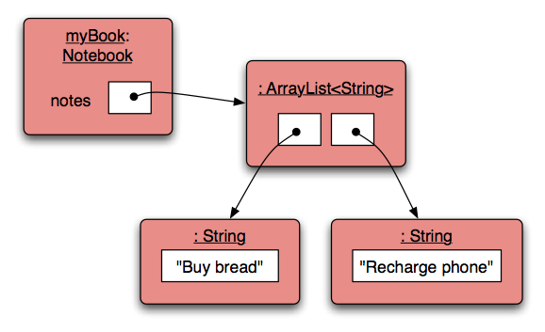
Object structures with collections

Slide 6
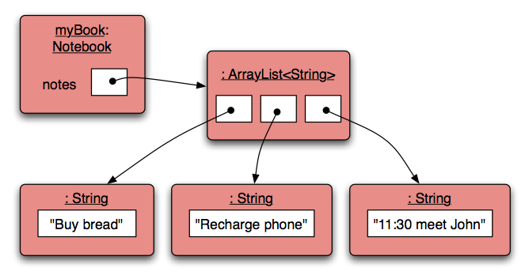
Adding a third note

Slide 7
Features of collections
It increases its capacity as necessary.
It keeps a private count (size() method).
It keeps the objects in order.
Details of how all this is done are hidden.
Does that matter? Does not knowing how prevent us from using it?

Slide 8
Using a collection
public class Notebook
{
private ArrayList<String> notes;
...
public void storeNote(String note)
{
notes.add(note);
}
public int numberOfNotes()
{
return notes.size();
}
...
}
Adding a new note
Returning the number
of notes (delegation)

Slide 9

Index numbering

Slide 10
Retrieving an object
Index validity checks
public void showNote(int noteNumber)
{
if(noteNumber < 0) {
// This is not a valid note number.
}
else if (noteNumber < numberOfNotes()) {
System.out.println(notes.get(noteNumber));
}
else {
// This is not a valid note number.
}
}
Retrieve and print the note

Slide 11
Removal may affect numbering
notes.remove(1);

Slide 12
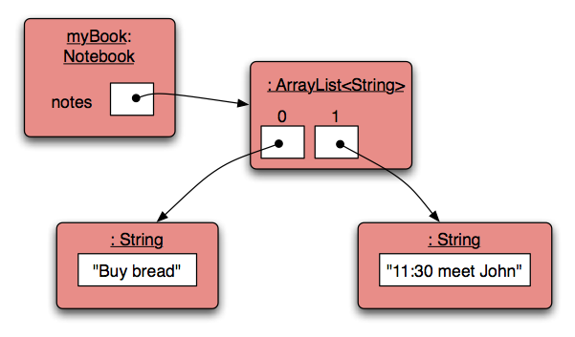
Removal may affect numbering
notes.remove(1);

Slide 13
The ArrayList Class (java.util.ArrayList)
An ArrayList object stores a list of objects, and is often processed using a loop
An ArrayList object grows and shrinks as needed, adjusting its capacity as necessary
You can reference each object in the list using a numeric index

Slide 14
The ArrayList Class
Index values of an ArrayList begin at 0:
0 "Bashful"
1 "Sleepy"
2 "Happy"
3 "Dopey"
4 "Doc"
Elements can be inserted and removed
The indexes of the elements adjust accordingly

Slide 15
Some ArrayList Methods
boolean add (E obj)
void add (int index, E obj)
Object remove (int index)
Object get (int index)
boolean isEmpty()
int size()

Slide 16
The ArrayList Class
The type of object stored in the list is established when the ArrayList object is created:
ArrayList<String> names = new ArrayList<String>();
ArrayList<Book> list = new ArrayList<Book>();
This makes use of Java generics, which provide additional type checking at compile time
An ArrayList object cannot store primitive types, use wrapper classes instead (Integer, Double, Character, etc.)

Slide 17
//********************************************************************
// Beatles.java Author: Lewis/Loftus
//
// Demonstrates the use of a ArrayList object.
//********************************************************************
import java.util.ArrayList;
public class Beatles
{
//-----------------------------------------------------------------
// Stores and modifies a list of band members.
//-----------------------------------------------------------------
public static void main (String[] args)
{
ArrayList<String> band = new ArrayList<String>();
band.add ("Paul");
band.add ("Pete");
band.add ("John");
band.add ("George");
continue

Slide 18
continue
System.out.println (band);
int location = band.indexOf ("Pete");
band.remove (location);
System.out.println (band);
System.out.println ("At index 1: " + band.get(1));
band.add (2, "Ringo");
System.out.println ("Size of the band: " + band.size());
for (String name : band)
{
System.out.println (name);
}
}
}

Slide 19
Output
[Paul, Pete, John, George]
[Paul, John, George]
At index 1: John
Size of the band: 4
Paul
John
Ringo
George
continue
System.out.println (band);
int location = band.indexOf ("Pete");
band.remove (location);
System.out.println (band);
System.out.println ("At index 1: " + band.get(1));
band.add (2, "Ringo");
System.out.println ("Size of the band: " + band.size());
for (String name : band)
{
System.out.println (name);
}
}
}

Slide 20
Loops & Repetition
Java has three kinds of repetition statements: while, for, and for each loops
Like if statements, if you want to repeat more than one line, use curly braces {}

Slide 21
For each Loops
Simplifies repetitive processing of items in a collection
For example, suppose bookList is an ArrayList<Book> object
The following loop will print each book:
for (Book myBook : bookList)
System.out.println (myBook);

Slide 22
Logic of a for-each loop
Are there more items in the collection?
true
false
Statements to process each item

Slide 23
Quick Check
Write a for-each loop that prints all of the Student objects in an ArrayList<Student> object called roster.
for (Student student : roster)
System.out.println (student);

Slide 24
Collection Basics
List (e.g., java.util.ArrayList)
Ordered elements
Allows duplicates
Set (e.g., java.util.HashSet)
Unordered elements
No duplicates
Map (e.g. java.util.HashMap)
Unordered elements, stored as key-value pairs
No duplicate keys (can be duplicate values)

Slide 25
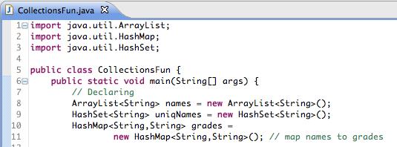
Using collections example

Slide 26
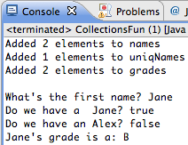
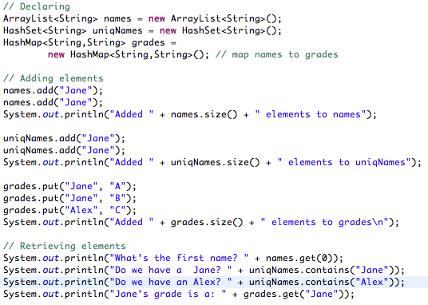
Using collections example

Slide 27
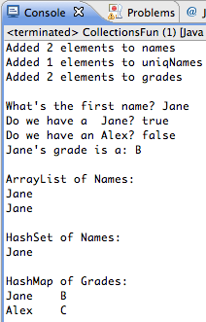
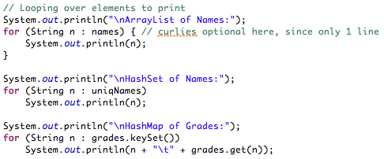
Using collections example

Slide 28
Try it!
BoxCar with arbitrary number of BoxCarPart objects

Slide 29
Try it!
iTunes & Song classes

Slide 30
iTunes class (Review)
Create a class Song with
4 Fields: private String title; private String artist; private String album; private double price;
2 Constructors: default, & with a parameter for each field
9 Methods: getters & setters for each field, and toString
Create an iTunes class that stores a list of songs as an ArrayList, and initialize the list to be empty
Create a method addSong to the iTunes class
Create a main method that adds 3 songs to iTunes (don’t use the default constructor)
Notes:
Should this example wait? Good intro to shopping cart…

Slide 31
iTunes class
Create a print method that prints the entire song list using a for each loop
Create a getTotalPrice method that returns the total cost of the entire song list
Create a getMinimumPrice method that returns the Song with the lowest price in the list
Notes:
D

