Slide 1
Hangman Project

Slide 2
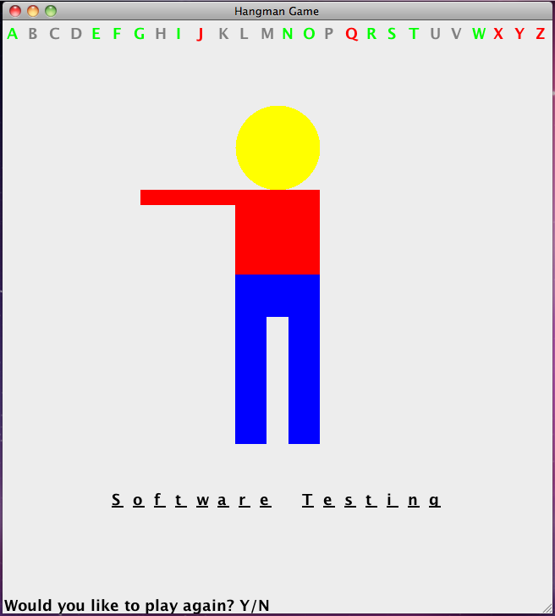
Hangman Game Project Overview
AlphabetPanel
Person
Hangman Game
GuessPhrasePanel
RandomString

Slide 4
git
Our collaboration tool

Slide 5
Setting up the project with git
Create a github account – e-mail it to me
Download & install SourceTree (https://www.sourcetreeapp.com/) it will install git for you if you tell it to
Download our repo from github through SourceTree
Import the repo into eclipse – do NOT copy the project into the workspace
When imported correctly, you should see [master after the project name

Slide 6
git workflow once imported into eclipse
In SourceTree, pull to get the latest version
Make any changes in eclipse
Ready for everyone else to see your changes? In SourceTree:
pull (if there are conflicting changes, address these in eclipse before proceeding)
Stage the files you changed
commit (make sure to give an informative message summarizing your changes!)
push your changes to make them available through github

Slide 7
Helper slides

Slide 8
Person
getNumLeft()
Returns the numLeft field
numLeft keeps track of how many more body parts the user has to lose
showNext()
Reduces numLeft & calls repaint
The real magic of showNext happens in the paint method
If there are no more body parts left to lose, resets person
Reset()
Resets numLeft to initial value (= total # of body parts)
repaints

Slide 9
AlphabetPanel
0 1 2 3 4 5 6 7 8 9 10 11 12 13 14 15 16 17 18 19 20 21 22 23 24 25
Each letter is a Text JPanel which you add to your AlphabetPanel JPanel using this.add
You should initialize the panel using a character for loop that loops through all the letters
Remember, each panel is a component
JPanels internally keep all their components in a list
To retrieve a Text JPanel (i.e., component), you need to figure out what index it has
If ‘A’ is the first letter added, it will be at index 0
Remember you can work with letters as if they are numbers

Slide 10
Working with characters like numbers
0 1 2 3 4 5 6 7 8 9 10 11 12 13 14 15 16 17 18 19 20 21 22 23 24 25
For example, to get the index of ‘C’, we just need to find how far away it is from ‘A’:
‘A’ = 65
‘C’ = 67
‘C’ – ‘A’ = 2
So, you can figure out where any letter’s Text JPanel is relative to ‘A’
For special characters like space, you can either use the literal character (‘ ‘) or the constant (KeyEvent.VK_SPACE)
Also check out the Character & String classes for some handy methods
Want to know more about what you can do with KeyEvent & it’s constants? Google it!

Slide 11
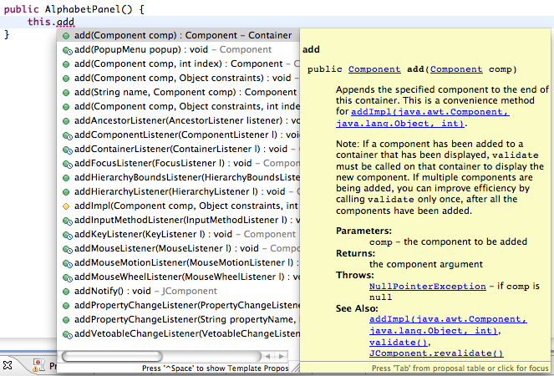
Don’t know how to work with JPanel components? Start typing! or google or check the textbooks
Or try: http://docs.oracle.com/javase/tutorial/uiswing/components/panel.html
(first “How To” tutorial link listed when googling for Java JPanel)
Notes:
What do you want to do? What words would describe it?

Slide 12
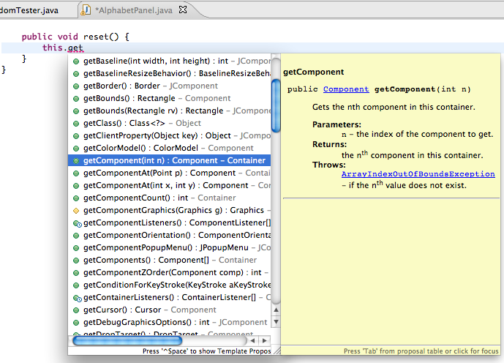
Don’t know how to work with JPanel components?

Slide 13
GuessPhrasePanel
You will also need to access letters in your GuessPhrasePanel, similar to your AlphabetPanel (although not the same)

Slide 14
Getting input
RandomString

Slide 15
Reading Input
Keyboard input is represented by System.in
Files by new File(“filename”)
The following line creates a Scanner object that reads from the keyboard:
Scanner scan = new Scanner (System.in);
Once created, the Scanner object takes various input methods, such as:
answer = scan.nextLine();
nextLine reads all input until the end of the line

Slide 16
//********************************************************************
// Echo.java Author: Lewis/Loftus
//
// Demonstrates the use of the nextLine method of the Scanner class
// to read a string from the user.
//********************************************************************
import java.util.Scanner;
public class Echo
{
//-----------------------------------------------------------------
// Reads a character string from the user and prints it.
//-----------------------------------------------------------------
public static void main (String[] args)
{
String message;
Scanner scan = new Scanner (System.in);
System.out.println ("Enter a line of text:");
message = scan.nextLine();
System.out.println ("You entered: \"" + message + "\"");
}
}
Notes:
What are the

Slide 17
Sample Run
Enter a line of text:
You want fries with that?
You entered: "You want fries with that?"
//********************************************************************
// Echo.java Author: Lewis/Loftus
//
// Demonstrates the use of the nextLine method of the Scanner class
// to read a string from the user.
//********************************************************************
import java.util.Scanner;
public class Echo
{
//-----------------------------------------------------------------
// Reads a character string from the user and prints it.
//-----------------------------------------------------------------
public static void main (String[] args)
{
String message;
Scanner scan = new Scanner (System.in);
System.out.println ("Enter a line of text:");
message = scan.nextLine();
System.out.println ("You entered: \"" + message + "\"");
}
}

Slide 18
Input Tokens
white space separates the elements (called tokens) of the input by default
White space includes space characters, tabs, new line characters
The next method of the Scanner class reads the next input token and returns it as a string
Methods such as nextInt and nextDouble read data of particular types

Slide 19
//********************************************************************
// GasMileage.java Author: Lewis/Loftus
//
// Demonstrates the use of the Scanner class to read numeric data.
//********************************************************************
import java.util.Scanner;
public class GasMileage
{
//-----------------------------------------------------------------
// Calculates fuel efficiency based on values entered by the
// user.
//-----------------------------------------------------------------
public static void main (String[] args)
{
int miles;
double gallons, mpg;
Scanner scan = new Scanner (System.in);
continue

Slide 20
int miles;
double gallons, mpg;
continue
System.out.print ("Enter the number of miles: ");
miles = scan.nextInt();
System.out.print ("Enter the gallons of fuel used: ");
gallons = scan.nextDouble();
mpg = miles / gallons;
System.out.println ("Miles Per Gallon: " + mpg);
}
}

Slide 21
int miles;
double gallons, mpg;
continue
System.out.print ("Enter the number of miles: ");
miles = scan.nextInt();
System.out.print ("Enter the gallons of fuel used: ");
gallons = scan.nextDouble();
mpg = miles / gallons;
System.out.println ("Miles Per Gallon: " + mpg);
}
}
Sample Run
Enter the number of miles: 328
Enter the gallons of fuel used: 11.2
Miles Per Gallon: 29.28571428571429

Slide 22
File I/O
RandomString

Slide 23
Java Loop templates
While Loop Index Template:
initialize index
while (condition){
statements to be repeated
update index
}
While Loop Sentinel Template:
get input value
while (input != end condition){
statements to be repeated
get input value
}
For Loop Template:
for(initialize index; condition; update index){
statements to be repeated
}
For Each Loop Template:
for (ElementType elementName : collection){
statements to be repeated
}
Notes:
Q: How is while loop going to change when using sentinal (flag)?

Slide 24
While Loop Sentinel Template (User Input):
get input value
while (input != end condition){
statements to be repeated
get input value
}
User Input Example:
ArrayList<String> guesses = new ArrayList<String>();
Scanner s = new Scanner(System.in);
String guess = s.nextLine(); // get input value
while (!guess.equals(“quit”) && !guess.equals(“exit”)){
guesses.add(guess); // add line to array list
guess = s.nextLine(); // get input value
}
Notes:
Q: How is while loop going to change when using sentinal (flag)?

Slide 25
While Loop Sentinel Template (File Input):
setup file scanner
while (there is more input){
get input
statements to be repeated
}
File Reading Example:
ArrayList<String> lines = new ArrayList<String>();
Scanner s = new Scanner(new File(“in.txt”));
while (s.hasNext()){
String line = s.nextLine(); // get input
System.out.println(line); // print line
lines.add(line); // add line to array list
}
Notes:
Q: How is while loop going to change when using sentinal (flag)?

Slide 26
Random

Slide 27
The Random Class
part of java.util
Provides methods that generate pseudorandom numbers
A Random object performs complicated calculations based on a seed value to produce a stream of seemingly random values
See RandomNumbers.java

Slide 28
//********************************************************************
// RandomNumbers.java Author: Lewis/Loftus
//
// Demonstrates the creation of pseudo-random numbers using the
// Random class.
//********************************************************************
import java.util.Random;
public class RandomNumbers
{
//-----------------------------------------------------------------
// Generates random numbers in various ranges.
//-----------------------------------------------------------------
public static void main (String[] args)
{
Random generator = new Random();
int num1;
float num2;
num1 = generator.nextInt();
System.out.println ("A random integer: " + num1);
num1 = generator.nextInt(10);
System.out.println ("From 0 to 9: " + num1);
continued

Slide 29
continued
num1 = generator.nextInt(10) + 1;
System.out.println ("From 1 to 10: " + num1);
num1 = generator.nextInt(15) + 20;
System.out.println ("From 20 to 34: " + num1);
num1 = generator.nextInt(20) - 10;
System.out.println ("From -10 to 9: " + num1);
num2 = generator.nextFloat();
System.out.println ("A random float (between 0-1): " + num2);
num2 = generator.nextFloat() * 6; // 0.0 to 5.999999
num1 = (int)num2 + 1;
System.out.println ("From 1 to 6: " + num1);
}
}
Sample Run
A random integer: 672981683
From 0 to 9: 0
From 1 to 10: 3
From 20 to 34: 30
From -10 to 9: -4
A random float (between 0-1): 0.18538326
From 1 to 6: 3

Slide 30
Examples – code to outcome
Given a Random object named gen, what range of values are produced by the following expressions?
Range?
0 to 24
1 to 6
10 to 109
100 to 149
-5 to 4
12 to 33
gen.nextInt(25)
gen.nextInt(6) + 1
gen.nextInt(100) + 10
gen.nextInt(50) + 100
gen.nextInt(10) – 5
gen.nextInt(22) + 12

Slide 31
Examples – outcome to code
Write an expression that produces a random integer in the following ranges:
Range
0 to 12
1 to 20
15 to 20
-10 to 0
gen.nextInt(13)
gen.nextInt(20) + 1
gen.nextInt(6) + 15
gen.nextInt(11) – 10

Slide 32
Practice Loops & File IO (Scanner)
Step 1: Create a class named Random
Step 2: Create a file named phrases.txt in the project that contains phrases to be guessed in your Hangman game
Step 3: write a main that reads in a file & prints out each line after storing it in an ArrayList
Step 4: print a random line
Step 5: convert into a class (OO format) for RandomString:
Something to store all the phrases
A constructor that accepts a name of a file
A read method that reads in the file
A next method that prints a random phrase
Write a main method to test

