Slide 1
Python For Data Science and Machine Learning
An Online MOOC via Udemy
By: Jose Portilla
Link: https://www.udemy.com/python-for-data-science-and-machine-learning-bootcamp/

Slide 2
About the Course

Slide 3
Data Science?

Slide 4
Need for Data Science!

Slide 5
Big Data?

Slide 6
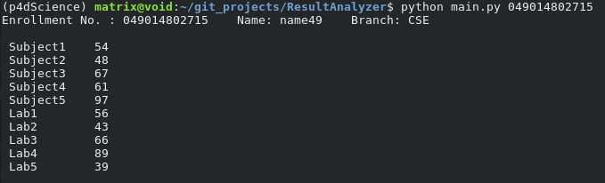
About Project

Slide 7
Technologies Used:

Slide 8
Python

Slide 9
Why Python?
Community like PyDelhi/Pycon India

Slide 10
Data Analysis

Slide 11
Numpy

Slide 12
Pandas

Slide 13
MatplotLIb

Slide 14
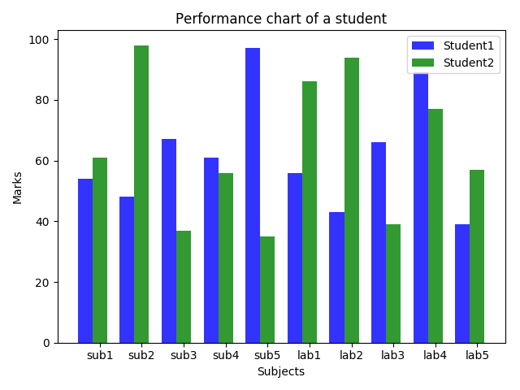
Screenshots

Slide 15
Future Scope:

Slide 16
Predicting Friends

Slide 17
Glad to join These Communities!

Slide 18
Thanks For Taking your time to read this.

