Slide 1
COVID19 and impact on Transportation in Montgomery County, MD
DATA512 A6
Emily Yamauchi

Slide 2
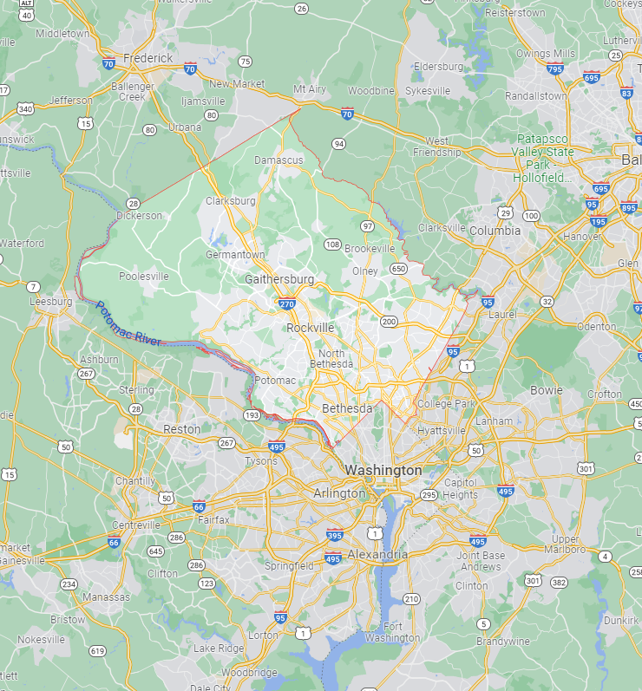
Montgomery County, MD
Most populous county in MD
Part of greater-DC area
Population: 1,062,061
Area: 507sq mi
Data Used:
COVID19 Data- GIVEN
Supplemental Data
Transit: WMATA
COVID19 Public Information
Daily bus/rail ridership data
LINK
Collisions: Montgomery County
Crash Reporting- Incidents Data
LINK

Slide 3
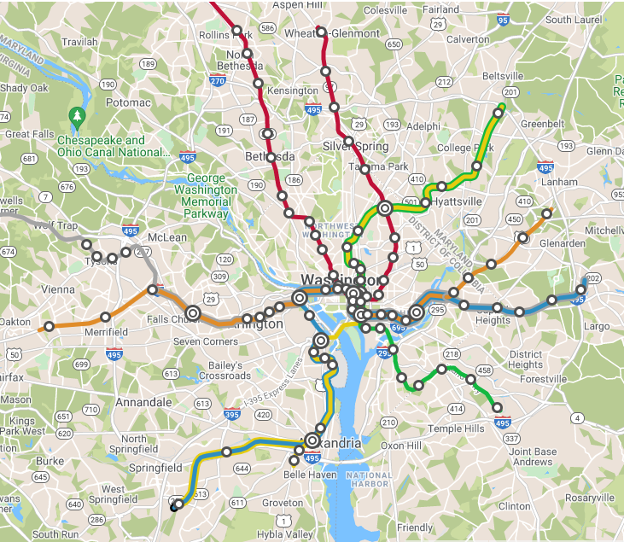
Human-Centered Motivation
COVID19 changed mobility patterns
Public transportation ridership decreased initially- has ridership recovered with decreased cases?
Collisions- with less commuters, have collisions decreased? Have they increased with easing stay-home mandates?

Slide 4
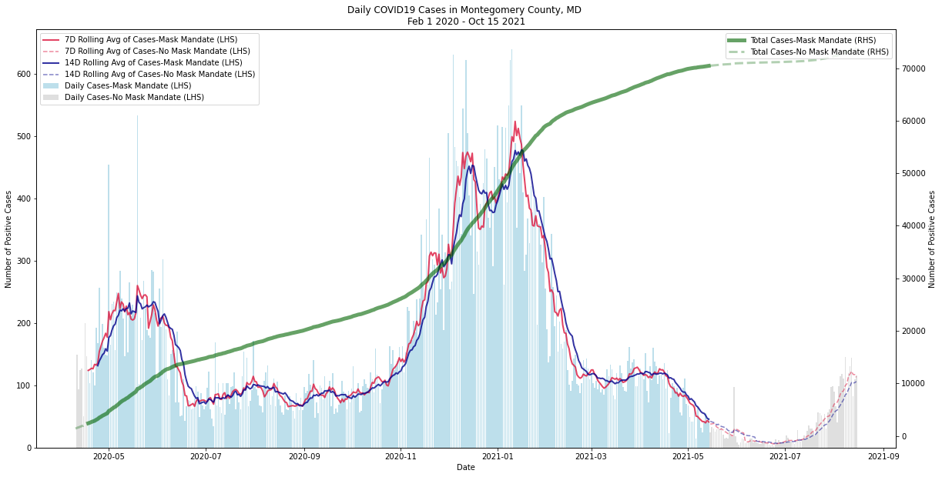
Daily COVID19 Cases

Slide 5
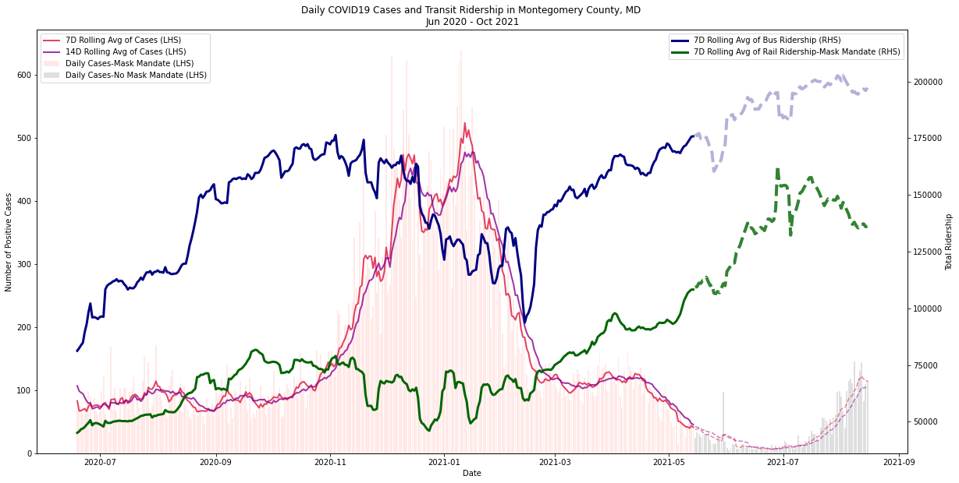
Daily COVID19 Cases + Transit Ridership

Slide 6
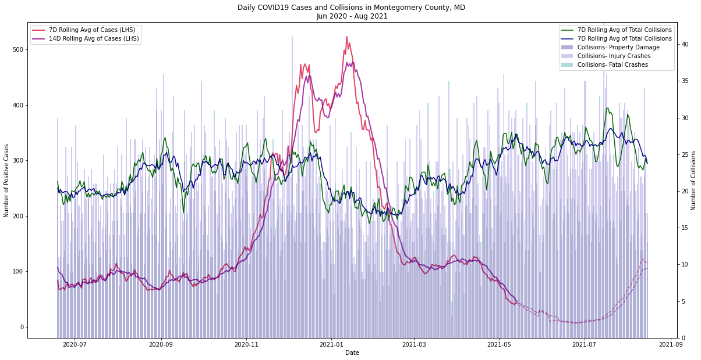
Daily COVID19 Cases + Collisions

Slide 7
Hypotheses:
Transit
H1: Bus Ridership ~ COVID19 Cases
H2: Rail Ridership ~ COVID19 Cases
H3: Transit Ridership ~ COVID19 Cases
“Return to normal as cases decrease”
Collisions
H4: Collisions ~ COVID19 Cases
Lagging indicator
“Stay home mandates → less commuters → less crashes”

Slide 8
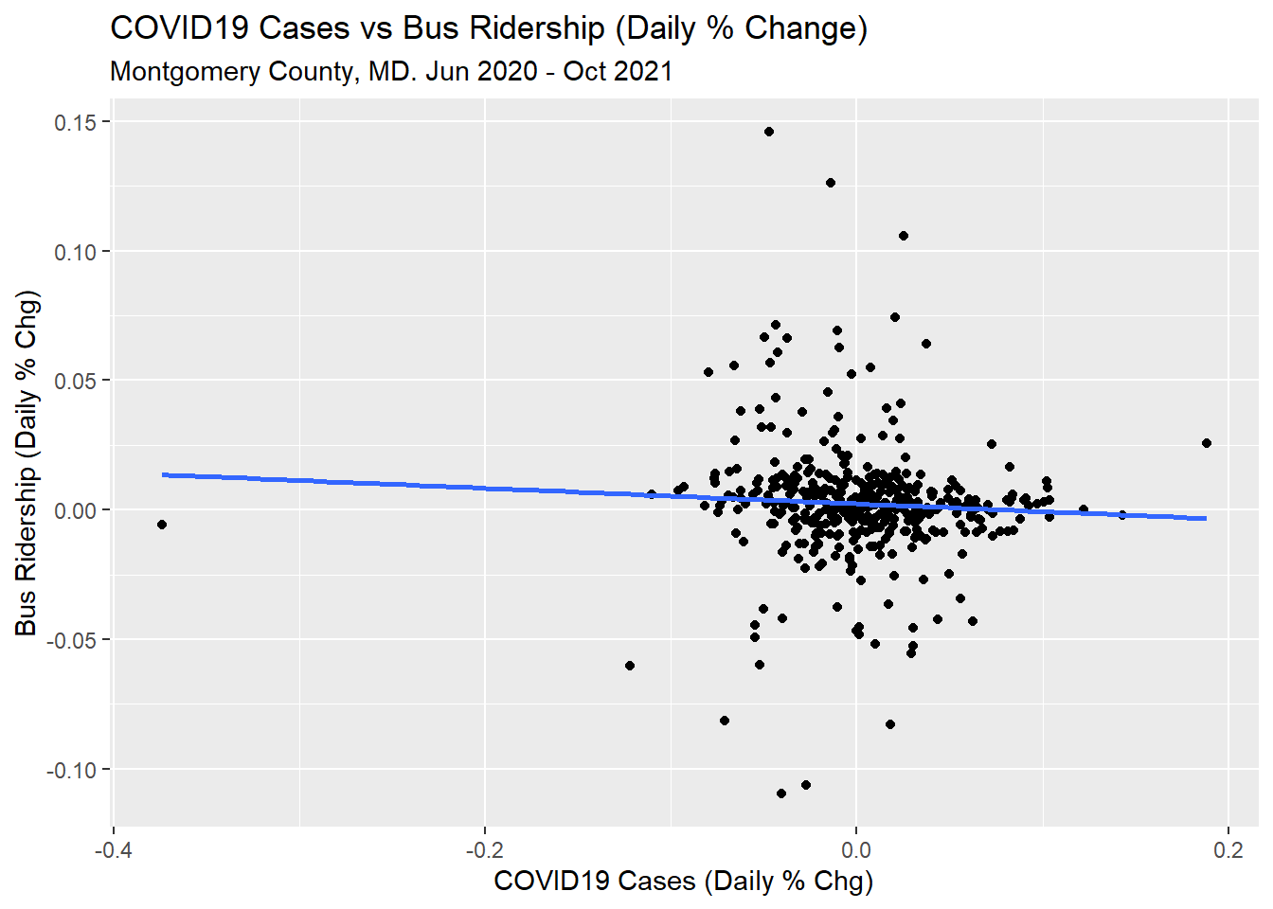
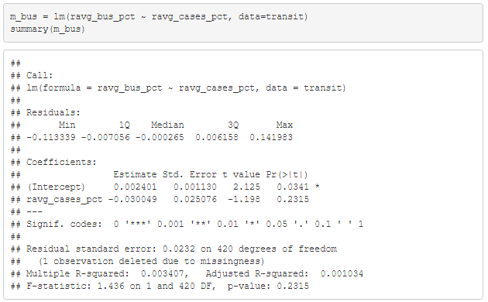
Hypotheses:
Transit
H1: Bus Ridership ~ COVID19 Cases
H2: Rail Ridership ~ COVID19 Cases
H3: Transit Ridership ~ COVID19 Cases
“Return to normal as cases decrease”
Collisions
H4: Collisions ~ COVID19 Cases
Lagging indicator
“Stay home mandates → less commuters → less crashes”

Slide 9
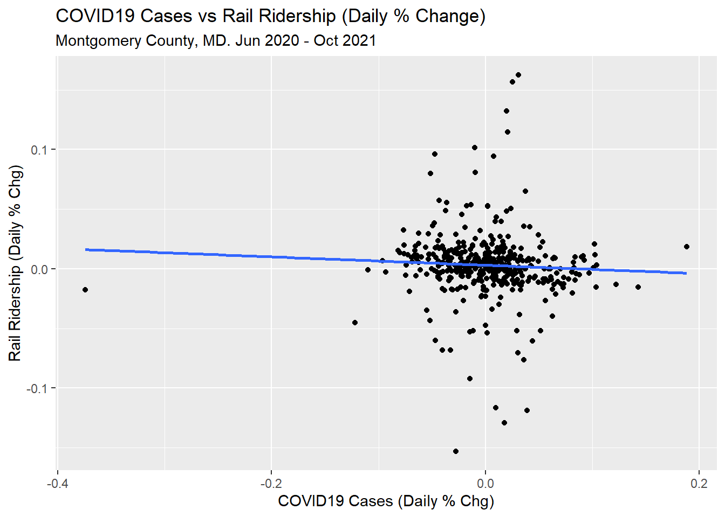
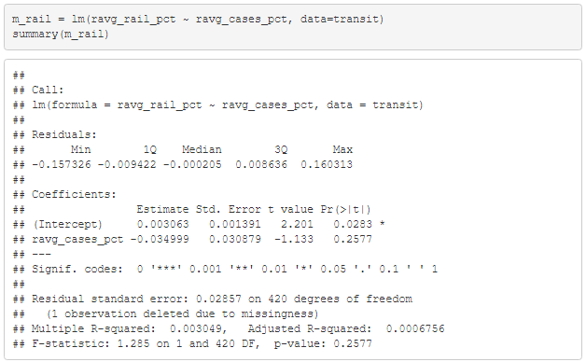
Hypotheses:
Transit
H1: Bus Ridership ~ COVID19 Cases
H2: Rail Ridership ~ COVID19 Cases
H3: Transit Ridership ~ COVID19 Cases
“Return to normal as cases decrease”
Collisions
H4: Collisions ~ COVID19 Cases
Lagging indicator
“Stay home mandates → less commuters → less crashes”

Slide 10
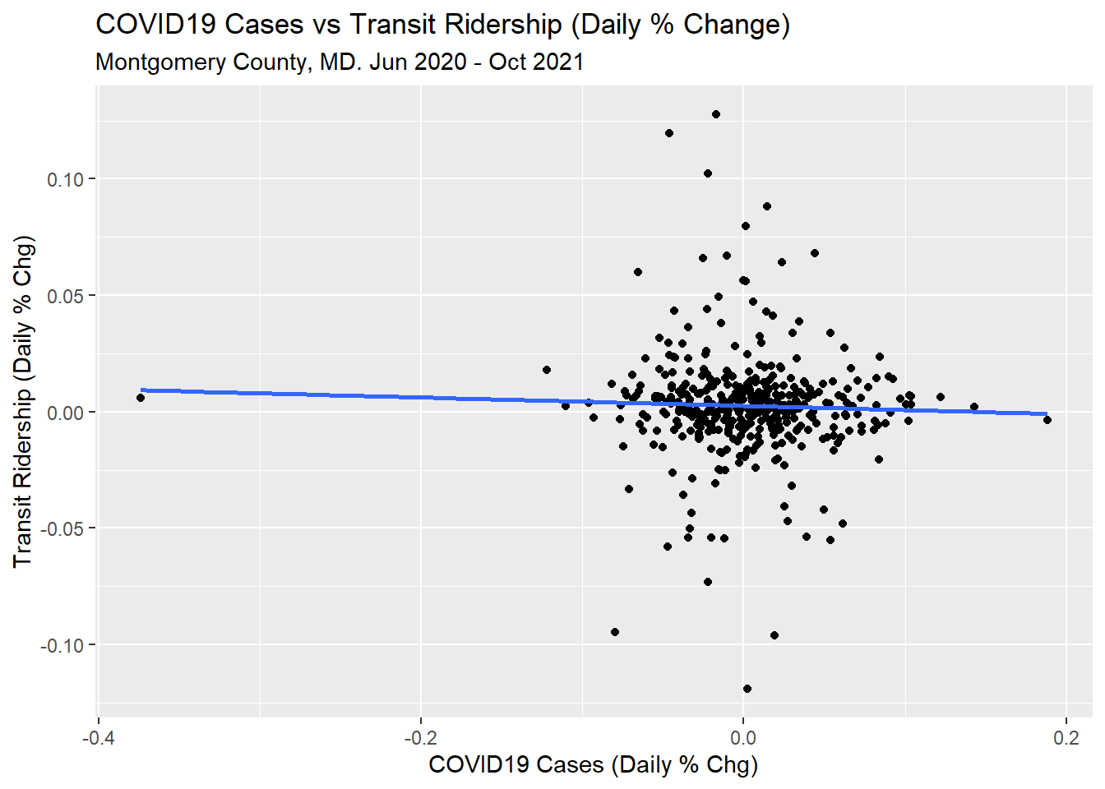
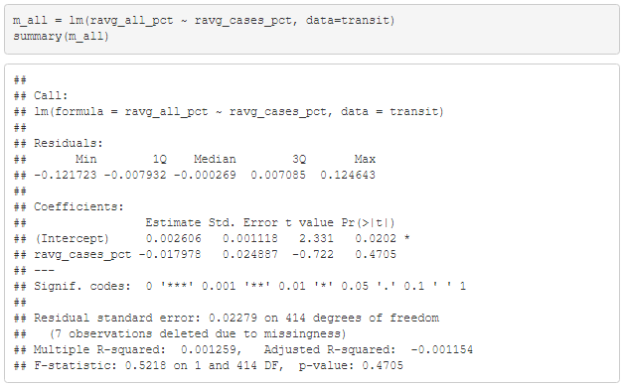
Hypotheses:
Transit
H1: Bus Ridership ~ COVID19 Cases
H2: Rail Ridership ~ COVID19 Cases
H3: Transit Ridership ~ COVID19 Cases
“Return to normal as cases decrease”
Collisions
H4: Collisions ~ COVID19 Cases
Lagging indicator
“Stay home mandates → less commuters → less crashes”
None of the models with bus and rail ridership as dependent variables were significant

Slide 11
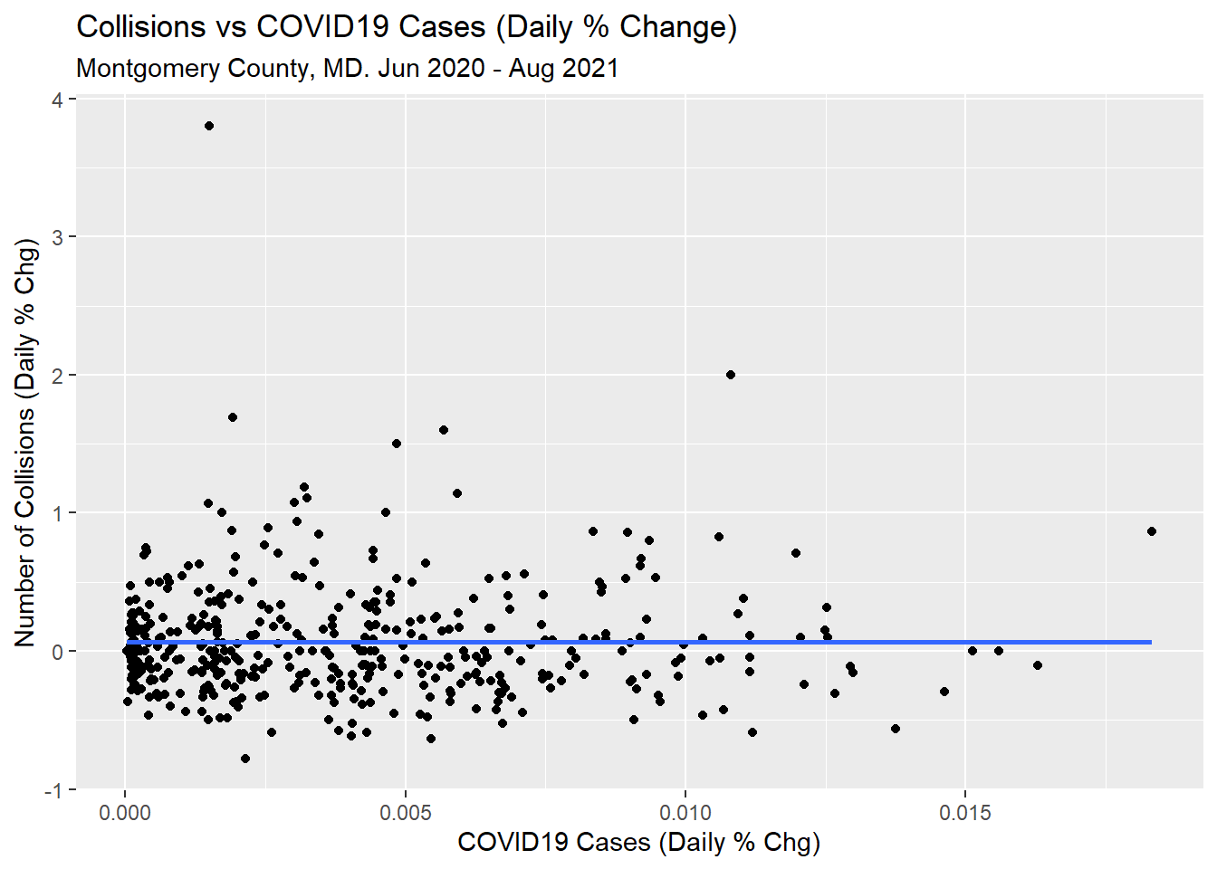
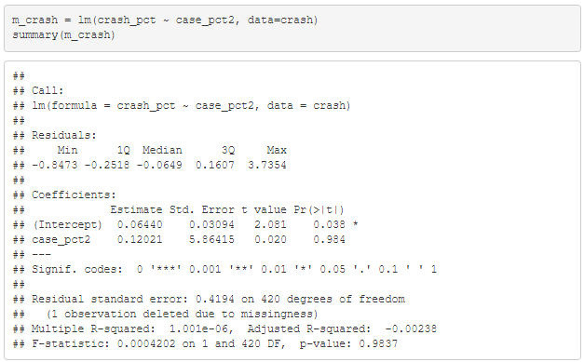
Hypotheses:
Transit
H1: Bus Ridership ~ COVID19 Cases
H2: Rail Ridership ~ COVID19 Cases
H3: Transit Ridership ~ COVID19 Cases
“Return to normal as cases decrease”
Collisions
H4: Collisions ~ COVID19 Cases
“Stay home mandates → less commuters → less crashes”
Crash data vs COVID cases also not significant

Slide 12
Conclusion
Transit
Could not find significant relationship between COVID19 cases and ridership
Collisions
Could not find significant relationship between COVID19 cases and collisions
Issues?
Do not have large time-frame due to constraints with COVID19 data (still recent pandemic)

