Slide 1
SelfDiagnose
“who is to blame”
ernest micklei, April 2007

Slide 2
Overview
Motivation
Introduction
Demo
Quick steps
Expert use

Slide 3
Motivation
Some application problems are related to:
  Configuration
  Availability
Logging not always pinpoints the cause
  level (debug)
  exception encapsulation
  “only when it happens”

Slide 4
Problem causes
Non-matching names in JNDI
Absent properties, files
Missing bindings in JNDI
No access to database,queue,host
Missing classes on runtime classpath
Missing System properties
….

Slide 5
Problem revealings
An error has occurred
SEVERE Could not start /myapp
DB2 SQL-ERROR 10493
Log4j shutting down

Slide 6
Who wants to know?
Development
  Is my configuration correct?
Application Server admin
  Is their configuration correct?
  Is my deployment script correct?
Maintenance
  Are all (detectable) resources available?
Functional Maintenance

Slide 7
SelfDiagnose
SelfDiagnose is a library of diagnotistic tasks that can verify the availability of resources
Application “itself” runs diagnose
Open-source Java project since 2006
  selfdiagnose.sourceforge.net

Slide 8
Task
A DiagnosticTask verifies the availability of a resource required for the execution of an application
Availability
  Deployment (configuration only)
  Runtime (execution only)

Slide 9
Example: Property
Configuration
  key present?
  does value matches pattern?
Availability
  classpath,JNDI
<checkresourceproperty
name="environment.properties"
property="ProviderStoreDB4O.bin" />

Slide 10
Example: Datasource
Configuration
  JNDI name, Driver, User, Access
Available
  host reachable?, connectable?
<checkdatasourceconnectable
name="jdbc/oracle/ubs_userBeheerService-ubsDs"/>

Slide 11
Example: Table exists
Configuration
  Table name
implies CheckDatasourceConnectable
<checkdatabasetableexists
name="UBS_CONTEXT"
datasource="jdbc/oracle/ubs_userBeheerService-ubsDs“
database=“oracle” />

Slide 12
Example: JMS
JMS Queue
  Configuration
    JNDI name, Queue name, CCSID
  Availability
    connectable?
<checkjndibinding
name="jms/mq/ubs_userBeheerServiceQCf"
class="javax.jms.QueueConnectionFactory"/>

Slide 13
Example: URL
Host reachable?
  Glue servlet
  mailserver
  other Webservice
  …
<checkurlreachable url=“http://s3browse.com"/>

Slide 14
Example: JMX
Managed Bean property
  value set?
  does value matches pattern?
Dangerous
  (if accessible at all)
<checkmbeanproperty
mbeanfactory="com…..AdminServiceFactory"
query="WebSphere….ontvangenBLIBerichtLp,*"
method="isStarted"
pattern="true" />

Slide 15
Example: MDB
EJB Message Driven Bean
  Configuration
    JNDI
  Availability
    process running?
(currently IBM WebSphere 5+ only)
<checkwebspherejmslistenerport name="ubs_userBeheerServiceLp"/>

Slide 16
Design
DiagnosticTask
Configuration
Reporting

Slide 17
DiagnosticTask
Initialize
  Load configuration parameters
Setup
  Verifiy parameters
Run
  Execute check using parameters
  Report to DiagnosticTaskResult

Slide 18
Configuration
XML
Java
<selfdiagnose
xmlns="http://selfdiagnose.sourceforge.net" xmlns:xsi="http://www.w3.org/2001/XMLSchema-instance" xsi:schemaLocation= "http://selfdiagnose.sourceforge.net http://selfdiagnose.sourceforge.net/selfdiagnose.xsd"> <tasks>
<!– add your tasks here -->
</tasks>
</selfdiagnose>
private final static String MAPS_URL =
Check.property(“environment.properties” , “google.maps.url”’);

Slide 19
Reporting
Log4j
SelfDiagnoseServlet
  remote invocation of SelfDiagnose.run()
  Formats: HTML,XML,plain
2007-Apr-16 11:03:09.050 […] INFO SelfDiagnose - JNDI binding [url/config/ubs_userBeheerService/config] of type [java.net.URL] is available in naming server - /appl/was00t/WebSphere/AppServer/installedApps/was00tcell/ubs_userBeheerService.ear/ubs_UserBeheerServiceWeb.war/selfdiagnose.xml

Slide 20
Reporting II
for each result
  Task name
  Status {passed,failed,error}
  Message
  Requestor
    = what component added the task

Slide 21
Quickstart
Add Maven dependency
Add Servlet to Web Descriptor
Define selfdiagnose.xml

Slide 22
Maven dependency
project.xml
<dependency>
<groupId>com.philemonworks</groupId>
<artifactId>selfdiagnose</artifactId>
<version>1.0</version>
<type>jar</type>
<properties>
<war.manifest.classpath>true</war.manifest.classpath>
<war.bundle>true</war.bundle>
</properties>
</dependency>

Slide 23
Servlet Descriptor
<!-- ================ SELFDIAGNOSE CONFIGURATION =========== -->
<servlet>
<servlet-name>selfdiagnose</servlet-name>
<display-name>selfdiagnose</display-name>
<servlet-class>
com.philemonworks.selfdiagnose.SelfDiagnoseServlet
</servlet-class>
</servlet>
<!-- ================ SELFDIAGNOSE CONFIGURATION =========== -->
<servlet-mapping>
<servlet-name>selfdiagnose</servlet-name>
<url-pattern>/selfdiagnose</url-pattern>
</servlet-mapping>

Slide 24
selfdiagnose.xml (example)
<selfdiagnose>
<tasks>
<checkdatasourceconnectable
name="jdbc/oracle/ubs_userBeheerService-ubsDs"/>
<checkdatabasetableexists
name="UBS_CONTEXT"
datasource="jdbc/oracle/ubs_userBeheerService-ubsDs"/>
<checkjndibinding
name="jms/mq/ubs_userBeheerServiceQCf"
class="javax.jms.QueueConnectionFactory"/>
<checkwebspherejmslistenerport name="ubs_userBeheerServiceLp"/>
<checkjndibinding name="mail/MailService"/>
</tasks>
</selfdiagnose>

Slide 25
Expert use
Variables
Custom Reports
Custom task

Slide 26
Variables
Capture result of a task
Do other checks on that result
<checkjndibinding
name="url/config/ubs_userBeheerService/config"
class="java.net.URL"
var="config"/>
<checkurlreachable url="${config}"/>

Slide 27
Custom Reporting
XML report + custom XSL
/selfdiagnose?format=xml&xsl=xsl/selfdiagnose.xsl

Slide 28
Custom Task
package com.mybusiness.myproduct;
public class MyTask extends DiagnosticTask {
public String getDescription() { … }
public void initialize(Attributes attributes) { … }
public void run(ExecutionContext ctx, DiagnosticTaskResult result) { … }
}
<task
class=“com.mybusiness.myproduct.MyTask”>
my-parameter1=“my-value1”
/>

Slide 29
Example: CheckWSDL
public class CheckWSDL extends DiagnosticTask {
private String url;
public String getDescription(){
return “checks that an URL refers to a WSDL”;
}
public void initialize(Attributes attributes) {
url = attributes.getValue(“url”);
}
public void run(ExecutionContext ctx, DiagnosticTaskResult result) {
URL newURL = new URL(url);
URLConnection newCon = newURL.openConnection();
…
result.setPassedMessage(
"URL ["+newURL+"] is reachable and ” +
“WSDL content could be retrieved.");
}

Slide 30
CheckWSDL config
<task
class=“CheckWSDL”>
url=“/context/Money4NothingService.wsdl”
/>

Slide 31
Testing SelfDiagnose
Is my configuration correct?
Add SelfTest class to your TestSuite

Slide 32
Wrapup
SelfDiagnose provides simple means for:
  Auto check of configuration
  Auto check availability of resources
  On demand report on “condition” of application

Slide 33
Contribute
Improve tasks + new
Documentation
More tests
Dashboard
http://selfdiagnose.sourceforge.net/
mailto: ernest.micklei@philemonworks.com

Slide 34
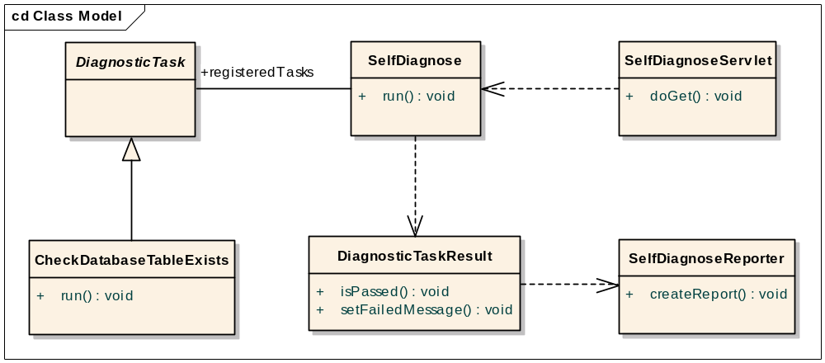
UML

