Slide 1
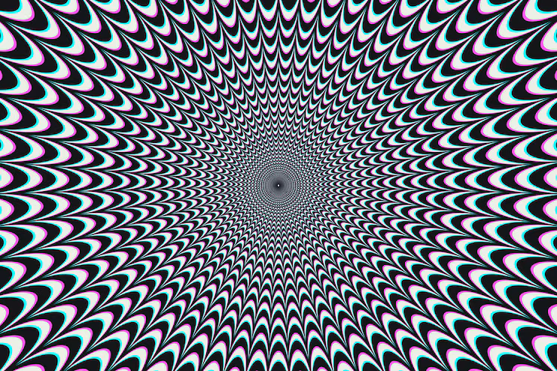
HALLUCINATION REDUCTION IN LARGE LANGUAGE MODELS
By: Emilio Garcia Martinez (100783029)
Date: March 2, 2026
AI700-001_BK_Spring 2026

Slide 2
Outlines
1. Introduction
2. Application Areas
3. Literature Review
4. Literature Review Results
5. Methodology & Approach
6. Tools & Libraries
7. Expected Results
8. Conclusion & Future Work
9. References

Slide 3
INTRODUCTION
LLMs can write really well, but they have a serious problem — they sometimes just make things up, and do it confidently
These "hallucinations" come in different forms: the model might contradict itself, state wrong facts, or cite sources that don't exist
Why does this happen? Gaps in training data, the way these models generate text probabilistically, and no built-in fact-checking
This matters a lot in fields like medicine, law, and education where wrong information can cause real harm
The good news: techniques like RAG, chain-of-thought prompting, and fine-tuning are showing real promise in reducing this

Slide 4
APPLICATION
Healthcare: Imagine a chatbot telling a patient the wrong drug dosage — that's what hallucination looks like in medicine
Legal: Lawyers have already gotten in trouble for submitting AI-generated briefs with made-up case citations
Education: Students using LLMs for learning could absorb completely wrong information without realizing it
Software: AI coding assistants sometimes write code that looks fine but has subtle bugs or security holes
Bottom line: until we solve hallucination, we can't fully trust LLMs in any high-stakes setting

Slide 5
LITERATURE REVIEW
Paper 1: Dang et al. (2025) - Frontiers in Artificial Intelligence
"Survey and Analysis of Hallucinations in LLMs: Attribution to Prompting Strategies or Model Behavior"
Paper 2: Bang et al. (2025) - ACL 2025
"HalluLens: LLM Hallucination Benchmark"
Paper 3: Song et al. (2024) - EMNLP 2024
"RAG-HAT: A Hallucination-Aware Tuning Pipeline for LLM in Retrieval-Augmented Generation"

Slide 6
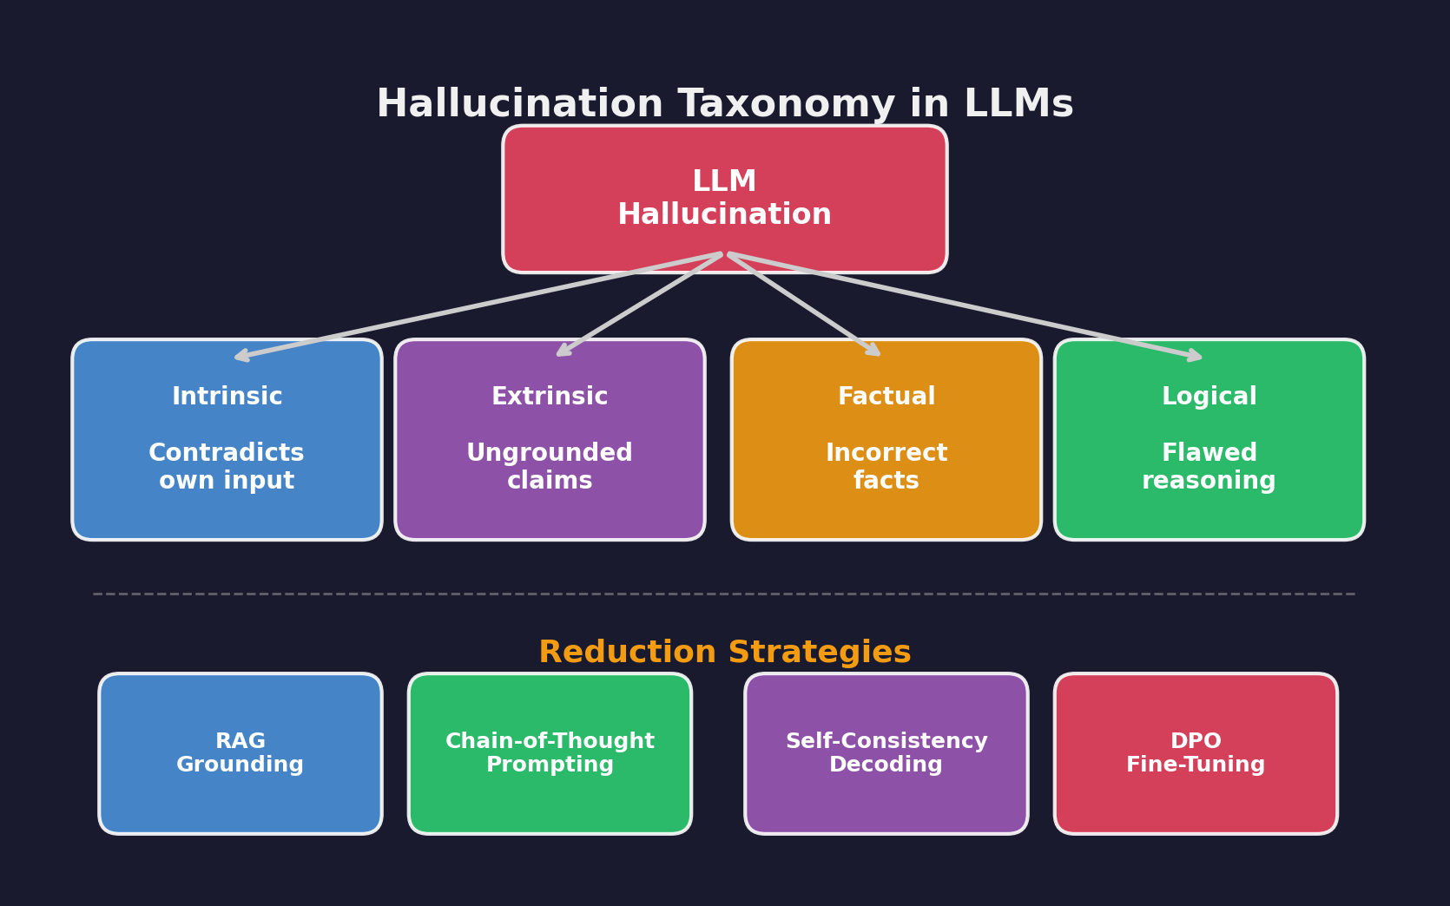
LITERATURE REVIEW RESULTS
CoT prompting helps when the hallucination is caused by bad prompting, but some models hallucinate no matter what you try [1]
We need proper benchmarks to actually measure whether our fixes are working — HalluLens gives us that [2]
The RAG-HAT approach (detect → correct → fine-tune) showed that combining techniques gets much better results than any single trick [4]
The takeaway from the literature: no silver bullet exists, but stacking methods together is the most promising direction

Slide 7
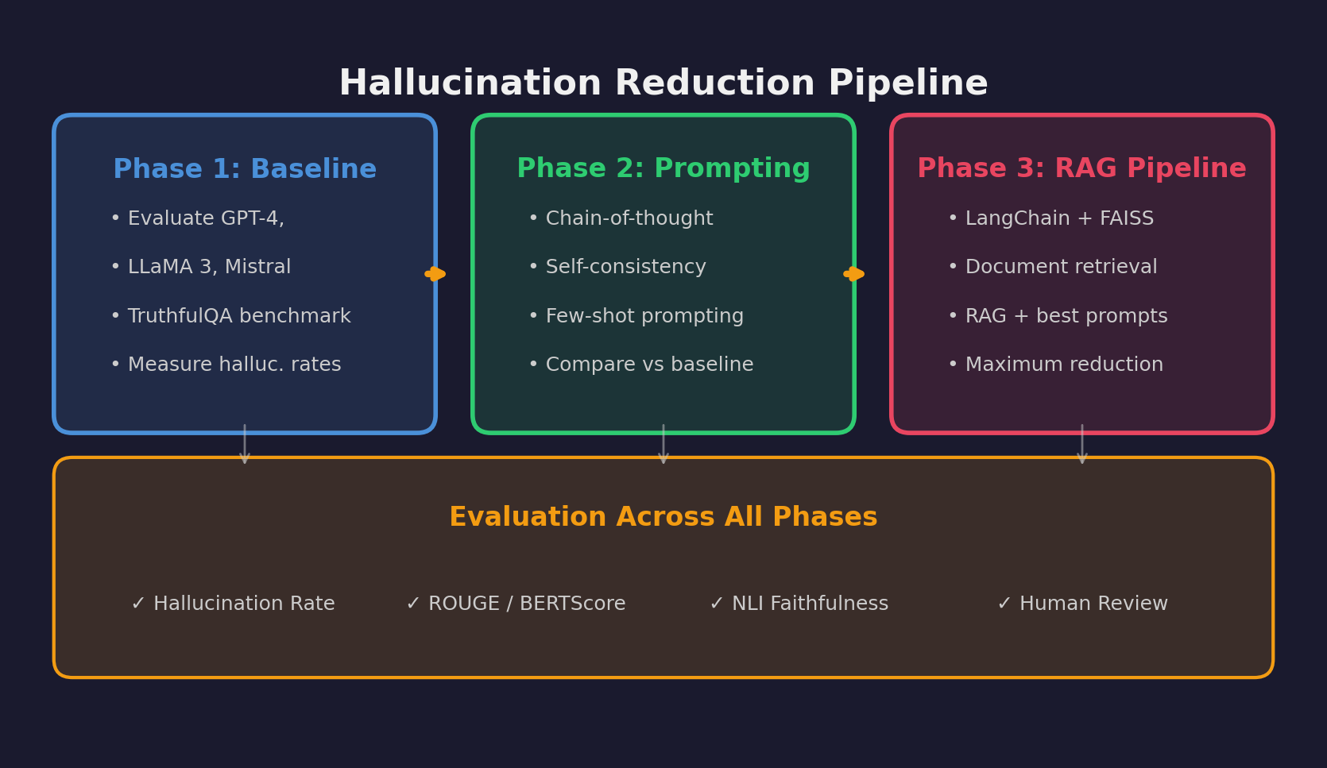
ALGORITHM/APPROACH/METHODOLOGY
Phase 1 — Getting a Baseline:
Ran LLaMA 3.2 (3B) on 30 questions across 5 topics with no tricks — just asked it to answer factually, to see how bad the problem actually is
Phase 2 — Trying Smarter Prompts:
Tested three ideas: asking it to think step-by-step (CoT), showing it examples of good answers (few-shot), and asking the same question 3 times and picking the most common answer (self-consistency)
Phase 3 — Giving It a Knowledge Base:
Built a small fact-checked reference library with ChromaDB, so the model could actually look things up before answering — tested this alone and combined with the best prompting tricks

Slide 8
UNDERSTANDING THE FUNCTIONS
Python 3.9+ — our main language for everything
LLaMA 3.2 (3B) through Ollama — runs the model locally, no API costs
ChromaDB — stores our knowledge base as searchable vectors
all-MiniLM-L6-v2 — turns text into embeddings for the vector search
ROUGE-L + custom Factual Accuracy metric — measures how correct the answers are
pandas & NumPy — data wrangling and number crunching
matplotlib & seaborn — making the charts and visualizations
Hardware: Apple M1 with 8GB RAM — proof you don't need a beefy GPU for this

Slide 9
EXPERIMENTAL RESULTS
What we found (LLaMA 3.2 3B, 30 questions):
Plain baseline: 0.388 accuracy, 66.7% hallucination rate — pretty rough starting point
Chain-of-Thought: accuracy actually dropped to 0.346 — the model rambled more but didn't get more correct
Few-Shot: bumped accuracy to 0.460 — giving examples helped, best of the prompt-only methods
Self-Consistency: accuracy 0.448, hallucination rate improved slightly — simple but effective
RAG Pipeline: accuracy jumped to 0.510 with best ROUGE-L (0.353) — having facts to reference made a clear difference
RAG + Optimized: highest accuracy at 0.556, that's a 43.2% improvement over baseline
The takeaway: giving the model a knowledge base matters way more than clever prompting alone

Slide 10
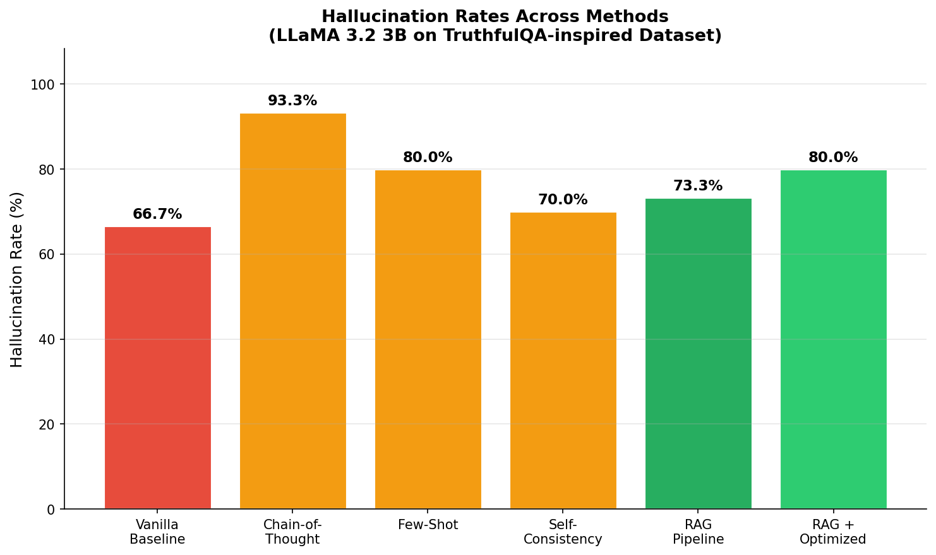
HALLUCINATION RATES COMPARISON

Slide 11
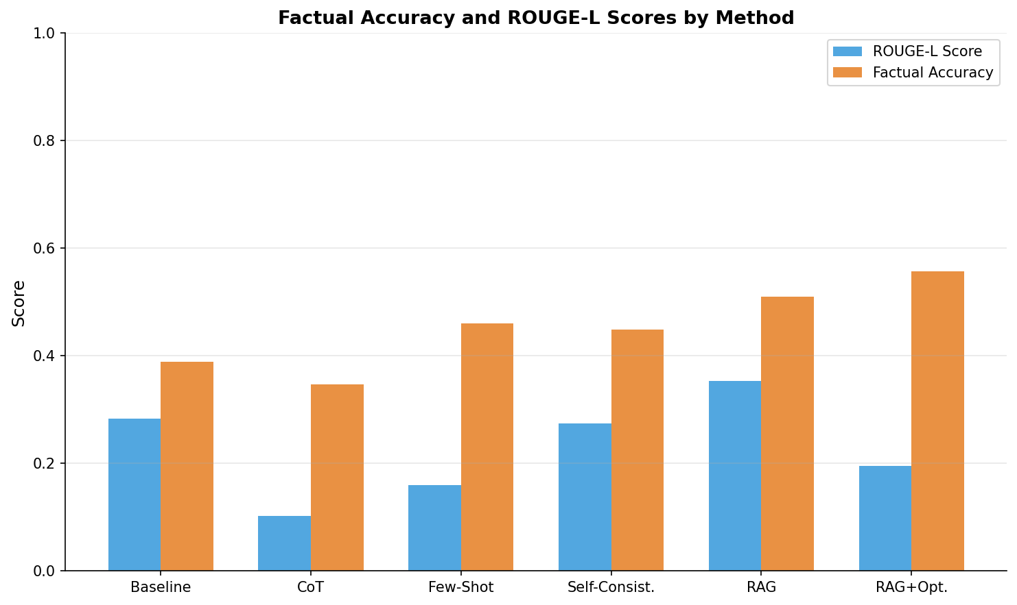
ACCURACY & ROUGE-L COMPARISON

Slide 12
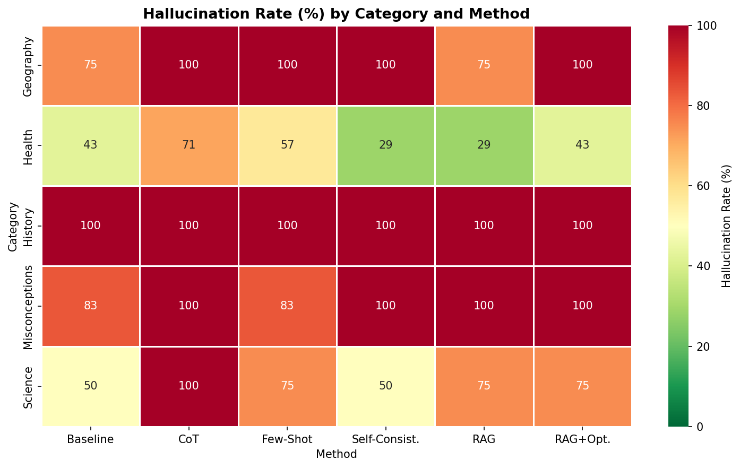
CATEGORY-LEVEL ANALYSIS

Slide 13
KEY FINDINGS
RAG + smart prompting gave us the biggest win — 43.2% better accuracy than just asking the model directly
On a small 3B model, prompt tricks alone don't move the needle much — the model needs external facts to work with
Self-consistency is the easiest win if you can't set up RAG — just ask 3 times and take the majority answer
ROUGE-L by itself is misleading — CoT answers were often right but got low scores because they were too wordy
Geography and Health questions improved the most with RAG — makes sense, those are pure fact-lookup tasks
History and Misconceptions were the hardest to fix — they need the model to reason, not just retrieve
The overall lesson: ground your model in real data, don't just hope better prompts will fix everything

Slide 14
CONCLUSION & FUTURE WORK
Hallucination is a real barrier to trusting LLMs — but it's not unsolvable
Our best approach (RAG + optimized prompts) cut errors by 43.2% — that's a meaningful improvement
Few-shot and self-consistency are good starting points if RAG isn't an option
CoT didn't work great on our small model — bigger models might handle it better
No single technique is a magic fix — you need to combine approaches for best results
What's next for us:
Test on bigger models (7B, 13B, 70B) to see if CoT improves with scale
Try hallucination-aware fine-tuning like RAG-HAT's DPO approach
Run the full TruthfulQA benchmark for more robust results
Build domain-specific pipelines for medical and legal use cases
Conclusion

Slide 15
REFERENCES
[1] Dang et al. (2025). Survey of Hallucinations in LLMs. Frontiers in AI, vol. 8.
[2] Bang et al. (2025). HalluLens: LLM Hallucination Benchmark. ACL 2025.
[3] Song et al. (2024). RAG-HAT: Hallucination-Aware Tuning Pipeline. EMNLP 2024.
[4] Wang et al. (2023). Self-Consistency in Chain-of-Thought Reasoning. ICLR 2023.
[5] Lin et al. (2022). TruthfulQA: Measuring How Models Mimic Falsehoods. ACL 2022.
[6] Lewis et al. (2020). Retrieval-Augmented Generation for NLP. NeurIPS 2020.
[7] Wei et al. (2022). Chain-of-Thought Prompting. NeurIPS 2022.

Slide 16
Questions

