Slide 1
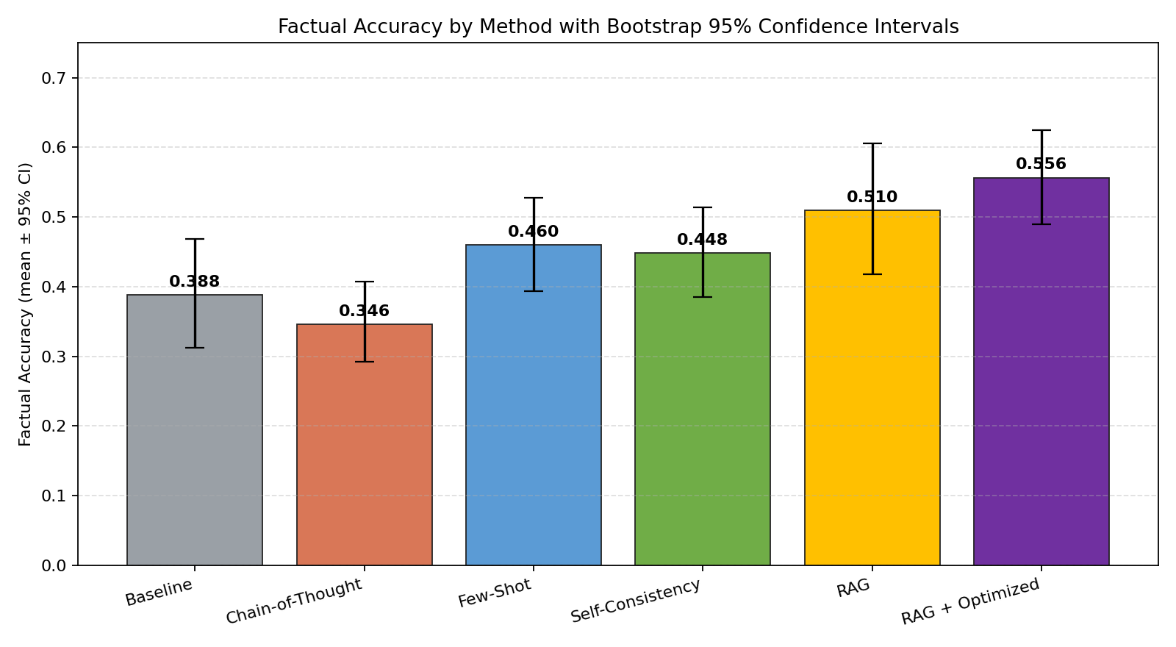
Hallucination Reduction in Large Language Models
A Comparative Study of Prompt Engineering and RAG
By: Emilio Garcia Martinez (ID: 100783029)
Course: AI700-001 | Prof. Reda Nacif Elalaoui
Date: May 2026 | Spring 2026

Slide 2
Outlines
1. Introduction & Motivation
2. Application & Real-World Importance
3. Literature Review
4. Literature Review Results
5. Methodology — Pipeline & Methods
6. Understanding the Functions (Metrics)
7. Obtained Results & Statistical Analysis
8. Conclusion & Future Work
9. References

Slide 3
INTRODUCTION
Hallucination: LLMs generating fluent but factually incorrect text.
Persistent failure mode in LLaMA, GPT, Claude — high-stakes risk in medicine, law, education.
Goal: compare six mitigation techniques on LLaMA 3.2 (3B) under one protocol.
Six methods: Baseline, Chain-of-Thought, Few-Shot, Self-Consistency, RAG, RAG + Optimized.
Evaluation: 30-question TruthfulQA subset, automated metrics, bootstrap statistics.

Slide 4
APPLICATION
Healthcare assistants — wrong dosage / drug-interaction advice can harm patients.
Legal & finance copilots — fabricated case law or numbers create liability.
Educational tutors — myth reinforcement in History / Science misinforms students.
Customer support automation — confidently wrong answers erode trust.
Reducing hallucination is foundational to deploying LLMs in any production setting.

Slide 5
LITERATURE REVIEW
Dang et al. (2025): survey & taxonomy of LLM hallucinations [1].
Bang et al. (2025): HalluLens benchmark for systematic evaluation [2].
Wang et al. (2023): Self-Consistency boosts CoT reasoning [3].
Song et al. (2024): RAG-HAT — hallucination-aware tuning for RAG [4].
Lin et al. (2022): TruthfulQA targets imitative falsehoods [5].
Lewis et al. (2020): Retrieval-Augmented Generation framework [7].
Wei et al. (2022): Chain-of-Thought prompting elicits reasoning [8].

Slide 6
LITERATURE REVIEW RESULTS
RAG and verification methods consistently outperform pure prompt engineering on factual tasks.
Self-Consistency's value depends on cost tolerance — 3+ inference passes per query.
CoT benefits scale with model size; small models (≤7B) often see marginal or negative gains.
Open evaluation gap: few studies report paired statistical tests on small open-weight models running locally.
This work contributes a fully reproducible local pipeline with bootstrap CIs and error-type analysis.

Slide 7
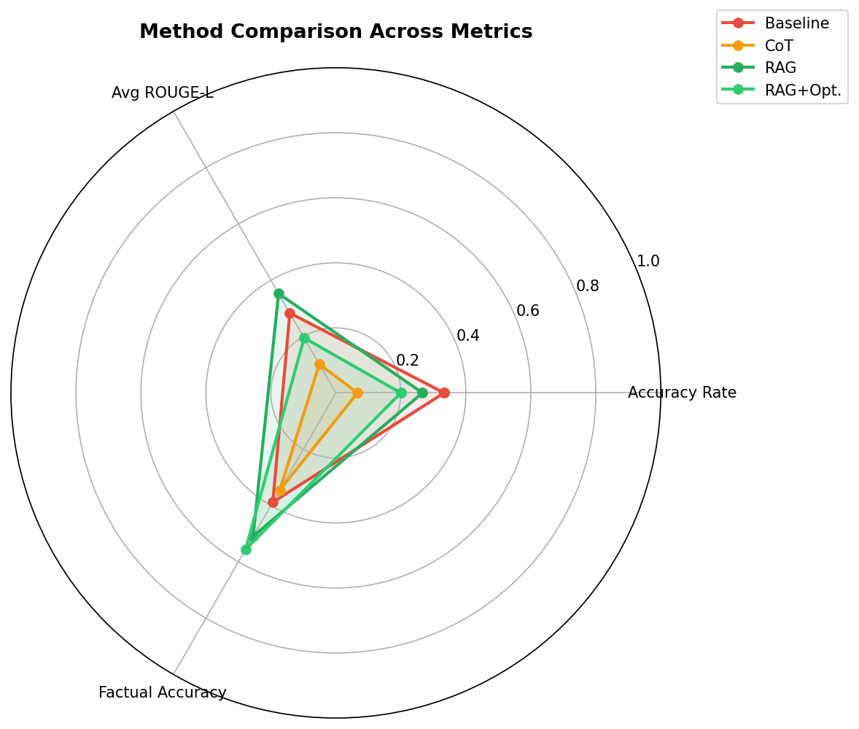
ALGORITHM/APPROACH/METHODOLOGY
Model: LLaMA 3.2 (3B) via Ollama on Apple M1 (8 GB RAM).
Dataset: 30 TruthfulQA-inspired questions across 5 categories.
Six methods: Baseline, CoT, Few-Shot, Self-Consistency, RAG, RAG+Opt.
RAG knowledge base: 27 chunks in ChromaDB; top-3 retrieval.
Evaluation: factual accuracy, ROUGE-L, hallucination rate.
Statistics: 10k bootstrap CIs and paired bootstrap vs baseline.

Slide 8
UNDERSTANDING THE FUNCTIONS
Hallucination Rate: 1 if response overlaps known-incorrect more than correct answer.
ROUGE-L: longest common subsequence overlap between response and ground truth.
Factual Accuracy = 0.6 × keyword recall + 0.4 × ROUGE-L (rewards salient facts under paraphrase).
Bootstrap 95% CI: 10,000 resamples per method.
Paired bootstrap test: per-question Δ vs baseline; two-sided p from sign-flip fraction.

Slide 9
OBTAINED RESULTS
Best method: RAG + Optimized (factual accuracy 0.556, +43.3% over baseline).
RAG + Optimized: 0.556 [0.489, 0.624] (+0.168 vs baseline, p = 0.001)
RAG: 0.510 [0.417, 0.605] (+0.121, p = 0.031)
Self-Consistency: 0.448 [0.385, 0.514] (+0.060, p = 0.034)
Few-Shot: 0.460 [0.394, 0.527] (+0.072, p = 0.125, n.s.)
Chain-of-Thought: 0.346 [0.292, 0.408] (-0.042, p = 0.340, n.s.)
Baseline: 0.388 [0.313, 0.468]
Error analysis: residual failures dominated by partial-truth, not full fabrication.

Slide 10
CONCLUSION & FUTURE WORK
RAG + Optimized prompting is the most reliable hallucination mitigation on LLaMA 3.2 (3B).
RAG and Self-Consistency also produce statistically significant gains.
Chain-of-Thought is not effective at this model size — confirms scale-dependence findings.
Residual errors are mostly partial-truth — model surfaces the topic but fails to commit to the verified fact.
Future work: factual-entailment verification, hallucination-aware fine-tuning [4], and larger-model replication.
Public release: full pipeline + dataset + results on GitHub for reproducibility.
Conclusion

Slide 11
REFERENCES
[1] Dang, Vu, Nguyen. "Survey on hallucinations in LLMs." Frontiers in AI, 2025.
[2] Bang et al. "HalluLens benchmark." ACL 2025.
[3] Wang et al. "Self-Consistency improves CoT." ICLR 2023.
[4] Song et al. "RAG-HAT." EMNLP 2024.
[5] Lin, Hilton, Evans. "TruthfulQA." ACL 2022.
[6] Lin. "ROUGE." 2004.
[7] Lewis et al. "Retrieval-Augmented Generation." NeurIPS 2020.
[8] Wei et al. "Chain-of-Thought prompting." NeurIPS 2022.
[9] AI@Meta. "LLaMA 3.2 model card," 2024.
[10] Ollama. "Run LLMs locally," 2024.

Slide 12
Questions

