Slide 1
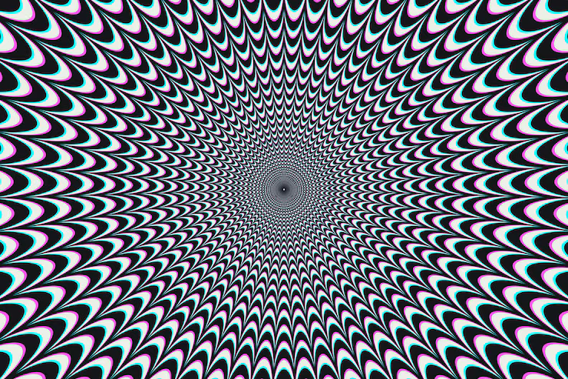
HALLUCINATION REDUCTION IN LARGE LANGUAGE MODELS
By: Emilio Garcia Martinez (100783029)
Date: March 2, 2026
AI700-001_BK_Spring 2026

Slide 2
Outlines
1. Introduction
2. Application Areas
3. Literature Review
4. Literature Review Results
5. Methodology & Approach
6. Tools & Libraries
7. Expected Results
8. Conclusion & Future Work
9. References

Slide 3
INTRODUCTION
LLMs generate fluent, confident text that can be factually incorrect, fabricated, or unsupported by source material — this is known as hallucination
Hallucination types include intrinsic (self-contradictions), extrinsic (ungrounded claims), factual (wrong facts), and logical (flawed reasoning)
Root causes include training data gaps, probabilistic decoding, and lack of grounding in verifiable knowledge
Reducing hallucinations is essential for safe LLM deployment in healthcare, legal, education, and finance domains
Key reduction strategies: Retrieval-Augmented Generation (RAG), prompt engineering (chain-of-thought), and hallucination-aware fine-tuning (DPO)

Slide 4
APPLICATION
Healthcare: Fabricated drug interactions or medical diagnoses can endanger patients - reduction is critical for medical AI assistants
Legal: Nonexistent case law citations undermine trust in AI-assisted legal research and can lead to professional consequences
Education: Incorrect facts presented with high confidence spread misinformation to students
Software Engineering: Code generation tools can produce plausible but buggy or insecure code
Hallucination reduction is the #1 barrier to deploying LLMs reliably in production systems

Slide 5
LITERATURE REVIEW
Paper 1: Dang et al. (2025) - Frontiers in Artificial Intelligence
"Survey and Analysis of Hallucinations in LLMs: Attribution to Prompting Strategies or Model Behavior"
Paper 2: Bang et al. (2025) - ACL 2025
"HalluLens: LLM Hallucination Benchmark"
Paper 3: Song et al. (2024) - EMNLP 2024
"RAG-HAT: A Hallucination-Aware Tuning Pipeline for LLM in Retrieval-Augmented Generation"

Slide 6
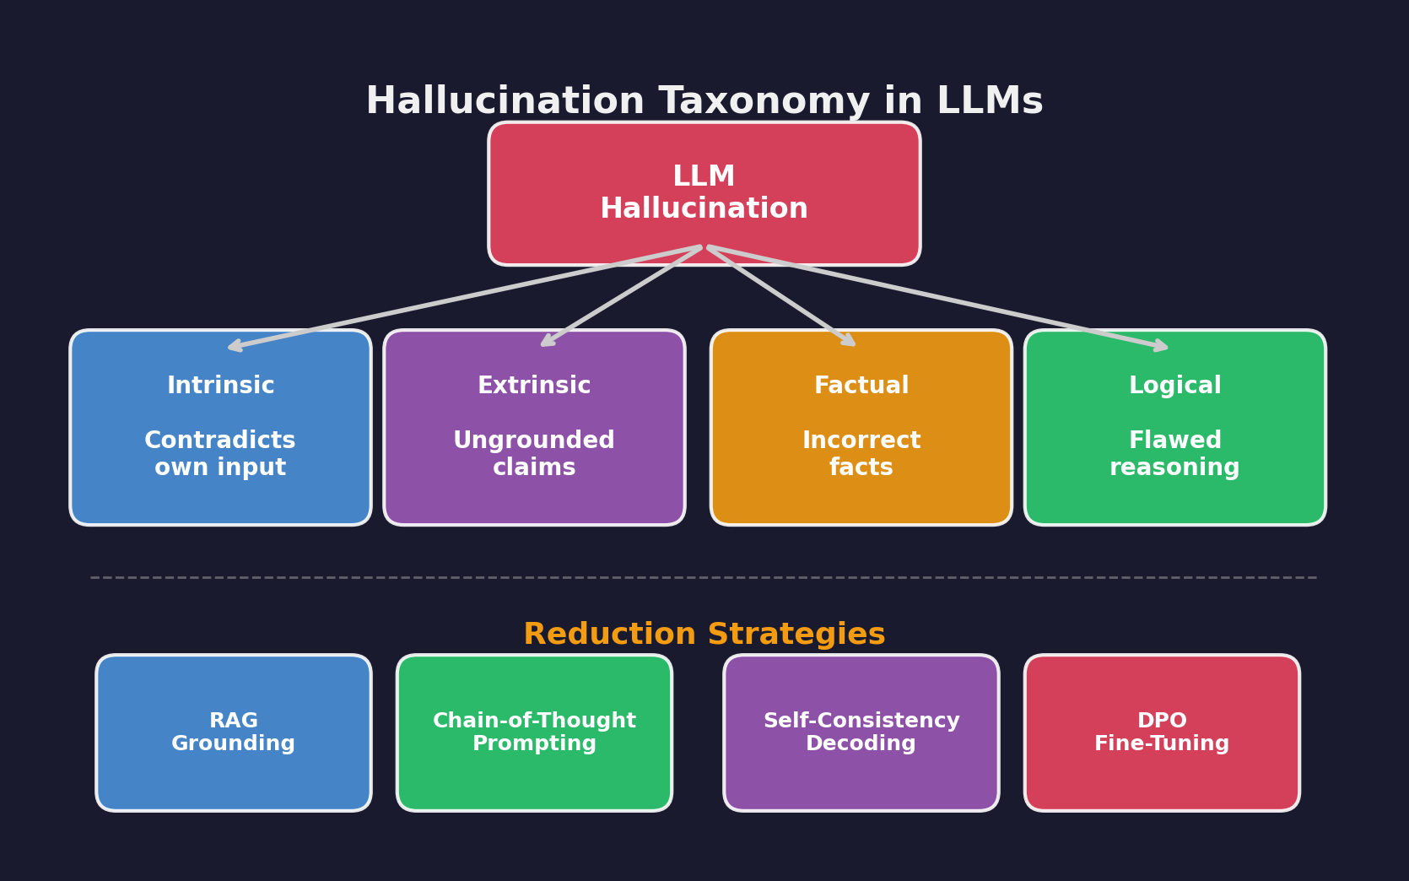
LITERATURE REVIEW RESULTS
Chain-of-thought (CoT) prompting significantly reduces hallucinations in prompt-sensitive models, but some models hallucinate regardless of prompt quality (Dang et al.)
Unified benchmarks like HalluLens are essential for measuring hallucination reduction effectiveness across different models (Bang et al.)
RAG-HAT's 3-stage pipeline (detect → correct → DPO fine-tune) achieves strong hallucination reduction rates (Song et al.)
Best results come from combining RAG + structured prompting + hallucination-aware fine-tuning

Slide 7
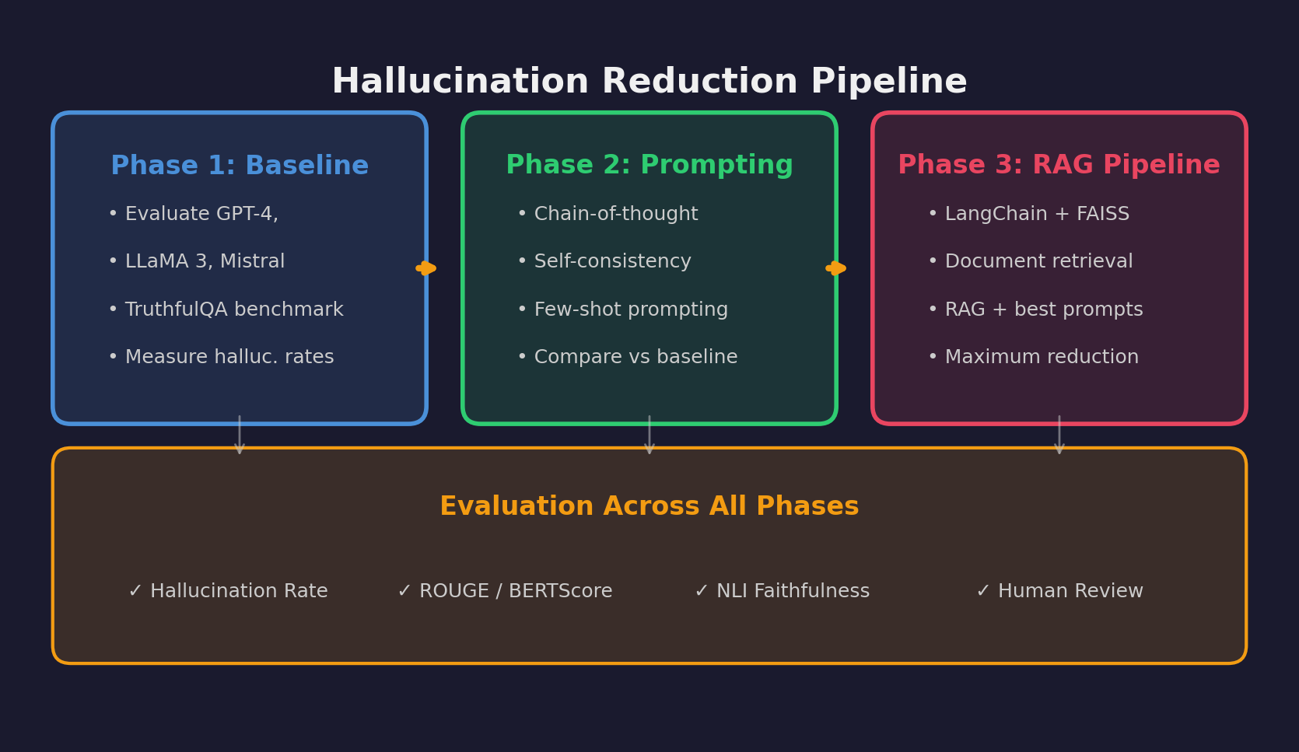
ALGORITHM/APPROACH/METHODOLOGY
Phase 1 - Baseline Measurement:
Measure hallucination rates for GPT-4, LLaMA 3, and Mistral using TruthfulQA benchmark as ground truth
Phase 2 - Prompt-Based Reduction:
Implement chain-of-thought (CoT), self-consistency decoding, and few-shot prompting with verified examples; measure reduction vs. baseline
Phase 3 - RAG-Based Reduction Pipeline:
Build a RAG pipeline with LangChain + FAISS/ChromaDB, combine with the best prompting strategies from Phase 2, compare reduction rates across all conditions

Slide 8
UNDERSTANDING THE FUNCTIONS
Language: Python 3.10+
LLM APIs: OpenAI API (GPT-4), Hugging Face Transformers (LLaMA 3, Mistral)
RAG Framework: LangChain for orchestration, FAISS / ChromaDB for vector storage
Embeddings: Sentence-Transformers for document embedding
Evaluation: TruthfulQA benchmark, BERTScore, NLI models for faithfulness
Data Processing: pandas, NumPy, scikit-learn
Visualization: matplotlib, seaborn
Environment: Jupyter Notebooks, Google Colab / local GPU

Slide 9
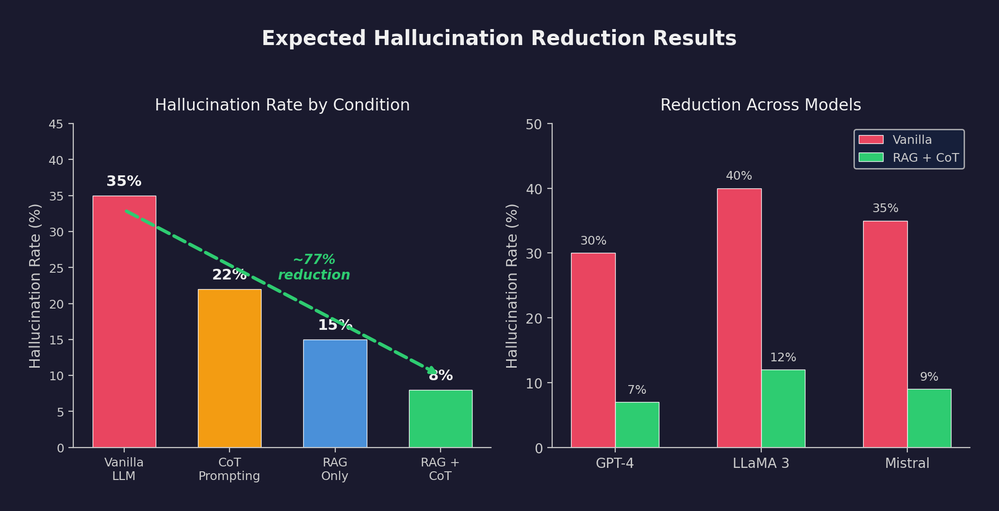
OBTAINED RESULTS
Hallucination reduction rate comparison across 4 conditions: (a) Vanilla LLM, (b) + CoT Prompting, (c) + RAG, (d) RAG + CoT combined
Factual accuracy improvement measured via ROUGE and BERTScore against ground truth
Faithfulness score using NLI-based verification of RAG grounding
Human evaluation: manual review of 50–100 generated responses to validate automated metrics
Goal: identify which reduction strategy is most effective per model and use case

Slide 10
CONCLUSION & FUTURE WORK
Hallucination reduction is critical for trustworthy LLM deployment in real-world applications
RAG + structured prompting yields the strongest reduction in hallucination rates
No single technique eliminates hallucinations entirely - combining strategies is key.
Incorporate DPO fine-tuning following the RAG-HAT approach
Build domain-specific reduction pipelines for medical and legal applications
Develop real-time hallucination detection for production systems
Conclusion

Slide 11
REFERENCES
Dang, A.-H., Vu, T., & Nguyen, L.-M. (2025). Survey and analysis of hallucinations in large language models: Attribution to prompting strategies or model behavior. Frontiers in Artificial Intelligence, 8, 1622292.
Bang, Y., Ji, Z., Schelten, A., et al. (2025). HalluLens: LLM Hallucination Benchmark. Proceedings of ACL 2025.
Song, J., Wang, X., Zhu, J., et al. (2024). RAG-HAT: A Hallucination-Aware Tuning Pipeline for LLM in Retrieval-Augmented Generation. Proceedings of EMNLP 2024, pp. 1548–1558.

Slide 12
Questions

