Slide 1
GUARDIAN
A security AGENT BASED ON PRODUCTIONS SYSTEMs AND a RETE WEB

Slide 2
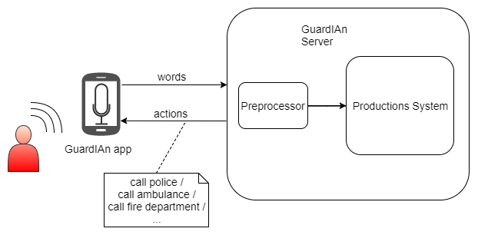
Agent’s structure

Slide 3
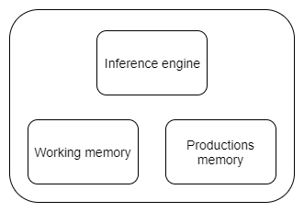
Productions systems

Slide 4
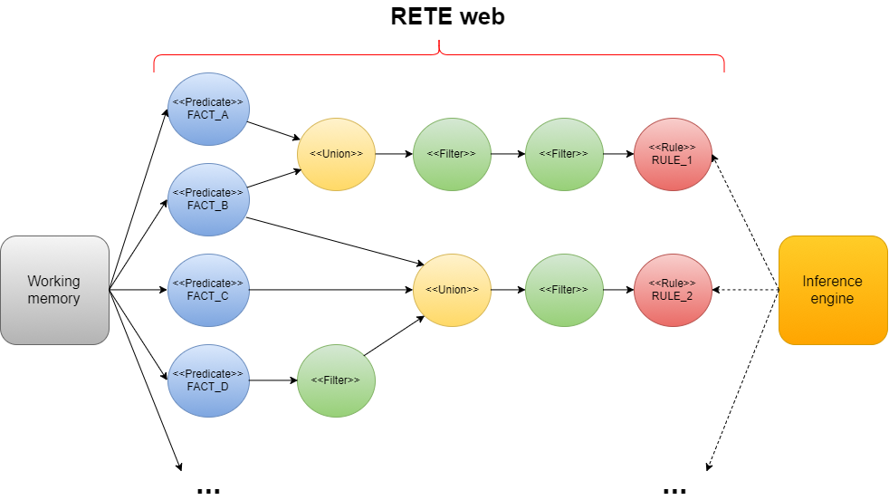

Slide 5
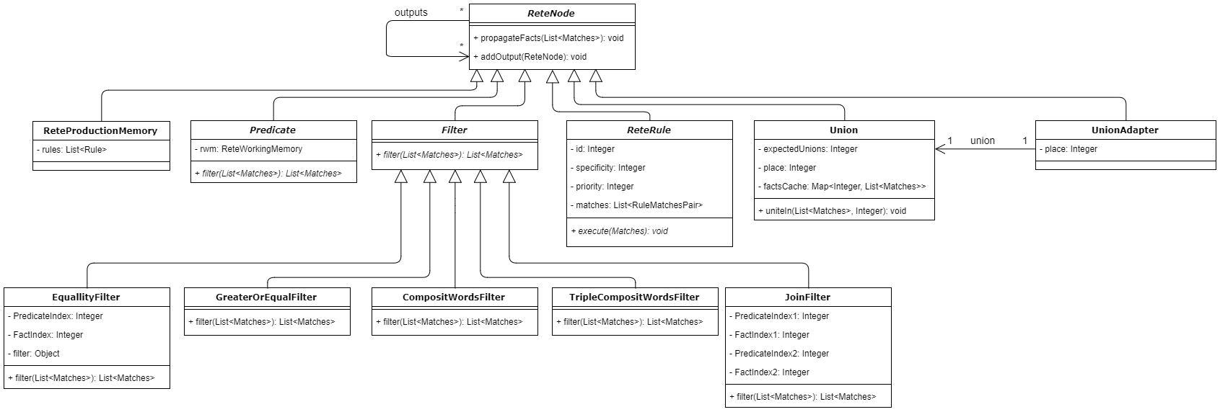
Rete Nodes Class diagram

