Slide 1

Audio Classification Using Transfer Learning
Emir Uncu
e273968@metu.edu.tr
Middle East Techinal University
Department of Computer Engineering

Slide 2

Introductıon
What is Audio Classification?
“Audio classification” is the process of automatically categorizing audio signals into meaningful groups, such as music genres, environmental sounds, or speech types.
Examples: Music recommendation systems, smart assistans, health monitoring etc.

Slide 3
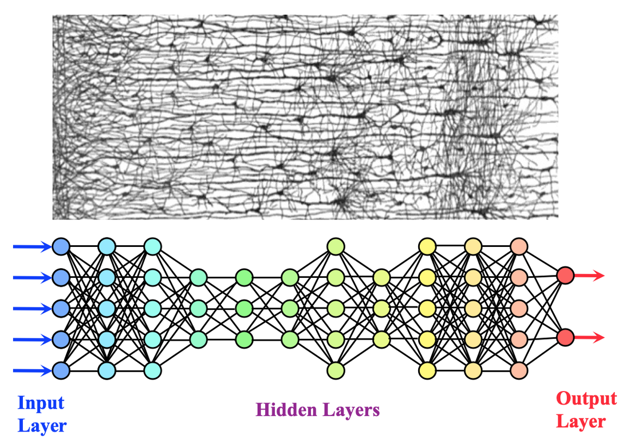
Problem statement
Why it’s hard with small data?
Musical Features are Complex.
Overfitting risk (Deep Models can memorize small datasets instead of generalizing.)
Some genres share acoustic traits (e.g rock vs metal, pop vs disco)
Intra-Genre Variability

Slide 4
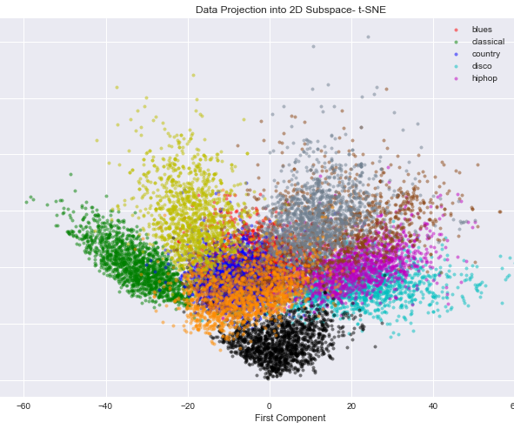
DATAset overview
Name: GTZAN Music Genre Dataset
Size: 1,000 audio tracks
Duration: 30 Seconds per track
Genres : blues, classical, country, disco, hip-hop, jazz, Metal, Pop, Reggae, Rock
Format: .wav with 22.05 kHz sampling rate
Class distribution: 100 clips per genre
Strengths: Clean, balanced, widely used for benchmarking
Limitations: Known mislabaled/duplicate samples; limited diversity

Slide 5
Audio features
MEL-SPECTROGRAM:
Visual representation of sound(time x frequency)
Frequencies scaled using the Mel scale (Human hearing)
Intensity encoded as color (log-scaled)
Preserves rich temporal and spectral patterns
Ideal for CNN-based audio classification
MFCCs:
Compact descriptor of the audio spectrum
Extracts ~ 12-13 coefficients per frame
Mimics human auditory perception
Widely used in speech processing
Less detailed than spectrogram, may miss musical complexity

Slide 6
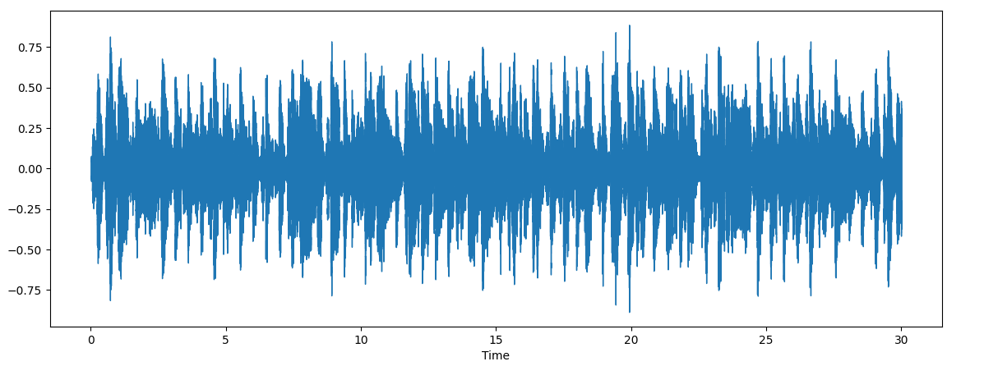
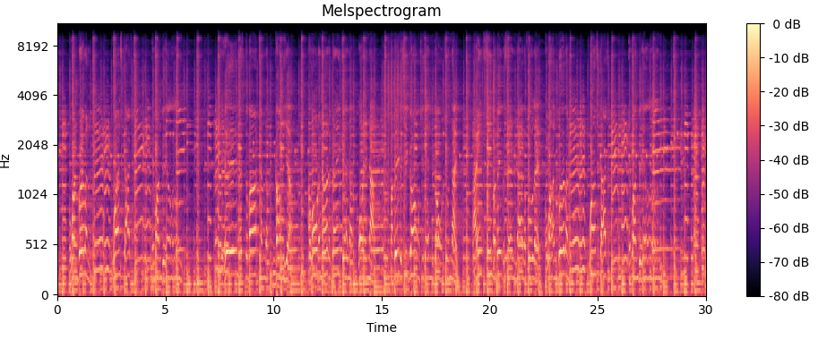
AUDIO Features

Slide 7
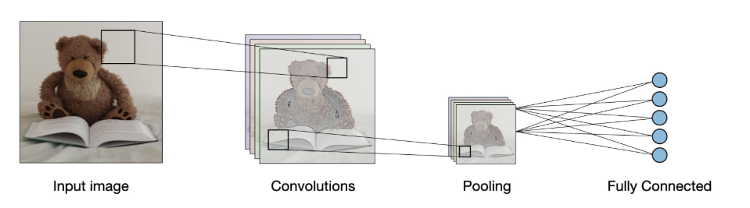
cnn model
What is CNN: Convolutional Neural Networks, are a type of deep learning architecture designed to process grid-like data (most commonly images). The key idea behind CNNs is their ability to automatically learn hierarchical patterns using a series of convolutional filters.

Slide 8
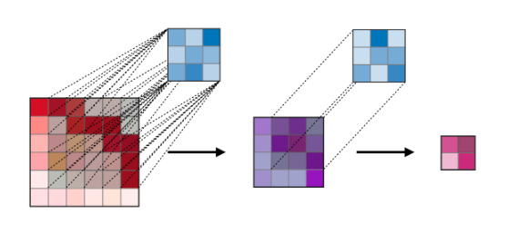
WHY cnn model?
Hierarchical learning makes CNNs incredibly powerful for tasks where spatial structure matters
CNNs are ideal for 2D type input because they can detect local patterns like textures, edges and shapes in the spectrogram, which correspond to musical elements such as timbre, rhythm, and harmoncis
Notes:
.

Slide 9
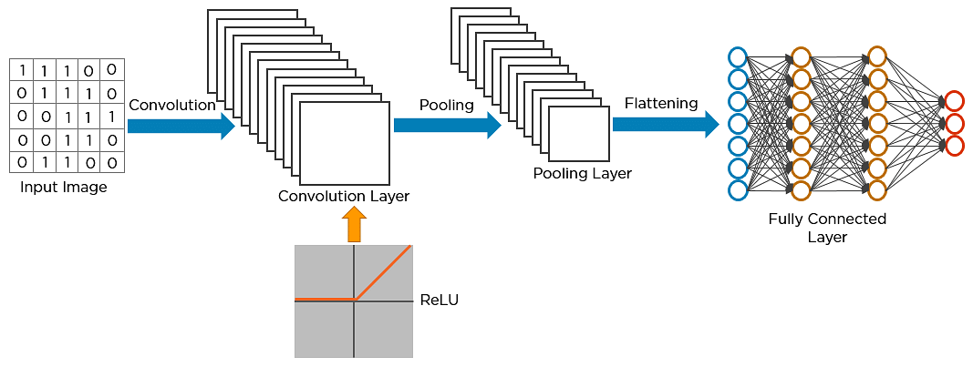
Baselıne model
CNN architecture with multiple convolutional and pooling layers.
The output layer uses softmax activation.

Slide 10
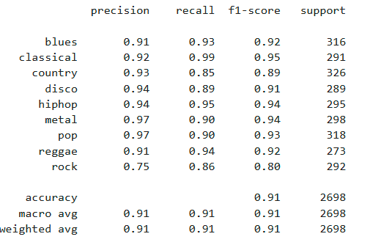
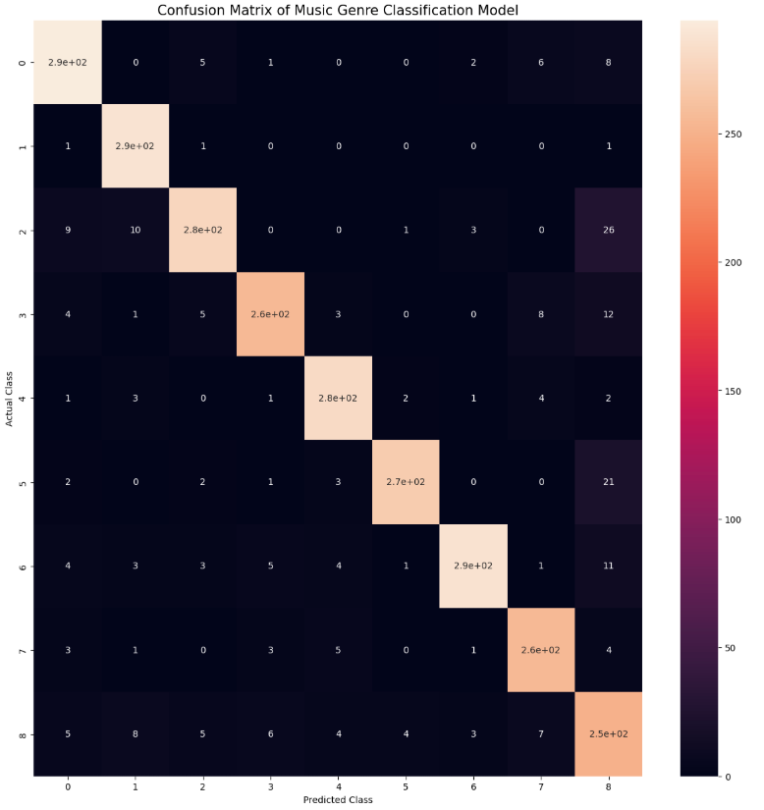
Baselıne model results

Slide 11
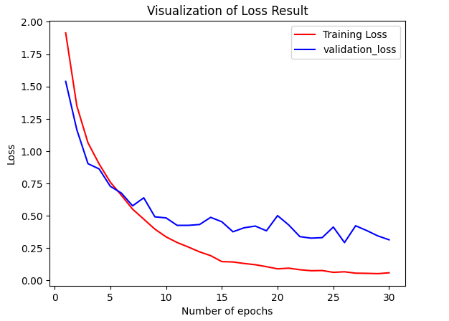
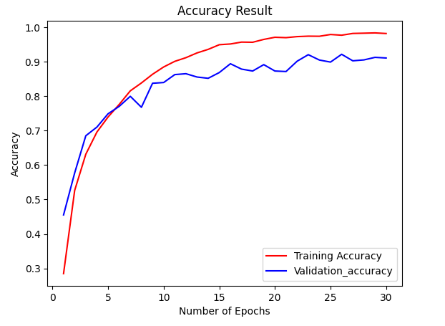
Baselıne model results
Validation Loss | Validation Accuracy
0.314206063747406 | 0.9106745719909668

Slide 12
Lımıtatıons of training cnn from scratch
Nature of the dataset, risk of overfitting.
Converges slower and requires many epochs to achieve decent performance.
Computationally expensive
Challenges in designing and tuning architecture.

Slide 13
What ıs transfer learning?
Transfer learning is a machine learning technique where a model pre-trained on one task is fine-tuned for a new related task.
This approach is beneficial when the second task is related to the first or when data for the second task is limited.

Slide 14
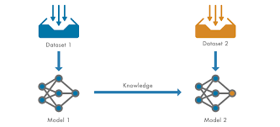
Why is transfer learning important?
Performs well on limited data.
Enhanced performance
Time and Cost Efficiency
Adaptability

Slide 15
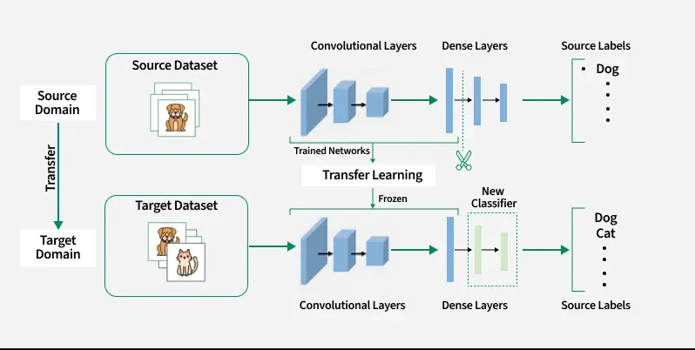
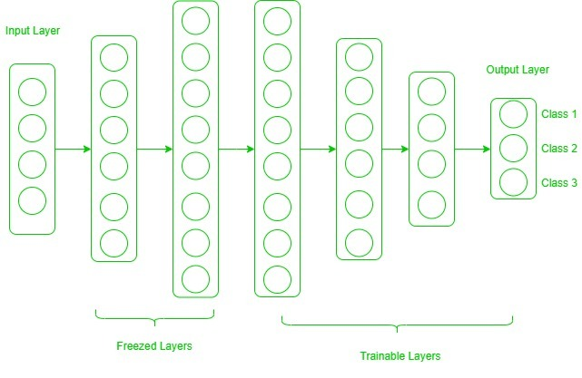
How does transfer learning work?
Pre-trained model
Base Model
Transfer Layers
Frozen Layers
Fine-tuning

Slide 16
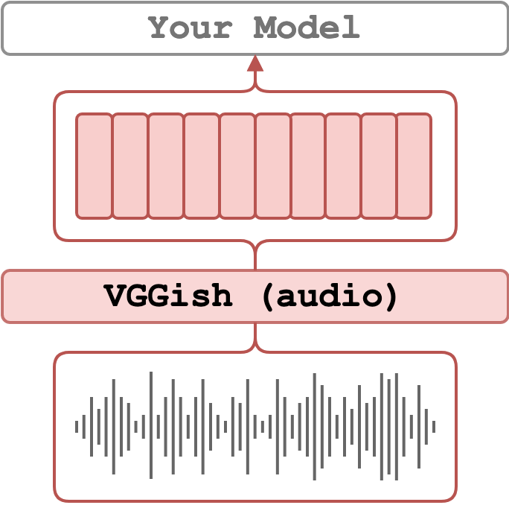
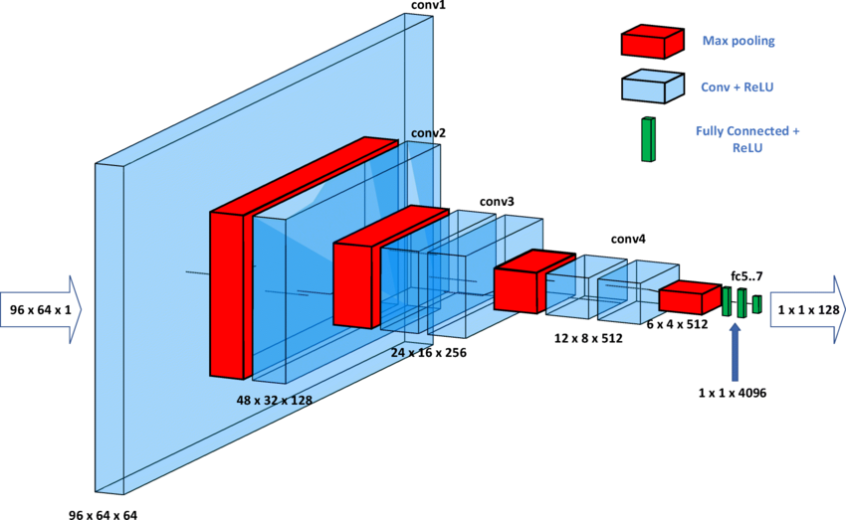
Transfer learning in audio
VGGish: Pre-trained CNN developed by google
Trained on AudioSet Dataset
Convert Mel-spectrograms to 128-dim embeddings
Used as feature extractor

Slide 17
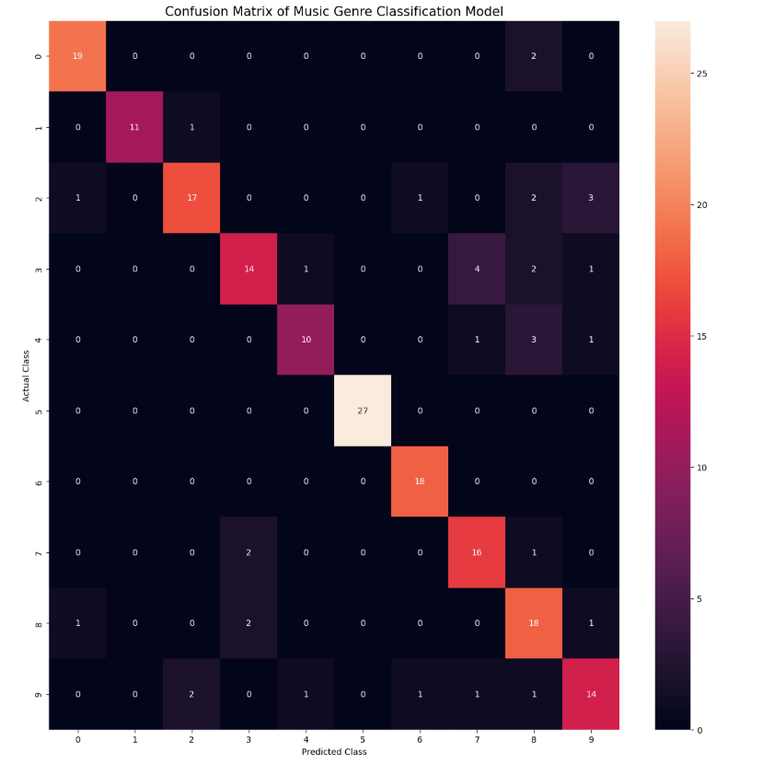
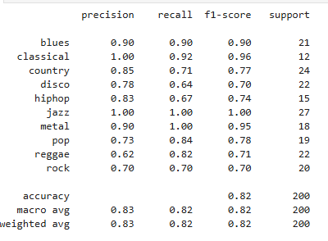
VGGIsh based model results

Slide 18
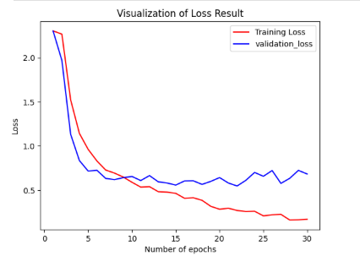
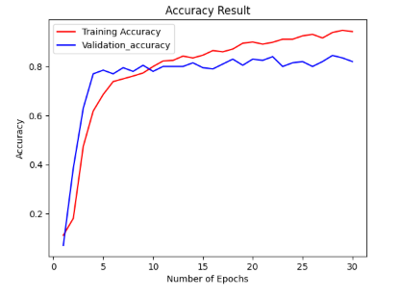
Vggısh based model results
Validation Loss | Validation Accuracy
0.6830357909202576 | 0.8199999928474426

Slide 19
SCRATCH MODEL VS VGGISH BASED MODEL
Criteria | Scratch CNN | VGGish Transfer learning
Validation Accuracy | ~%91(Higher) | ~%82
Training Time | Long (even with GPU) | Low (Even on CPU)
Architecture design | Manual architecture tuning required | No tunning needed for base model
Hardware requirement | Requires GPU for efficient training | CPU is sufficient
Feature Learning | Learns features from scratch | Uses robust pre-trained embeddings
Overfitting risk | Higher- full model trained | Lower- base model frozen
Ease of implementation | Complex model design and training loop | Simpler with pre-extracted features

Slide 20
Further ımprovements for transfer learning model
Try alternative pretrained models (YAMNet, OPENL3, PANNs)
Unfreeze and Fine-Tune Top layers
Data Augmentation For Audio
Use a Deeper Custom classifier
Hyperparameter optimization
Use Cross-Validation
Ensemble multiple Models(Combine predictions from multiple transfer learning models VGGish+YAMNet) to reduce variance increase accuracy.

Slide 21
Literature revıew
[1] G. Tzanetakis and P. Cook, "Musical genre classification of audio signals," IEEE Transactions on Speech and Audio Processing, vol. 10, no. 5, pp. 293–302, 2002.
[2] S. J. Pan and Q. Yang, "A survey on transfer learning," IEEE Transactions on Knowledge and Data Engineering, vol. 22, no. 10, pp. 1345–1359, 2010.
[3] K. Choi, G. Fazekas, M. Sandler, and K. Cho, "Transfer learning for music classification and regression tasks," in Proc. of the International Society for Music Information Retrieval Conference (ISMIR), 2017.
[4] A. van den Oord, S. Dieleman, and B. Schrauwen, "Transfer learning with VGGish for audio event and scene classification," arXiv preprint arXiv:1807.09902, 2018.
[5] Q. Kong, Y. Cao, T. Iqbal, Y. Wang, W. Wang, and M. D. Plumbley, "PANNs: Large-scale pretrained audio neural networks for audio pattern recognition," IEEE/ACM Transactions on Audio, Speech, and Language Processing, vol. 28, pp. 2880–2894, 2020.

