Slide 1

Energy Consumption
Classification & Prediction
CSCI-6767 Applied Machine Learning — Course Project 2
Riyad Abdurrahimov · Emil Naghizade
ADA University

Slide 2

Problem & Motivation
The Challenge
Our Approach
Buildings account for ~40% of total energy use
Accurate prediction enables cost optimization
Operators need demand forecasting tools
Classification: Is consumption HIGH or LOW?
Regression: Predict exact kWh consumed
Logistic Regression (binary + multiclass)
Linear Discriminant Analysis (LDA)
Quadratic Discriminant Analysis (QDA)
Naïve Bayes classifier
Linear vs Poisson Regression

Slide 3
Dataset Overview
1,100
6
3
1,684–6,531
Observations
Features
Building Types
kWh Range
Feature | Type | Range | Description
Building Type | Categorical | 3 categories | Residential / Commercial / Industrial
Square Footage | Continuous | 560 – 49,997 | Building floor area
Num. Occupants | Integer | 1 – 99 | People in building
Appliances Used | Integer | 1 – 49 | Active appliances
Avg. Temperature | Continuous | 10 – 35 °C | Ambient temperature
Day of Week | Binary | 2 values | Weekday vs Weekend

Slide 4
Preprocessing Pipeline
1. Label Encoding
2. Standard Scaling
3. Target Engineering
Categorical features converted to integers:
• Commercial → 0, Industrial → 1, Residential → 2
• Weekday → 0, Weekend → 1
Fit on train, applied to test.
Continuous features standardized:
z = (x − μ) / σ
Centered to mean=0, std=1.
Scalers fit on training data only.
Binary: median threshold (4,176 kWh)
• Above → HIGH (1)
• Below → LOW (0)
3-class: tertile boundaries
• Low / Medium / High

Slide 5
1. Logistic Regression
Theory & Inference
Coefficient Table (statsmodels)
P(Y=1|X) = e^(βX) / (1 + e^(βX))
Variable | Coef | Z | p-val
Sq Footage | 3.731 | 14.76 | 2.59e-49
Occupants | 1.532 | 10.00 | 1.47e-23
Appliances | 1.260 | 8.95 | 3.68e-19
Building Type | −1.293 | −7.80 | 6.33e-15
Day of Week | −0.487 | −2.08 | 0.038
Avg Temp | −0.161 | −1.37 | 0.171
Maximum Likelihood Estimation (MLE)
Statsmodels provides SE, Z-stat, p-values
Square Footage: strongest (Z=14.76, p<0.001)
Avg Temperature: non-significant (p=0.17)
All VIFs ≈ 1.0 → No multicollinearity
No confounders detected in this dataset
Multinomial extension for 3-class problem → next slide

Slide 6
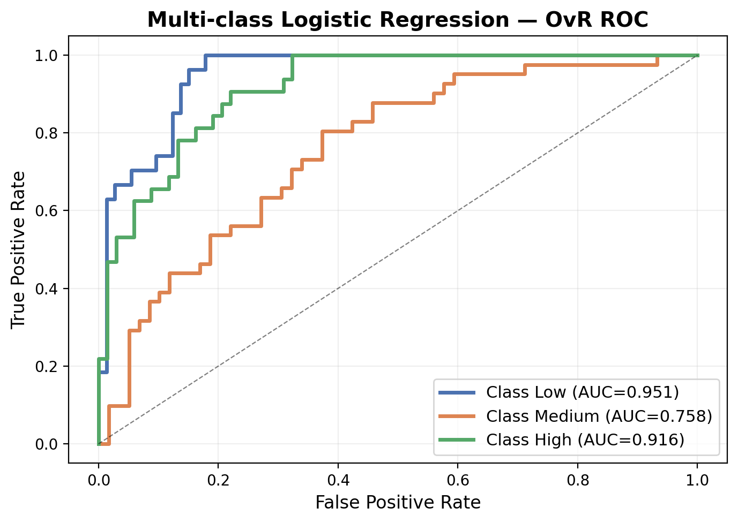
1d. Multi-class Logistic Regression
Multinomial (Softmax) Extension
Binary LR handles 2 classes. For K > 2, we use multinomial logistic regression.
The model learns K linear functions and applies the softmax function:
P(Y=k|X) = e^(βₖX) / Σ e^(βₗX)
All K probabilities sum to 1. Each observation is assigned to the highest-probability class.
Our 3 classes (tertile-based):
Low: Energy < 3,733 kWh
Medium: 3,733 – 4,638 kWh
High: Energy > 4,638 kWh
Evaluated via One-vs-Rest (OvR) ROC — each class treated as positive vs all others.
Interpretation
Class | AUC | Meaning
Low | 0.951 | Easy to identify low consumers
Medium | 0.758 | Hardest — overlaps both neighbors
High | 0.916 | Clear separation at high end

Slide 7
2. Discriminant Analysis — Methodology
(2a) Linear Discriminant Analysis
(2d) Quadratic Discriminant Analysis
Models X|Y=k as multivariate Gaussian with shared covariance Σ
fₖ(x) = N(μₖ, Σ) for each class k
Uses Bayes’ theorem to get posteriors:
P(Y=k|X) = πₖ fₖ(x) / Σ πₗ fₗ(x)
Shared Σ produces linear decision boundaries
Discriminant score for class k:
δₖ(x) = xᵀΣ⁻¹μₖ − ½μₖᵀΣ⁻¹μₖ + log(πₖ)
Classify to the class with highest δₖ(x)
Each class gets its own covariance Σₖ
fₖ(x) = N(μₖ, Σₖ) — class-specific
This relaxation means the decision boundary becomes quadratic (curved) rather than linear
Quadratic discriminant score:
δₖ(x) = −½ log|Σₖ| − ½(x−μₖ)ᵀΣₖ⁻¹(x−μₖ) + log(πₖ)
More flexible than LDA — better when class spreads differ significantly
Trade-off: more parameters to estimate, higher variance with small n

Slide 8
2. Discriminant Analysis — Threshold & ROC Curve
(2b) Defining Effective Threshold
(2c) ROC Curve
Default threshold is 0.5, but often suboptimal
We use the ROC curve to find the optimal threshold by maximizing Youden’s J statistic:
J = TPR − FPR = Sens + Spec − 1
The optimal point is the point on the ROC curve farthest from the diagonal
Results:
LDA optimal threshold = 0.764
QDA optimal threshold = 0.788
Both > 0.5: models require higher confidence before predicting HIGH energy
Plots True Positive Rate (sensitivity) vs False Positive Rate (1−specificity) at all thresholds
TPR = TP/(TP+FN) — actual positives caught
FPR = FP/(FP+TN) — negatives wrongly flagged
AUC (Area Under Curve) summarizes performance:
AUC = 1.0 → Perfect classifier
AUC = 0.5 → Random guessing (diagonal)
AUC > 0.9 → Excellent discrimination
A curve hugging the top-left corner means strong class separation

Slide 9
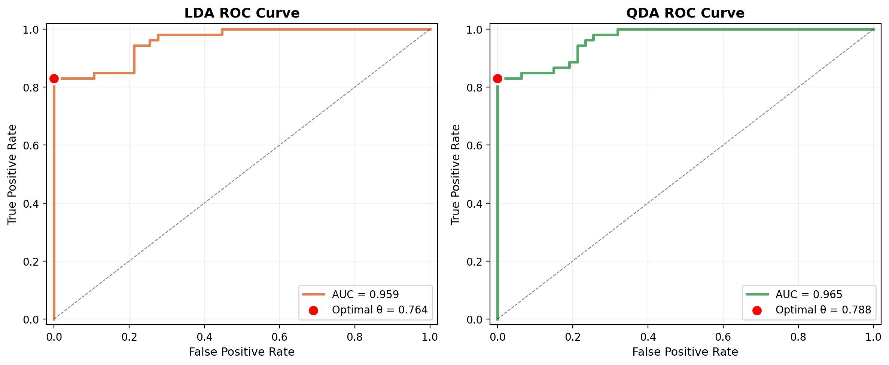
2. Discriminant Analysis — LDA vs QDA ROC Curves
Interpretation of Results
Both curves hug the top-left corner closely, confirming excellent class separation. QDA’s slightly higher AUC suggests its flexible boundaries capture marginally more structure.
LDA: AUC = 0.960, optimal θ = 0.764
→ At this threshold: Accuracy = 91%, Precision = 1.000, Recall = 0.830
QDA: AUC = 0.965, optimal θ = 0.788
→ At this threshold: Accuracy = 91%, Precision = 1.000, Recall = 0.830

Slide 10
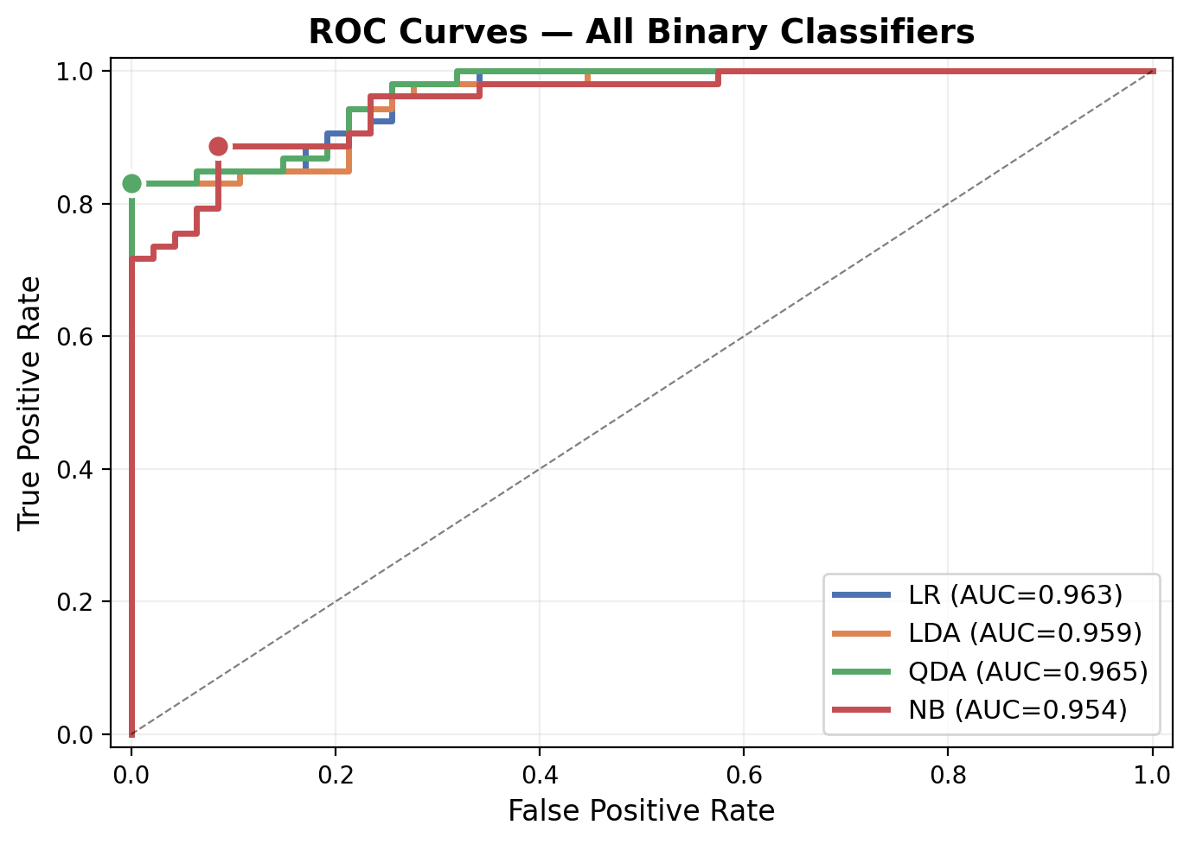
3. Naïve Bayes & Full Model Comparison
Naïve Bayes Classifier
Assumes conditional independence:
P(X|Y=k) = ∏ P(Xⱼ|Y=k)
Each feature modeled as Gaussian per class
Simple yet competitive baseline
Model | Thresh | Acc | Prec | Rec | F1 | AUC
LR | 0.779 | 0.91 | 1.000 | 0.830 | 0.907 | 0.963
LDA | 0.764 | 0.91 | 1.000 | 0.830 | 0.907 | 0.960
QDA | 0.788 | 0.91 | 1.000 | 0.830 | 0.907 | 0.965
NB | 0.557 | 0.90 | 0.922 | 0.887 | 0.904 | 0.954
All ROC curves are tightly clustered near the top-left → all four methods achieve excellent, near-identical discrimination on this dataset

Slide 11
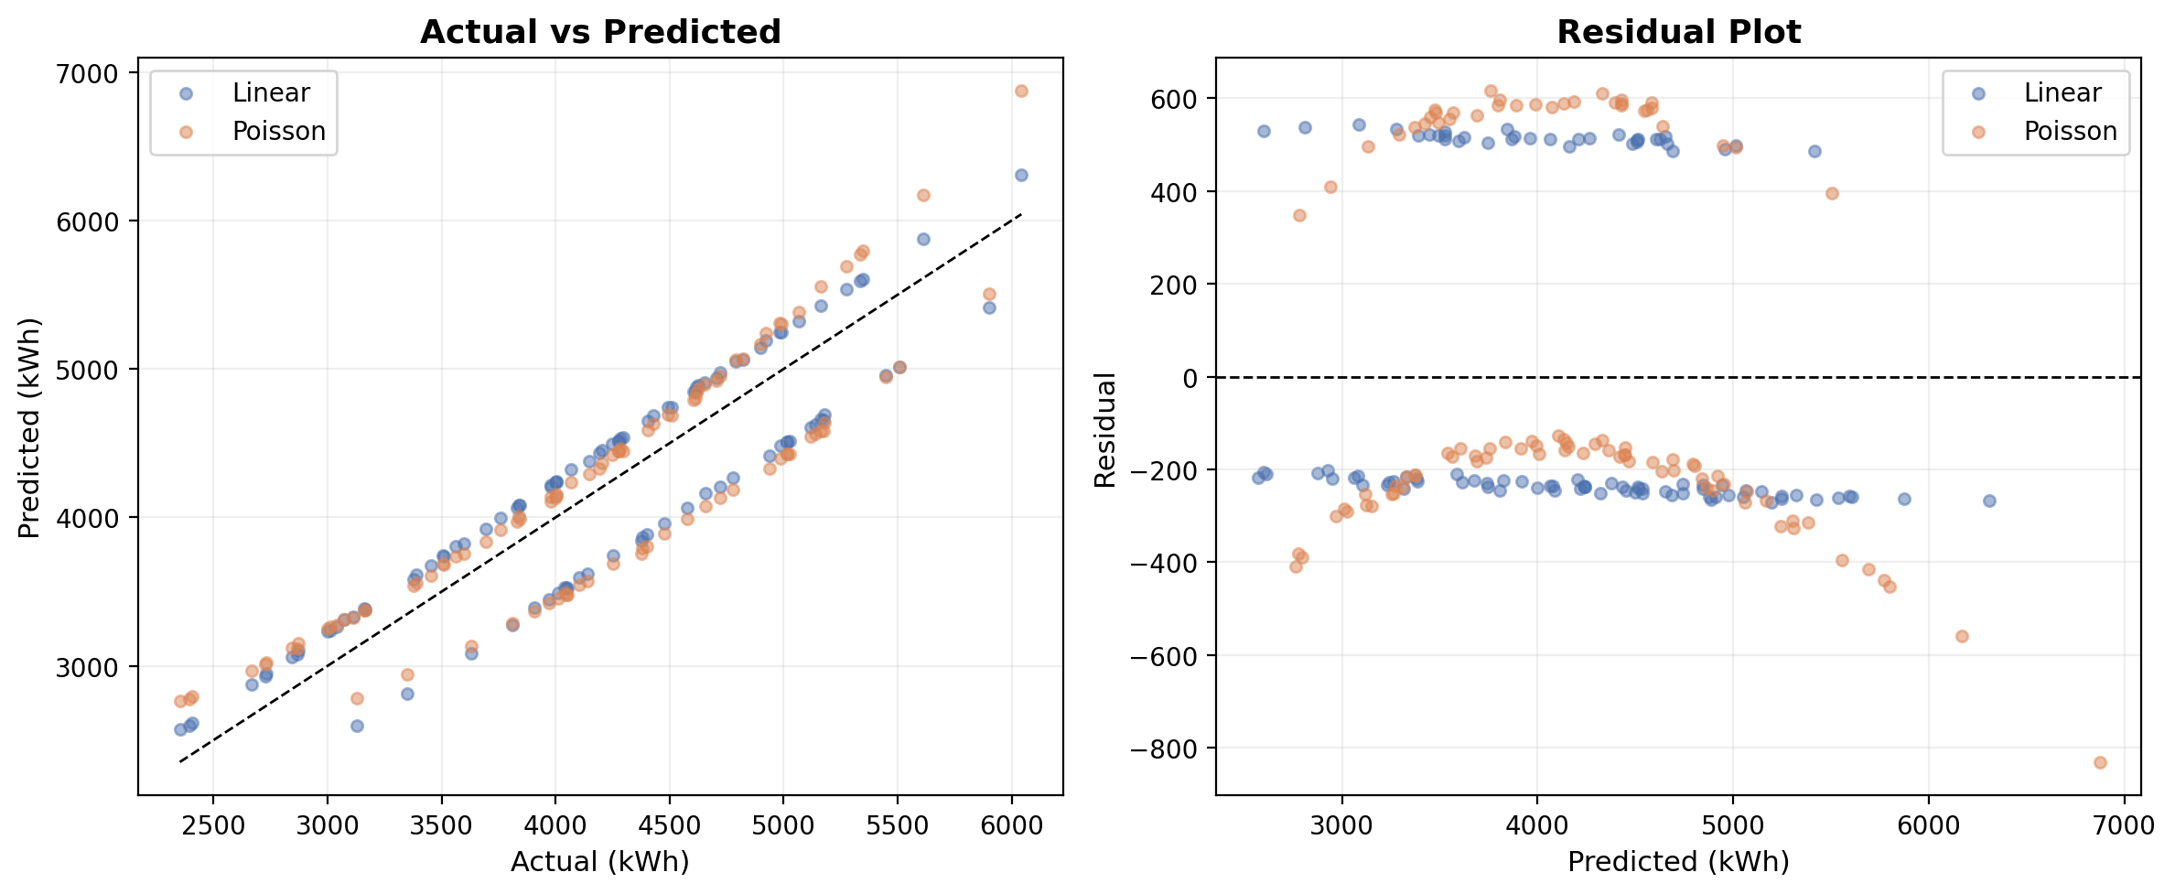
4. Linear vs Poisson Regression
Performance
Metric | Linear | Poisson
R² | 0.814 | 0.778
RMSE | 357.1 | 390.4
MAE | 332.1 | 347.6
Linear Regression outperforms Poisson on all metrics. Energy consumption is a continuous variable (kWh), not count data, so the identity link of OLS is a better fit than Poisson’s log-link. The scatter plot shows both models track the ideal line closely, but Linear Regression’s residuals are more tightly distributed around zero. R² = 0.814 means ~81% of energy variance is explained by our six features.

Slide 12
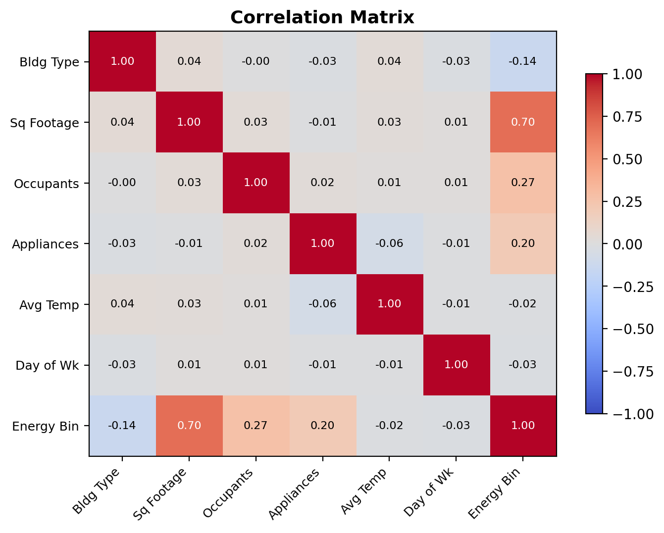
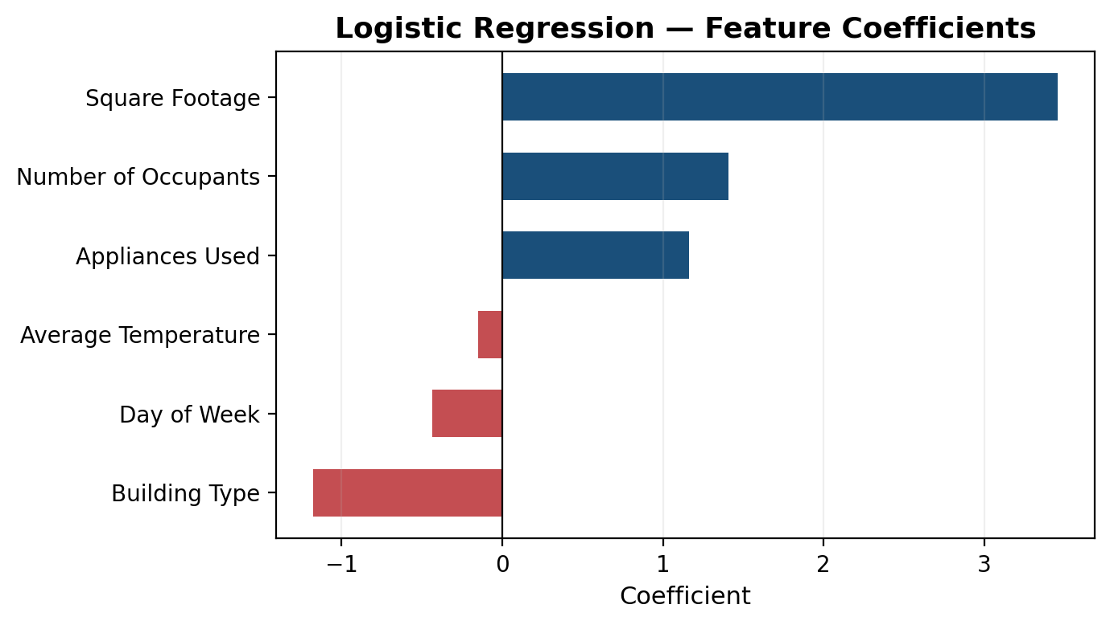
Confounding Analysis & Feature Importance
All VIF values ≈ 1.0 → no multicollinearity
No confounders detected (features are independent)
Square Footage dominates (coeff 3.46)
Occupants and Appliances are strong secondary
Avg Temperature has minimal predictive power

Slide 13




Interactive Streamlit Application
Predictions
LR Details
Discriminant
Real-time inference from all models with adjustable thresholds
Coefficient table, SE, Z-statistics, p-values
LDA & QDA ROC curves with optimal threshold markers
Comparison
Regression
Importance
Side-by-side metrics, ROC overlay, and bar charts
Actual vs Predicted & Residual plots
Feature coefficients for LR, LDA, Linear Reg

Slide 14

Conclusion
91% classification accuracy with AUC > 0.95 across all four classifiers
LDA (AUC=0.960) and QDA (AUC=0.965) both achieve excellent discrimination
Optimal thresholds (0.764 and 0.788) yield perfect precision with 83% recall
Linear Regression explains 81% of energy variance (R² = 0.814)
Square Footage is the dominant predictor; no confounders detected
Interactive Streamlit app enables real-time exploration and prediction
Thank You

